Slide 1

ENTREPRENEURSHIP
MBAD 823
Prof Stéphan
van der Merwe
Contact Session 3
2018

Slide 2

CORPORATE ENTREPRENEURSHIP

Slide 3
Introduction to Entrepreneurship
Entrepreneurial mind and fit
Idea generation
Design thinking
Rocket pitch
Entrepreneurial process
Feasibility & planning
Managing the business
South African business environment
Corporate entrepreneurs

Slide 4
OUTCOMES OF THEME 11 (1/2)
Read the article posted on the web “How can companies keep the entrepreneurial spirit alive”. Critically analyse the article and debate how corporate organisations can keep the entrepreneurial spirit alive.
Coherently demonstrate your understanding of where corporate entrepreneurship fits in with the strategy of an corporate organisation.

Slide 5
OUTCOMES OF THEME 11 (2/2)
Critically analyse your own and other organisations with regard to the state of corporate entrepreneurship and an entrepreneurial orientation in the organisation.
Formulate a corporate entrepreneurial strategy and action plans to the organisation.
Apply the entrepreneurial principles in your own working environment.

Slide 6
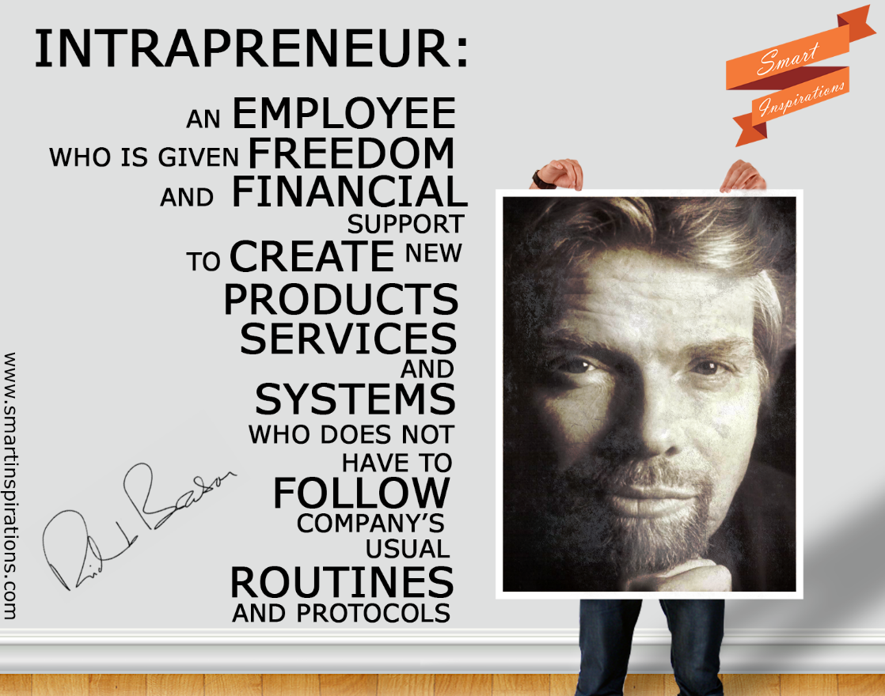
DEFINING AN INTRAPRENEUR

Slide 7

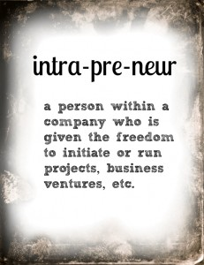
DEFINING INTRAPRENEURSHIP
Intrapraneurship is the process of attempting to identify, encourage, enable and assist entrepreneurship within a large, established organisation so as to create new products, processes, services or improvements that become major new revenue streams and/or sources of cost savings for the organisation.

Slide 8
WHAT IS INTRAPRENEURSHIP?
The people who do entrepreneurial work within large organisations are called intrapreneurs, and the process by which they effect change, is called intrapreneurship.

Slide 9

KEEP THE INTRAPRENEURIAL SPIRIT ALIVE:
3M
Spend 15% time on own projects.
Managers should trust people.
Intrapreneurs should learn from their mistakes (if not, get rid of them).
Traits: Inquisitive, passionate, self-starting, work in spurts.
Balance: Freedom vs. discipline.
Challenge: To employ innovators.

Slide 10
KEEP THE INTRAPRENEURIAL SPIRIT ALIVE:
THERMO ELECTRON
Open communication between management and workers.
Actively encourage new ideas.
Incentive/reward structures critical.
Stock options – Spin-outs (publicly traded divisions).
Failures allowed.
Change the risk/reward ratio (for the individuals).

Slide 11
KEEP THE INTRAPRENEURIAL SPIRIT ALIVE:
STARLIGHT TELCOM.
Identify and communicate goals relating to new ventures/projects.
Management support important.
Intrapreneurs should be protected and rewarded.
Rewards – buyouts.
Proposals should move quickly through the approval process.
Manage the gap between the executive and intrapreneur.

Slide 12
KEEP THE INTRAPRENEURIAL SPIRIT ALIVE: INTUIT
Create separate business units.
Flatten the organisation structure.
Delegate decision-making authority to business units and project teams.
Respond quickly to customer needs (look outward, not inward).
Rewarding intelligent failure.
Judge intrapreneurs by quality of efforts.

Slide 13
KEEP THE INTRAPRENEURIAL SPIRIT ALIVE: XEROX
Be on the leading edge of technology.
Cultivating customer-oriented behaviour.
Focus also on unconscious needs.
Enhance communication and a multi-team approach.
Bridge the gap between researchers / inventors and business.
Enhance business skills.

Slide 14

TEN COMMANDMENTS OF INTRAPRENEURS: 3M (1/2)
Do any job to make your project work regardless of your job description.
Share credit (for success) wisely.
It is easier to ask for forgiveness than permission.
Come to work each day willing to be fired.
Ask for advice before asking for resources.

Slide 15
TEN COMMANDMENTS OF INTRAPRENEURS: 3M (2/2)
Follow your intuition about people – build a team of the best.
Build a quiet coalition for your idea – be aware of the corporate immune system.
Never bet on a race unless you are running in it.
Be true to your goals but realistic about ways to achieve them.
Honour your sponsors.

Slide 16
TOP FIVE ACTION LIST FOR INTRAPRENEURS
Find a senior executive to be your sponsor and to protect you.
Negotiate how your project will be measured and what “success” means.
Get your organisation to give you at least two years to make your project a success.
Do whatever needs to be done to make your project a success.
Select the best people you can to help you – from in- and outside the organisation.

Slide 17

INTRAPRENEURIAL ENVIRONMENT (1/2)
Organisation operates on frontiers of technology.
New ideas encouraged.
Trial and error encouraged.
Failures allowed.
No opportunity parameters/boundaries.
Resources available and accessible.

Slide 18
INTRAPRENEURIAL ENVIRONMENT (2/2)
Multidiscipline teamwork approach.
Long term horison.
Volunteer programme.
Appropriate reward system.
Sponsors and champions available.
Support of top management.

Slide 19
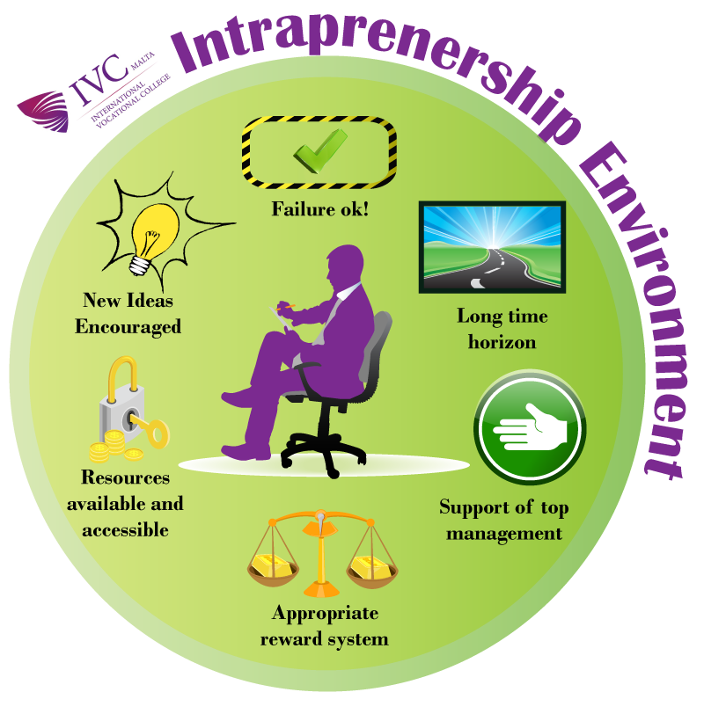

Slide 20

INTRAPRENEURSHIP LEADERSHIP CHARACTERISTICS
Understands the environment.
Visionary and flexible.
Create management options.
Encourages teamwork.
Encourages open discussion.
Builds a coalition of supporters.
Persists.

Slide 21
ASSESSING THE ENTREPRENEURIAL CLIMATE (1/3)
Entrepreneurial leadership (articulation of vision – fostering an entrepreneurial climate)
Management support (active encouragement of innovativeness and creative thinking)
Availability of sponsors (influential people) to support new ideas/processes/projects
Tolerance for risks, mistakes and failure (allow mistakes, foster innovative thinking, protection of intrapreneurs)

Slide 22
ASSESSING THE ENTREPRENEURIAL CLIMATE (2/3)
5. Innovation and creativity/New ideas encouraged (quick response to viable suggestions or new ideas)
6. Appropriate rewards and reinforcement (reward or reinforce innovation – focus on value-adding)
7. Clear vision and objectives set to middle management (Vision and strategic intent)
8. Discretionary time and work (allow people time to work on new ideas or projects – flexibility)

Slide 23
ASSESSING THE ENTREPRENEURIAL CLIMATE (3/3)
9. Empowered project teams (multi-disciplined and diverse)
10. Resource availability and accessibility (resources committed to innovations)
11. Continuous and cross-functional learning (sharing of knowledge)
12. Strong customer orientation (product/service innovation driven by customer needs)
13. Flat, open organisational structure (fast approvals, open communication, less hierarchical control)

Slide 24

CONTRIBUTION OF MBA STUDENTS: CE RESEARCH (1/2)
Human-related factors:
Entrepreneurial leadership
Work autonomy and freedom
Multidisciplinary team approach
Cross-functional learning
Empowered employees
Findings provide some evidence of validity (factor analysis) and reliability (Cronbach alpha)

Slide 25
CONTRIBUTION OF MBA STUDENTS: CE RESEARCH (2/2)
Organisational-related factors:
Appropriate rewards and reinforcement
Fostering innovative behaviour
Resource availability and accessibility
Customer orientation
Vision and strategic intent
Findings provide some evidence of validity (factor analysis) and reliability (Cronbach alpha)

Slide 26

DEFINITION OF ENTREPRENEURIAL ORIENTATION
Entrepreneurial orientation (EO) refers to a business’ strategic orientation, one which captures the specific entrepreneurial aspects of decision-making styles, methods and practices. The entrepreneurial orientation construct consists of five independent dimensions, namely autonomy, innovativeness, risk-taking, pro-activeness and competitive aggressiveness.

Slide 27

ITEMS MEASURING AUTONOMY
I have enough autonomy in my job without continual supervision to do my work.
Our organisation allows me to be creative and try different methods to do my job.
Employees in our organisation are allowed to make decisions without going through elaborate justification and approval procedures.
Employees in our organisation are encouraged to manage their own work and have flexibility to resolve problems.
I seldom have to follow the same work methods or steps while performing my major tasks from day to day.

Slide 28

ITEMS MEASURING INNOVATIVENESS (1/2)
Our organisation regularly introduces new services/products/ processes.
Our organisation places a strong emphasis on new and innovative products/ services/processes.
Our organisation has increased the number of services/products offered during the past two years.
Our organisation is continually pursuing new opportunities.
Over the past few years, changes in our processes, services and product lines have been quite dramatic.

Slide 29

ITEMS MEASURING INNOVATIVENESS (2/2)
In our organisation there is a strong relationship between the number of new ideas generated and the number of new ideas successfully implemented.
Our organisation places a strong emphasis on continuous improvement in products/service delivery/processes.
Our organisation has a widely held belief that innovation is an absolute necessity for the organisation's future.
Our leaders seek to maximise value from opportunities without constraint to existing models, structures or resources.

Slide 30
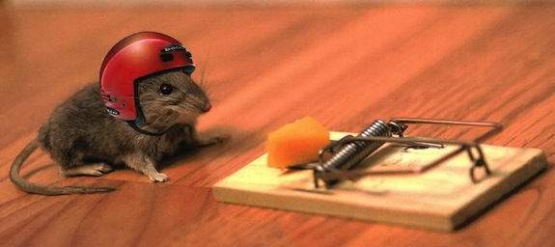
ITEMS MEASURING RISK-TAKING
When confronted with uncertain decisions, our organisation typically adopts a bold posture in order to maximise the probability of exploiting opportunities.
In general, our organisation has a strong inclination towards high-risk projects.
Owing to the environment, our organisation believes that bold, wide-ranging acts are necessary to achieve the organisation’s objectives.
Employees are often encouraged to take calculated risks concerning new ideas.
The term ‘risk-taker’ is considered a positive attribute for employees in our organisation.

Slide 31

ITEMS MEASURING PRO-ACTIVENESS
Our organisation is very often the first to introduce new products/services/processes.
Our organisation typically initiates actions that competitors respond to.
Our organisation continuously seeks out new products/ processes/services.
Our organisation continuously monitors market trends and identifies future needs of customers.

Slide 32

ITEMS MEASURING COMPETITIVE AGGRESSIVENESS
In dealing with competitors our organisation typically adopts a very competitive undo-the-competitor "posture.
Our organisation is very aggressive and intensely competitive.
Our organisation effectively assumes an aggressive posture to combat trends that may threaten our survival or competitive position.
Our organisation knows when it is in danger of acting overly aggressive (this could lead to erosion of our organisation’s reputation or to retaliation by our competitors).

Slide 33
OPERATIONALISATION OF EO VARIABLES (1/2)
Autonomy refers to employees being encouraged to manage their own work without continual supervision and being allowed flexibility to be creative and try different methods to do their jobs.
Innovativeness refers to the regular introduction of new products/ services/processes, the increase in the number of service or product offerings during the past few years and the extent to which these new products/services/processes have been dramatic within the past few years.
Risk-taking refers to the organisation having a strong inclination towards high risk projects and when confronted with uncertainty, the organisation typically adopts a bold posture to maximise the probability of exploiting opportunities.

Slide 34

OPERATIONALISATION OF EO VARIABLES (2/2)
Pro-activeness refers to a posture of anticipating and acting on future wants and needs in the marketplace, thereby creating a first-mover advantage vis-à-vis competitors.
Competitive aggressiveness refers to an organisation’s propensity to directly and intensely challenge its competitors in an attempt to improve their position in the market place.

Slide 35

ESTABLISHING INTRAPRENEURSHIP (1/2)
Commitment by all management levels.
Identify focus areas and risk profile.
Use available technology to make organisation more flexible and competitive.
Train the employees – intrapreneurship, business plans.
Get closer to the customer.

Slide 36

ESTABLISHING INTRAPRENEURSHIP (2/2)
Learn to be more productive with fewer resources – lean and mean.
Establish a strong support structure for intrapreneurship.
Establish an appropriate reward system.
Implement an evaluation system – commitment & de-commitment.

Slide 37
INDIVIDUAL EXERCISES (1/2)
Discuss how corporate organisations can keep the entrepreneurial spirit alive.
Discuss the benefits of intrapreneurship to corporate organisations.
Discuss the business pressures that have led to intrapreneurship.
Explain why traditional corporate management has not been conducive to intrapreneurship.

Slide 38
INDIVIDUAL EXERCISES (2/2)
Discuss the intrapreneurial leadership characteristics necessary for a successful intrapreneur.
Conduct a literature review on Entrepreneurial orientation and make sure you fully understand the concept.
7. Determine the state of intrapreneurship in your organisation.
8. Draft an organisational entrepreneurial strategy for your organisation.

Slide 39

Thank you!!!

