Slide 1
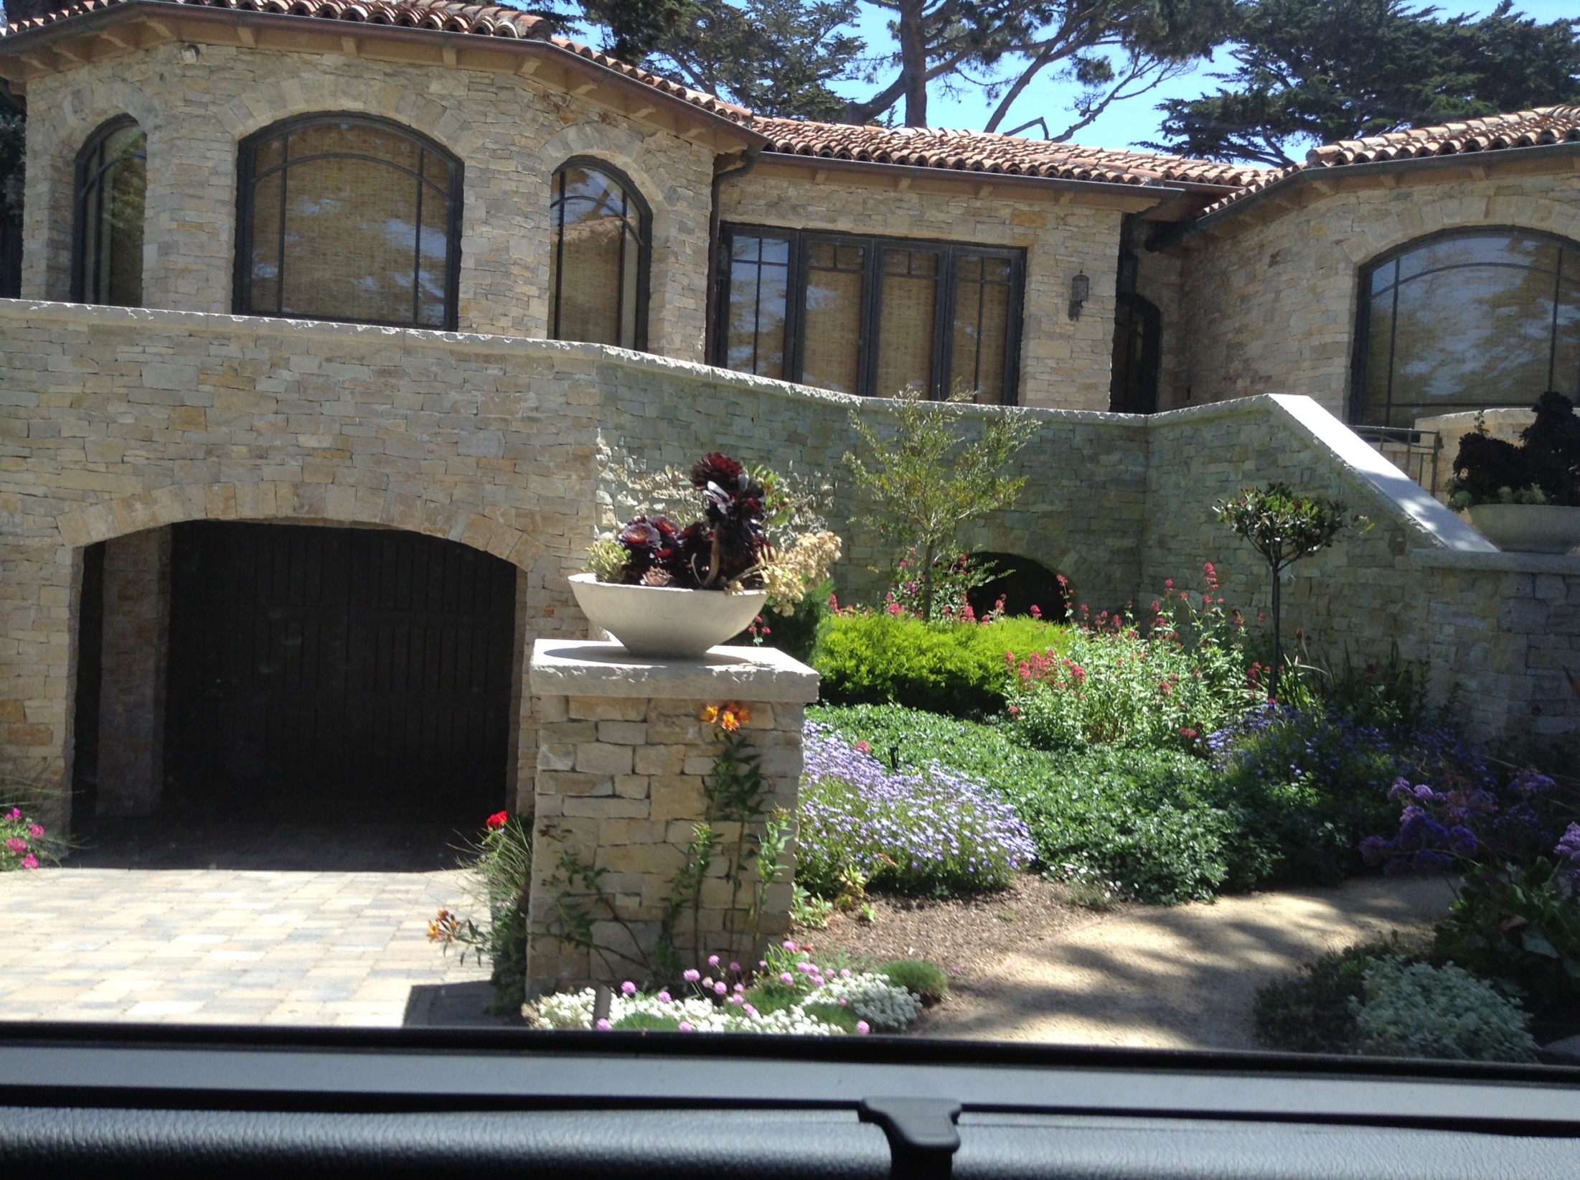
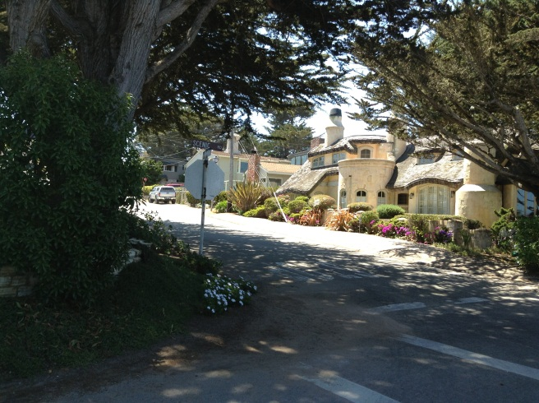
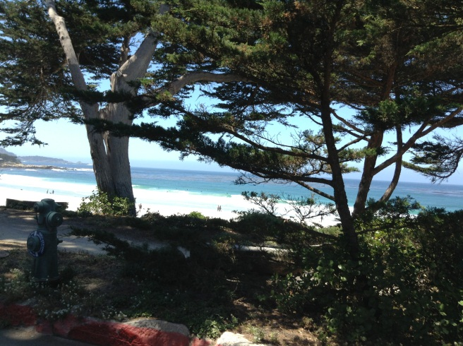
MARKETING MANAGEMENT
Contact 8
TOWN OF CARMEL
$15 MIL VIEW

Slide 2
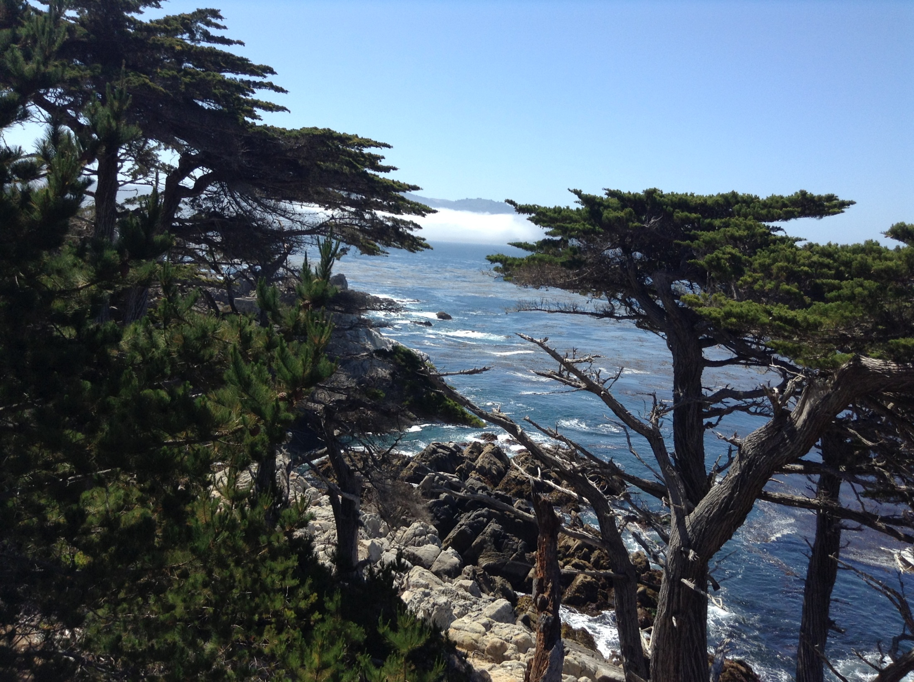
OBJECTIVES
To finalize the module in marketing:
Final presentations
Questions and unclear issues
Semester marks
Revision

Slide 3
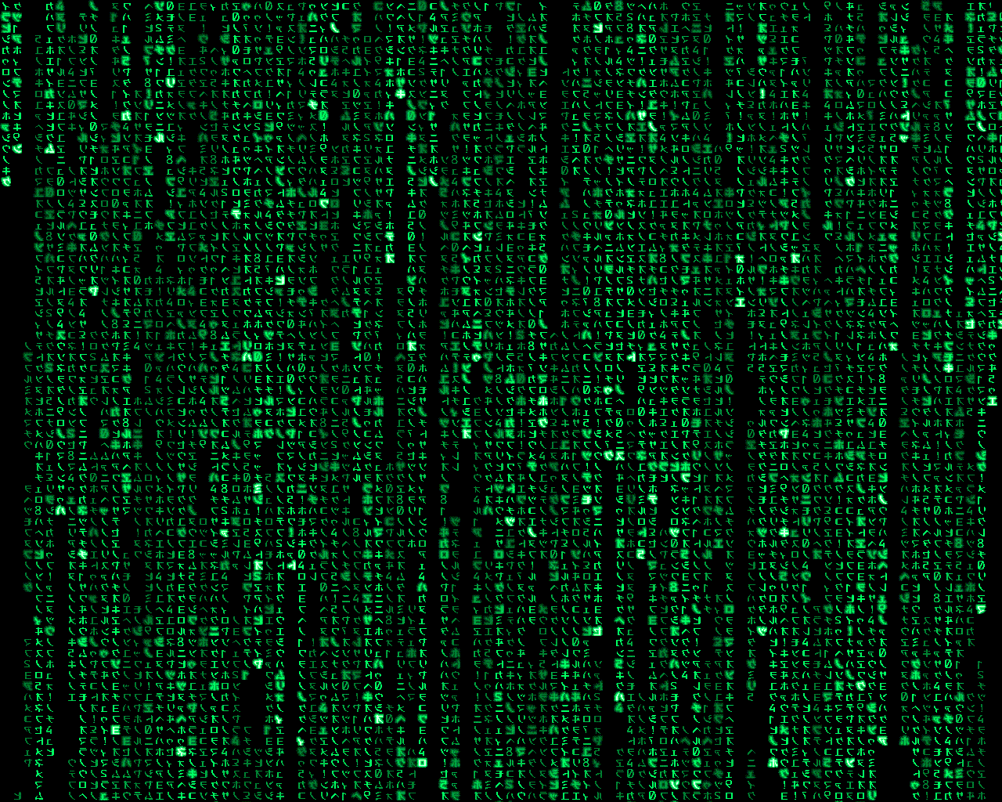
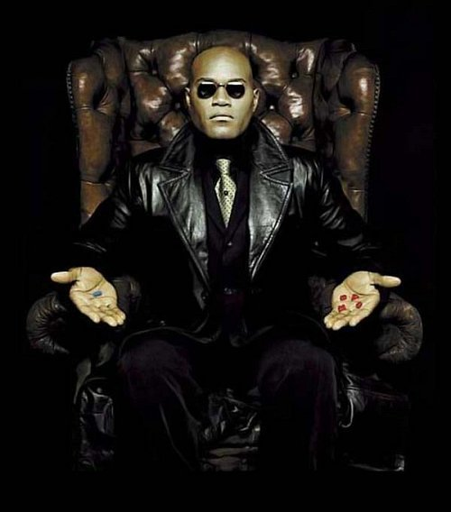
MARKET OR MIX?
Money
Willingness
Need
Which P is failing?

Slide 4
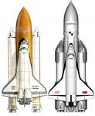
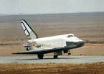
PERCEPTIONS: WHAT YOU
BELIEVE TO BE TRUE.
(And act upon)
Space Shuttle Discovery?
The first and only orbital launch of the Russian space shuttle Buran was at 3:00 GMT on November 15, 1988. The flight was unmanned, and the vehicle launched on the powerful Energiya booster into an 247 by 256 km orbit at 51.6 degrees inclination. The Buran orbited the Earth twice before firing its thrusters for reentry. The flight ended at 6:25 GMT when the vehicle touched down at Tyuratum. The Buran 1 mission was limited to 2 orbits due to computer memory limitations.

Slide 5
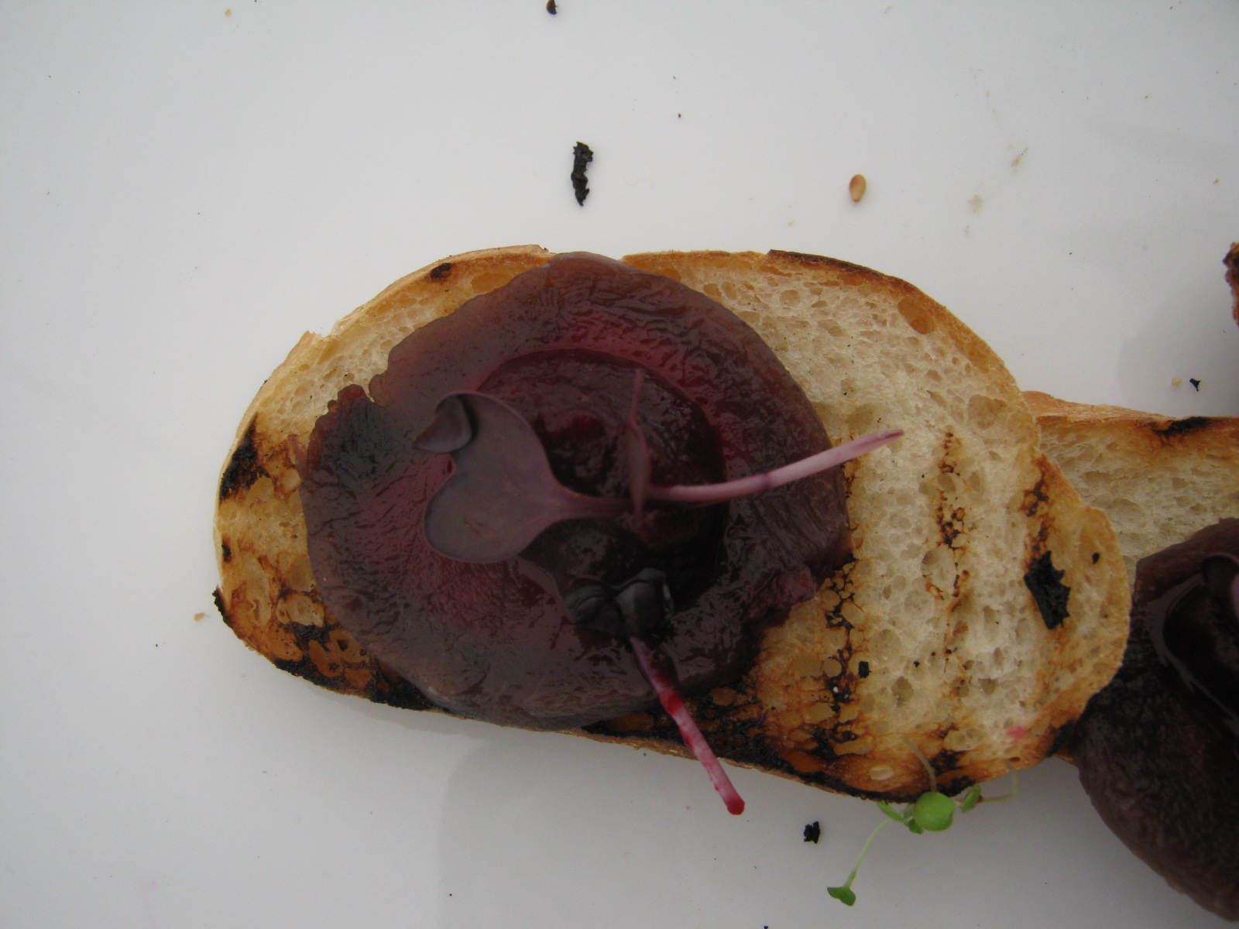
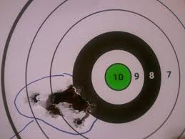


RESEARCH
RELIABILITY:
Will this happen again?
Cronbach Alpha (0.70)
VALIDITY:
“the extent to which a test measures what it
claims to measure.”
RELIABLE AND VALID

Slide 6
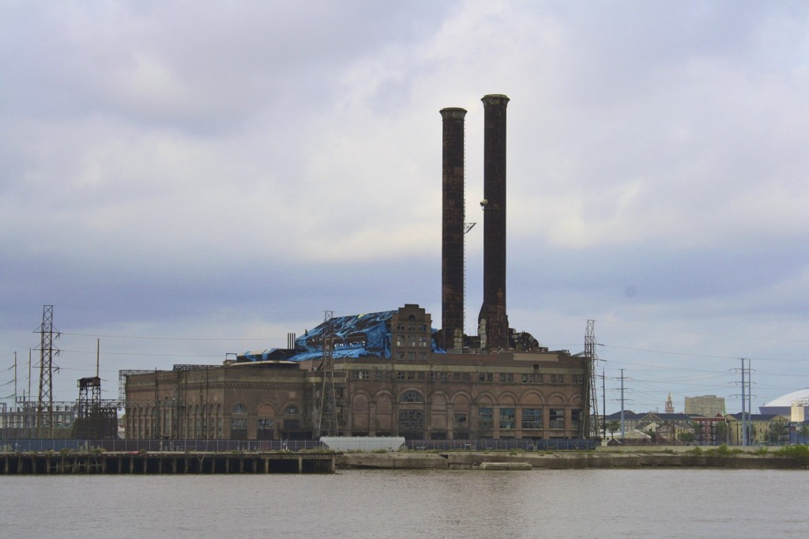
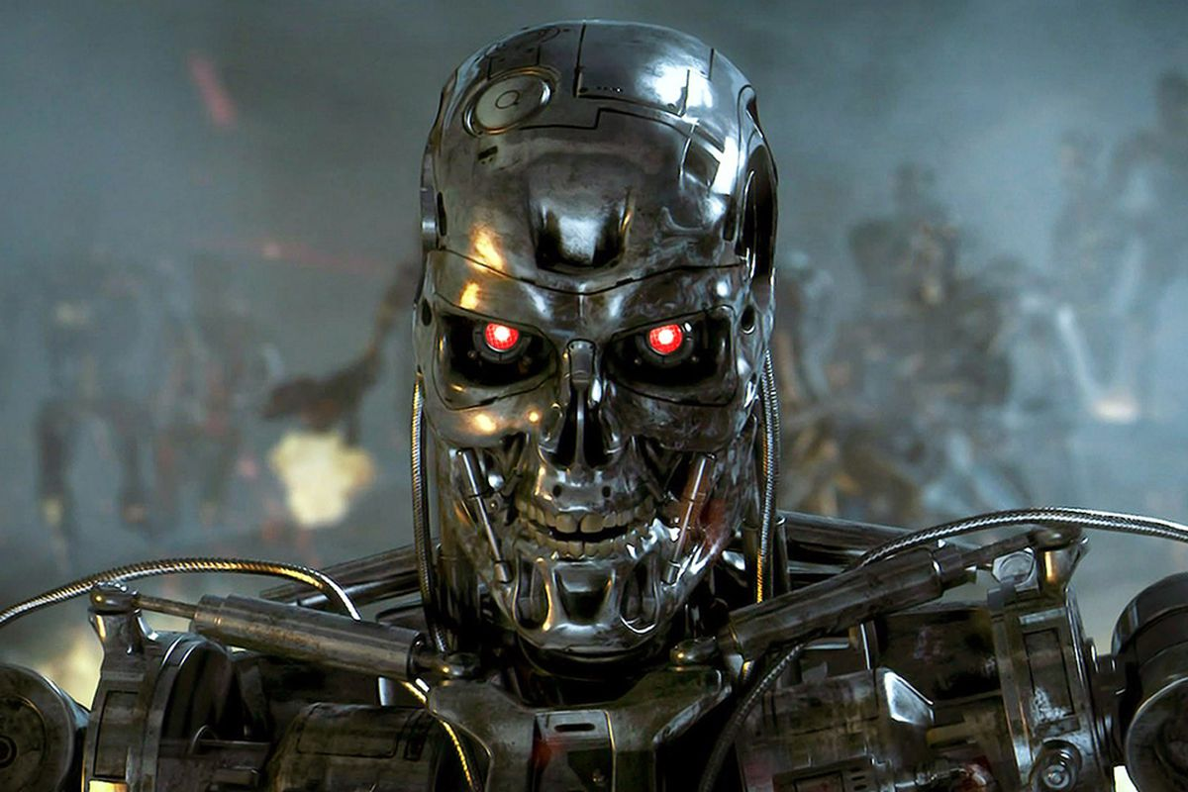
DO PROPER RESEARCH AND DRAW
CORRECT CONCLUSIONS
GET OUT OF LOS ANGELES !
ACTUALLY… THAT IS NEW ORLEANS

Slide 7
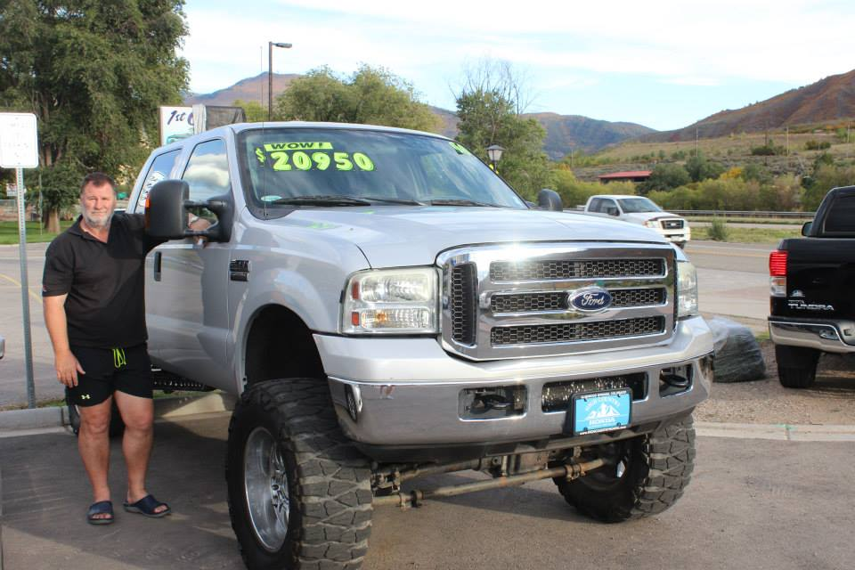
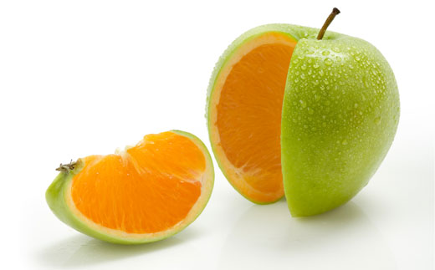
DIFFERENTIATION: WILL YOU EXTRA PAY FOR THIS?

Slide 8
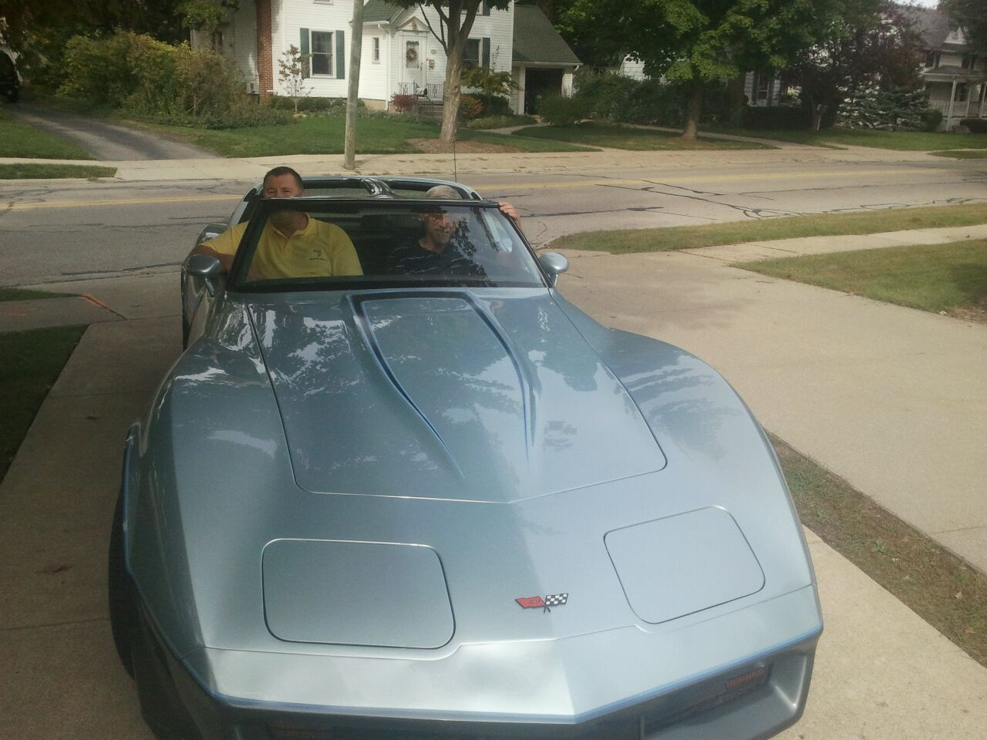
DIFFERENTIATION
Important component of brand name is that it is different from competitor products in market
Difference must be significant
Difference must be marketable
Will customers pay for this difference?
NB Difference could by physical or psychological

Slide 9
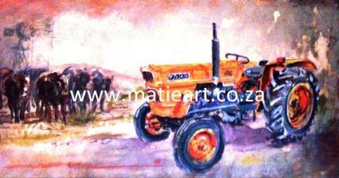
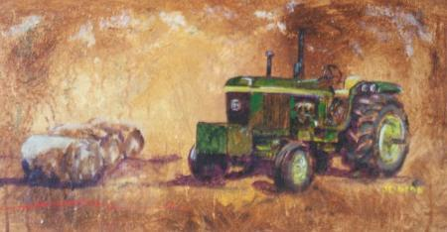
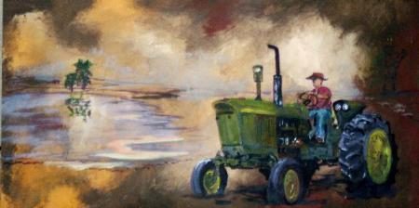
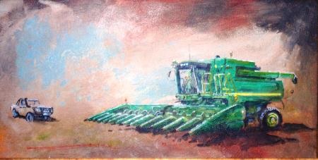
DIFFERENSIATION:
MATIEART – PAINTER MATIE BOTHA
Paints tractors in SA
Marketing: Nampo and agricultural magazines
Paints from pictures on demand
Specializes in gifts – wives order paintings of beloved tractor on farm for husband.
http://www.trekkerskilder.co.za/

Slide 10
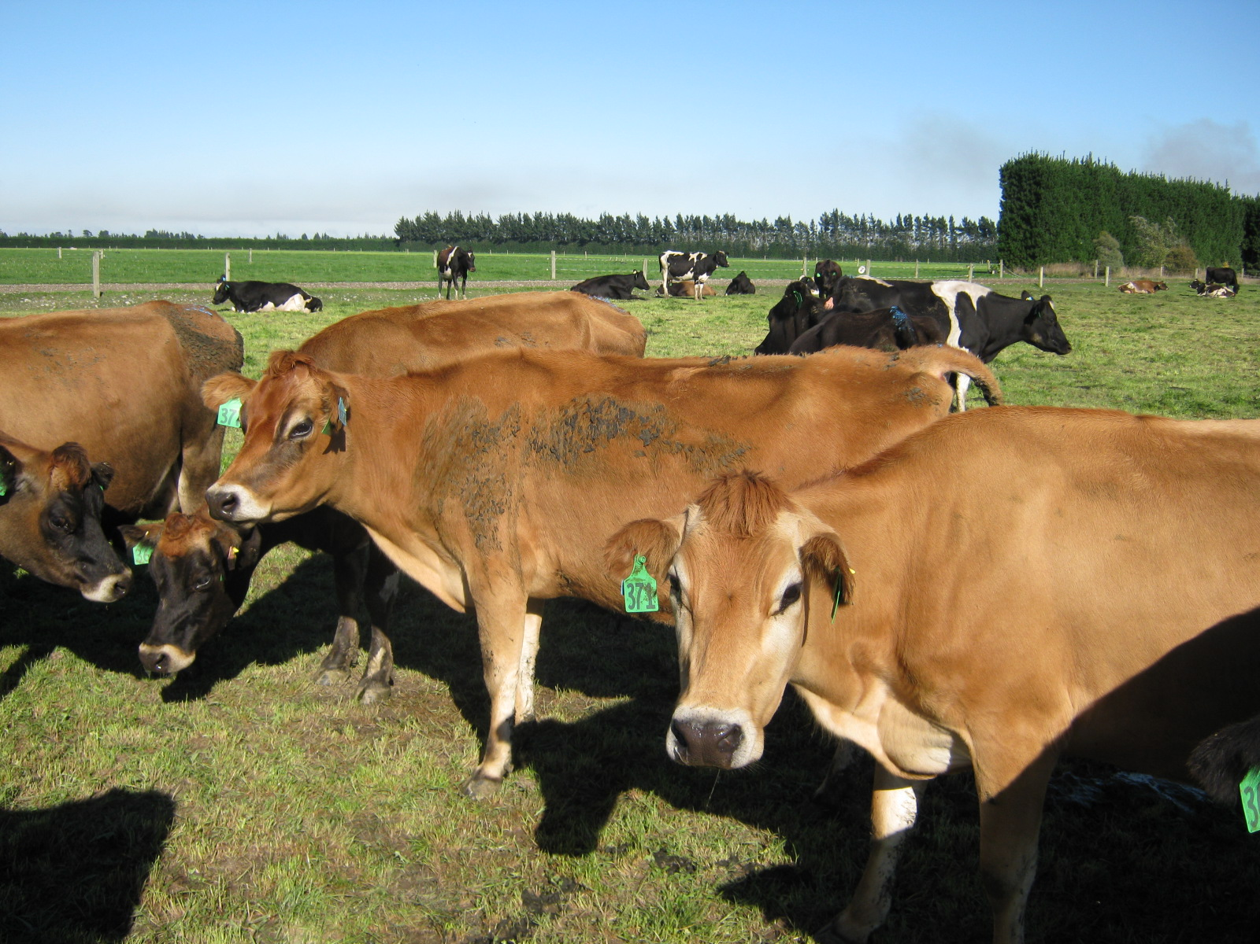
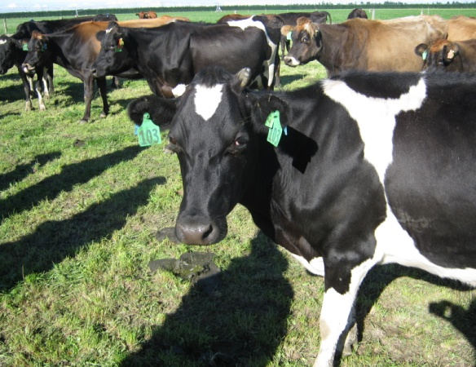
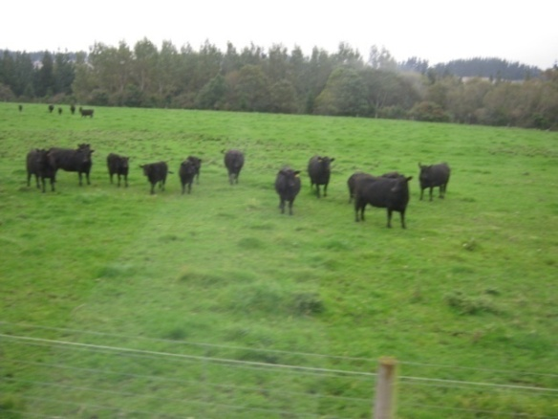
WHICH P (OR P’s) IS FAILING?
MILK CATTLE IN NZ
CATTLE & MILK SOLIDS
  High production drive
  NZ X-bred (between Jersey and
  Friesland)
  Optimal cow production on weight
  Export milk solids – no water
  No need for calves / heifers
  Market exists, yet grazing does not
  (takes place of a cow that can be milked)
Product: Cattle too heavy
Product: Bull calves
Place (Distribution): Milk – water weight
Price: Distribution of water as weight makes price too expensive

Slide 11
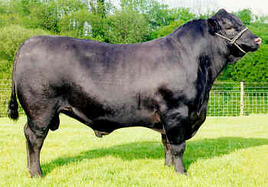
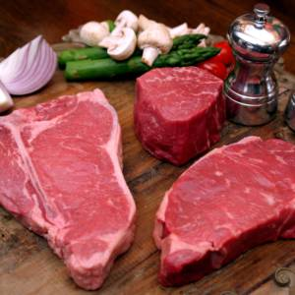
HIER IS DIE VERSKIL!!
THE DIFFERENCE IS…
Price premium of 10% on Angus Beef!!
Customers pay more for Angus beef
Farmer expects better prices for his stock!

Slide 12

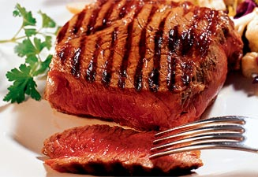
KARAN BEEF
Focus on the fattening and conditioning of the carcass
Not on specific beef or cattle breeds
Thus: differentiate on conditioning

Slide 13
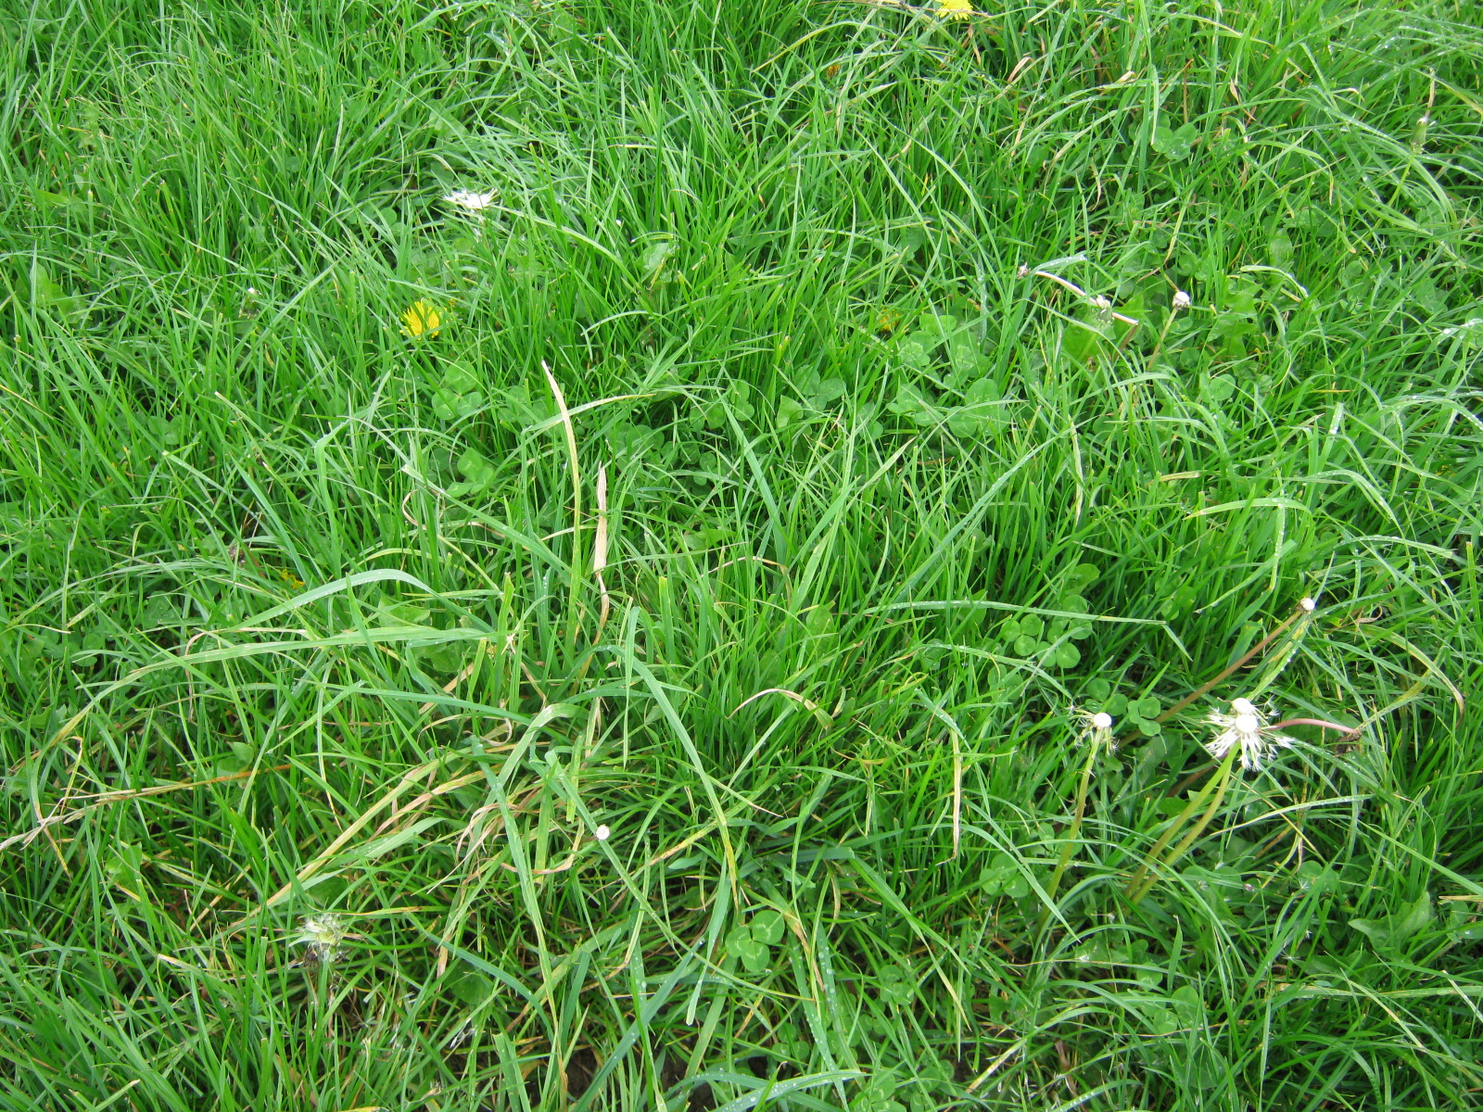
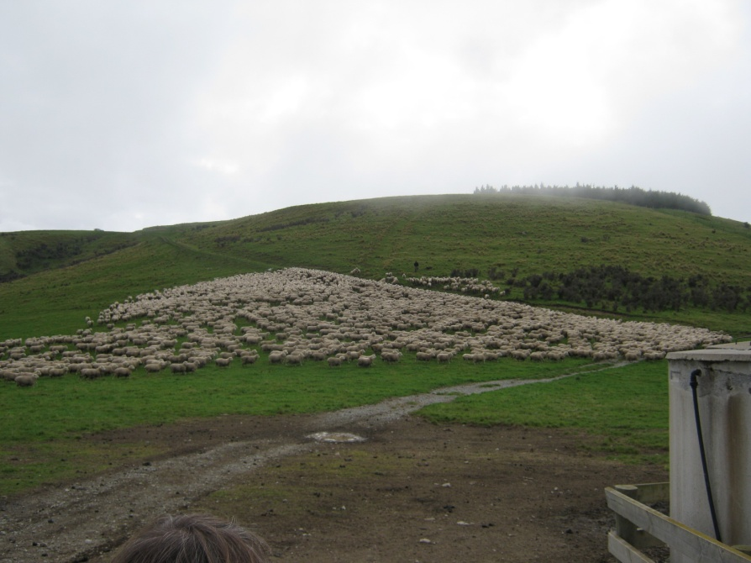
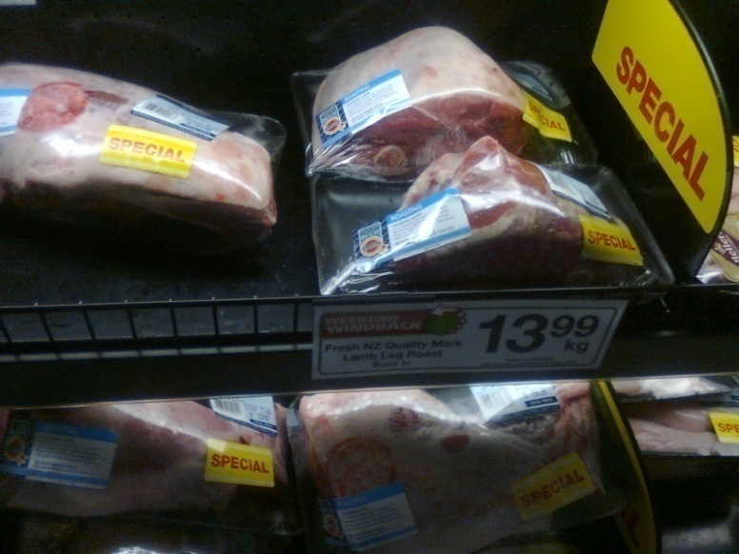
KIWI LAMB
Are these lamb different?
  Relative expensive
  Grass conditioned (not grain)
  Resistance against Lucerne as grazing (Kiwi sheep is tasty because of grazing on grasslands!)
  Parasite free environment - green farming

Slide 14
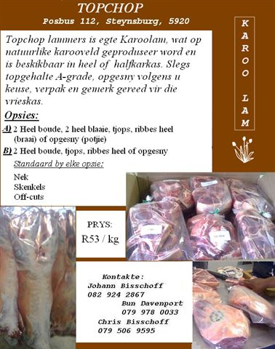
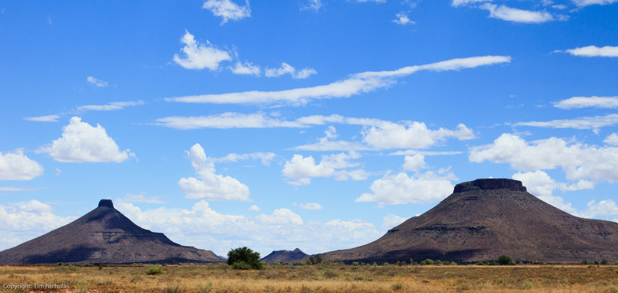
Now what about SA lamb?
Toptjop. Karoo-lamb
Special taste of Karoo-lamb
Differentiate on taste
Delivery all over SA
Price premiums: 12-20% because of branded meat.

Slide 15
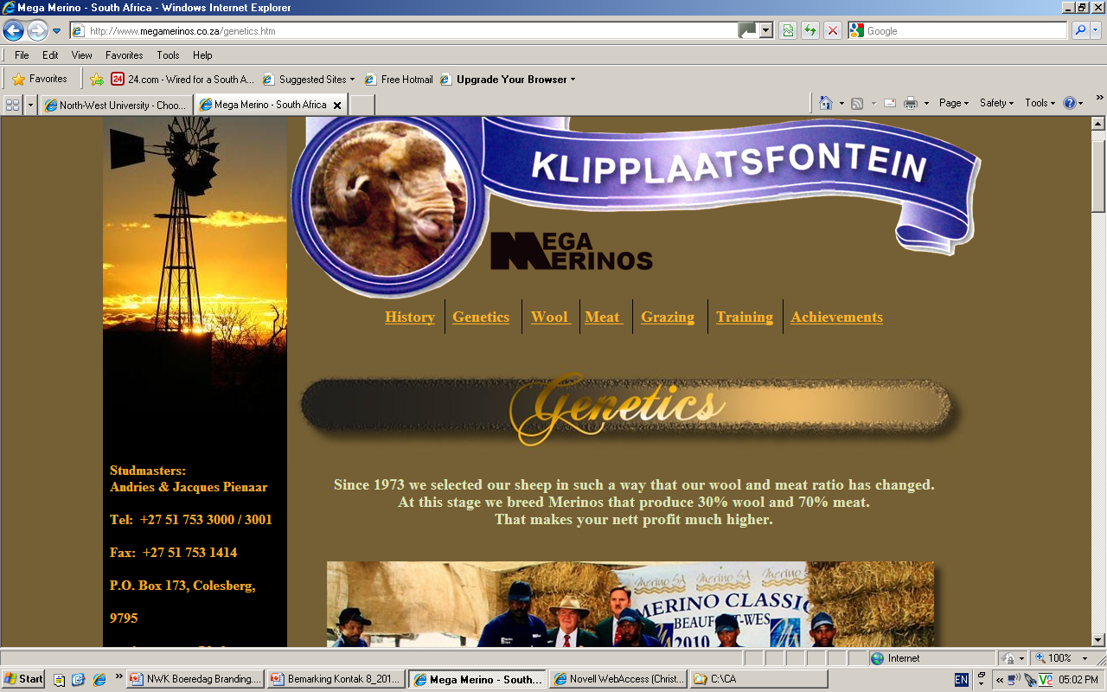
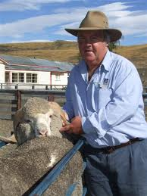
SOME OTHER EXAMPLES OF BRANDING?
Andries (Tot) Pienaar of Colesberg bred his merino stud for production (30% wool & 70% meat).
Branded it as “Mega merino”
Currently in partnerships with NZ and Australia studs where he markets his rams’ semen
(Individual brandname)
Communal attempts of Langkloof area – Langkloof Apples (Regional brandname)
Real California cheese / Outspan oranges / South African whines (State / Country brandname)

Slide 16
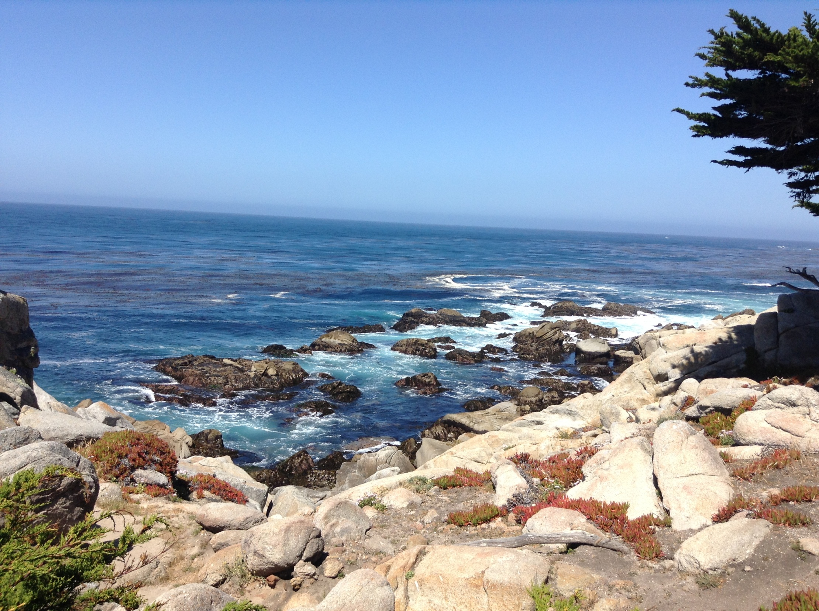
CARMEL
So? How have Clint Eastwood and fellows differentiated the town?

Slide 17
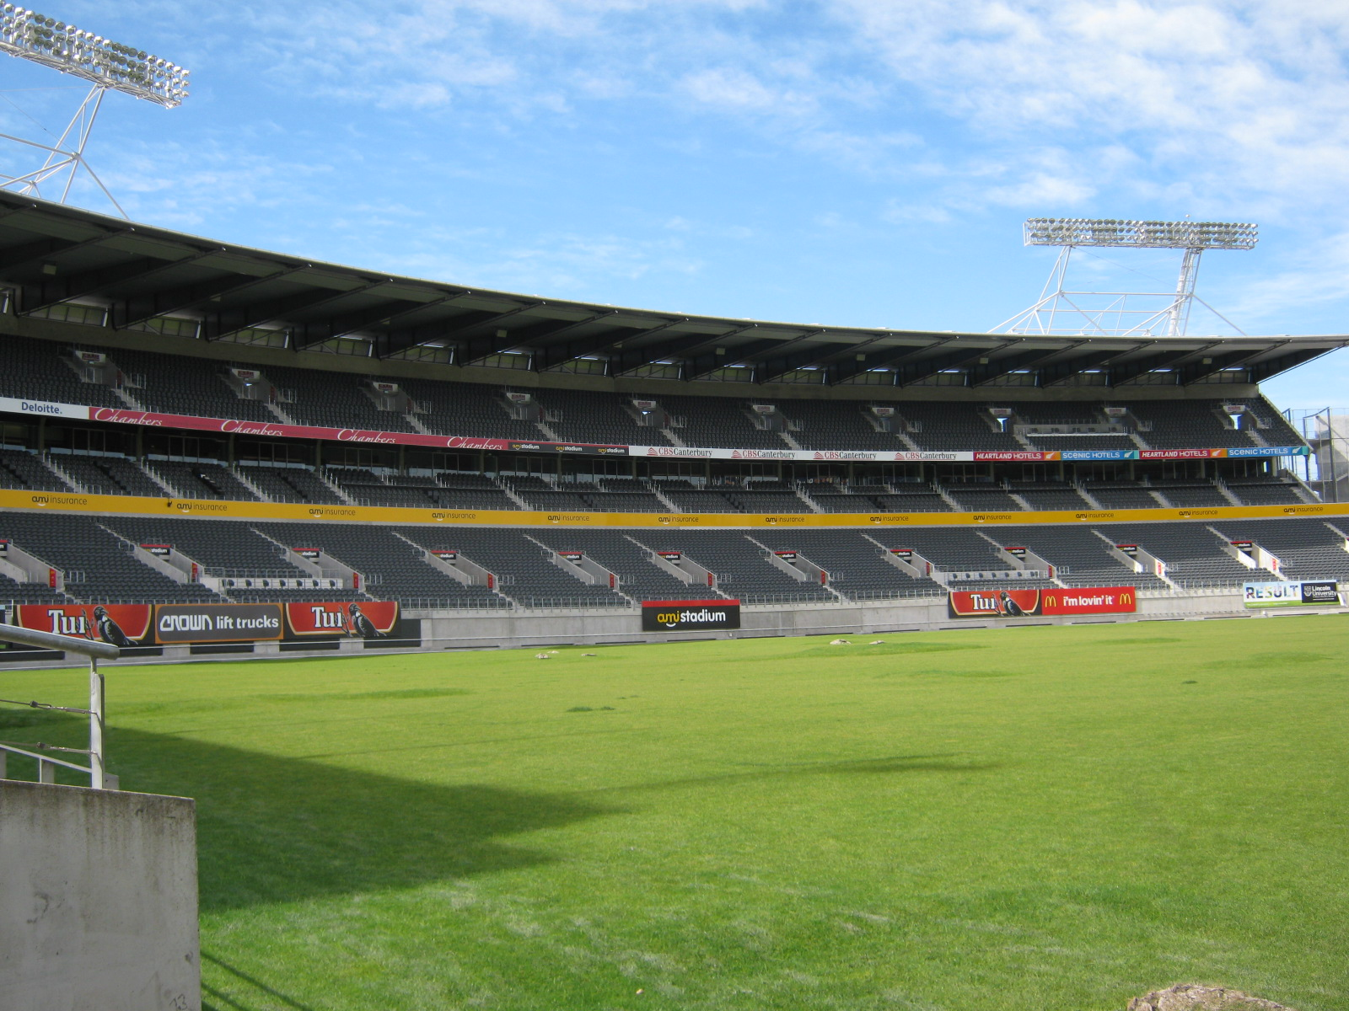
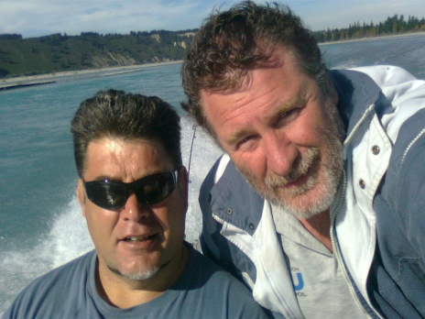
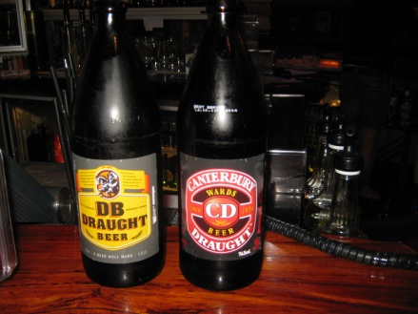
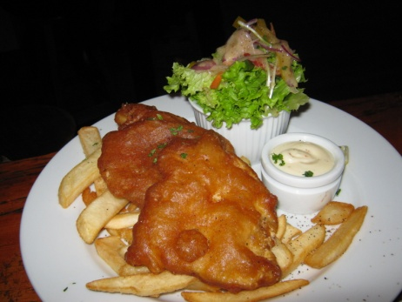
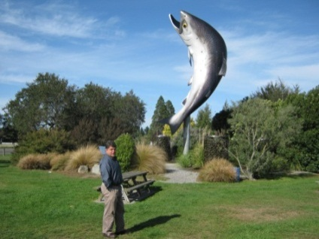
STRATEGY
AIM STADUIM STRATEGY:
THE DAY THE SHARKS TOOK ON THE CRUSADERS
2. FROM ANALYSIS TO STRATEGY
1. SITUATION ANALYSIS
INTERNAL ANALYSIS
FORECASTING
CUSTOMER ANALYSIS
SWOT ANALYSIS
INDUSTRY ANALYSIS
CORPORATE & MARKING STRATEGIES
COMPETITOR ANALYSIS
ANALYSIS OF DISTRIBUTION & SUPPLIERS
3. IMPLEMENTATION & CONTROL

Slide 18
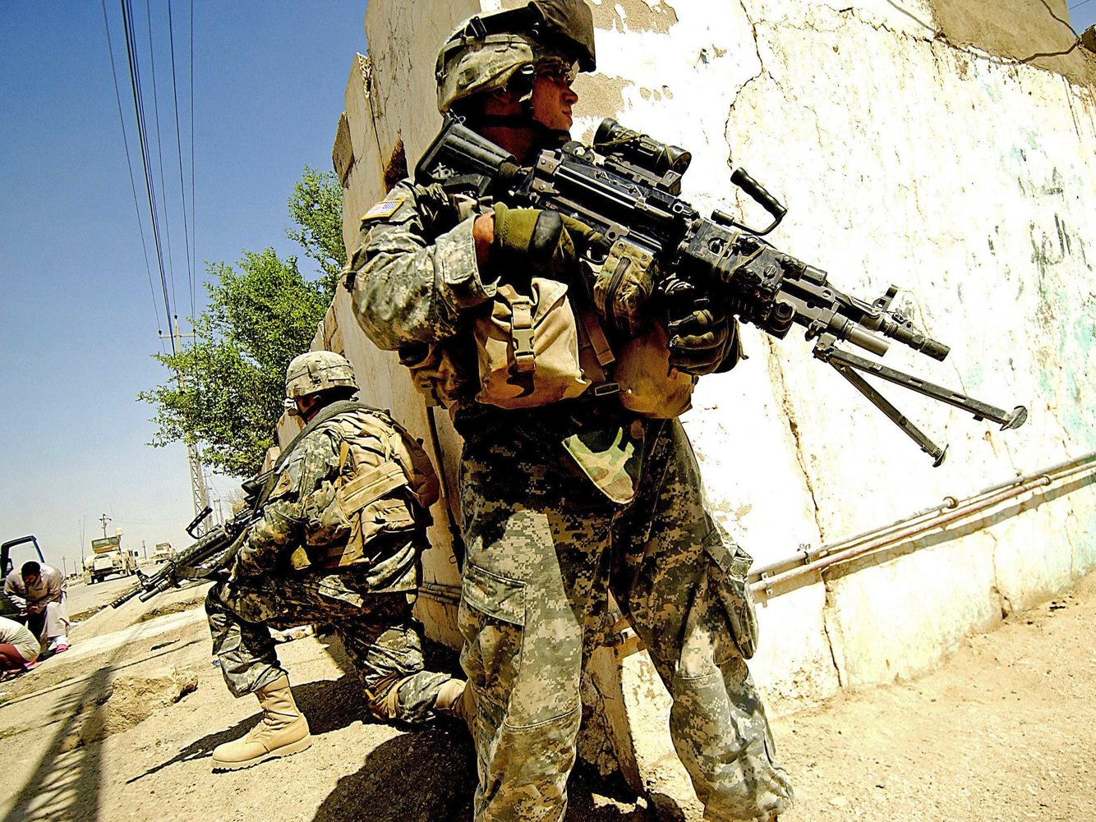
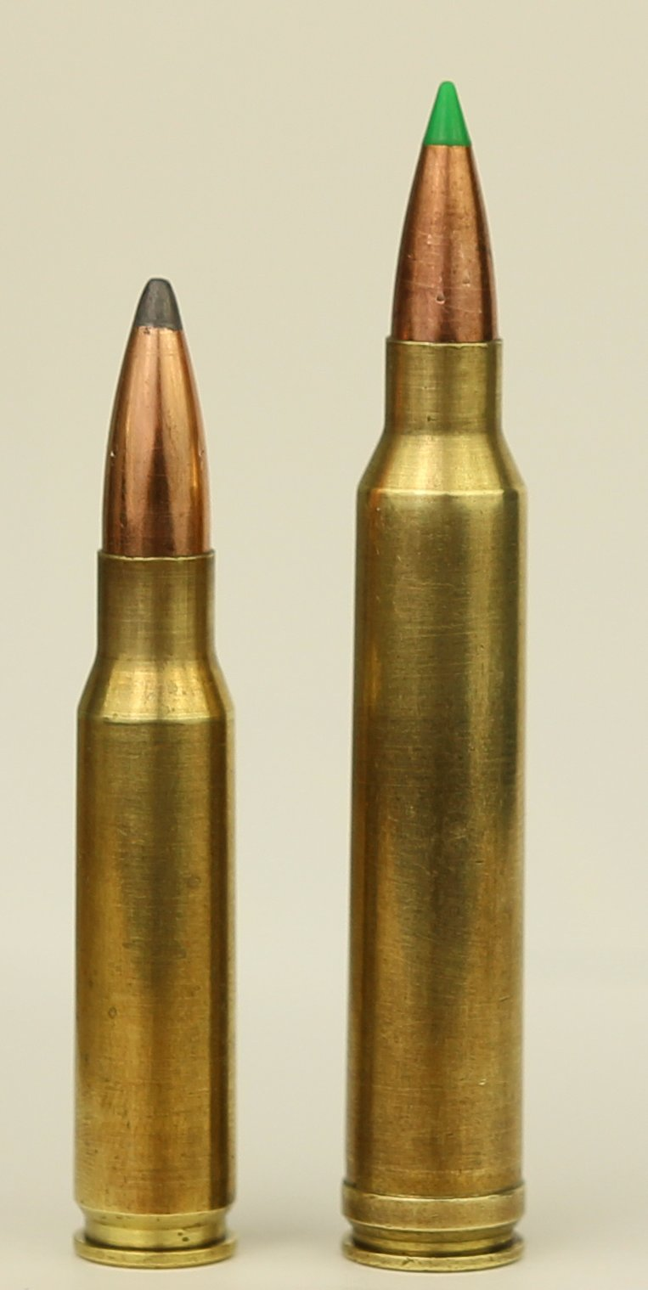
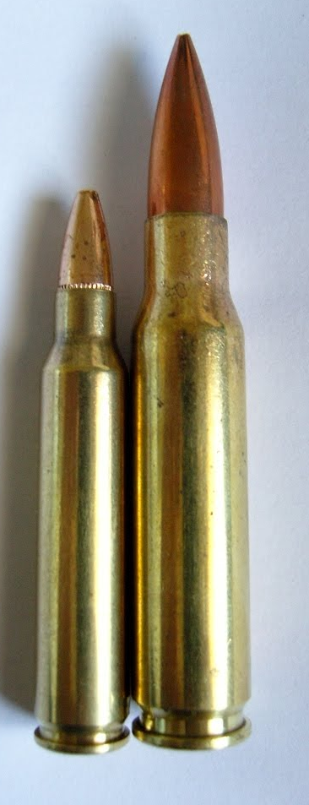
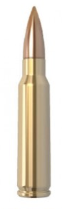
NEW CONDITIONS… NEW MARKET OPPORTUNITIES
New military calibre – market will soon follow big time!
270
308
308
223

Slide 19
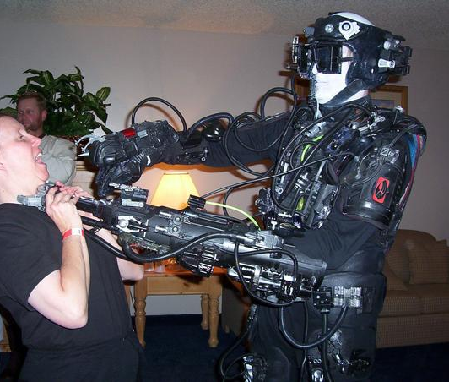
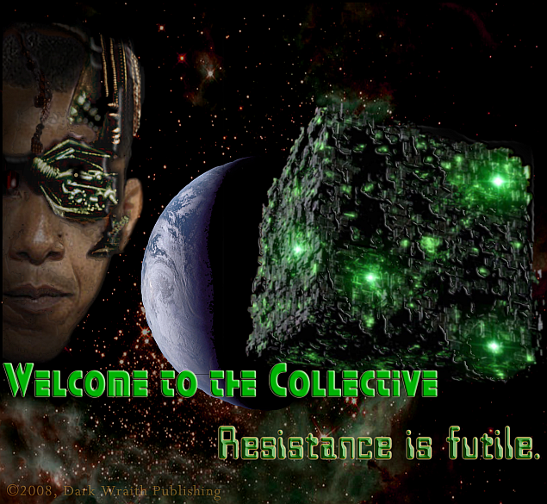
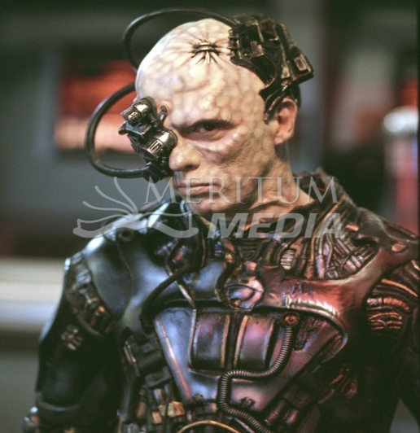
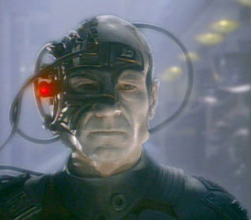
THE BORG!!
IN THE STRENGTH THERE IS A WEAKNESS:
FIND IT AND ATTACK !!
Resistance is futile, you WILL be assimilated!

Slide 20
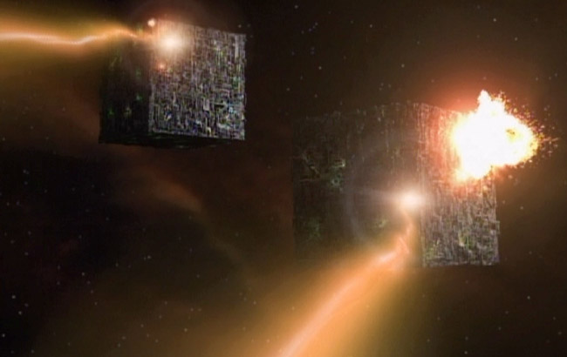
STRENGTH = COMMUNICATION
WEAKNESS = CENTRALLY ORGANISED COMUNICATION
DESTROY CENTRAL COMMUNICATION NODE !
(AND LIVE!!!)

Slide 21
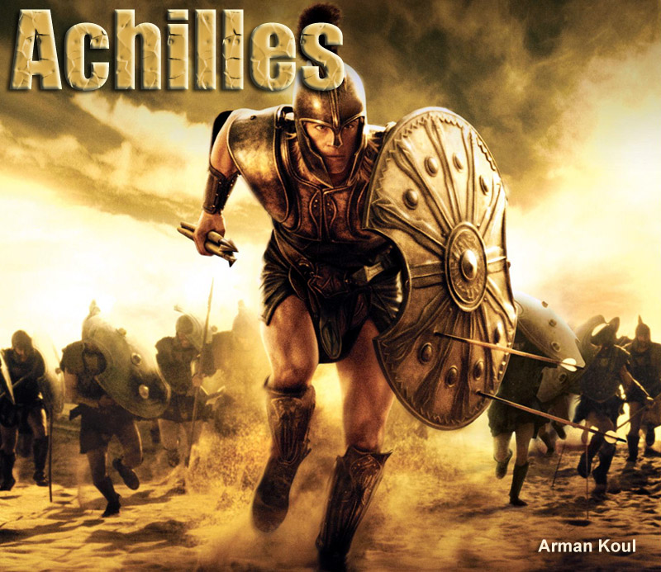
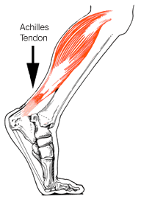
FIND THAT COMPETITORS’ ACHILLES HEEL
AND FOCUS YOUR ATTACK ON THAT HEEL

Slide 22
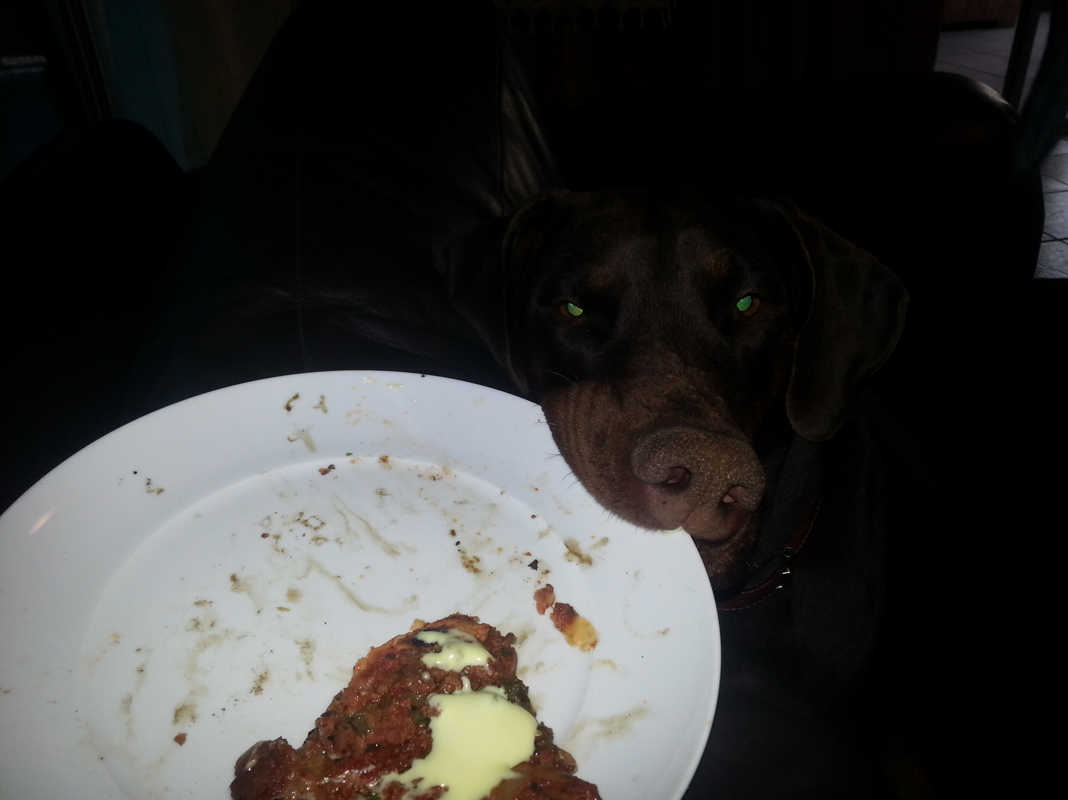


FINAL QUESTIONS?

