Slide 1
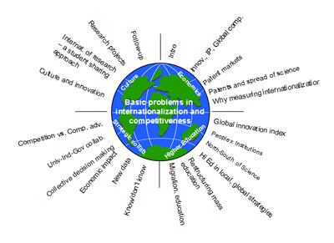
MARKETING COMPETITIVENESS AND STRATEGY
Contact 7
1

Slide 2
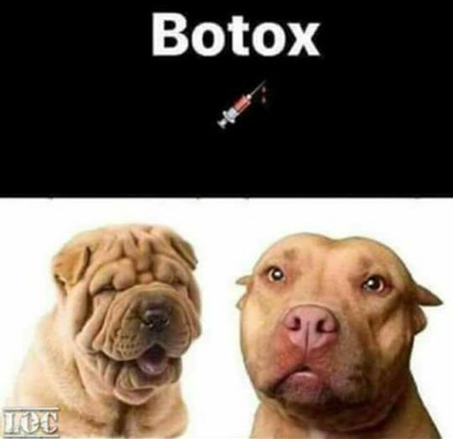
Competitor Analysis
Competitor’s strengths and weaknesses
What can our competitors do?
Benchmarking
Estimating competitor’s reactions
What will our competitors do?
Assessing Competitors

Slide 3


Competitor Analysis
Selecting Competitors to Attack and Avoid
Notes:
Note to Instructor
This hyperlink is for a small credit union with a clear message—the other banks have high fees. They should have performed a customer value analysis to realize this is one of their benefits that the competitors do not offer.

Slide 4


Competitor Analysis
Selecting Competitors to Attack and Avoid
Finding uncontested market spaces
BLUE OCEAN
(FACEBOOK)
Notes:
Note to Instructor
This is called “blue ocean” strategy where there are no direct competitors.

Slide 5
Competitive Strategies
Approaches to Marketing Strategy
Entrepreneurial marketing involves visualizing an opportunity and constructing and implementing flexible strategies
Formulated marketing involves developing formal marketing strategies and following them closely
Intrepreneurial marketing involves the attempt to reestablish an internal entrepreneurial spirit and refresh marketing strategies and approaches

Slide 6
Competitive Strategies
Basic Competitive Strategies
Michael Porter’s four basic
competitive positioning strategies
Overall cost leadership
Differentiation
Focus
Middle of the road

Slide 7

Competitive Strategies
Basic Competitive Strategies
Overall cost leadership strategy is when a company achieves the lowest production and distribution costs and allows it to lower its prices and gain market share
Notes:
Note to Instructor
This hyperlink is to Dell’s Web site. They have a changing banner on their site that almost always gives a message of how the consumer can save money with a Dell.

Slide 8
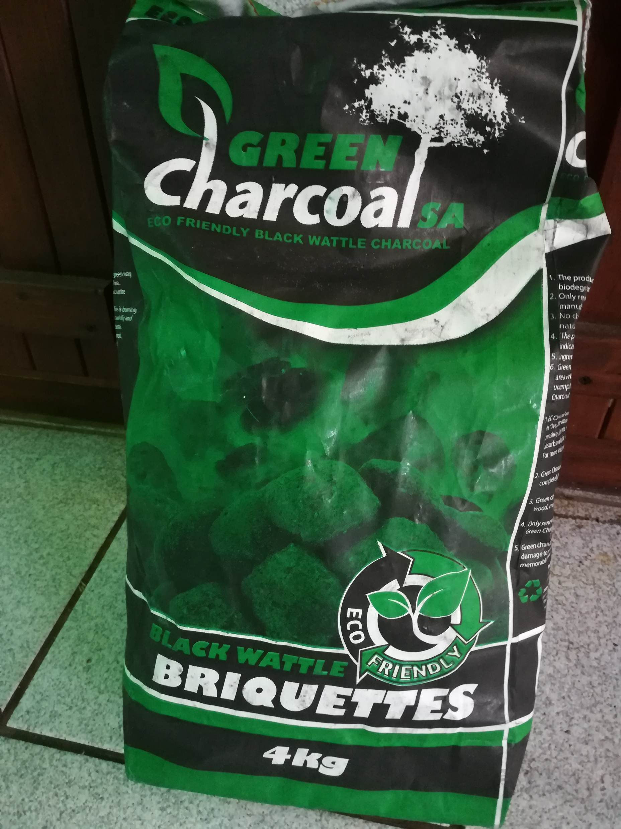
Competitive Strategies
Differentiation strategy is when a company concentrates on creating a highly differentiated product line and marketing program so it comes across as an industry class leader
Focus strategy is when a company focuses its effort on serving few market segments well rather than going after the whole market
Basic Competitive Strategies

Slide 9
Competitive Strategies
Basic Competitive Strategies
Porter believed that a company that pursued a clear strategy would achieve superior performance and that companies without a clear strategy would not succeed
Porter considered no clear strategy to be “middle of the road”

Slide 10
Competitive Strategies
Basic Competitive Strategies
Operational excellence refers to a company providing value by leading its industry in price and convenience by reducing costs and creating a lean and efficient value delivery system

Slide 11
Competitive Strategies
Basic Competitive Strategies
Customer intimacy refers to a company providing superior value by segmenting markets and tailoring products or services to match the needs of the targeted customers
Notes:
Note to Instructor
Discussion Question
How do you know you can trust a Web site?
This Web link ties directly to the customer service page of Nordstrom.com. The students might comment on how well organized the site appears, how they show easy returns and free exchanges, and how they offer alterations.

Slide 12
Competitive Strategies
Basic Competitive Strategies
Product leadership refers to a company providing superior value by offering a continuous stream of leading-edge products or services. Product leaders are open to new ideas and solutions and bring them quickly to the market.

Slide 13
Competitive Strategies
Competitive Positions
Market leader strategies
Market challenger strategies
Market follower strategies
Market nicher strategies
Notes:
Note to Instructor
Forty percent of the market is in the hands of the market leader, the firm with the largest market share. Another 30 percent is in the hands of market challengers, runner‑up firms that are fighting hard to increase their market share. Another 20 percent is in the hands of market followers, other runner‑up firms that want to hold their share without rocking the boat. The remaining 10 percent is in the hands of market nichers, firms that serve small segments not being pursued by other firms.

Slide 14
Competitive Strategies
Competitive Positions
Market leader is the firm with the largest market share and leads the market price changes, product innovations, distribution coverage, and promotion spending
Market challengers are firms fighting to increase market share
Market followers are firms that want to hold onto their market share
Market nichers are firms that serve small market segments not being pursued by other firms

Slide 15

Competitive Strategies
Market Leader Strategies
Protecting Market Share
Protect current market by:
Fixing or preventing weaknesses that provide opportunities to competitors
Maintain consistent prices that provide value
Keep strong customer relationships
Continuous innovation
Lock in resources

Slide 16
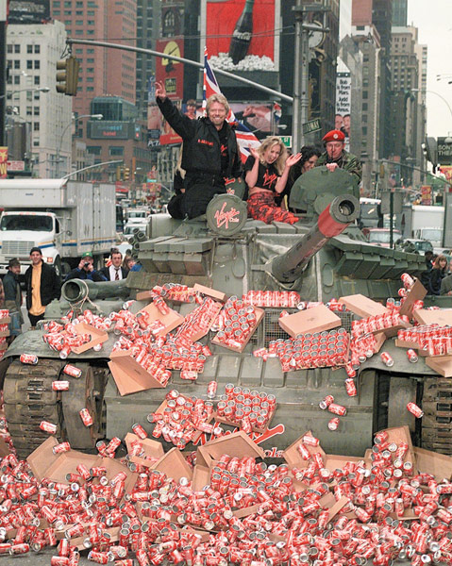
Competitive Strategies
Market Challenger Strategies
Challenge the leader with an aggressive bid for more market share
Play along with competitors and not rock the boat
Notes:
Note to Instructor
The text gives an excellent example of a market challenger:
Virgin Drinks took on the leaders head-on, launching its own cola, advertising heavily, and trying to get into all the same retail outlets that stocked the leading brands. At Virgin Cola’s launch, Virgin CEO Richard Branson even drove a tank through a wall of rivals’ cans in New York’s Times Square to symbolize the war he wished to wage on the big, established rivals. However, Coke’s and Pepsi’s viselike grip on U.S. shelf space proved impossible for Virgin Drinks to break. Although Virgin Drinks is still around, it has never gained more than a 1percent share of the U.S. cola market.
Red Bull, by contrast, tackled the leaders indirectly. It entered the U.S. soft drinks market with a niche product: a carbonated energy drink retailing at about twice what you would pay for a Coke or Pepsi. It started by selling Red Bull through unconventional outlets not dominated by the market leaders, such as bars and nightclubs, where twenty-something's gulped down the caffeine-rich drink so they can dance all night. After gaining a loyal following, Red Bull used the pull of high margins to elbow its way into the corner store, where it now sits in refrigerated bins within arm’s length of Coke and Pepsi. In the United States, where Red Bull enjoys a 65 percent share of the energy drink market, its sales are growing at about 35 percent a year.

Slide 17

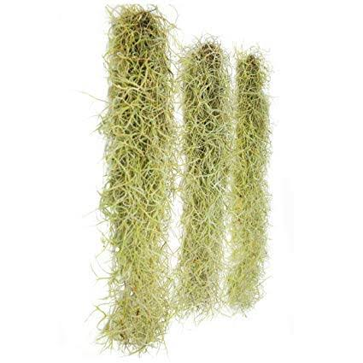
Competitive Strategies
Market Follower Strategies
Second mover advantage occurs when a market follower observes what has made the leader successful and improves on it
Challenges firms its own size or
smaller
Learn from mistakes
Improve materials / resources
SLEEP TIGHT, DON’T LET THE BEDBUGS BITE!

Slide 18

Competitive Strategies
Market Nicher Strategies
Ideal market niche is big enough to be profitable with high growth potential and has little interest from competitors
Key to market niching is specialization
Market
Customer
Product
Marketing mix
Notes:
Note to Instructor
This link refers to the example in the text for R.A.B. Food Group. The text mentions its Kosher line but it is interesting to see some of their smaller lines including Guiltless Gourmet.

Slide 19

?
Red Ocean Strategy
Blue Ocean Strategy
Notes:
Cirque du Soleil broke the best practice rule of the circus industry,
achieving both differentiation and low cost by reconstructing
elements across existing industry boundaries.In the red ocean, differentiation costs because
firms compete with the same best-practice rule. Here, the
strategic choices for firms are to pursue either differentiation or
low cost. In the reconstructionist world, however, the strategic aim
is to create new best-practice rules by breaking the existing value cost
trade-off and thereby creating a blue ocean. (For more discussions
on this, see appendix B, “Value Innovation: A Reconstructionist
View of Strategy.”)
Cirque du Soleil broke the best practice rule of the circus industry,
achieving both differentiation and low cost by reconstructing
elements across existing industry boundaries.

Slide 20
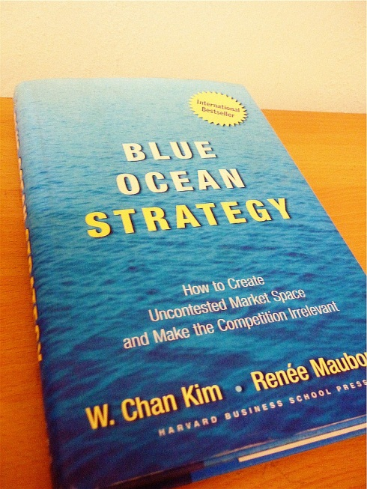
Blue ocean strategy
Blue Oceans represent all industries
NOT
in existence today.
This is undefined market space, otherwise known as OPPORTUNITY.
Key words might be value innovation, focus, differentiation, creation of demand, new marketplace

Slide 21
Red ocean strategy
Red Oceans represent all industries
in existence today.
They have defined rules, competitors, and market boundaries.
Key words might include competition, price wars, market share, commoditization, benchmarking, strategic positioning, value add.

Slide 22
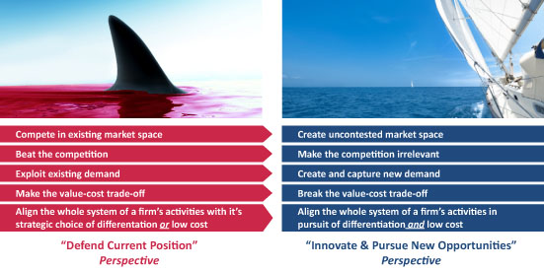
Blue ocean vs Red ocean strategy

Slide 23
Turn back the clock
Which industries did not exist?
  100 years
  50 years
  30 years
  20 years
  10 years
  5 years

Slide 24

Creating Uncontested Market Space and Making the Competition Irrelevant
Blue Ocean Strategy
Notes:
An that is exactly why Cirque du Soleil has everything to do with Blue Oceans….

Slide 25

Summary of Blue Ocean Strategy
New Market Space
Continuing Creation of Blue Oceans
Impact of Creating Blue Oceans
Rising Imperative of Creating Blue Oceans
From Company and Industry to Strategic Move
Value Innovation
Formulating and Executing Blue Oceans
Notes:
Create Uncontested Market Space
Make the Competition Irrelevant

Slide 26
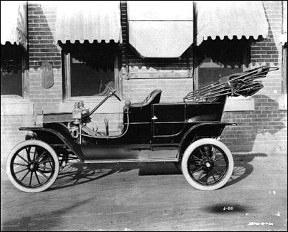


New Market Space
Creating Blue Oceans Is Consistent Across Time Regardless of Industry
Ford’s 1908 Model T
1970 The First Mouse
CNN 1980
Real-Time News 24/7
2002 Apple’s ipod
Continuing Creation of Blue Oceans
Notes:
We studied more than one hundred fifty strategic moves made from 1880 to 2000 in more than thirty industries, and we closely examined the relevant business players in each of these events. Industries ranged from hotels, the cinema, retail, airlines, energy, computers, broadcasting, and construction to automobiles and steel. We analyzed not only winning business players who created blue oceans but also their less successful competitors.study shows that the strategic move, and not the company or the industry, is the right unit of analysis for explaining the creation of blue oceans and sustained high performance

Slide 27
What is the Blue Ocean?
High profit growth at low risk
Industries not in existence today
Untapped market demand
Unknown market space

Slide 28
Summary
Conventional Logic
Blue Ocean Logic
Industry
Assumption
Industry conditions are given
Industry condition can be shaped.
Strategic
Focus
Build competitive advantages to beat the competition.
Create a quantum leap in buyer value to dominate the market.
Customers
Retain and expand the customer base through further segmentation and customization.
Think in terms of embracing customer differences.
Go for the mass of buyers and willingly let some existing customers go. Think in terms of embracing key customer value commonalities.

Slide 29
Summary
Conventional Logic
Blue Ocean Logic
Assets &
Capabilities
Think in terms of a company’s existing assets and capabilities.
Build on what it has.
Think free from a company’s existing assets and capabilities.
Ask, what if we start anew?
Product/
Service
offerings
Think in terms of products/services offered by the industry. Seek to maximize the value of these offerings.
Think in terms of buyers’ solution even if that transcends the industry. Seek to solve buyers’ major bottlenecks/chief compromises in using the products/services of the industry.

Slide 30
Four Actions to create a Blue Ocean
Raise
What factors should be raised well beyond the industry standard?
Eliminate
Create
What factors should be eliminated that the industry has taken for granted?
What factors should be created that the industry has never offered?
Reduce
What factors should be reduced well below the industry standard?

Slide 31


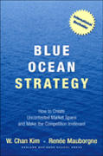
Read more:
The Book and the Authors
© JOHN ABBOTT
© JOHN ABBOTT
Prof Chan Kim
Prof Renee Mauborgne

Slide 32
STRATEGY – ELEMENTS FOR SUCCESS
2. FROM ANALYSIS TO STRATEGY
1. SITUATION ANALYSIS
INTERNAL ANALYSIS
FORECASTING
CUSTOMER ANALYSIS
SWOT ANALYSIS
INDUSTRY ANALYSIS
CORPORATE & MARKING STRATEGIES
COMPETITOR ANALYSIS
ANALYSIS OF DISTRIBUTION & SUPPLIERS
3. IMPLEMENTATION & CONTROL

Slide 33
1. SITUATION ANALYSIS
INTERNAL ANALYSIS
STRENGTHS
WEAKNESSES
CONSUMER BEHAVIOUR
SEGMENTTION
TARGETING
POSITIONING
CUSTOMER ANALYSIS
INDUSTRY ANALYSIS
PORTER 5 FORCES MODEL
INDUSTRY LIFE CYCLE
PRODUCT LIFE-CYCLE
COMPETITOR ANALYSIS
OPPORTUNITIES
THREATS
G&E MATRX
BOSTON CONSULTNG MATRIX
ANALYSIS OF DISTRIBUTION & SUPPLIERS

Slide 34
Corporate Growth Strategies
Current products
New products
Market penetration strategies
Increase market share
Increase product usage
Increase frequency of use
Increase quantity used
New applications
Product development strategies
Product improvements
Product-line extensions
New products for same
market
2 Major directions for future growth:
  1.
  Expansion of its current businesses and activities
  2. Diversification into new businesses
Current
markets
Market development strategies
Expand markets for existing products
Geographic expansion
Target new segments
Diversification strategies
Vertical integration
Forward/backward integration
Diversification into related businesses
(concentric diversification)
Diversification into unrelated businesses
(conglomerate diversification)
New
markets

Slide 35


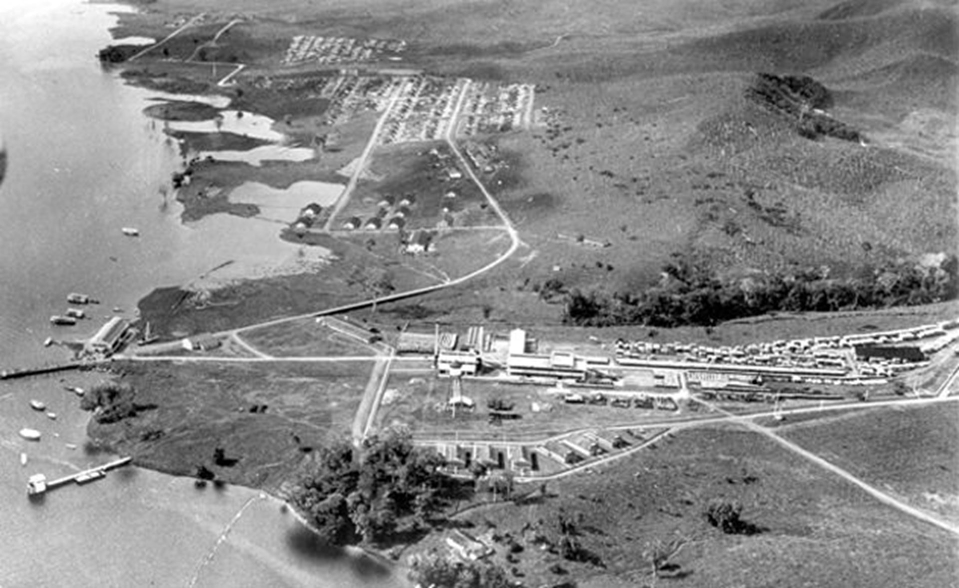

VERICAL BACKWARD INTEGRATION
HOW NOT TO DO IT

Slide 36


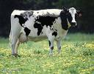

BOSTON CONSULTING GROUP’s Market Growth Relative Share Matrix
MARKET GROWTH (%)
MARKET SHARE (RELATIVE)
Notes:
A tool for allocating resources in diversified companies: The BCG Growth Share Matrix
Why is the BCG model useful?
It analyzes the impact of investing resources in different businesses on the corporation’s future earnings and cash flows.
It gives a company a quick glance on where their business units fall in an industry in terms of market share and market growth. This in turn can help generate competitive strategies to improve or maintain a position in the market.
What are its limitations?
Market growth rate is an inadequate descriptor of overall industry attractiveness.
Relative market share is inadequate as a descriptor of overall competitive strength.
The outcomes of a growth-share analysis are highly sensitive to variations in how growth and share are measured
While the matrix specifies appropriate investment strategies for each business, it provides little guidance on how best to implement those strategies.
The model implicitly assumes that all business units are independent of one another except for the flow of cash.

Slide 37
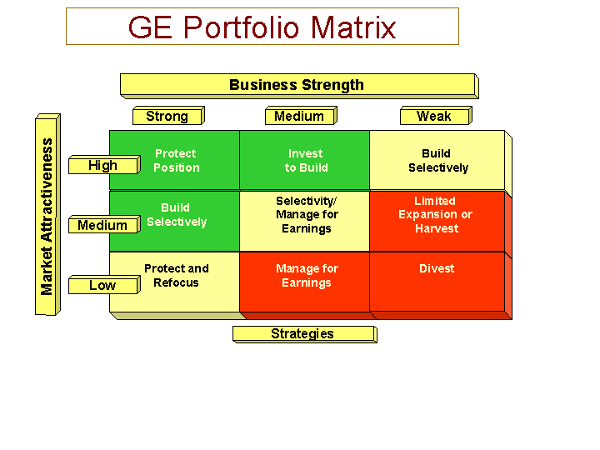
Invest/grow
Selective investment/ maintain position
Harvest/divest
Notes:
The Industry Attractiveness- Business Position Matrix
How would you assess competitive position and industry attractiveness?
Factors to assess competitive position
Relative share
Customer loyalty
Margins
Distribution
Technology
Marketing skills
Patents
Factors to assess industry attractiveness
Size
Growth
Competitive intensity
Price levels
Profitability
Technological sophistication
Government regulations

Slide 38
MAJOR FORCES OF INDUSTRY ATTRACTIVENESS – PORTER 5 FORCES
Threat of new
entrants
Rivalry among
existing industry
firms
Bargaining
power
of buyers
Bargaining
power
of suppliers
Threat of substitute
products

Slide 39
2. FROM ANALYSIS TO STRATEGY
FORECASTING
STRATEGIC DEMAND FORECASTING
FORECASTING TECHNIQUES
SWOT ANALYSIS
S
W
CORPORATE & MARKING STRATEGIES
O
T

Slide 40
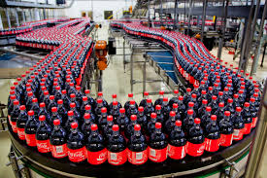
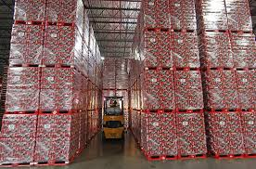
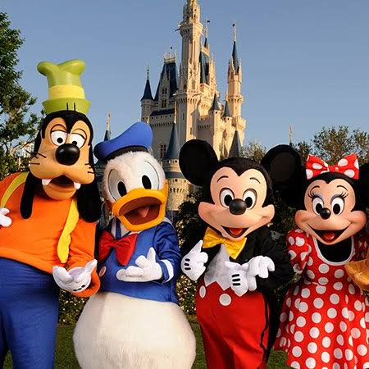

2. STRATEGY: IN YOUR STRENGTH THERE IS A WEAKNESS!!
STRENGTH – INTENSIVE DISTRIBUTION
WEAKNESS – HIGH INVENTORY COSTS
STRENGTH – BEST FAMILY ENTERTAINMENT
WEAKNESS – LONG LINES & WAITING

Slide 41


3. IMPLEMENTATION & CONTROL

Slide 42

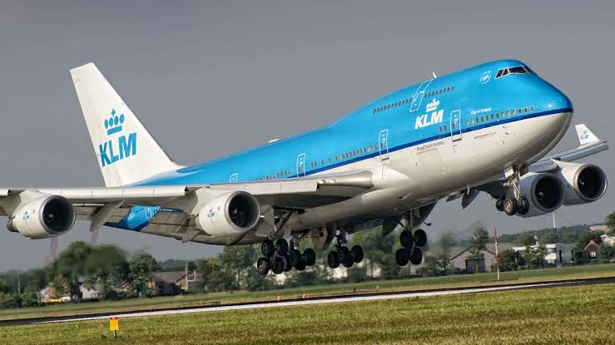
3. OOH WHEE – YOU ALL MISSED A MAJOR COMPETITOR TO 747-98 !

Slide 43

ANY QUESTIONS ?
Oak Alley Plantation (Louisiana)

