Slide 1
Group submission: Contact session: 8
Name of syndicate group: Invictus Case C9-18, p368
Person presenting on behalf of group: Lebohang Ramonyadioa
Topic(s) of this contact session: ABC SYSTEM
Name: (Members contributing to project) | Student number
Makintane Seiso | 33329443
Monethi Leballo | 25799959
Mohau Modise | 22436863
Malaku Bangane | 29778069
Nkosi Thabang | 33467919
Ramonyadioa Lebohang | 28167279
Name: (Members NOT contributing )

Slide 2
ABC System
  Costing method that is designed to provide managers with cost information for strategic and other decisions that potentially affect capacity and therefore fixed costs
  It is used a supplement to, rather than as a replacement for, the company’s formal cost accounting system
  Used to determine product and other costs for external financial reports
  To give better understanding of overhead and the profitability of products and customers
  Costs of idle capacity in Activity-Based Costing:
  Products are charged for the costs of capacity they use
  The costs of idle capacity are not charged to products
  More stable unit costing and consistent
  ABC System v/s Traditional System:
  ABC System considers both manufacturing and non manufacturing products
  Traditional system considers only manufacturing costs
  What can be profitable in traditional costing system can be unprofitable in ABC system and vice versa

Slide 3
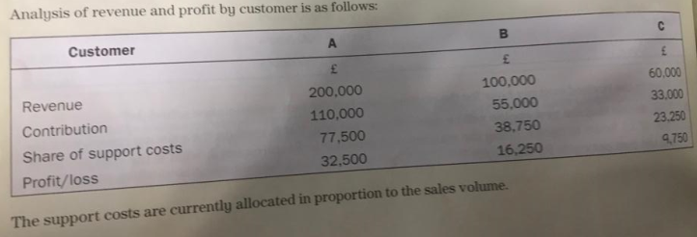
Case Study:
Analysis
The case study can be classified as an example to ‘assign costs to activity cost pools’ outlined in page 325 – 327 of accounting textbook.
In this sub-topic, most overheads costs are classified in the company’s basic accounting system according to the departments in which they are incurred.
The process called First Stage Allocation is used to allocate costs
This applies to the given case-study in such a way that the costs shared by the three customers are from Share of support costs Department (R 139 500.00)- Activity cost pool

Slide 4
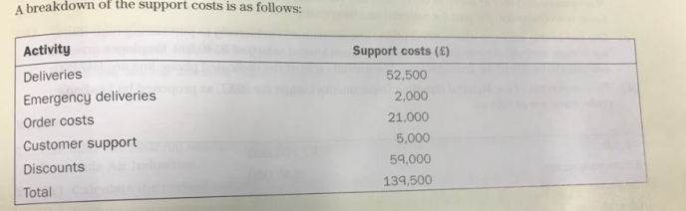
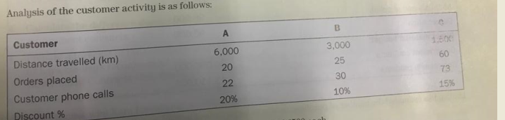
The given costs is again shared amongst the customers’ activities:

Slide 5
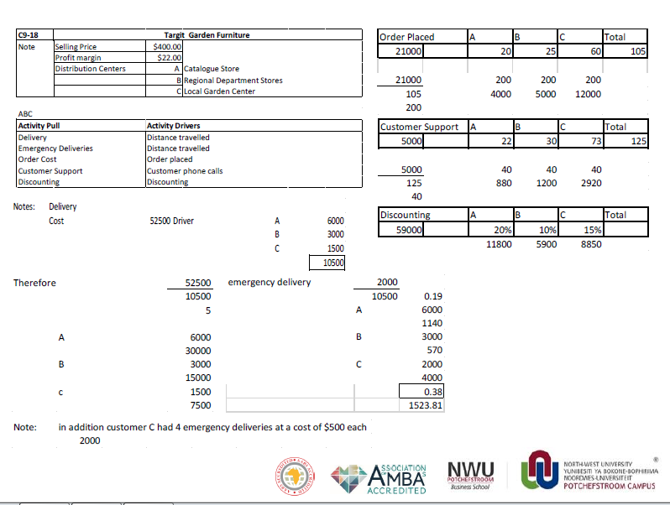
What is given and what can be deduced!!
Addition of 4 Emergency deliveries at 500 euro

Slide 6
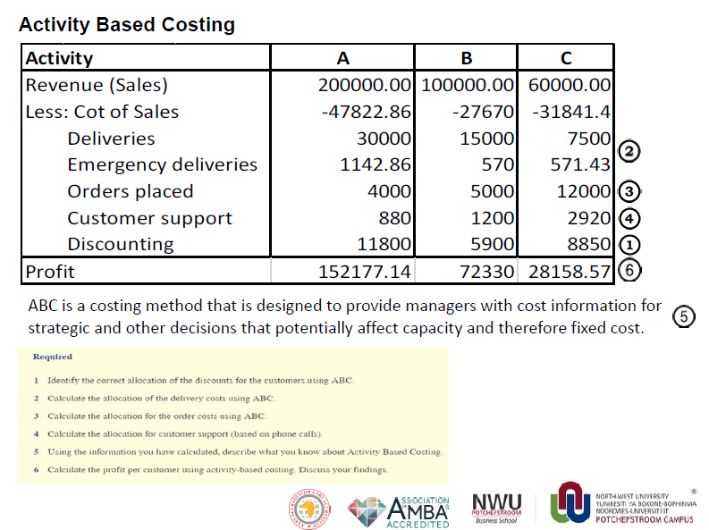

Slide 7
THANK YOU

