Slide 1


TEAM MEMBERS
Name Student No.
Christo Louw 20557213
Johan Nienaber 33483132
Danie Kirchner 23428120
Elé Wessels 24466077
Marius Cronje 33461538
Dorothy Flint 22224920
Managerial Accounting (MBAB 823)
Classroom Participation
PROBLEM 2-17

Slide 2
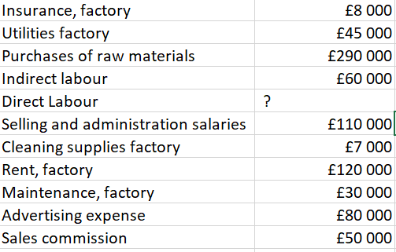
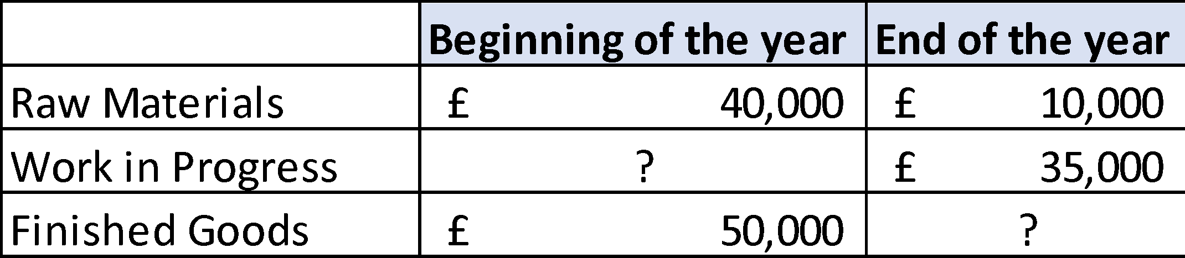
Question P2-17 (p55)
Prepare a schedule of cost of goods manufactured in good form and the cost of goods sold section of the company’s statement of profit or loss for the year.
Assume that the pound amounts given above are for the equivalent of 40,000 units produced during the year. Compute the unit cost for direct materials used and the unit cost for rent on the factory building.
Assume that in the following year the company expects to produce 50,000 units. What per unit and total cost would you expect to be incurred for direct materials? For rent on the factory building? (In preparing your answer, you may assume that direct materials is a variable cost and that rent is a fixed cost.)
As the manager in charge of production costs, explain to the managing director the reason for any difference in unit costs between Requirement 2 and Requirement 3 above.
The total manufacturing costs for the year were £683,000; the goods available for sale totalled £740,000; and the cost of goods sold totalled £660,000.

Slide 3
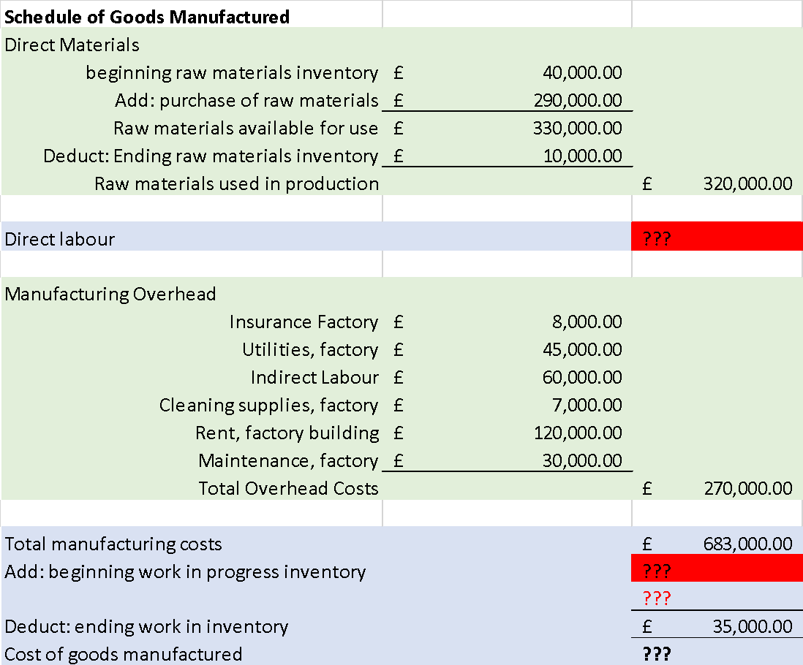
Question 1
Direct Materials
Direct Labour
Manufacturing Overhead
Cost of Goods Manufactured

Slide 4
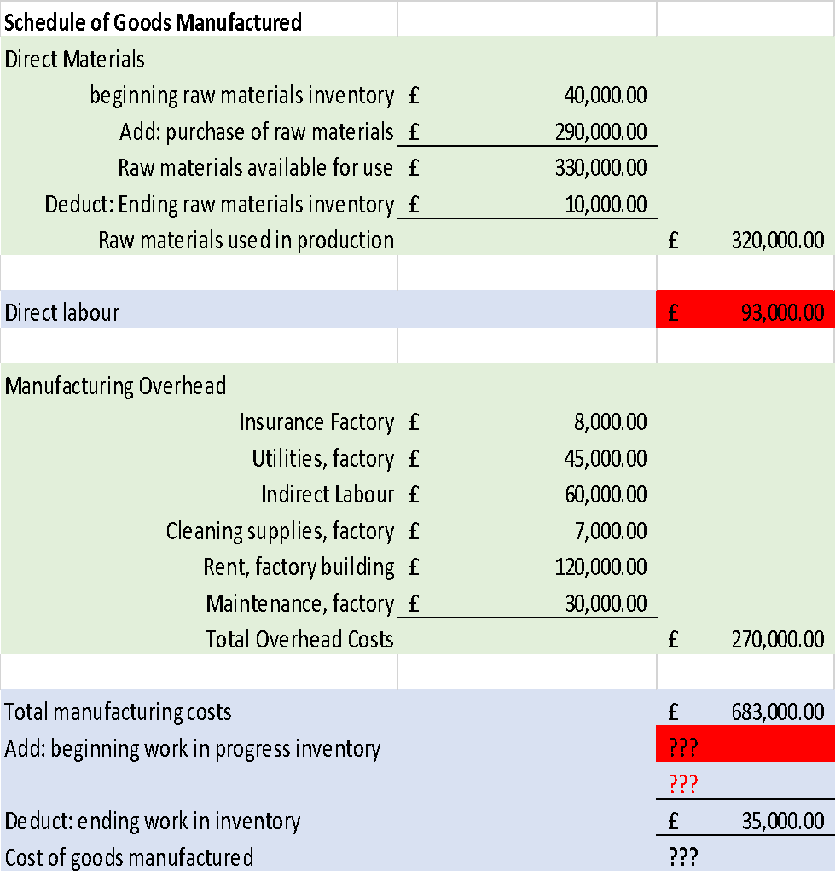
Question 1
Manufacturing Overhead
Less
Direct Materials
Less
Cost of Goods Manufactured
=
Direct Labour

Slide 5
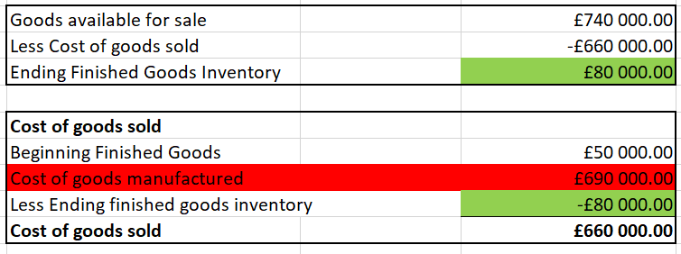
Question 1
Cost of Goods Sold
Goods Available for Sale
£740,000
Cost of Goods Sold
£660,000
Ending finished Goods Inventory
£80,000
less
=
Goods Available for Sale
£740,000
Beginning Finished Goods Inventory
£50,000
Cost of Goods Manufactured
£690,000
less
=
This is taken back to the Schedule of Cost of Goods Manufactured

Slide 6
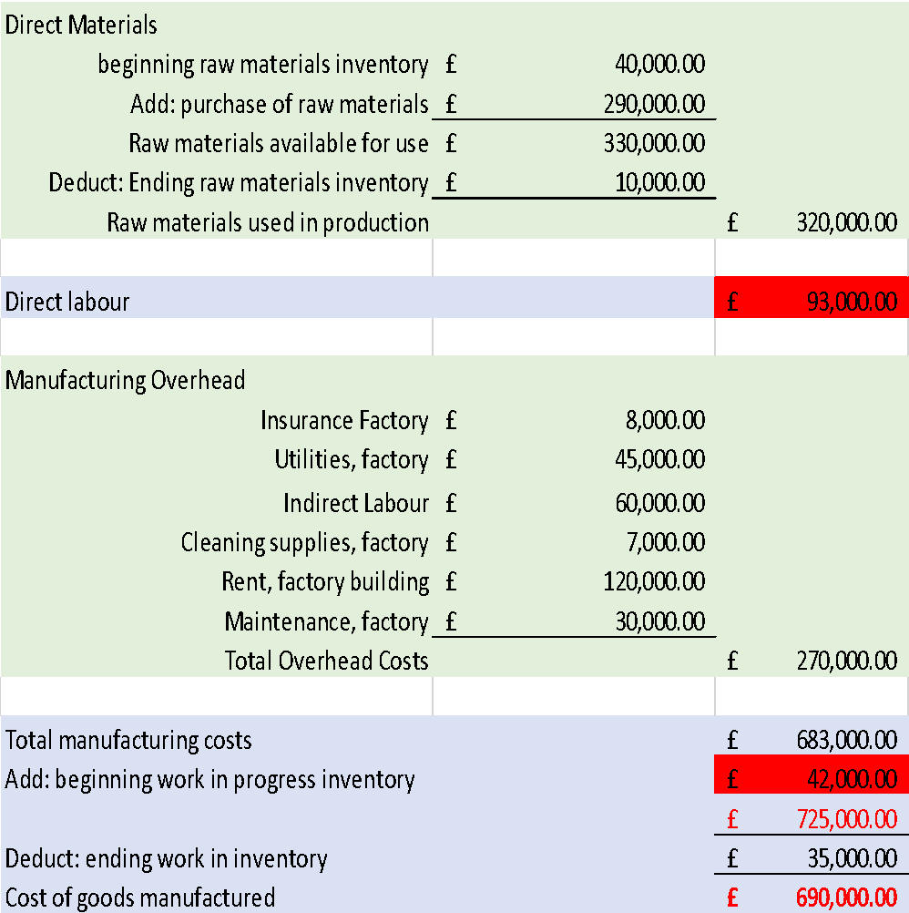
Question 1
Cost of Goods Manufactured
£ 725,000
less
plus
Total Manufacturing Cost
Ending WIP
=
£ 725,000
=
Beginning WIP
£ 42,000

Slide 7
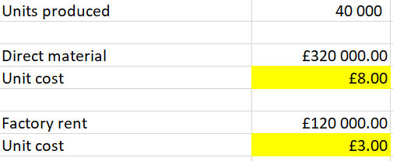
Question 2
Assume that the pound amounts given above are for the equivalent of 40,000 units produced during the year. Compute the unit cost for direct materials used and the unit cost for rent on the factory building.

Slide 8
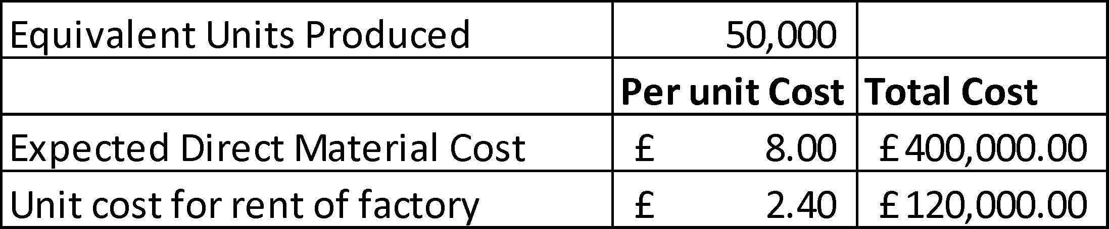
Question 3
Assume that in the following year the company expects to produce 50,000 units. What per unit and total cost would you expect to be incurred for direct materials? For rent on the factory building? (In preparing your answer, you may assume that direct materials is a variable cost and that rent is a fixed cost.)
Assumptions
that the ‘per unit cost’ for Direct Material Cost remained the same
Rent for the factory has remained the same

Slide 9
Question 4
As the manager in charge of production costs, explain to the managing director the reason for any difference in unit costs between Requirement 2 and Requirement 3 above.
Item | Type of Cost | Total Cost | Per Unit Cost
Direct Material Cost | Variable Cost | Direct proportion to changes in level of activity. The more units produced, the higher the total cost and visa versa | Remains constant (within relevant range)
Rent on the factory building | Fixed Cost | Remains Constant, regardless of level of activity (within relevant range) | Fixed costs decreases per unit as the activity level increases or increases per unit as activity decreases

