Slide 1

ENTREPRENEURSHIP
MBAD 823
Prof Stéphan
van der Merwe
Contact session 2
2019

Slide 2

THE ENTREPRENEURIAL
MIND AND FIT
PBSB 821

Slide 3
Introduction to Entrepreneurship
Entrepreneurial mind and fit
Idea generation
Design thinking
Rocket pitch
Entrepreneurial process
Feasibility & planning
Managing the business
South African business environment
Corporate entrepreneurs

Slide 4

STRUCTURE OF THIS SESSION
Entrepreneurial attributes.
Myths about entrepreneurship.
3. An entrepreneurial mindset.
4. The concept of apprenticeship.
Self-understanding.
Mind mapping.
Crafting your own entrepreneurial strategy.

Slide 5
ENTREPRENEURIAL ATTRIBUTES

Slide 6


Slide 7
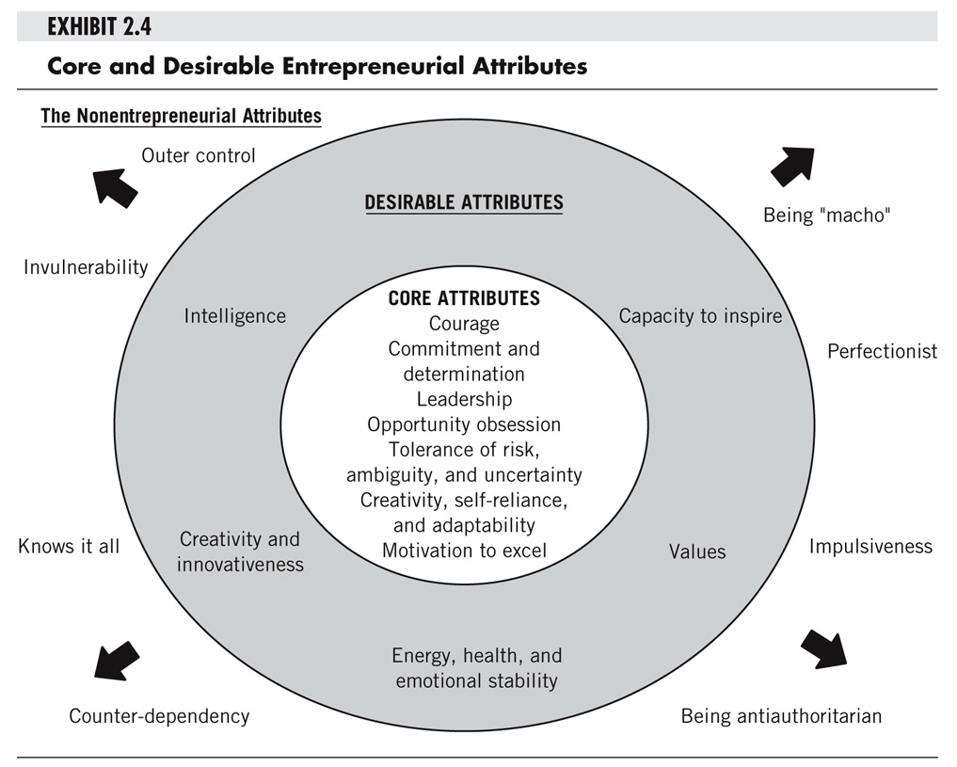

Slide 8
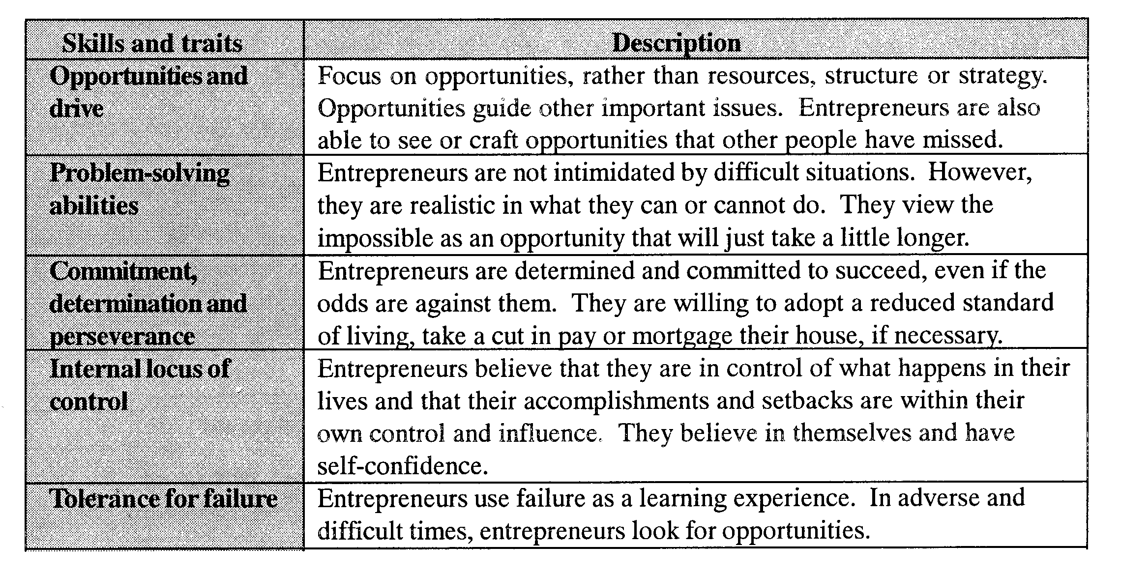
ENTREPRENEURIAL ATTRIBUTES

Slide 9
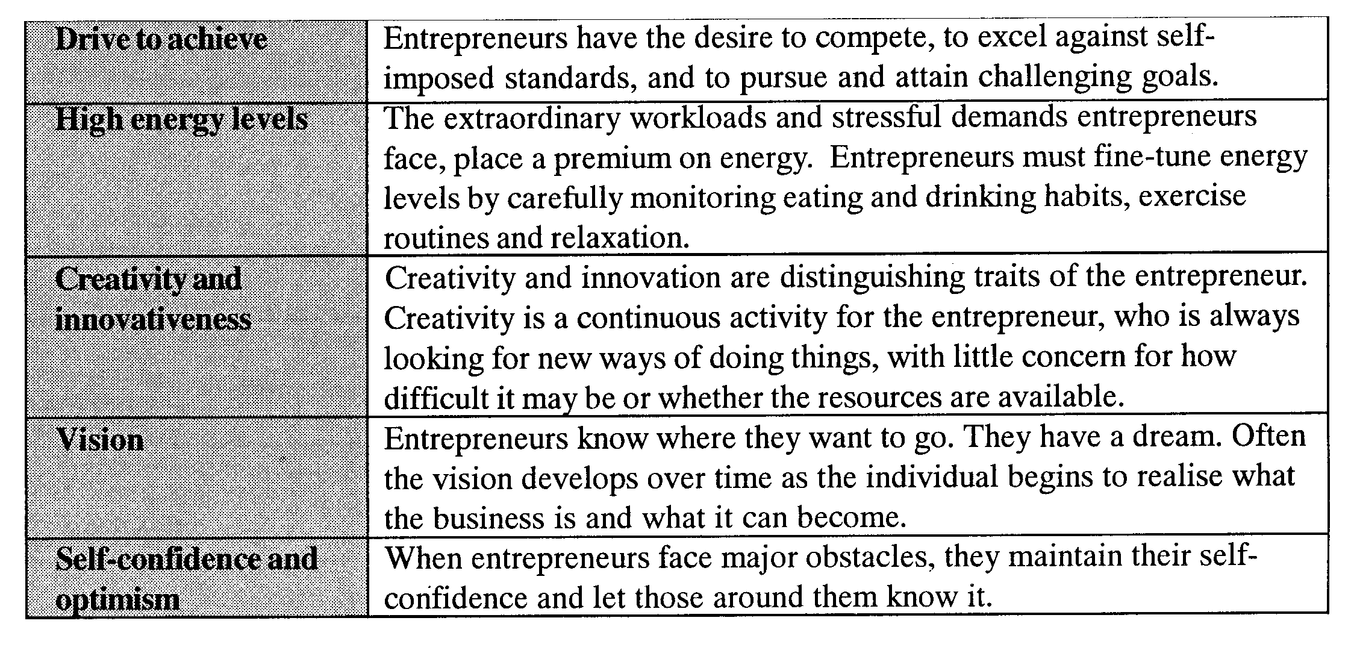
ENTREPRENEURIAL ATTRIBUTES

Slide 10
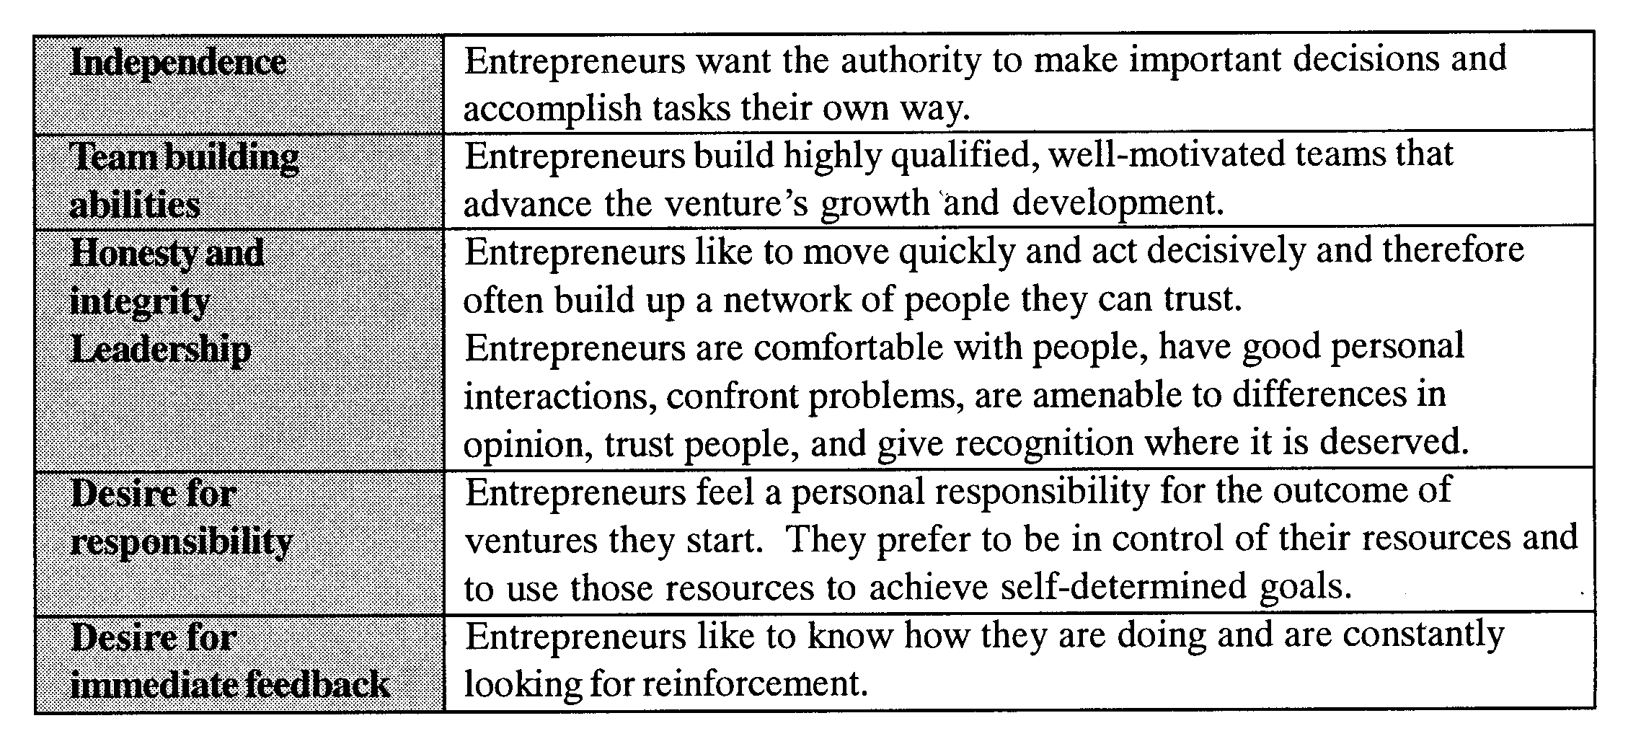
ENTREPRENEURIAL ATTRIBUTES

Slide 11
MYTHS ABOUT ENTREPRENEURSHIP

Slide 12


MYTHS ABOUT ENTREPRENEURS/ENTREPRENEURSHIP
Entrepreneurs are born not made.
It takes a great idea!!
Entrepreneurs are always inventors.
If an entrepreneur is talented, success will happen in a year or two.
Entrepreneurs are gamblers and extreme risk takers.
A business plan is required for success.
Anyone can start a business.
Entrepreneurs should be young and energetic.
Notes:
Entrepreneurs are born not made – There is a lot about entreprenuership that can be taught, including certain skills and behaviours. Entrepreneurship is a discipline and like any discipline it can be learned.
It takes a great idea – Most businesses that have been successful for at least 50 years did not start with a great idea. They started with a great team who simply wanted to create and ednuring company. Often it is not the idea, but the execution plan that makes the business a success.
Entrepreneurs are always inventors – While many inventors are also entrepreneurs, there are numverous entrpeneurs who pursue all sorts of innovative acitity beyond forml inventions e.g. Ray Kroc did not invent the fast-food franchise, but his innovative ideas made McDonald’s the largetst fast-food enterprise in the world. Many innovations can be found in operating prodecures, pricing approach, packaging…….
If an entrepreneur is talented, success with happen in a year or two
Entrepreneurs are gamblers and extreme risk takers – Risk I a mjaor eleent of the entrepenerial process. While it may appear tha an entr is gambling on a wildchance, the fact is that the ent is usually working on a moderate or calculated risk.
A business plan is required for success – Researchers do not agree on the relationship between a completed business plan and new venture success. Some believe that a plan takes time away from more valuable activities. Others argue that a plan facilitate resource acquitison and managmenet, making goals more achieveable.
Anyone can start a business – Anyone can start – very few can let a business grow, survice and prosper.
Entrepreneurs should be young and energetic – Ray Kroc started McDonalds at age 52; Average age often 39
Entrepreneurs are motivated solely by the quest for the almighty rand/euro/dollar (All entrepreneurs need is money) – Mostly need for independence and to start something new. They are secondarily motivated by estrincis rewards such as the financial performance of the venture.
All entrepreneurs need is luck – Being at the right place and right time always and advantage. But luck happens when preparation meets opportunity. What appears to be luck is really prepartion, determination, desire, knowledge…….
Entrepreneurship is unstructured and chaotic – Tendency to think of entrepreneurs as gunslingers - people who shoot from the hip and ask questions later. Realtiy is that entre are heavily involved in all facets of their ventures, and they usually have an umber of balls in the air at the same time. They are typically well-organised individuals.
Most entrepreneurial initiatives fail – It is true that mnay entrp suffer a number of failures before they are successful. Failure can teach many lessons to those willing to learn and often leads to future successes.The 3M company invented Post-it notes using a glue that had not been strog enough for its intended use.
Start a business and fail and you will never raise money again
You need a lot of money to start a business – Bootstrapping – Some research has determined that it is not specifically the amount of capital the entrpeneur posesses at startup that is important but rather how many resources (founding team, network of contacts, connections in the value chane and so forth) the entrpeneurs can acess and or control.
E-myth ????

Slide 13
MYTHS ABOUT ENTREPRENEURS/ENTREPRENEURSHIP
Entrepreneurs are motivated solely by the quest for the almighty rand/euro/dollar (All entrepreneurs need is money).
All entrepreneurs need is luck.
Entrepreneurship is unstructured and chaotic.
Most entrepreneurial initiatives fail.
Start a business and fail and you will never raise money again.
You need a lot of money to start a business.
E-myth – entrepreneurial thinking is critical.
Notes:
Entrepreneurs are born not made – There is a lot about entreprenuership that can be taught, including certain skills and behaviours. Entrepreneurship is a discipline and like any discipline it can be learned.
It takes a great idea – Most businesses that have been successful for at least 50 years did not start with a great idea. They started with a great team who simply wanted to create and ednuring company. Often it is not the idea, but the execution plan that makes the business a success.
Entrepreneurs are always inventors – While many inventors are also entrepreneurs, there are numverous entrpeneurs who pursue all sorts of innovative acitity beyond forml inventions e.g. Ray Kroc did not invent the fast-food franchise, but his innovative ideas made McDonald’s the largetst fast-food enterprise in the world. Many innovations can be found in operating prodecures, pricing approach, packaging…….
If an entrepreneur is talented, success with happen in a year or two
Entrepreneurs are gamblers and extreme risk takers – Risk I a mjaor eleent of the entrepenerial process. While it may appear tha an entr is gambling on a wildchance, the fact is that the ent is usually working on a moderate or calculated risk.
A business plan is required for success – Researchers do not agree on the relationship between a completed business plan and new venture success. Some believe that a plan takes time away from more valuable activities. Others argue that a plan facilitate resource acquitison and managmenet, making goals more achieveable.
Anyone can start a business – Anyone can start – very few can let a business grow, survice and prosper.
Entrepreneurs should be young and energetic – Ray Kroc started McDonalds at age 52; Average age often 39
Entrepreneurs are motivated solely by the quest for the almighty rand/euro/dollar (All entrepreneurs need is money) – Mostly need for independence and to start something new. They are secondarily motivated by estrincis rewards such as the financial performance of the venture.
All entrepreneurs need is luck – Being at the right place and right time always and advantage. But luck happens when preparation meets opportunity. What appears to be luck is really prepartion, determination, desire, knowledge…….
Entrepreneurship is unstructured and chaotic – Tendency to think of entrepreneurs as gunslingers - people who shoot from the hip and ask questions later. Realtiy is that entre are heavily involved in all facets of their ventures, and they usually have an umber of balls in the air at the same time. They are typically well-organised individuals.
Most entrepreneurial initiatives fail – It is true that mnay entrp suffer a number of failures before they are successful. Failure can teach many lessons to those willing to learn and often leads to future successes.The 3M company invented Post-it notes using a glue that had not been strog enough for its intended use.
Start a business and fail and you will never raise money again
You need a lot of money to start a business – Bootstrapping – Some research has determined that it is not specifically the amount of capital the entrpeneur posesses at startup that is important but rather how many resources (founding team, network of contacts, connections in the value chane and so forth) the entrpeneurs can acess and or control.
E-myth ????

Slide 14
THE ENTREPRENEURIAL MINDSET

Slide 15

WHAT IS AN ENTREPRENEURIAL MINDSET
An entrepreneurial mindset refers to a specific state of mind which orientates human conduct towards entrepreneurial activities and outcomes.
Individuals with entrepreneurial mindsets are often drawn to opportunities, innovation and new value creation.
Notes:
Entrepreneurs are born not made – There is a lot about entreprenuership that can be taught, including certain skills and behaviours. Entrepreneurship is a discipline and like any discipline it can be learned.
It takes a great idea – Most businesses that have been successful for at least 50 years did not start with a great idea. They started with a great team who simply wanted to create and ednuring company. Often it is not the idea, but the execution plan that makes the business a success.
Entrepreneurs are always inventors – While many inventors are also entrepreneurs, there are numverous entrpeneurs who pursue all sorts of innovative acitity beyond forml inventions e.g. Ray Kroc did not invent the fast-food franchise, but his innovative ideas made McDonald’s the largetst fast-food enterprise in the world. Many innovations can be found in operating prodecures, pricing approach, packaging…….
If an entrepreneur is talented, success with happen in a year or two
Entrepreneurs are gamblers and extreme risk takers – Risk I a mjaor eleent of the entrepenerial process. While it may appear tha an entr is gambling on a wildchance, the fact is that the ent is usually working on a moderate or calculated risk.
A business plan is required for success – Researchers do not agree on the relationship between a completed business plan and new venture success. Some believe that a plan takes time away from more valuable activities. Others argue that a plan facilitate resource acquitison and managmenet, making goals more achieveable.
Anyone can start a business – Anyone can start – very few can let a business grow, survice and prosper.
Entrepreneurs should be young and energetic – Ray Kroc started McDonalds at age 52; Average age often 39
Entrepreneurs are motivated solely by the quest for the almighty rand/euro/dollar (All entrepreneurs need is money) – Mostly need for independence and to start something new. They are secondarily motivated by estrincis rewards such as the financial performance of the venture.
All entrepreneurs need is luck – Being at the right place and right time always and advantage. But luck happens when preparation meets opportunity. What appears to be luck is really prepartion, determination, desire, knowledge…….
Entrepreneurship is unstructured and chaotic – Tendency to think of entrepreneurs as gunslingers - people who shoot from the hip and ask questions later. Realtiy is that entre are heavily involved in all facets of their ventures, and they usually have an umber of balls in the air at the same time. They are typically well-organised individuals.
Most entrepreneurial initiatives fail – It is true that mnay entrp suffer a number of failures before they are successful. Failure can teach many lessons to those willing to learn and often leads to future successes.The 3M company invented Post-it notes using a glue that had not been strog enough for its intended use.
Start a business and fail and you will never raise money again
You need a lot of money to start a business – Bootstrapping – Some research has determined that it is not specifically the amount of capital the entrpeneur posesses at startup that is important but rather how many resources (founding team, network of contacts, connections in the value chane and so forth) the entrpeneurs can acess and or control.
E-myth ????

Slide 16

CHARACTERISTICS OF AN ENTREPRENEURIAL MINDSET
You take action (action trumps everything!!!)
You are resourceful.
You don’t ask for permission.
You are fearless (brave) but also scared to fail (so you work very hard to succeed).
You are a good listener.
You welcome change.
You love a challenge.
You consider yourself as an outsider.
You recover quickly.
Notes:
Entrepreneurs are born not made – There is a lot about entreprenuership that can be taught, including certain skills and behaviours. Entrepreneurship is a discipline and like any discipline it can be learned.
It takes a great idea – Most businesses that have been successful for at least 50 years did not start with a great idea. They started with a great team who simply wanted to create and ednuring company. Often it is not the idea, but the execution plan that makes the business a success.
Entrepreneurs are always inventors – While many inventors are also entrepreneurs, there are numverous entrpeneurs who pursue all sorts of innovative acitity beyond forml inventions e.g. Ray Kroc did not invent the fast-food franchise, but his innovative ideas made McDonald’s the largetst fast-food enterprise in the world. Many innovations can be found in operating prodecures, pricing approach, packaging…….
If an entrepreneur is talented, success with happen in a year or two
Entrepreneurs are gamblers and extreme risk takers – Risk I a mjaor eleent of the entrepenerial process. While it may appear tha an entr is gambling on a wildchance, the fact is that the ent is usually working on a moderate or calculated risk.
A business plan is required for success – Researchers do not agree on the relationship between a completed business plan and new venture success. Some believe that a plan takes time away from more valuable activities. Others argue that a plan facilitate resource acquitison and managmenet, making goals more achieveable.
Anyone can start a business – Anyone can start – very few can let a business grow, survice and prosper.
Entrepreneurs should be young and energetic – Ray Kroc started McDonalds at age 52; Average age often 39
Entrepreneurs are motivated solely by the quest for the almighty rand/euro/dollar (All entrepreneurs need is money) – Mostly need for independence and to start something new. They are secondarily motivated by estrincis rewards such as the financial performance of the venture.
All entrepreneurs need is luck – Being at the right place and right time always and advantage. But luck happens when preparation meets opportunity. What appears to be luck is really prepartion, determination, desire, knowledge…….
Entrepreneurship is unstructured and chaotic – Tendency to think of entrepreneurs as gunslingers - people who shoot from the hip and ask questions later. Realtiy is that entre are heavily involved in all facets of their ventures, and they usually have an umber of balls in the air at the same time. They are typically well-organised individuals.
Most entrepreneurial initiatives fail – It is true that mnay entrp suffer a number of failures before they are successful. Failure can teach many lessons to those willing to learn and often leads to future successes.The 3M company invented Post-it notes using a glue that had not been strog enough for its intended use.
Start a business and fail and you will never raise money again
You need a lot of money to start a business – Bootstrapping – Some research has determined that it is not specifically the amount of capital the entrpeneur posesses at startup that is important but rather how many resources (founding team, network of contacts, connections in the value chane and so forth) the entrpeneurs can acess and or control.
E-myth ????

Slide 17
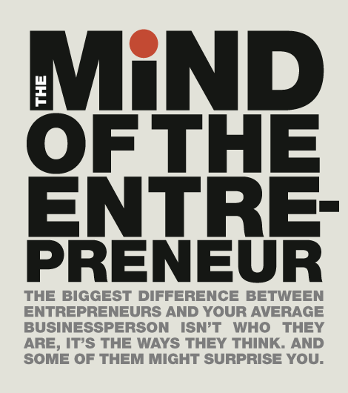

Slide 18
THE PRACTICAL APPLICATION OF AN ENTREPRENEURIAL MINDSET

Slide 19


PUZZLE VS QUILT
Putting together pieces of a puzzle
Using fabric to create a quilt
Managerial Thinking
Predictive reasoning
Entrepreneurial Thinking
Creative reasoning
Entrepreneurial Thought and Action

Slide 20
PREDICTIVE VS CREATIVE LOGIC
Prediction (analytic)
Inductive and deductive logic.
Mathematical tools and other analytic methods.
Rules of thumb.
Core logic of virtually all educational settings.
Core logic of large organisations.
Works superbly to extent that the future can be divined or extrapolated from the past.
Creation
Favoured by serial (“expert”) entrepreneurs 89% of the time.
Favours what is real and confirmable over projections and assumptions.
Smart action trumps analysis.
Suitable when the future cannot be predicted from the past.
In extreme uncertainty or unknowability it is the only logical choice.
Entrepreneurial Thought and Action

Slide 21
PREDICTIVE VS. CREATIVE LOGIC
PREDICTION
CREATION
Large amounts of information analysed to narrow down options, evaluate and make decisions.
Every input
(actions, information, resources) expands the possible opportunities available.
DEDUCTIVE (top-down)
INDUCTIVE (bottom-up)

Slide 22

THE METHOD OF ENTREPRENEURIAL THOUGHT & ACTION
DESIRE
Intriguing area,
attractive partners
Sufficient to
get started
Clear, sharply defined, robust plan
Start with means at hand
“Pay” only what you can afford to lose (acceptable loss)
Enrol others to join your journey
ACT
BUILD ON WHAT YOU LEARN
ACT.LEARN.BUILD.

Slide 23


THE ENTREPRENEURIAL MIND IN ACTION
Successful entrepreneurs have a wide range of personality types.
  Research has considered genetics, family, education, career experience, among others, but no psychological model of entrepreneurship has been supported.
Acquired skills are more important that specific inherent traits.

Slide 24
Now more than ever, the world needs entrepreneurs of all kinds who think and act entrepreneurially—who can transform opportunity into reality, and create social and economic value for themselves and for others.

Slide 25
BRAIN DOMINANCE

Slide 26
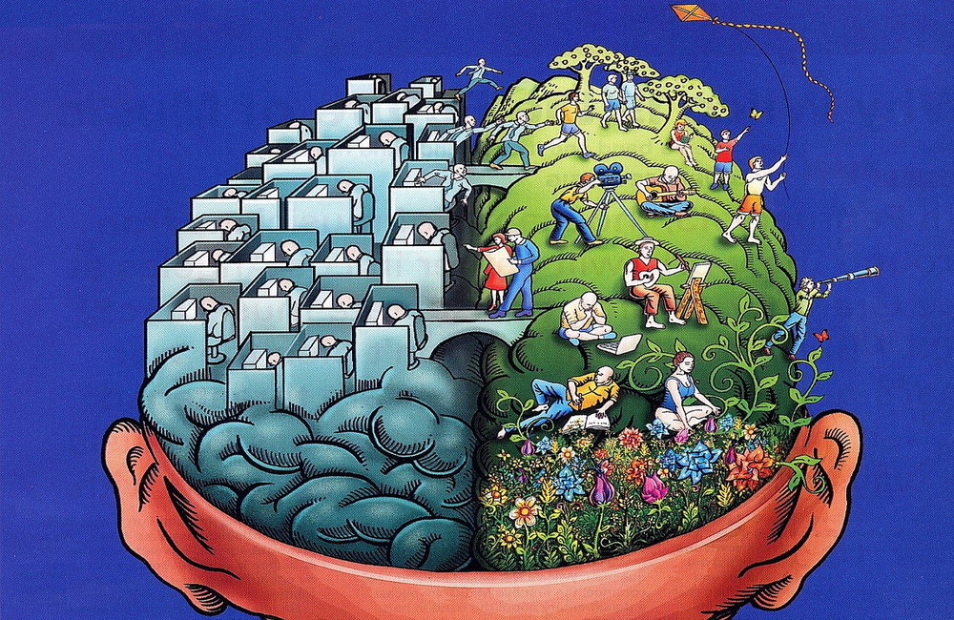
BRAIN DOMINANCE
Notes:
Entrepreneurs are born not made – There is a lot about entreprenuership that can be taught, including certain skills and behaviours. Entrepreneurship is a discipline and like any discipline it can be learned.
It takes a great idea – Most businesses that have been successful for at least 50 years did not start with a great idea. They started with a great team who simply wanted to create and ednuring company. Often it is not the idea, but the execution plan that makes the business a success.
Entrepreneurs are always inventors – While many inventors are also entrepreneurs, there are numverous entrpeneurs who pursue all sorts of innovative acitity beyond forml inventions e.g. Ray Kroc did not invent the fast-food franchise, but his innovative ideas made McDonald’s the largetst fast-food enterprise in the world. Many innovations can be found in operating prodecures, pricing approach, packaging…….
If an entrepreneur is talented, success with happen in a year or two
Entrepreneurs are gamblers and extreme risk takers – Risk I a mjaor eleent of the entrepenerial process. While it may appear tha an entr is gambling on a wildchance, the fact is that the ent is usually working on a moderate or calculated risk.
A business plan is required for success – Researchers do not agree on the relationship between a completed business plan and new venture success. Some believe that a plan takes time away from more valuable activities. Others argue that a plan facilitate resource acquitison and managmenet, making goals more achieveable.
Anyone can start a business – Anyone can start – very few can let a business grow, survice and prosper.
Entrepreneurs should be young and energetic – Ray Kroc started McDonalds at age 52; Average age often 39
Entrepreneurs are motivated solely by the quest for the almighty rand/euro/dollar (All entrepreneurs need is money) – Mostly need for independence and to start something new. They are secondarily motivated by estrincis rewards such as the financial performance of the venture.
All entrepreneurs need is luck – Being at the right place and right time always and advantage. But luck happens when preparation meets opportunity. What appears to be luck is really prepartion, determination, desire, knowledge…….
Entrepreneurship is unstructured and chaotic – Tendency to think of entrepreneurs as gunslingers - people who shoot from the hip and ask questions later. Realtiy is that entre are heavily involved in all facets of their ventures, and they usually have an umber of balls in the air at the same time. They are typically well-organised individuals.
Most entrepreneurial initiatives fail – It is true that mnay entrp suffer a number of failures before they are successful. Failure can teach many lessons to those willing to learn and often leads to future successes.The 3M company invented Post-it notes using a glue that had not been strog enough for its intended use.
Start a business and fail and you will never raise money again
You need a lot of money to start a business – Bootstrapping – Some research has determined that it is not specifically the amount of capital the entrpeneur posesses at startup that is important but rather how many resources (founding team, network of contacts, connections in the value chane and so forth) the entrpeneurs can acess and or control.
E-myth ????

Slide 27
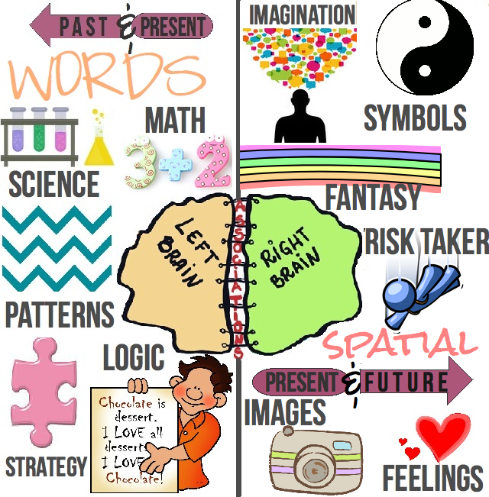

Slide 28
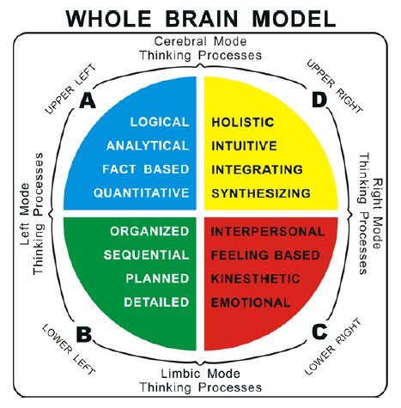

Slide 29
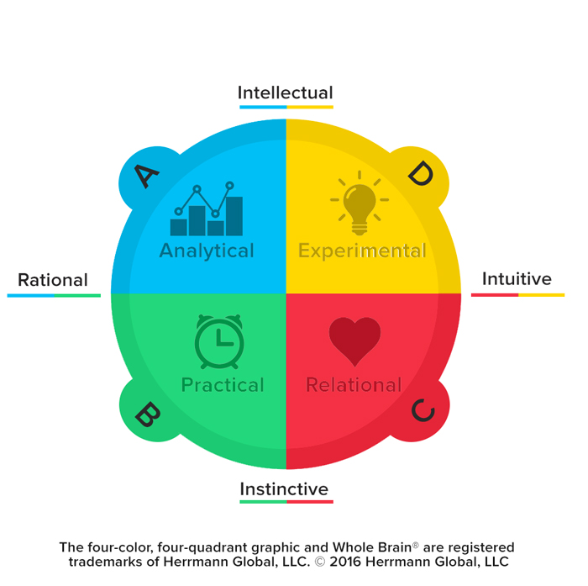

Slide 30
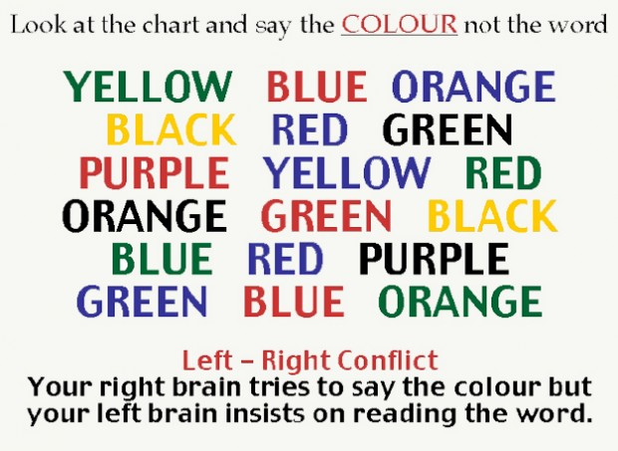

Slide 31
THE CONCEPT OF APPRENTICESHIP

Slide 32

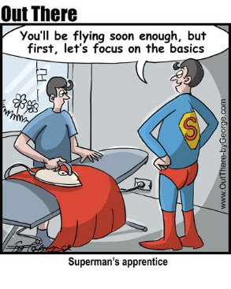
THE CONCEPT OF APPRENTICESHIP
Shaping and managing an apprenticeship.
Windows of apprenticeship.
The concept of apprenticeship: Acquiring the 50 000 chunks of experience or 10 000 hours.
The role of role models.
The myths and realities of entrepreneurship.
What can be learned?

Slide 33
SELF-UNDERSTANDING
AND REFLECTION

Slide 34



Why is this important?
WHY IS THIS IMPORTANT?
Often little time is allocated to self-understanding and reflection.
Who am I?
What are my capabilities?
BUT this is the foundation of entrepreneurial activity.

Slide 35
The ART of REFLECTION
THE ART OF REFLECTION
Reflection is a form of mental processing, that we use to fulfill a purpose.
Reflection is what allows us to learn form our experiences.
Reflection is an assessment of where we have been and where we want to go next.

Slide 36


Slide 37
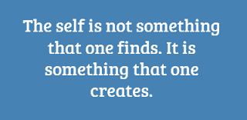
WHY DOES SELF-UNDERSTANDING MATTER?
Opportunity
recognition
Improved
matching
Self
understanding
Higher
commitment
Venture
success

Slide 38
MIND MAPPING

Slide 39
WHAT IS A MIND MAP?
A Mind Map is a powerful graphic technique which provides a universal key to unlock the potential of the brain.
It harnesses the full range of cortical skills – word, image, number, logic, rhythm, colour and spatial awareness – in a single, uniquely powerful manner. In so doing, it gives you the freedom to roam the infinite expanses of your brain.
The Mind Map can be applied to every aspect of life where improved learning and clearer thinking will enhance human performance (Tony Buzan)

Slide 40
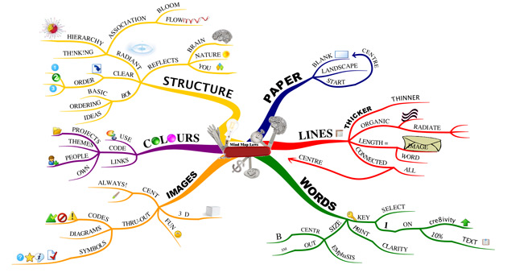
WHAT IS A MIND MAP?

Slide 41
BASIC MIND MAPPING STEPS –
TONY BUZAN (1/2)
Start in the CENTRE of a blank page turned sideways. Why? Because starting in the centre gives your Brain freedom to spread out in all directions and to express itself more freely and naturally.
Use an IMAGE or PICTURE for your central idea. Why? Because an image is worth a thousand words and helps you use your Imagination. A central image is more interesting, keeps you focussed, helps you concentrate, and gives your Brain more of a buzz!
Use COLOURS throughout. Why? Because colours are as exciting to your Brain as are images. Colour adds extra vibrancy and life to your Mind Map, adds tremendous energy to your Creative Thinking, and is fun!

Slide 42
BASIC MIND MAPPING STEPS –
TONY BUZAN (2/2)
4. CONNECT your MAIN BRANCHES to the central image and connect your second- and third-level branches to the first and second levels, etc. Why? Because your Brain works by association. It likes to link two (or three, or four) things together. If you connect the branches, you will understand and remember a lot more easily.
5. Make your branches CURVED rather than straight-lined. Why? Because having nothing but straight lines is boring to your Brain.
6. Use ONE KEY WORD PER LINE. Why? Because single key words give your Mind Map more power and flexibility.
7. Use IMAGES throughout. Why? Because each image, like the central image, is also worth a thousand words. So if you have only 10 images in your Mind Map, it’s already the equal of 10,000 words of notes!

Slide 43
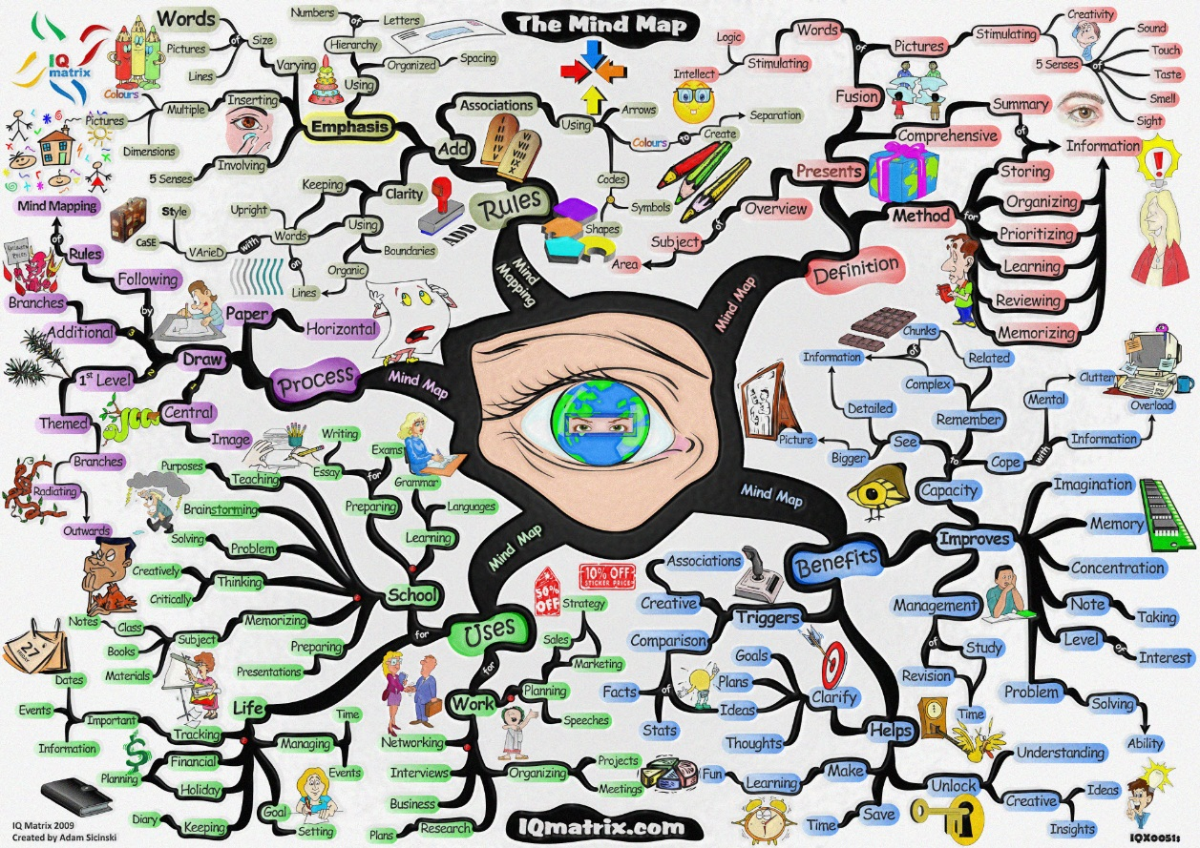

Slide 44
YOUR PERSONAL ENTREPRENEURIAL STRATEGY

Slide 45


INDIVIDUAL EXERCISES
The “Crafting a Personal Entrepreneurship Strategy” exercise addresses the apprenticeship issue further.
The “Personal Entrepreneurial Strategy” exercise is an inventory of one’s entrepreneurial abilities.

Slide 46

CRAFTING A PERSONAL ENTREPRENEURIAL STRATEGY
A conceptual scheme for self assessment.
Crafting an entrepreneurial strategy:
  Profiling the past.
  Profiling the present.
  Getting constructive feedback.
Putting it all together.
Thinking ahead.

Slide 47

PERSONAL ENTREPRENEURIAL STRATEGY:
BASIC STEPS OR PROCESS
Gather data from yourself (both past and present profiles).
Gather data from others (constructive feedback).
Evaluate the data you have.
Think ahead.
Craft your personal entrepreneurial strategy.
Estimated time to complete this important planning and goal setting exercise is 90 minutes to three hours.

Slide 48
PERSONAL ENTREPRENEURIAL STRATEGY:
SELF ASSESSMENT (1/2)
Generate data through observation of his or her thoughts and actions and by getting feedback from others for the purposes of the following:
  Becoming aware of blind spots.
  Reinforcing or changing existing perceptions of both strengths and weaknesses.
Study the data generated.

Slide 49

PERSONAL ENTREPRENEURIAL STRATEGY:
SELF ASSESSMENT (2/2)
Develop insights.
Establish apprenticeship goals to gain any learning, experience, and so forth.
Determine goals and opportunities to be seized.

Slide 50
PERSONAL ENTREPRENEURIAL STRATEGY:
CONSTRUCTIVE FEEDBACK (1/3)
Solicit feedback from those who know you well and who can be trusted.
Seek specific comments in particularly important areas and probe for detail if the feedback is unclear.
Recognize that feedback is most helpful if it is neither all positive nor all negative.

Slide 51

PERSONAL ENTREPRENEURIAL STRATEGY:
CONSTRUCTIVE FEEDBACK (2/3)
Ask for feedback in writing for contemplation and so feedback from various sources can be pulled together.
Be honest and straightforward with yourself and with others.
Avoid game playing or hidden agendas; avoid defensiveness over negative comments.
Listen carefully to what is being said and think about it; avoid answering, debating, or rationalizing.

Slide 52

PERSONAL ENTREPRENEURIAL STRATEGY:
CONSTRUCTIVE FEEDBACK (3/3)
Assess whether all important information has been considered and you have been realistic in your inferences and conclusions.
Request help in identifying common threads or patterns, possible implications of self-assessment data and certain weaknesses, and other relevant information that is missing.
Seek additional feedback from others to verify feedback and to supplement data.
Reach final conclusions at a later time.

Slide 53
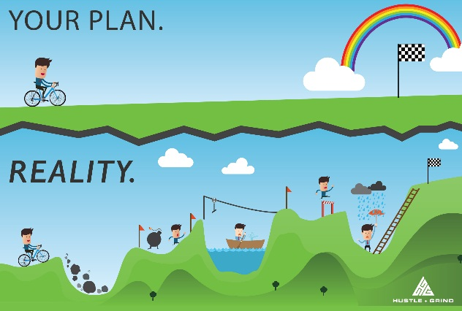
PERSONAL ENTREPRENEURIAL STRATEGY:
CRITICAL QUESTIONS (1/2)
Is there a fit between your skills and the requirements for entrepreneurship?
Do you think you can be a successful entrepreneur?
Do you know yourself?
What are your strengths and weaknesses?

Slide 54
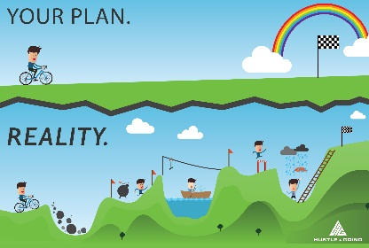
PERSONAL ENTREPRENEURIAL STRATEGY:
CRITICAL QUESTIONS (2/2)
Do you have an entrepreneurial strategy?
Are you satisfied with your current job situation?
Do you have a back-up plan?
What is your contribution to the economy?
What is your contribution to job creation?

Slide 55

INDIVIDUAL EXERCISE
How do you evaluate yourself against the seven dominant themes (exhibit 2.3)? What do you need to develop and improve?
Who can be an entrepreneur, and who cannot? Motivate your point of view with regard to desirable and not so desirable attitudes and behaviour.
How would you describe and evaluate your own apprenticeship? Is the concept of apprenticeship relevant to your situation?

Slide 56
INDIVIDUAL EXERCISES
By means of an interview with an entrepreneur, you can gain valuable insight into an entrepreneur’s reasons, strategies, approaches and motivations for starting and owning a business.
Turn to Spinelli and Adams (2016: 17-19) and do the exercise “Create a Lifelong Learning Log and Visit with an Entrepreneur”. Follow the steps outlined in the text book.
Turn to Spinelli and Adams (2016: 19, 20). Work trough the exercise and start creating your own Venturekipedia.

Slide 57
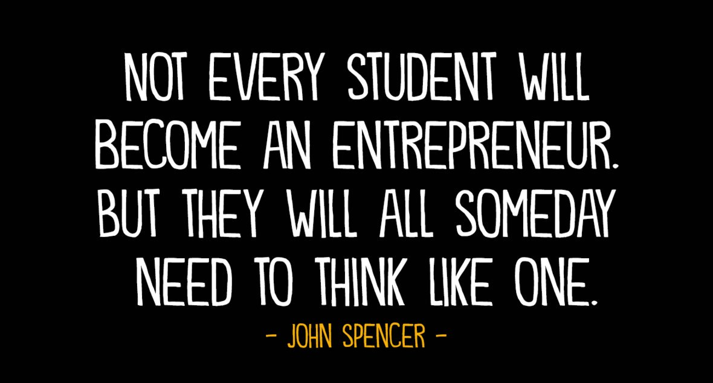

Slide 58
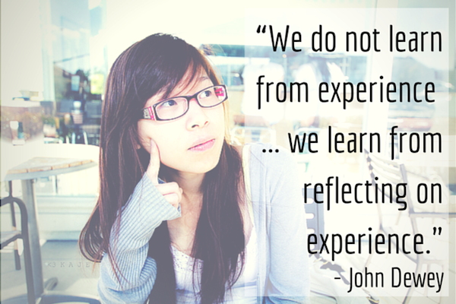
LEARNING AND REFLECTION

Slide 59
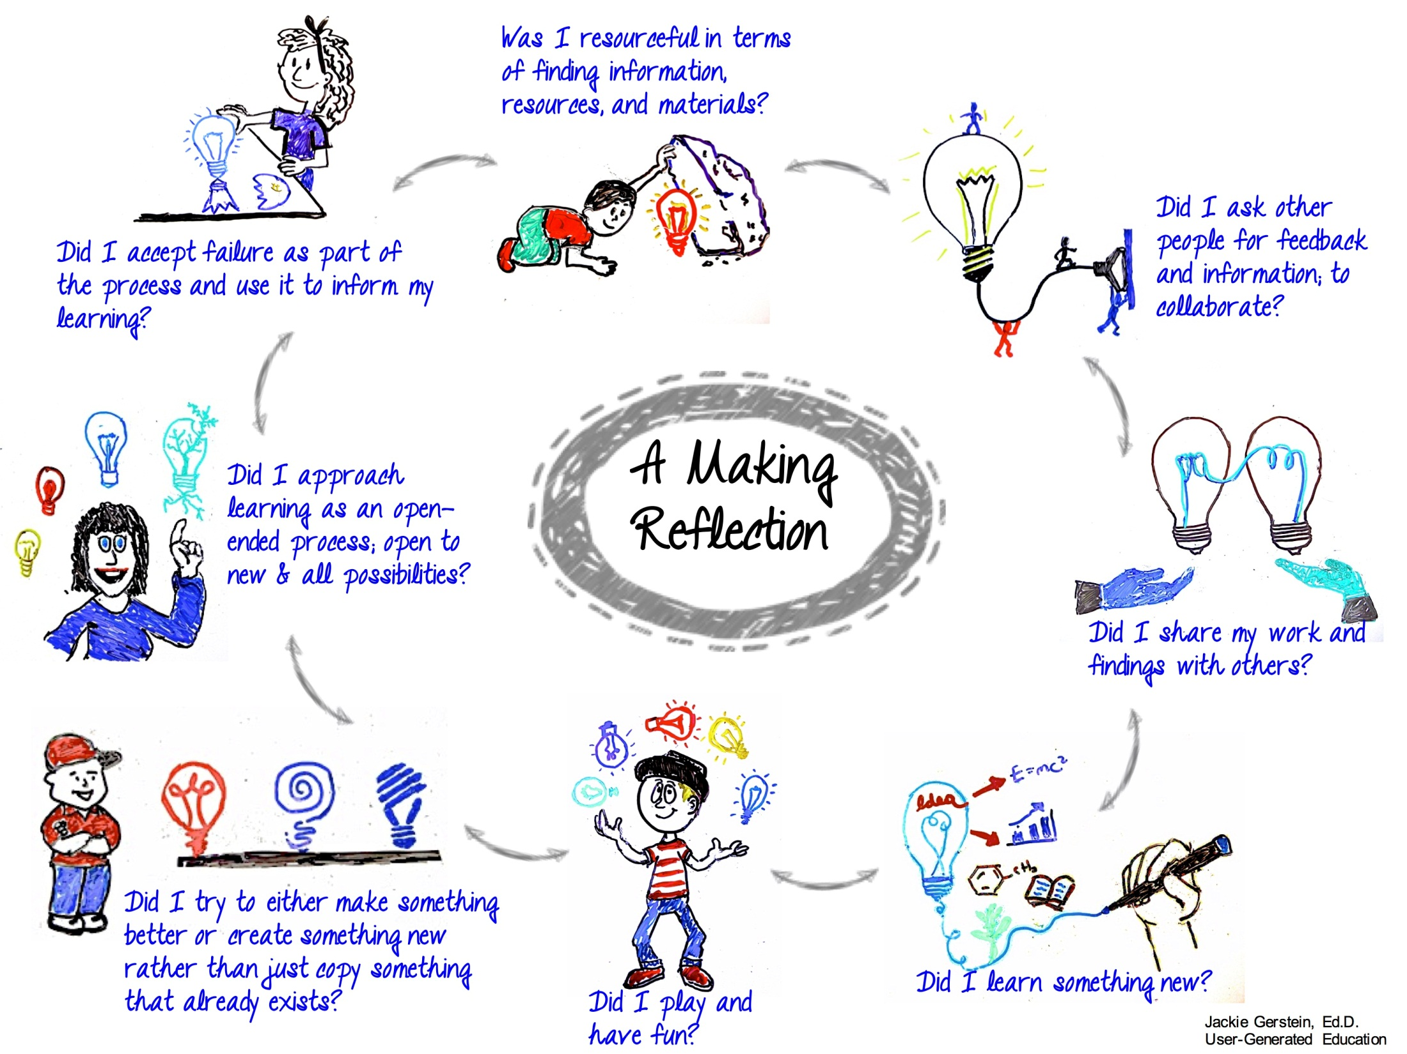

Slide 60
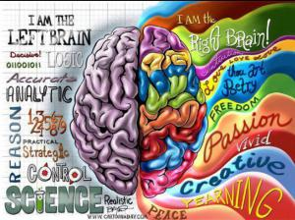
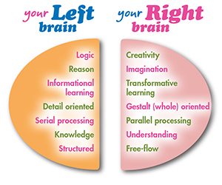
INDIVIDUAL CLASS EXERCISE
In your view. What is your brain dominance? Are you left-brained or right-brained dominant? Motivate.
Please submit this exercise.

Slide 61
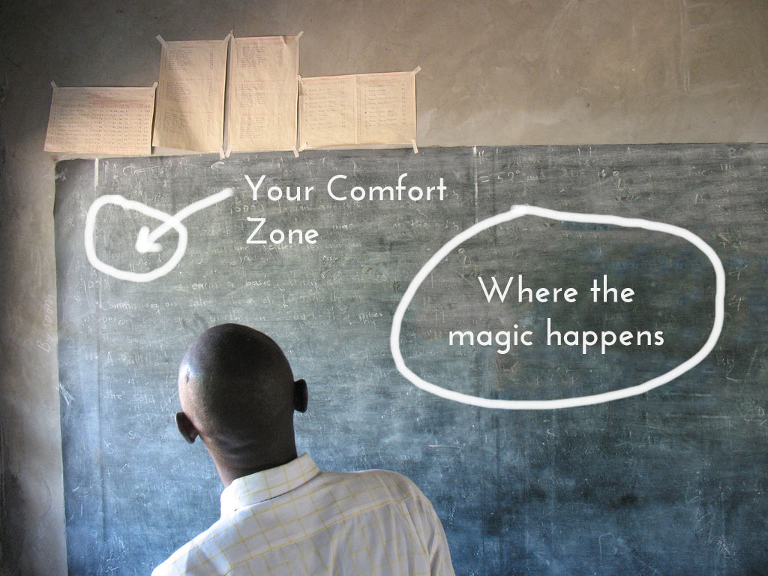
Thank you!!!

