Slide 1
Lecture 2: Chapter 4
Competitor analysis

Slide 2
Identifying competitors
Level 1: Direct competitors (MTN vs Vodacom)
Level 2: Indirect competitors (Chokkies vs all
other sweets)
Level 3: Satisfy the same customer needs
(Bus, railway, airline trains)
Level 4: Compete for the same spending power
(disposable income)
Beware of Competitor myopia: Focus on current competitors…
What about latent ones: eg. Bookstores … then Amazon
Appliance stores… then Takealot
Car manufacturers… Then underground trains (Singapore)

Slide 3
Approaches to identifying competitors
Market perspective/
customer-based
approach
Industry concept /
strategic group
approach
All firms that satisfy the same customer needs
Firms that offer products that are close substitutes for each other
4 industry structures (Monopoly, Monopolistic competition, Oligopoly, Pure competition

Slide 4
Approaches to identifying competitors
Identify actual and potential competitors
Customer-based approach
customer choices
product-use
associations
Strategic groups approach
similar competitive
strategies,
characteristics,
assets and
competencies

Slide 5
The strategic group approach to identifying competitors
AKA industry concept of competition
All competition seen in context of industry
Industry = group of firms that offer product/s that are close substitutes
Classified according to:
  Number of sellers
  Degree of product differentiation
  Presence/absence of barriers
  Cost structure
  Degree of vertical integration
  Degree of globalisation

Slide 6
The strategic group approach to identifying competitors (cont.)
Different groups of firms within industry
Strategic group = group of firms that follow the same strategy in a given target market
A strategic group is a group of firms that:
  Pursue similar competitive strategies
  Have similar characteristics
  Have similar assets and competencies
React to the same environmental changes
Mobility barriers prevent movement between groups

Slide 7

Competitor Analysis
Can they compete with us?

Slide 8

Competitor Analysis
Assessing Competitors
Competitor’s strengths and weaknesses
What can our competitors do?
Benchmarking
Estimating competitor’s reactions
What will our competitors do?

Slide 9

Competitor Analysis
Selecting Competitors to Attack and Avoid
How will they retaliate?
Check out the attack plan now
video on the Russian General’s
Notes:
Note to Instructor
This hyperlink is for a small credit union with a clear message—the other banks have high fees. They should have performed a customer value analysis to realize this is one of their benefits that the competitors do not offer.

Slide 10
Competitive Strategies
Basic Competitive Strategies
Michael Porter’s four basic
competitive positioning strategies
Overall cost leadership
Differentiation
Focus
Middle of the road

Slide 11
Competitive Strategies
Basic Competitive Strategies
Overall cost leadership strategy is when a company achieves the lowest production and distribution costs and allows it to lower its prices and gain market share
Notes:
Note to Instructor
This hyperlink is to Dell’s Web site. They have a changing banner on their site that almost always gives a message of how the consumer can save money with a Dell.

Slide 12
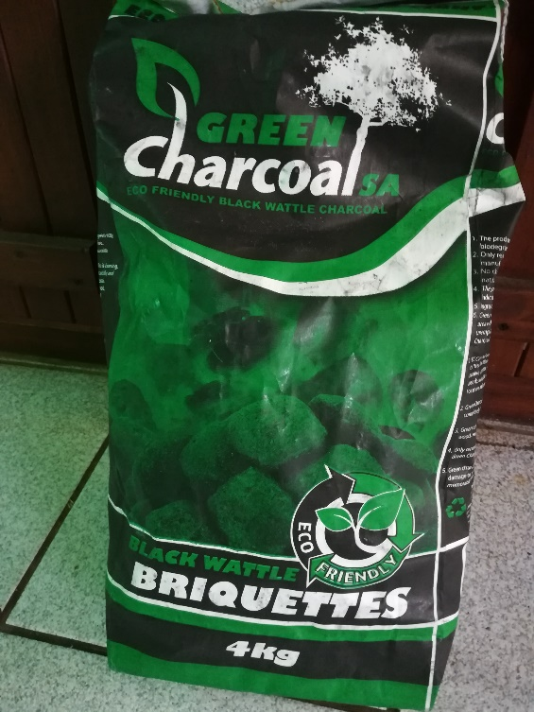
Competitive Strategies
Differentiation strategy is when a company concentrates on creating a highly differentiated product line and marketing program so it comes across as an industry class leader
Focus strategy is when a company focuses its effort on serving few market segments well rather than going after the whole market
Basic Competitive Strategies

Slide 13
Competitive Strategies
Operational excellence refers to a company providing value by leading its industry in price and convenience by reducing costs and creating a lean and efficient value delivery system
(COST LEADERSHIP)

Slide 14
Competitive Strategies
Porter believed that a company that pursued a clear strategy would achieve superior performance and that companies without a clear strategy would not succeed
Porter considered no clear strategy to be “middle of the road”

Slide 15

Competitive Strategies
Customer intimacy refers to a company providing superior value by segmenting markets and tailoring products or services to match the needs of the targeted customers
Notes:
Note to Instructor
Discussion Question
How do you know you can trust a Web site?
This Web link ties directly to the customer service page of Nordstrom.com. The students might comment on how well organized the site appears, how they show easy returns and free exchanges, and how they offer alterations.

Slide 16
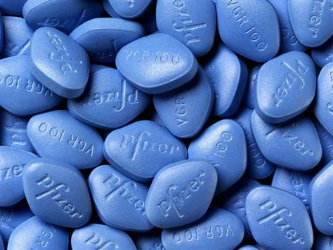
Competitive Strategies
Product leadership refers to a company providing superior value by offering a continuous stream of leading-edge products or services. Product leaders are open to new ideas and solutions and bring them quickly to the market.

Slide 17

How could they market the jet plane better?
Product placement in movies (especially Bond movies) – still to come

Slide 18
Competitive Strategies
Market leader strategies
Market challenger strategies
Market follower strategies
Market nicher strategies
Notes:
Note to Instructor
Forty percent of the market is in the hands of the market leader, the firm with the largest market share. Another 30 percent is in the hands of market challengers, runner‑up firms that are fighting hard to increase their market share. Another 20 percent is in the hands of market followers, other runner‑up firms that want to hold their share without rocking the boat. The remaining 10 percent is in the hands of market nichers, firms that serve small segments not being pursued by other firms.

Slide 19

Competitive Strategies
Protecting Market Share
Protect current market by:
Fixing or preventing weaknesses that provide opportunities to competitors
Maintain consistent prices that provide value
Keep strong customer relationships
Continuous innovation
Lock in resources

Slide 20
Competitive Strategies
Second mover advantage occurs when a market follower observes what has made the leader successful and improves on it
Challenges firms its own size or smaller
Learn from mistakes
Improve materials / resources

Slide 21
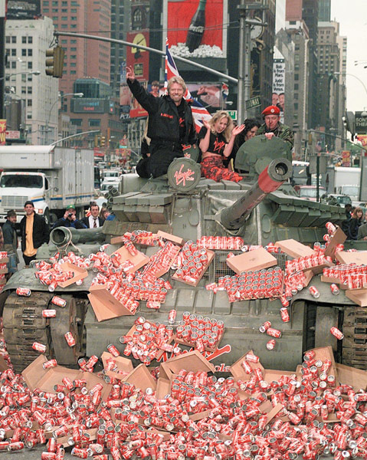
Competitive Strategies
Market Challenger Strategies
Challenge the leader with an aggressive bid for more market share
Play along with competitors and not rock the boat
Notes:
Note to Instructor
The text gives an excellent example of a market challenger:
Virgin Drinks took on the leaders head-on, launching its own cola, advertising heavily, and trying to get into all the same retail outlets that stocked the leading brands. At Virgin Cola’s launch, Virgin CEO Richard Branson even drove a tank through a wall of rivals’ cans in New York’s Times Square to symbolize the war he wished to wage on the big, established rivals. However, Coke’s and Pepsi’s viselike grip on U.S. shelf space proved impossible for Virgin Drinks to break. Although Virgin Drinks is still around, it has never gained more than a 1percent share of the U.S. cola market.
Red Bull, by contrast, tackled the leaders indirectly. It entered the U.S. soft drinks market with a niche product: a carbonated energy drink retailing at about twice what you would pay for a Coke or Pepsi. It started by selling Red Bull through unconventional outlets not dominated by the market leaders, such as bars and nightclubs, where twenty-something's gulped down the caffeine-rich drink so they can dance all night. After gaining a loyal following, Red Bull used the pull of high margins to elbow its way into the corner store, where it now sits in refrigerated bins within arm’s length of Coke and Pepsi. In the United States, where Red Bull enjoys a 65 percent share of the energy drink market, its sales are growing at about 35 percent a year.

Slide 22

Competitive Strategies
Market Nicher Strategies
Ideal market niche is big enough to be profitable with high growth potential and has little interest from competitors
Key to market niching is specialization
Market
Customer
Product
Marketing mix
Notes:
Note to Instructor
This link refers to the example in the text for R.A.B. Food Group. The text mentions its Kosher line but it is interesting to see some of their smaller lines including Guiltless Gourmet.

Slide 23
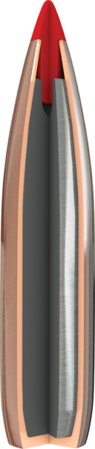


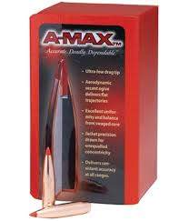
Believe in Zombies?
…enough people do to make money!

Slide 24

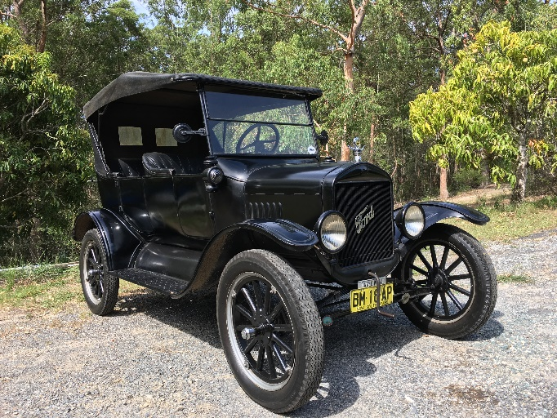
Competition
A marketing program is influenced by four types of competitive structures
  Pure competition: Large number of sellers, standardised product to well informed consumers e.g. Wheat farmers
  Monopolistic competition: Large number of suppliers offer similar, but not identical products e.g. Fridges, TVs, cars
  Oligopoly: Small number of firms dominate the market for goods or a service e.g. Vodacom, MTN, Cell C
  Monopoly: one firm controls output and price of a
  product that has no close substitutes e.g. Eskom
  .
2-4

Slide 25
The competitive structure of an industry (Porter)
Five competitive forces:
1
Threat of new entrants
Threat of substitute products
Bargaining power of buyers
Bargaining power of suppliers
Rivalry between existing competitors
2
3
4
5

Slide 26
The 5 competitive forces
1
Threat of new entrants
Attractiveness depends on entry and exit barriers. Most attractive = low exit barriers, high entry barriers
Entry barriers:
Factor cost advantages
Economies of scale
Effective differentiation and high switching costs
Channel crowding
Defense:
Lock in suppliers / raw material
Brand loyalty

Slide 27
The 5 competitive forces
2
Threat of substitute products
Are there actual/potential substitutes? Substitutes limit prices and therefore, profits.
Substitutes impact significantly if they possess additional benefits:
Performance benefits
Security benefits
Availability benefits
Flexibility benefits
Defense:
Deliver better benefits
Brand loyalty
Original product loyalty – “cheap substitutes”
Customer service levels

Slide 28
The 5 competitive forces
3
Threat of buyers’ growing bargaining
power
If buyers have strong buying power, segment is unattractive. Buying power grows when:
They become more organised/concentrated
Product is large % of buyers’ costs
Product is undifferentiated
Buyers’ switching cost is low
Buyers are price-sensitive
Buyers can integrate upstream
Defense:
Select buyers without power
Develop superior offers

Slide 29
The 5 competitive forces
4
Threat of suppliers’ growing bargaining power
A segment is unattractive if suppliers can raise prices/reduce quantities
Suppliers tend to be powerful when:
Concentrated/well-organised
Few substitutes available
Supplied product is important input in production process
High cost of switching suppliers
Supplier able to integrate downstream
Defense:
Build win-win relations
Use multiple sources of supply

Slide 30
The 5 competitive forces
5
Threat of intense segment rivalry
Segment is unattractive if it already contains many, strong competitors
Customer power depends on their bargaining leverage which is enhanced when there are:
Few customers make large-volume purchases
Few constraints on customers to switch suppliers
Credible threats of backward integration
Knowledgeable customers
High price sensitivity

Slide 31
Analysing key competitors
Key competitor = any firm targeting the same market segment as the firm
Understand
current competitors
potential
competitors

Slide 32
Understanding potential competitors
Potential market entrants – firms may engage in:
Market expansion
Product expansion
Integration (forward,
backward, vertical)
Export of assets or
competencies
Retaliatory or defensive
strategies
Entry barriers

Slide 33
Evaluating competitor’s strengths and weaknesses
Key Success Factor (KSF) = those characteristics or conditions in a particular industry that have a significant impact on the performance of the firm in that industry
Step 1 = Identify key success factors in the industry;
use a relative importance score
Step 2 = Rate the firm and competitors on each KSF
Step 3 = Consider the implications for competitive strategy

Slide 34
Key Success Factor analysis
Step 1 = Identify Key Success Factors
in the industry
Ask the following questions:
  Why are competitors successful or unsuccessful?
  What motivates customer choice and what is important to customers?
  Which phase(s) in the production process/supply chain create the highest added value?
  What entry barriers exist in the industry and target segment?
  Decide on a relative importance score
  allocate weights to each KSF;
  the weights must add up to 1

Slide 35
Key Success Factor analysis
Step 2 = Rate the firm and competitors on each KSF
Rate the firms using a scale
(e.g. 1 = very poor; 5 = very good)
KSF score = (KSF weight) x (KSF rating)
Add all KSF scores to get a total for each firm

Slide 36
Key Success Factor analysis
Step 1
Step 2
Key success factors | Weight | Rating | KSF Score
KSF 1: Innovativeness | 0,25 | 3 | 0,75
KSF 2: Financial strength | 0,45 | 2 | 0,90
KSF 3: Product quality | 0,30 | 4 | 1,20
 | 1,00 |  | 2,85 | Total score
+
X
Step 1 = identify KSFs; allocate weights to each KSF
Step 2 = allocate rating score; multiply weight and rating = KSF score;
add up to get total KSF score

Slide 37
Key Success Factor analysis
Step 3 = Consider the implications for competitive strategy
Consider 6 competitive positions:
Dominant
Strong
Favourable
Tenable
Weak
Non-viable
NOW WATCH THE COMPETITIVE GRID VIDEO ON EFUNDI (YES AGAIN!)

Slide 38
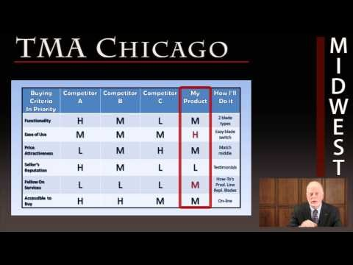
Know your market
Describe the Ideal customer
What “things” do they think about when they consider buying? = List their buying criteria (reputation, size, quality, trendy etc.)
Identify your competitors
Asses each competitor
(NB Price attractiveness – not main criteria)

Slide 39
Anticipating competitors’ actions
How a competitor reacts will be determined by its business philosophy,
its organisational culture and its values. Likely competitor reaction patterns:
Laid-back competitor (Slow to – and if – they react)
Selective competitor (reacts only to certain types of attacks)
Tiger competitor (Swift and strong reaction)
Stochastic competitor (unpredictable)
Competitive capability=
agility x reach
time-to-market

Slide 40
Selecting competitors to attack/avoid
Attacking weak competitors is cheaper; but not much to be gained
Benchmarking and competing with strong competitors may enhance the firm’s capabilities and skills
Most firms compete with those that resemble them the most
Firms should avoid destroying their closest competitors
Form coalitions and partnerships with competitors

Slide 41
Managerial applications
Learn the skill to profile competitors
Predict competitor behaviour (attack/defend)
Adapt marketing strategies to outmaneuver competitors
Remember – apply your unique USP for the market segments you target
Do proper analysis !!!
Analysis is only halfway there!
Implement implement implement planning into action strategy

Slide 42
ALSO CONSIDER THIS COMPETITOR ANALYSIS GRID
https://www.mykpono.com/how-to-conduct-competitive-analysis/

Slide 43

ANY QUESTIONS ?
Oak Alley Plantation (Louisiana)
What is the competitive advantage of this pic?

