Slide 1
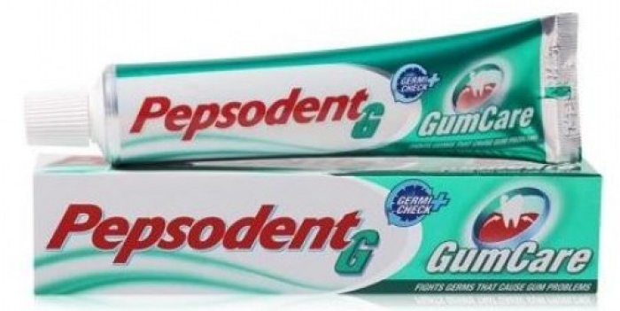
Marketing in Practice
Pepsodent

Slide 2
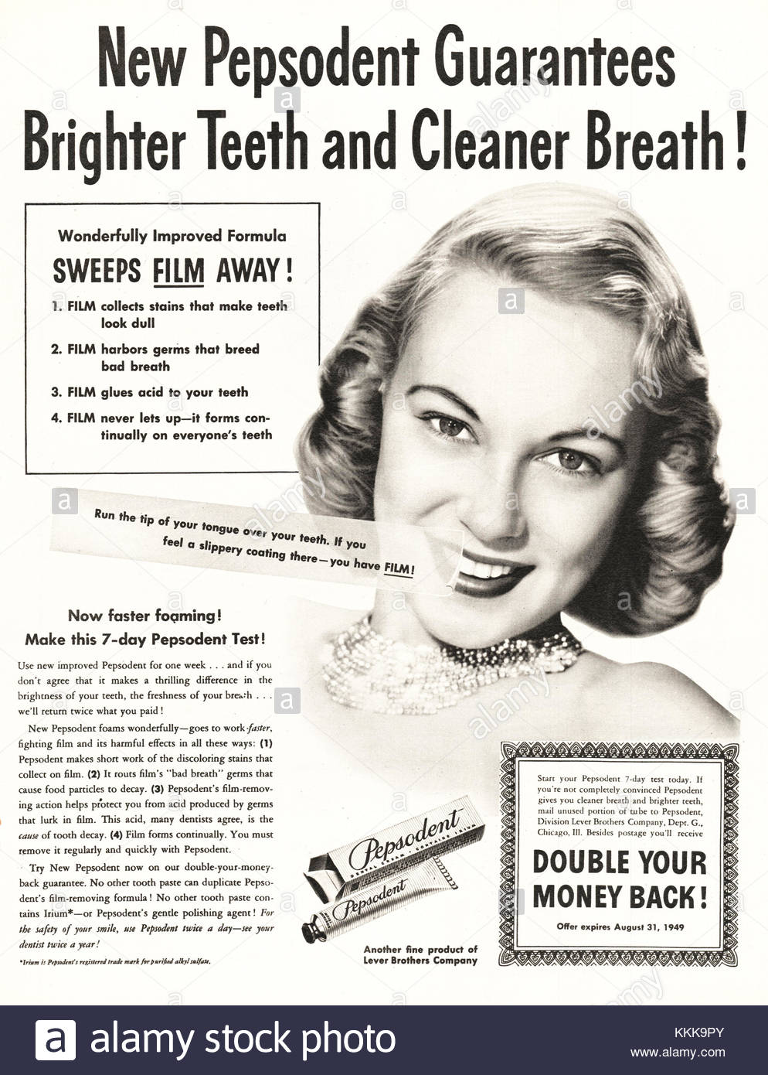
Schedule
Introduction
Pepsodent
Ford Edsel
Conclusion

Slide 3
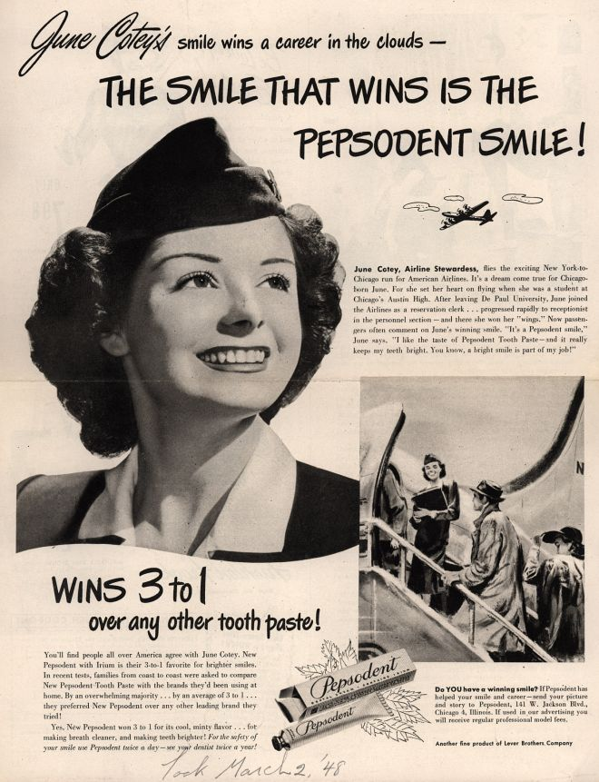
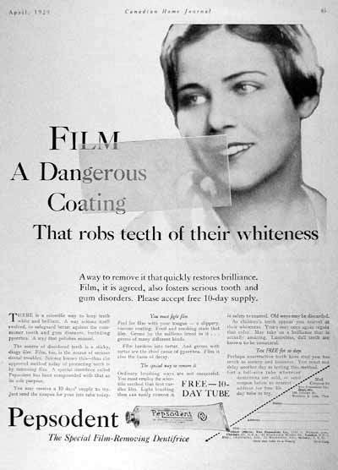
1949 ads

Slide 4
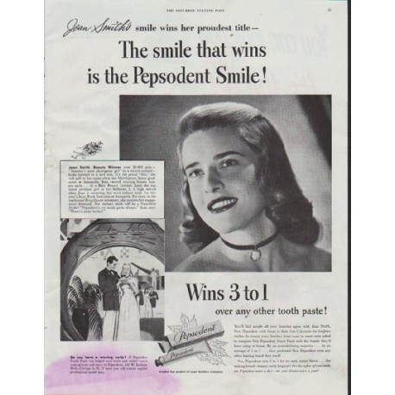
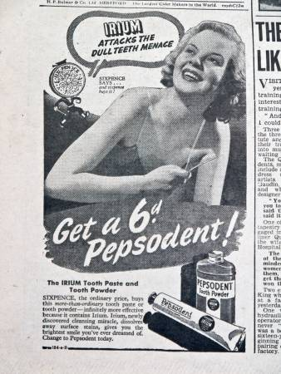
Pepsodent ads. “Just run your tongue across your teeth,” “You’ll feel a film — that’s what makes your teeth look ‘off color’ and invites decay.”

Slide 5
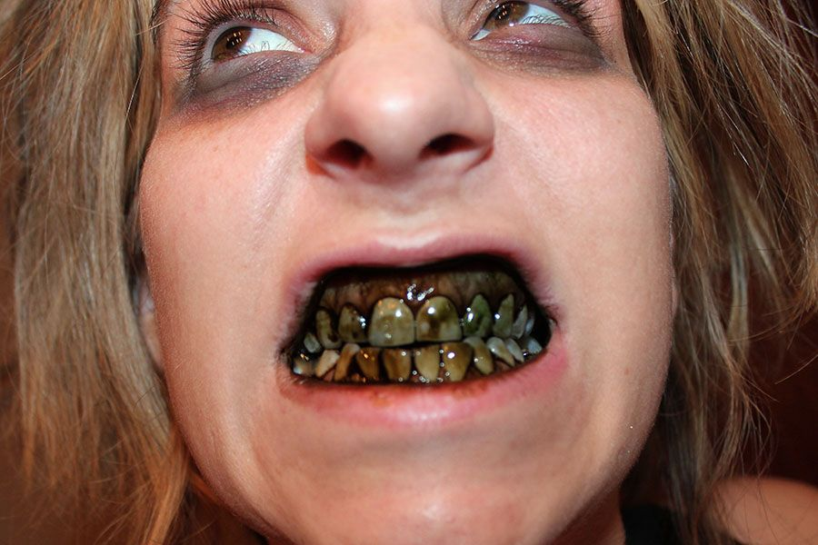

What can we learn from this case study?
Appeal to what consumer regards as important – CUE and REWARD it
CUE + Reward = Habit (neurological craving)
Don’t want to be healthy (well maybe today) – but then – CUE = Attractive / Pretty / Boyfriend / Girlfriend
White teeth = pretty
Smile = attractive
Brush teeth every day
Product superiority – mint taste
Texture not putty-like as those of competitors
Why lost market share – did not innovate – too slow to add fluoride
(Henry Ford’s Model T perhaps?)
Cool tingling feeling = clean
      AND TODAY?
      GOING ON THAT DIET TO BE IN BETTER HEALTH…
      OR TO LOOK BETTER? … WELL HOPEFULLY BOTH?

Slide 6
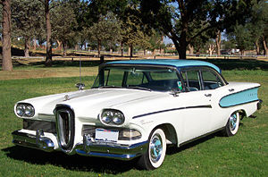
Marketing in Practice
FORD EDSEL

Slide 7
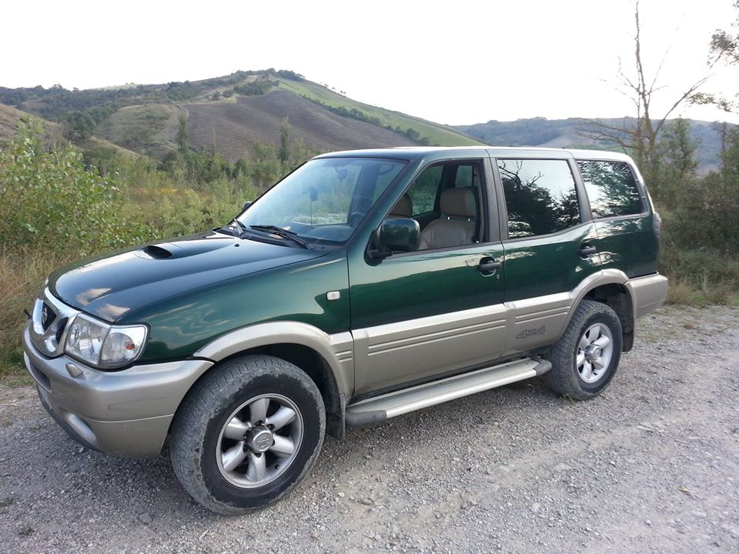
Marketing mix?
Product
Wrong car for wrong time?
Large car
Heavy on fuel
Poor assembly / incomplete to dealers
Had 18 ! Model on launch to choose from
Quality issues
  Rust
  Overheat
  Headlights pop out
Price
2-3 times market segment’s salary
Too highly priced
Fuel consumption
Duplicating Ford distribution channels expensive

Slide 8
Distribution
Did not use trusted Ford distribution channels
Duplicating Ford distribution channels expensive
Service of vehicles = product maintenance issues
Unfinished cars distributed – dealers had to fit bumpers etc.
Promotion
Well advertised
Year before – create expectation of “E-Car” (good)
Bit of over-promise (my view)

Slide 9
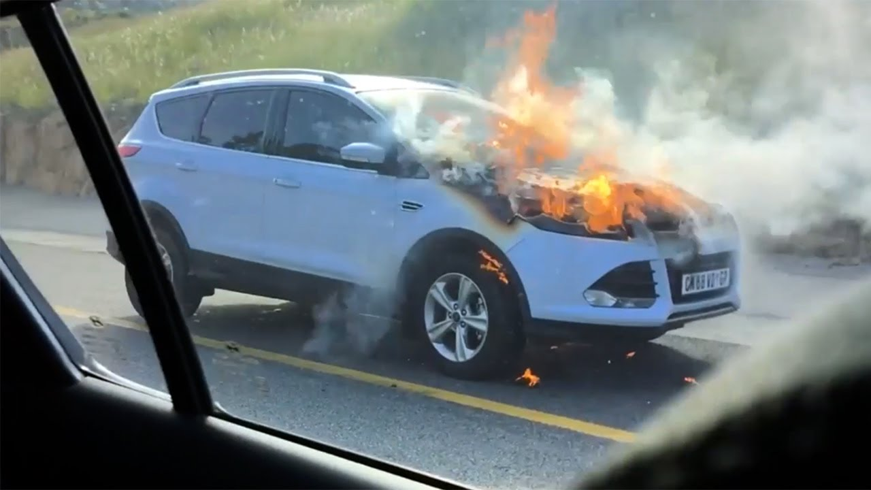
Any solutions?
Corporate brand Brand
Ford Edsel
Damage to the brand – corporate brand damage limited
Incorrect segmentation & positioning
Discontinue or blow more money (already lost $350 mil.)
Only correct decision was to cut their losses
NB NB Do not attempt to manipulate marketing mix to rescue car
  Discounting (low price) for exampe
This will only lead to a more severe marketing failure
Ford Kuga
4 LESSONS FROM THE EDSEL SAGA
Ego should never supersede research
Focus vision – cant be everything for everybody (18 models!)
Do not create a situation that compromises you to a must commit
If fail – accept and move on

