Slide 1
ENTREPRENEURSHIP
MBAD 823
Prof Stéphan van der Merwe
Contact Session 3
2020

Slide 2


ENTREPRENEURSHIP 2020

Slide 3

CREATING WINNING IDEAS/OPPORTUNITIES

Slide 4
Introduction to Entrepreneurship
Entrepreneurial mind and fit
Idea generation
Design thinking
Lean start-up & Agile development
Entrepreneurial process
Feasibility & planning
Family businesses
Women entrepreneurship
Corporate entrepreneurs
Logic & Effectuation
Social entrepreneurship
Entrepreneurial ecosystems
Managing the business

Slide 5

STRUCTURE OF THIS SESSION
The difference between ideas and opportunities.
Creativity, innovation and entrepreneurial behaviour.
3 Obstacles to successful creativity, idea generation and innovation.
4 The sources of new ideas.
The phases of the creative process.
Successful ideas.
Enhancing creativity.
Application of the principles.

Slide 6
IDEAS AND OPPORTUNITIES

Slide 7

DIFFERENCE BETWEEN AN IDEA
AND AN OPPORTUNITY (1/2)
An idea is a thought, impression or notion. It may or may not meet the criteria of an opportunity.
Many businesses fail, not because the entrepreneurs that started the businesses didn’t work hard, they fail because there was no real opportunity to begin with.
Before getting excited about a business idea, it is crucial to understand whether the idea fills a need and meets the criteria for an opportunity.

Slide 8

DIFFERENCE BETWEEN AN IDEA
AND AN OPPORTUNITY (2/2)
An opportunity has the unique qualities
of being attractive, durable, and timely.
It is also anchored in a product or service that creates or adds value for its buyer or end user.

Slide 9

WHAT IS AN OPPORTUNITY?
An opportunity is a timely and favourable circumstance providing a good chance for a successful venture that addresses a customer need:
New combinations of products/services
New markets
New processes
New distribution channels
New ways of organising
New means of production/supply

Slide 10
ANCHORS OF VIABLE BUSINESS OPPORTUNITIES
They create and add significant value to the customers or end-users.
They do so by solving a significant problem, removing a serious pain-point or meeting a significant want or need.
They have a robust market, good margins and money-making characteristics to sustain growth.
There is a good fit between the entrepreneur/ team, resources and opportunity with an attractive risk-reward balance.

Slide 11
HOW TO SPOT
ENTREPRENEURIAL OPPORTUNITIES
Monitor trends and exploit them early on (ICT - first mover advantage).
Take a different approach to an existing market (e-commerce).
Put a new twist on an old idea (pivot the business model).
Look for creative ways to use existing resources (laser cutting).
Realize that others have the same problem that you do (and then render that service).
Notice what is missing (not a specific service in town).

Slide 12

DEFINING ENTREPRENEURIAL OPPORTUNITY SPACES
The opportunity space is the broad space of ideas and opportunities where you and your team want to create value.
It is defined (or limited) by what you are, what you know, what you can do and what you want.
It is also defined by the outside world and in particular the unmet needs, trends and opportunities it offers.

Slide 13


FUNDAMENTAL REALITIES OF NEW VENTURE CREATION
  Most new ventures are works in process and works of art.
  Most business plans are obsolete at the printer.
  Speed and adaptability are crucial.
  The key to succeeding is failing quickly and recouping quickly.
  Success is highly situational, depending on time, space, context, and stakeholders.
  The best entrepreneurs specialize in making “new mistakes” only.
  Do not try to do it solo – a well-balanced team is important for success.

Slide 14
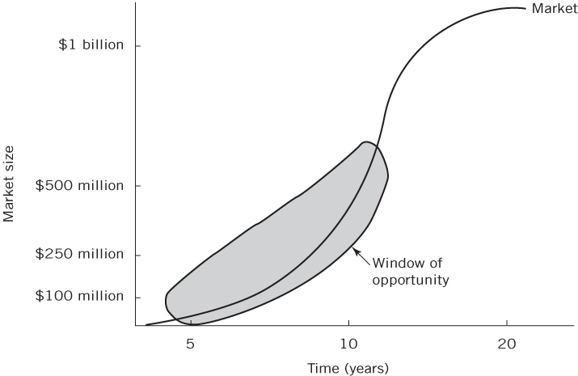


WINDOW OF OPPORTUNITY
An entrepreneur is a person who sees an opportunity in the market, gathers resources and creates and grows a business venture to meet these needs. He or she bears the risk of the venture and is rewarded with profit if it succeeds.
(Nieman & Nieuwenhuizen, 2009).

Slide 15


Slide 16

CRITERIA FOR EVALUATING VENTURE OPPORTUNITIES (S&A, 2016:120, 121)
  Industry and market (size, attractive, growth)
  Economics (high margins, break-even)
  Harvest issues (value-added potential)
  Competitive advantage issues (cost, barriers to entry)
  Sustainability (social and environmental impact)
  Management team issues (A-team, balance)
  Fatal flaw issues (number, severity)
  Personal criteria (fit, risks-rewards)
  Strategic differentiation (high risk = high potential)
  [See exhibit 5.6 – high vs. low potential]

Slide 17
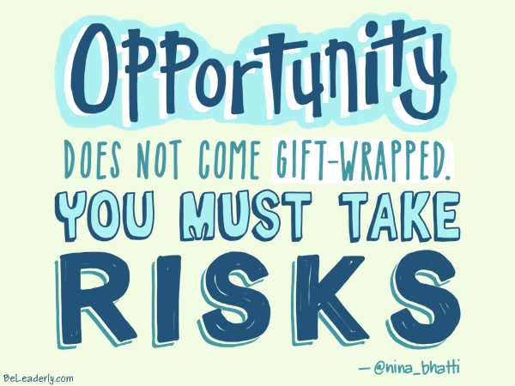

Slide 18

INDIVIDUAL AND GROUP EXERCISES
Homework: Turn to S&A (2016:131). Do “The Next Sea Changes” exercise. Also discuss it during a syndicate group meeting.
2. Refer to the “Opportunity-Creating Concepts and the Quest for Breakthrough Ideas” exercise in S&A (2016:132). Read through the exercise. Discuss it.

Slide 19
CREATIVITY, INNOVATION AND ENTREPRENEURIAL BEHAVIOUR

Slide 20


CREATIVITY AND INNOVATION
Creativity vs Innovation
  Creativity – the ability to develop new ideas and to discover new ways of looking at problems and opportunities.
  Innovation – the ability to apply creative solutions to problems and opportunities to enhance or to enrich people’s lives.

Slide 21


Slide 22

CREATIVITY AND ENTREPRENEURIAL BEHAVIOUR
Creativity is the generation of new ideas and approaches that result in the improved efficiency or effectiveness of a system [Innovativeness is the implementation of it].
Entrepreneurial behaviour, on the other hand, involves the ability to identify opportunities based on these new ideas and approaches, and to turn them into an economically viable product, service or venture [Vehicle].
Creativity implies a vision for what is possible, the entrepreneur translates that vision into action.

Slide 23


Slide 24

THE ROLE OF CREATIVITY
More than 450 definitions of creativity.
The product of creativity is firstly a result of a thinking process.
This thinking process is usually unconventional, meaning that previously accepted ideas or concepts are normally rejected or modified.
The thinking process is supported by performance motivation and is mostly time and energy consuming.
The initial problem is normally vague and not structured.
Creativity is as much a state of mind as a way of thinking.
Left and right modes – shift, use both.
Emotional/irrational more important than intellectual/rational – understand these elements.

Slide 25
OBSTACLES TO SUCCESSFUL CREATIVITY, IDEA GENERATION AND INNOVATION

Slide 26


Slide 27

THE CREATIVITY MYTH
Creativity is an innate skill and cannot be acquired by means of training.
You need to be a rebel to be seen as creative.
Artists are the only creative beings.
You need to be “crazy” before creativity kick in.
There is a correlation between intelligence and creativity.
Group vs individual (both – process important).
All new products were accidental discoveries.

Slide 28


FACTORS THAT INHIBIT CREATIVITY (1/2)
People fear change or failure.
Negativity bias (in evaluating others’ intellectual work).
Business people believe that it was unwise to be creative.
Foster intellect-dependent relationships.
Searching for the “right” answers.
Focusing on being logical.

Slide 29

FACTORS THAT INHIBIT CREATIVITY (2/2)
Blindly following the rules.
Constantly being practical.
Viewing play as frivolous (no real value).
Becoming overly specialised.
Avoid ambiguity.
Fearing looking foolish.
Believe “I am not creative”.

Slide 30

KANTERS 10 RULES FOR
STIFLING INNOVATION (1/3)
Regard any new idea from below with suspicion – because its new and from below.
Insist that people who need your approval to act first go through several other levels of management to get their signatures.
Ask departments or individuals to challenge and criticise each other’s proposals (saves you the job – you pick the survivor).
Express your criticisms freely and withhold your praise (keeps people on their toes – let them know they can be fired at any time).

Slide 31
KANTERS 10 RULES FOR
STIFLING INNOVATION (2/3)
Treat identification of problems as signs of failure, to discourage them from letting you know when something isn’t working.
Control everything carefully. Make sure that people count anything that can be counted, frequently.
Make decisions to reorganise or changes policies in secret and spring them on people (keeps them on their toes).
Make sure that requests for information are fully justified, and make sure that it is not given out to managers freely (you do not want data falling in the wrong hands).

Slide 32

KANTERS 10 RULES FOR
STIFLING INNOVATION (3/3)
Assign to lower-level managers responsibility for cut backs, lay-offs, implement threatening decisions.
And above all, never forget that you, the higher-ups, already know everything important about this business.

Slide 33
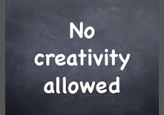
CREATIVITY CURBS
It’s never been done before.
It would cost too much.
I don’t have time.
It’s not my job.
Let someone else try it first.
I don’t have the authority.
I’ve always done it this way.
People won’t approve it.
There is only one way to do this.

Slide 34
HOW TO OVERCOME THESE OBSTACLES TO CREATIVITY
What can you as a manager do to overcome these obstacles?

Slide 35

VENTURING INTO THE UNKNOWN – THE IDEAL

Slide 36

VENTURING INTO THE UNKNOWN – THE REALITY

Slide 37

If you want something in your life you have never had, you will have to do something you have never done!!
JD Houston

Slide 38
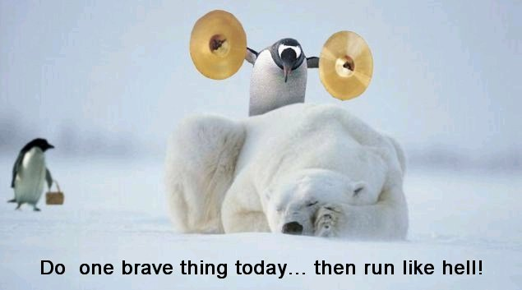

Slide 39
THE SOURCES OF NEW IDEAS

Slide 40

SOURCES OF NEW IDEAS (1/4)
Trends:
Societal trends (for instance the ageing demographics, fitness growth…).
Technology trends (for instance mobile tech, e-commerce, Internet advances…) – SEA-CHANGE – NEW KNOWLEDGE.
Economic trends (for instance higher disposable incomes, dual wage-earner families…).
Government trends (for instance increased regulations, terrorism….)
Unexpected occurrences:
Infamous terrorist attack of 9/11
For instance impact on security industry

Slide 41
SOURCES OF NEW IDEAS (2/4)
Incongruities/incompatibilities:
Exist in the gap between expectations and reality.
Example - overnight package delivery.
Industry and market changes:
Changes in consumer attitudes, advancements in technology, and growth in the structure, design or definition of markets or industries are sources of emerging opportunities.
Example – the health care industry: changing to home health care and preventive medicine have replace hospitalization and surgery as primary focus areas.

Slide 42
SOURCES OF NEW IDEAS (3/4)
Process needs:
Process needs = “pain” and innovative solutions = “pain killers”.
Need to do something better leads to new medical devices, healthier foods, time saving devices…..
Example - sugar-free products; caffeine-free coffee; microwave ovens.
Demographic changes:
Changes in population size, age, education,…..
Example - retirement communities for older people

Slide 43
SOURCES OF NEW IDEAS (4/4)
Perceptual changes:
Perceptual changes in people’s interpretation of facts and concepts may be intangible but meaningful.
Example - exercise (aerobics) and the growing concern for fitness.
Too many carbs or sugar in our diet?
Knowledge-based concepts:
Inventions, which are the product of new thinking, new methods, and new knowledge, often require the longest time period between initiation and market implementation because of the need for testing and modification.
Example - mobile technology, pharmaceutical industry, robotics….

Slide 44
IDEA GENERATION SOURCES (1/2)
Create new market for existing product
Existing businesses
Franchises
Patents
Product licensing
Corporations
Not-for-profit research institutes
Universities
Trade shows and meetings

Slide 45
IDEA GENERATION SOURCES (2/2)
Customers
Distributors and wholesalers
Competitors
Former employees
Professional contact
Consulting
Networking
Websites and Internet
………….

Slide 46
THE PHASES OF THE CREATIVE PROCESS

Slide 47

THE PHASES OF CREATIVITY
Phase 1: Background or knowledge accumulation
Phase 2: The incubation process
Phase 3: The idea experience
Phase 4: Evaluation and implementation

Slide 48

PHASE 1: BACKGROUND OR KNOWLEDGE ACCUMULATION
Successful creations are generally preceded by investigation and information gathering [empathy].
Extensive reading, conversations with other working in the field, attendance at professional meetings and workshops.
General absorption of information relative to the problem or issue under study.
Human, social and intellectual capital!!!
Networks!!!
Example - talk to anyone and everyone about
your subject; scan magazines, newspapers….
Carry a small notebook…..

Slide 49
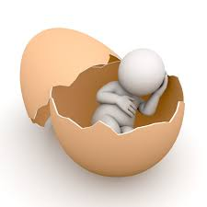
PHASE 2: INCUBATION PROCESS
Creative individuals allow their subconscious to mull over tremendous amounts of info gathered during Phase 1.
Often occurs while they are engaged in activities totally unrelated to the subject or problem.
Even when they are sleeping.
Example - engage in routine, “mindless” activities; exercise regularly; play; think about the project or problem before falling asleep; meditate or practice self-hypnosis or mindfulness….

Slide 50

PHASE 3: IDEA EXPERIENCE
Often most exciting – EUREKA moment/factor.
Sometimes the idea appears as a bolt out of the blue.
Often the answer comes to the individual incrementally.
Slowly but surely the person begins to formulate the solution [Ideation].
Often a natural overflow from Phase 2 to Phase 3.

Slide 51


PHASE 4: EVALUATION AND IMPLEMENTATION (1/2)
Most difficult step [implementation/execution].
Requires courage, self-discipline and perseverance.
Successful entrepreneurs can identify ideas that are workable and that they have the skills to implement.
They do not give up when they run into obstacles.
Often will fail several times before they successfully develop their best ideas.
Some cases they take the idea in an entirely different direction or will discover a new and more workable idea.

Slide 52
PHASE 4: EVALUATION AND IMPLEMENTATION (1/2)
During the evaluation and implementation phase:
Exercise, diet and rest.
Educate yourself in the business planning process and all facets of business.
Test your ideas with knowledgeable people.
Take notice of your intuitive hunches and feelings.
Educate yourself in the selling process.
Seek advice from others (it is not a sign of weakness)

Slide 53
SUCCESSFUL IDEAS

Slide 54

CHARACTERISTICS OF SUCCESSFUL IDEAS
Relative advantage over existing products/services.
Compatibility with existing attitudes and beliefs – drastic change not necessary.
Simple for the buyer to understand.
Easy to communicate results/benefits.
Should be made available to try out without incurring a large risk – samples [experimentation].
Should be readily available once the buyer decides to make the purchase.
An immediate benefit should be associated with product.

Slide 55



A WINNING IDEA (1/2)
Makes money now and in 5 years times.
Sounds attractive to financiers and your bank manager.
Is easy to promote.
Is something that appeals to a growing number of consumers.
Encourages repeat purchasing.
Is recession-proof. It has downside risk protection.

Slide 56

A WINNING IDEA (2/2)
Makes money if your sales are only 80% of what you project, or 50% (scenarios).
Is what you want to do.
Is easy to package and put into practice.
Gives others the opportunity to participate and to make money with you.
Is simple (usually).
Is legal.

Slide 57

INDIVIDUAL EXERCISES
1. Describe in your own words the differences between an idea and an opportunity.
2. List the sources of ideas that are the most relevant to your personal interests, and conduct a search using the Internet.
3. Evaluate your best idea against the summary criteria in Exhibit 5.6 (S&A, 2016:120, 121). What appears to be its potential? What has to happen to convert it into a viable business?

Slide 58

STEP 1: IDEA GENERATION GUIDE
Work through the Idea Generation Guide in Spinelli and Adams (2016:133, 134).
The steps include:
Generate a list of new venture ideas
Expand your list if possible
Get feedback from at least three people
Dot down insights, observations and conclusions

Slide 59
ENHANCING YOUR CREATIVITY

Slide 60

ENHANCING YOUR CREATIVITY
What can you do to enhance your creative thinking?

Slide 61
ENHANCING YOUR CREATIVITY
If you act like an idea person, you will become one. It is the intention and going through the motions that count.
If you want to become an artist and paint a picture every day, you will become one.
You may not become another Van Gogh, but you will become more of an artist than someone who has never gone through the motions.
These exercises are designed to help you go through the motions of being a creative thinker.

Slide 62
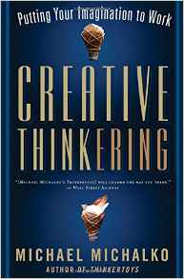

CREATIVITY EXERCISES
The following two books have a lot of fun exercises to stimulate your creativity.
You can also search more exercises on websites.
Have fun!!!!

Slide 63
CREATIVITY EXERCISES
CREATIVE SQUARES
Count the total number of squares in the figure below. Assume that the figure is a square box on a single flat plane. In counting, angles of any square must be right angles, and the sides must be of equal length.

Slide 64
CREATIVITY EXERCISES:
CAN YOU READ THIS?
“Aoccdrnig to rscheearch at Cmabridge Uinvervtisy, it deosn’t mttaer in waht oredr the litteers in a wrod are, the olny iprmoetnt tihng is taht the frist and lsat ltteer be at the rghit pclae. The rset can be a ttoal mses and you can sitll raed it wouthit a porbelm. Tihs is besauae ocne we laren how to raed we bgien to aargnre the lteerts in our mnid to see waht we epxcet to see. The huamn mnid deos not raed ervey lteter by istlef, but preecsievs the wrod as a wlohe. We do tihs ucnsoniuscoly wuithot tuhoght.“ –
See more at: http://creativethinking.net/are-you-seeing/# sthash.JwamFCTe.dpuf

Slide 65

CREATIVITY EXERCISES
WHAT DO YOU SEE?

Slide 66
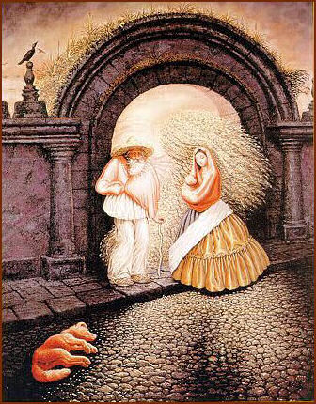
CREATIVITY EXERCISES
HOW MANY FACES DO YOU SEE?

Slide 67

CREATIVITY EXERCISES
CAN YOU SPOT THE BEAN HEAD?

Slide 68
CREATIVITY EXERCISES
HOW OBSERVANT ARE YOU (1/2)
Only one of these objects appears in both drawings.
If you can find it within one minute, consider yourself highly observant. Can you find it?

Slide 69

CREATIVITY EXERCISES
HOW OBSERVANT ARE YOU (2/2)

Slide 70

CREATIVITY EXERCISES
THE DOOR
Here is a classic door with rectangular frames. If you look at the X in the middle of the door and think circles instead of rectangles, circles will pop up out of nowhere.

Slide 71
CREATIVITY EXERCISES
CREATIVE MANAGEMENT CHALLENGE
Below are four simple questions. Try to answer all of them before looking at the answers.
How do you put a giraffe into a fridge?
How do you put an elephant into a fridge?
The King of the Jungle is holding a meeting for all of the animals. One of them is not there. Which one?
You are standing on the bank of an alligator infested river and have to get to the other side. What do you do?

Slide 72
CREATIVITY EXERCISES
THREE MEN IN A ROOM (1/2)
Three men pay $30 as a group to rent a room. The clerk discovers he has overcharged the group $5 and he gives the bellhop the money to return to the three men. The bellhop decides that $5 is too hard to divide by three and then he gives each man a dollar each and keeps the remaining $2 for himself. The three men have paid $9 each, the bellhop has kept $2, making $29. Where did the extra dollar go?

Slide 73
CREATIVITY EXERCISES
THREE MEN IN A ROOM (1/2)
Answer: Words and the way words are arranged play a significant role in the way we approach problems. This problem is structured so that we focus on how to divide the $5 by three and end up losing a dollar. We’re looking at the wrong things. To find the missing dollar, subtract the $3 the bellhop returns to the men from the original $30. This leaves $27. Then subtract the bellhop’s stolen two dollars (27 - 2 = 25). Now all the money ($30) is accounted for. $25 for the room, $3 returned to the men, $2 stolen by the bellhop.

Slide 74

HOW CAN THE MANAGER CREATE AN ENTREPRENEURIAL ENVIRONMENT?
Management should actively support entrepreneurial behaviour.
Link entrepreneurial behaviour to strategy (long term horizon).
Encourage all employees to be innovative (actively encourage new ideas).
Tolerate mistakes (but only “new mistakes”).
Build in appropriate rewards.
Make resources available and accessible.
Regular meetings to discuss innovativeness.

Slide 75

Thank you!!!

