Slide 1



COMMUNITY
PROJECT
SAVF
AQUAPONICS
SYSTEM

Slide 2
Group submission: Contact session: Eight (8).
Name of syndicate group: Brain Power Troopers
Name of community organisation: SAVF
Person submitting on behalf of group: J.J.P Hattingh
Topic(s) of this contact session: Final Presentation
Name of community organisation: SAVF
Nature of community work: Welfare and welfare related services .
Nature of business venture: Infrastructure, improvement & optimisation
By posting this on eFundi, we
declare that this submission
is our own work.
Name: (Members contributing to project) | Student number
Johan Hattingh | 31575846
Johan Pretorius | 33464154
Sheldon Rostron | 12874949
Lisel Dahms | 28282817
Lizanné Smit | 24451312
Elize van Aswegen | 28242459
Stanley Taylor | 26316919
Ryan Fernandes | 12663271
Name: (Members NOT contributing )
None

Slide 3
Table of content
Introduction to SAVF pg 5
Operation management principles pg 6
  3.1 Project Management & design pg 7
  3.2 Process & layout pg 8,9
  3.3 Aggregate planning and scheduling pg 10
  3.4 Forecasting pg 11
  3.5 Quality pg 12
  3.7 Quality: Progress Report pg 13
  3.8 Maintenance pg 14
Impact on organization and future projects pg 15
The value of the project to the individual pg 16
The value of the project to the group pg 17
Addendums of the project:
  Community project registration & consent form Attachment A
  Energy optimization plan Attachment B
  Project planning: estimated aquaponics costs Attachment C
  Aggregate plan Attachment D
  Maintenance checklist Attachment E
  RACI Matrix Attachment F

Slide 4
SAVF Carletonville

Slide 5
Introduction
Child
Youth care, statutory work, foster care and care in children's homes
Development Programs
Job creation, life enhancement programs
Support
To individuals and families, combating poverty
Support
The aged and disabled persons
Administration
And management tasks
SAVF has resources & property available that they rent out to those less fortunate.
The rental income includes housing for rehabilitated people @ R500 per month, use of the workshop by a panel beater, a church tent and storage for two school busses.
Proposal for improvement: We identified and embarked on an innovative project to introduce a Garden aquaponics project.
The benefits of the proposed process strategy are:
To assist SAVF with cost savings
Transform resources into goods and services - Process and product strategy
A product focus - using vegetables as input and few variations of output
The produce provides nutritious food, teach essential life skills
No hard & time-consuming manual labour required.
Lap pop Day care
Accommodates 80 disadvantaged toddlers daily with meals.
Reënboog Nursery
Accommodates 50 disadvantaged toddlers with meals daily.
Community Clothing Bank
Approximately 65 people provide with 2nd hand clothing at a minimum fee.
Legae/ Ikhaya for the Aged
A service centre and accommodation for the elderly. 124 elderly are being accommodated in self-catering units with meals.
Service centre
Provide transportation services and social services for the elderly
Centre for traumatized women and children
40 women and children housed and assisted with
social services and counselling.

Slide 6
Operations Management Principles
“Getting the hands dirty”

Slide 7
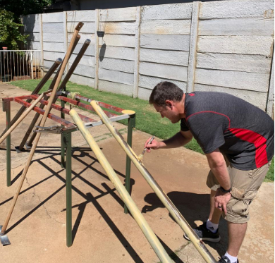
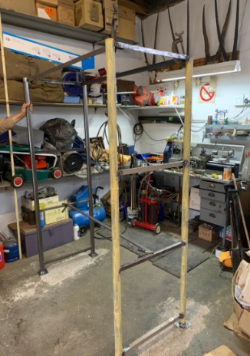
Project Management and Design
One of the essential needs identified for the SAVF are the costs and resources involved to feed the people in the shelter.
Brain Power Troopers felt that this critical need and difficulties they were having was critical to solve as it is a large part of the critical services, they provide.
The aim of the project is:
  To implement an Aquaponic system at the SAVF.
  To ensure a sustainability and indecency.
  To involve the children & members to grow vegetables yielding vegetables and therapeutic benefit.
  To be effective, efficient and economically feasible in the solutions we provide.
Aquaponics system with pump on cement slab
Building
Dam for fish
Jojo tank connected from gutter to aquaponics system and dam, on cement slab
Version 1: design of aquaponics system
20-22 m
Reuse tyre to make garden bedding for hardy vegetable garden (carrots, potatoes, radishes etc.)
Building
Fence (Poles at 3m intervals)
Farm gate with lock
Version 2: design of aquaponics system – we needed to build a more modular system that would allow us to transport it easily as well as construct it on site. Pre-fabrication meant quicker installation and less hands required
9 m
Notes:
CH 5 197

Slide 8
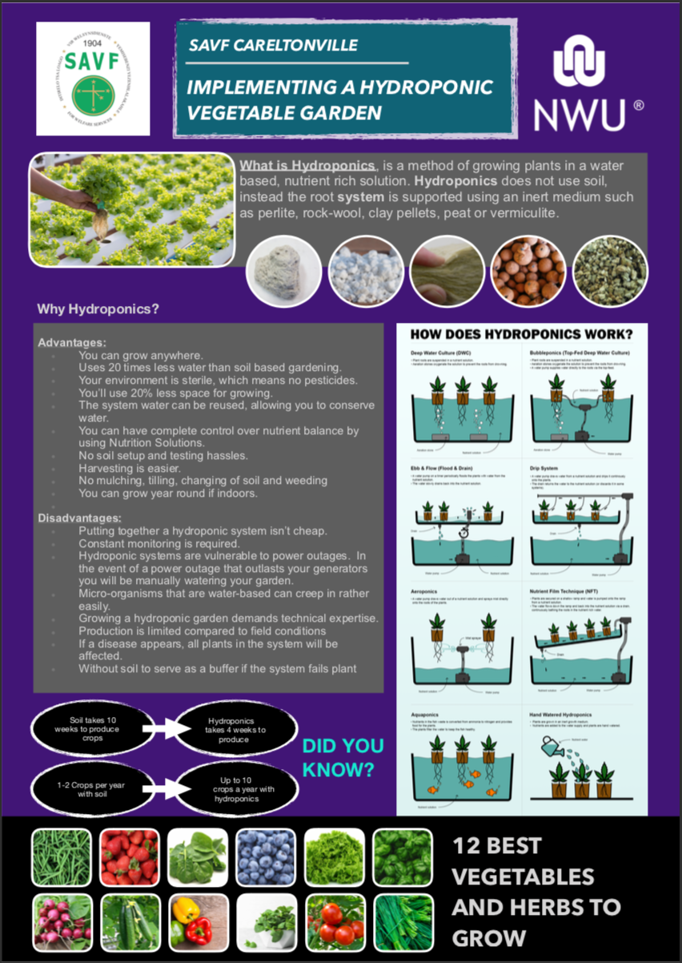
Process & Layout
Process Strategy is an approach to transforming resources into goods or and services. SAVF in Carletonville’s resources at the moment is the building/property that they rent out.
By doing the Garden- Aquaponics project, SAVF can make use of a product focus with few inputs and variation of output during the year by planting different vegetable using the same inputs.
The Aquaponics project will be a continuous process.
The process focused on 4 key elements:
Utilizing solar energy to reduce electrical costs/not add additional costs.
Utilize minimal water or retain water in a system that would not add to their costs already. We have also looked to utilize rainwater to retain in the system by connecting it to gutters.
Maximizing production – utilizing a farming technique that would yield more crops in a year than conventional gardening.
Additional value – whether gaining value from developing production, creating sales to maintain or continued sustainability, training others to farm, providing a distraction and creating social cohesion or even adding therapeutic value.
Notes:
Ch 7
Product and process focused: High productivity, low variation and way the process works must flow.

Slide 9
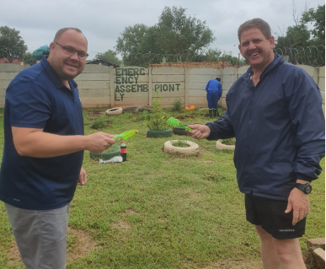
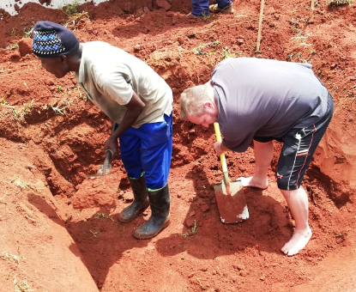
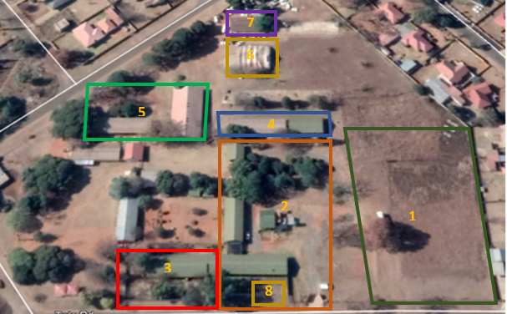
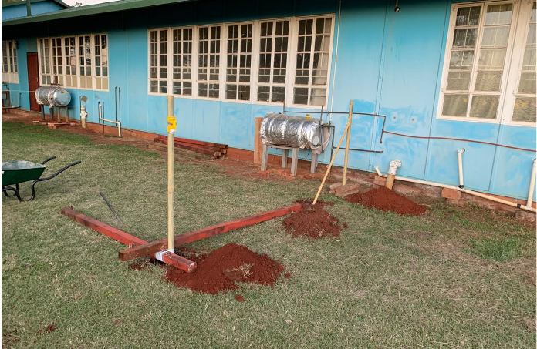
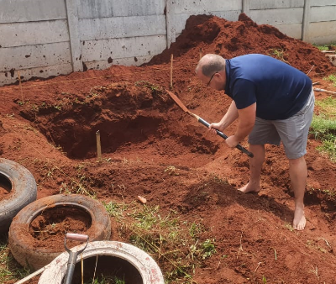
Process & Layout
Potential Commercial garden area (60m x 95 m = 5,700 m ² / 0.57 ha) & Bus storage
Community area (park, stores, rentals)
Shelter for abused woman & children
Rental @ R 500 / month
Nursery (funded / food included)
Rental income (tent Church)
Rental income (workshop / panel beaters)
Project footprint - Aquaponics system feeding the Shelter for abused women & children (nr.3)
Building an Aquaponics system that will produce food for people residing in area 3. This is seen as a pilot system whereby people can be trained and be empowered to learn a new skill. A larger system can be built in area 1 which will allow the SAVF to commercially grow produce that can be marketed.
Image: SAVF Carletonville layout and work team getting their hands dirty after layout setup and developed
Notes:
CH 9 405

Slide 10
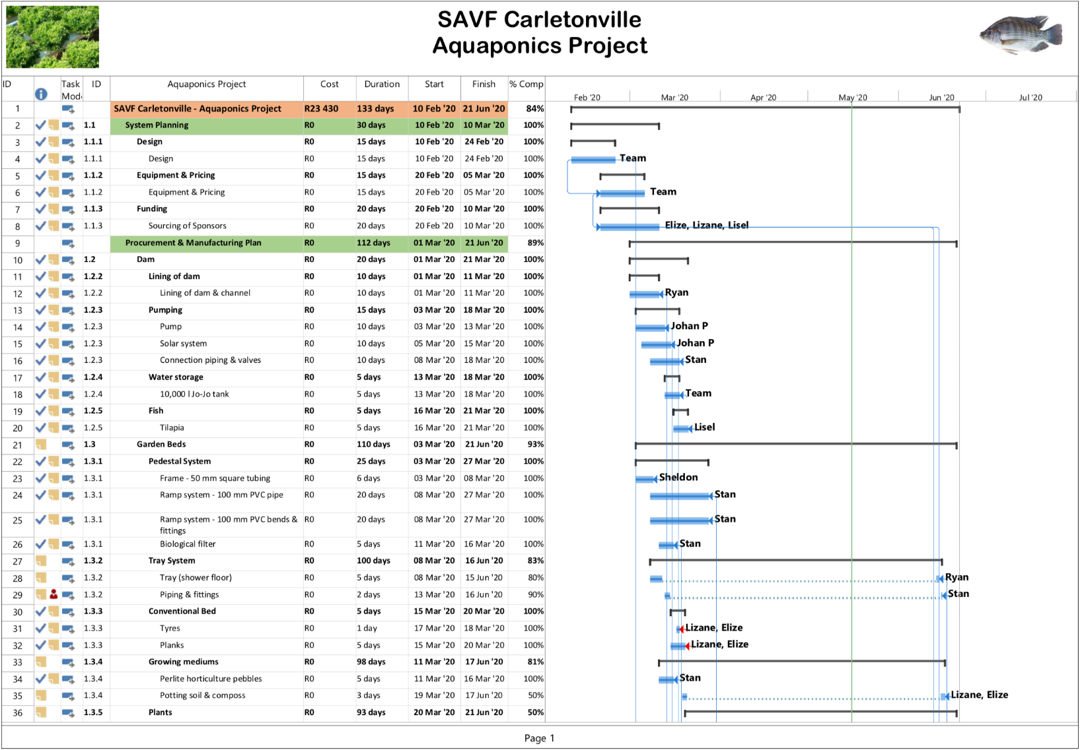
Aggregate Planning & Scheduling
Key aggregate focuses:
Reduced production time – more yield
Increased productivity on less space
Reduced operational costs and savings on the small budget they have
Reduce variability and labour-intensive activities
Product | Week | Month | Year
Spinach x 37 plants | R 110 | R 445 | R 5,340
Cherrie Tomato's x 5 plants | R 60 | R 240 | R 2,880
Lettuce x 37 plants | R 150 | R 600 | R 7,200
Cabbage x 36 plants | R 150 | R 600 | R 7,200
Beans x 5 plants | R 60 | R 240 | R 2,880
Potatoes x 10 plants |  | R 190 (8 months production) | R 1520
Tilapia |  | R 100 | R 1,200
Total projected savings | R 530 | R 1,935 | R 28,220

Slide 11
Forecasting
Harvesting – 4 to 8 weeks depending on products and season availability
120 plants (2m²) that can be harvested regularly are planted in 110mm PVC tubing = 24 running meters, and 10 plants in growing beds (1m²)
Maintenance and cleaning of equipment
Capacity options used:
  Inventory and change of inventory have to be calculate because it has a cost implication
  Varying in people. To train the people to be self- sustainable in providing vegetables.

Slide 12
Quality
Aquaponics require a total quality management – Doing it write the first time.
Biological filters ensure water quality and control pest and disease (plants & fish).
To ensure a quality product the oxygen and protein of the water monitored regularly. Correction action can be taken by increasing or decreasing the water flow, increasing or decreasing the fish quantities, cleaning the filter or replacing the water.
A flow chart helps to improve quality by ensure when to harvest and or when vegetables must be replaced.
Process planning and scheduling
Maintenance and pest control
Continuous production and quality control
Production and harvesting control
Quality assurance during manufacturing and construction

Slide 13
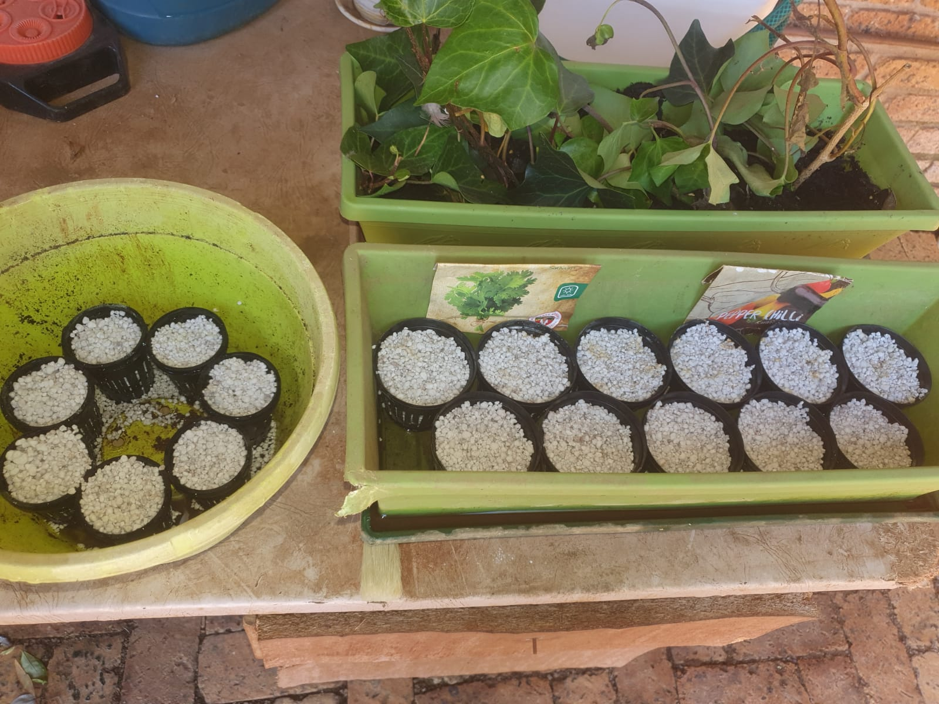
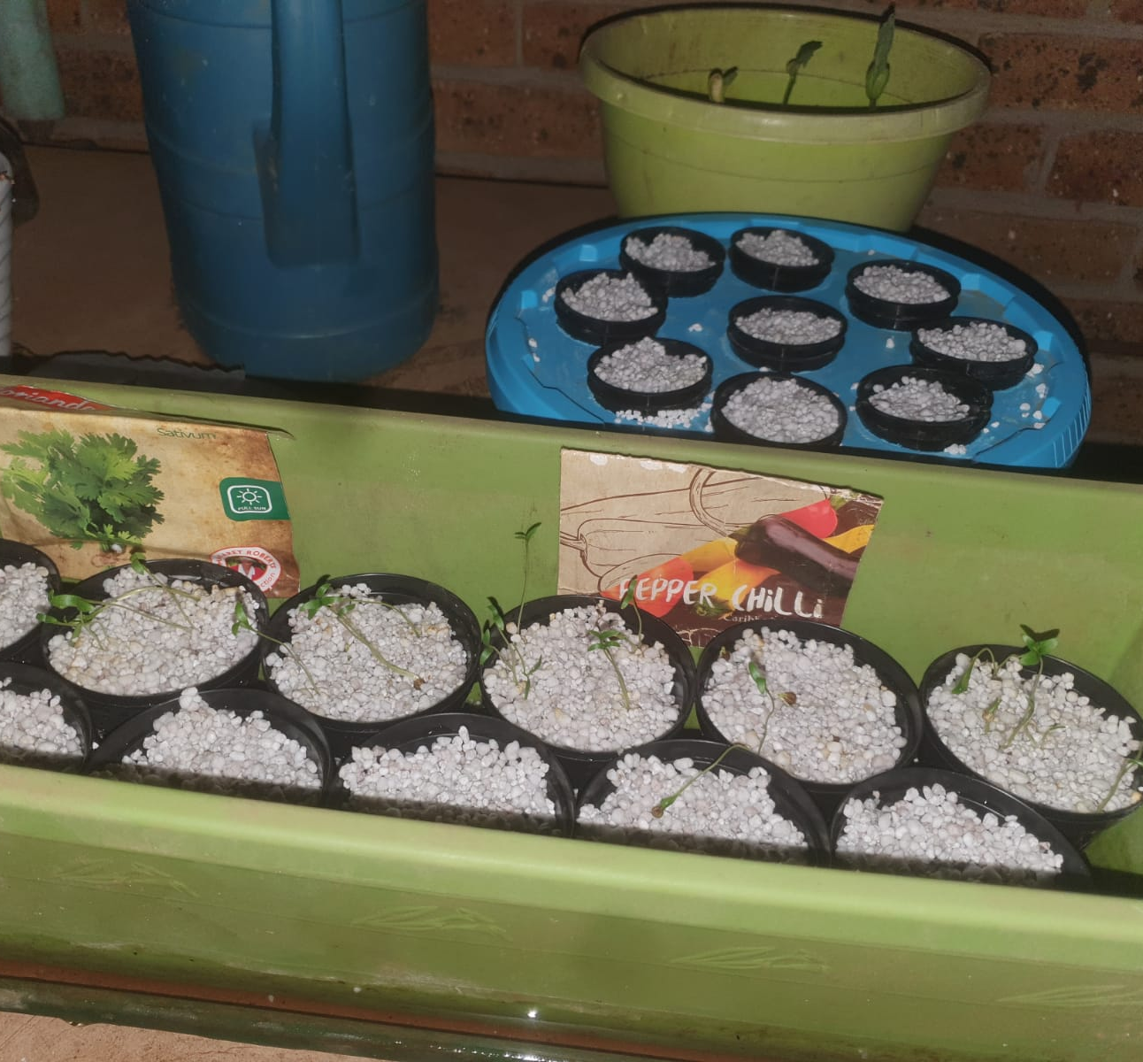
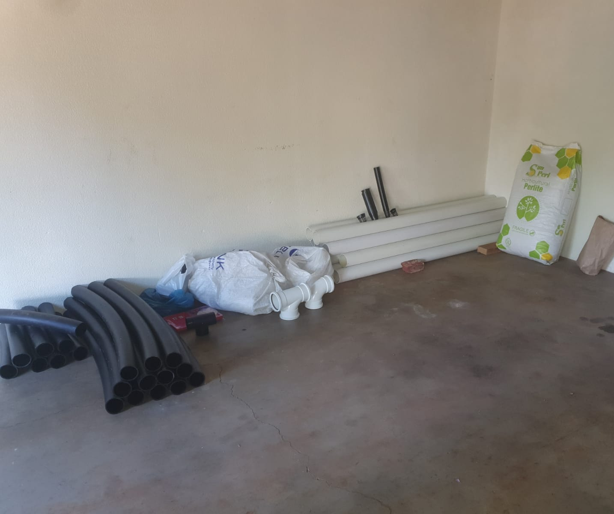
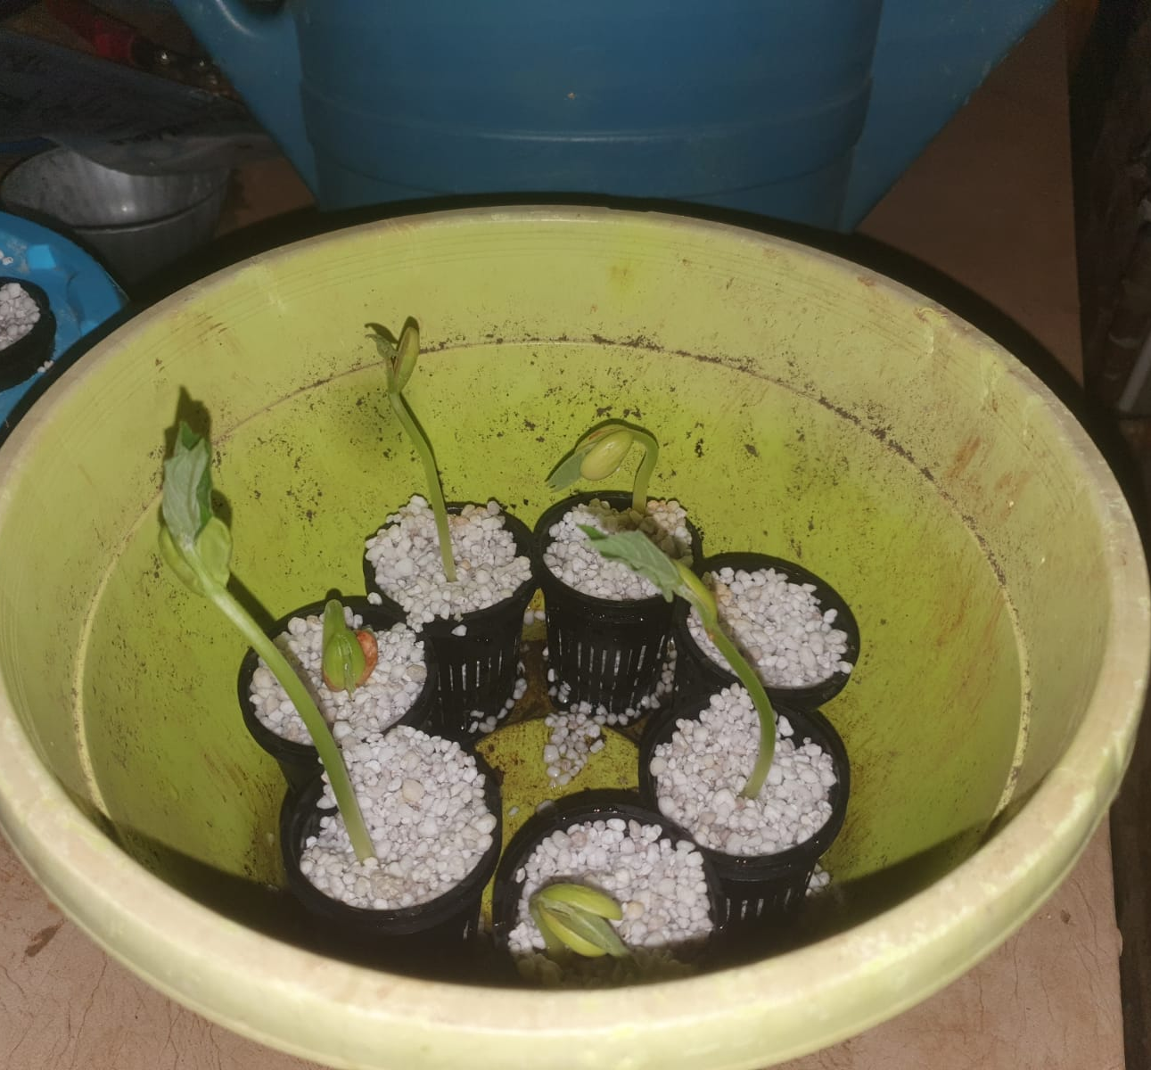
13
15
15
Progress Report Work Done and Site Visits
Site visit – 04/02/2020 Meet with SAVF personal
Site visit – 22/02/2020 Introduce the team to SAVF and meet with personal
Run Win Deed Property report for ownership of a property – 02/03/2020
Site visit, strategizing & digging of 5 m³ dam – 03/03/2020
SAVF donated 10,000 l Jo-Jo tank – 07/03/2020
Purchases grow medium (perlite) and baskets – 12/03/2020
Plant fence poles – 15/03/2020
Donation for solar & solar pump (Stahl Cranes) – 15/03/2020
Jo-Jo tank placed – 18/03/2020
Donation from JT Project Services – 17/03/2020
Purchases PVC pipes & Fittings – 26/03/2020
Complete & deliver Pedestal – 26/03/2020
Manufacturing from home continues – Delivery after 35 days lockdown.
Donation from Mr Werno van Aswegen – 01/04/2020
Lockdown – The seedlings was planted at home so that the growing process won't be delayed (Beans, Coriander, Jam tomatoes, Peppers) – 08/04/2020.
Donation from Indwe Risk Services – 15/04/2020
Lockdown – Seedling start growing 23/04/2020
Modular Aquaponics system complete – 05/05/2020
11
15

Slide 14
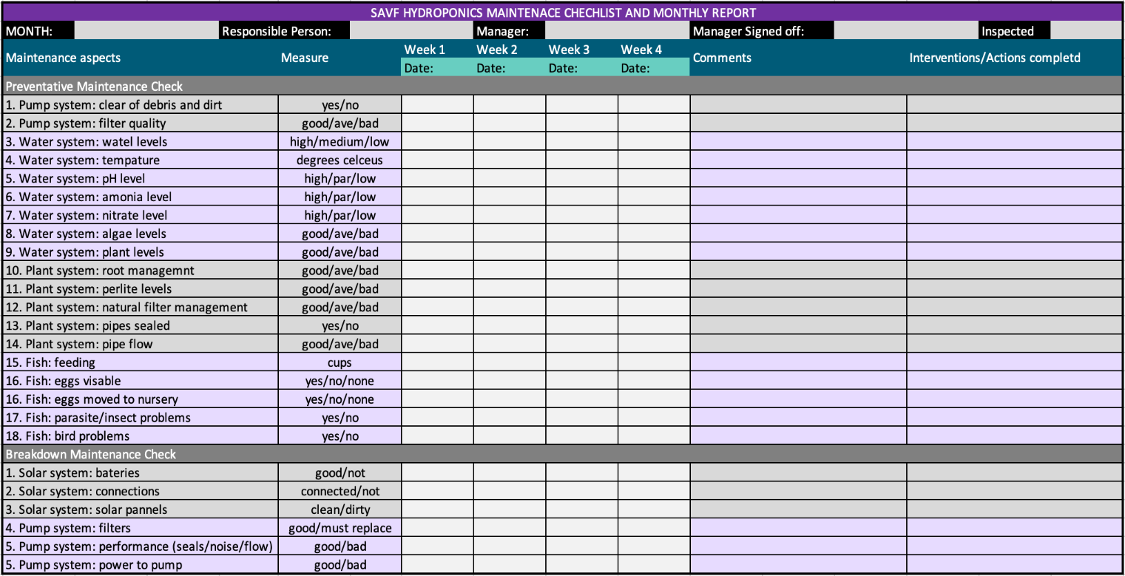
Maintenance
Preventative Maintenance:
Pump System:
  Intakes clear of debris and dirt
  Filter replacements
Water System:
  Water levels correct
  Temperatures
  pH Levels as well as ammonia and nitrate levels
  Balanced plant and algae management
Plant System:
  Root management
  Perlite and biological filters: healthy & maintained
  Sealed and flow
Fish:
  Fish feeding
  Eggs & fingerlings to be moved to grow area(nursery)
Breakdown Maintenance:
Solar System:
  Connections
  Batteries
Pump System:
  Filters
  Performance (sealed and flow)
  Power
* Maintenance checklist implemented for intervention actions to be recorded and logged.
Employee involvement
Autonomous system – little input
Training and maintenance plan
Reward and empowerment system
Room to improve and develop
Results
Yield
Improved quality
System protection/care
Increased capacity
Reduced variability
Enhanced Production
Reduced production time
Sustainability
Maintenance & Reliability
Cleaning and maintenance
Monitor and adjustments
Small repairs and fixes
Record and measurement

Slide 15
Impact on the organization and future projects
Impact on the organization
Future projects and impacts
Identified and presented change options and improvement through operation management
Developed and created social entrepreneurship opportunities
Food creation aiding and assisting in cost reduction and improvement of services.
Provided sustainable solutions and infrastructure
Shown how to utilize current assets and infrastructure as part of enhancing capabilities and productivity
Administrative and quality assessment tools to aid in productivity, maintenance and quality.
Empowering and instilling skills and knowledge that will impact current programs and business opportunities for the future.
Power consumption management: R30000 monthly bills (See addendum 1)
  Solar systems to reduce (+/- 10000 square meters)
  Heated pumps and solar geysers
  Convection ovens and units
  Energy saving lighting.
Development of social entrepreneurship program:
  Further expansion of Aquaponics
  Development of further farming (layout section 1)
  Skills development programs

Slide 16
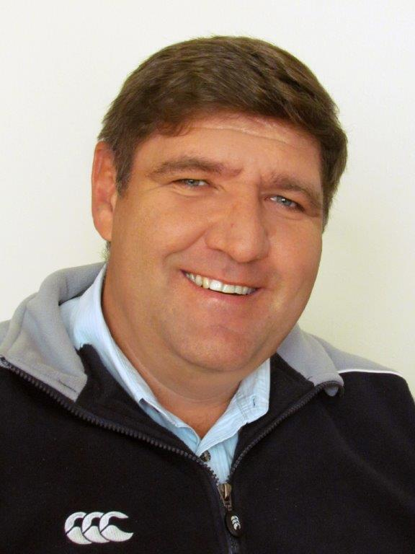
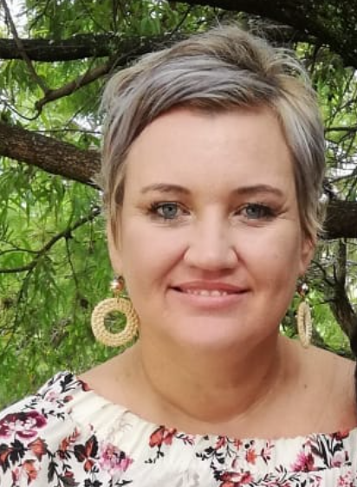
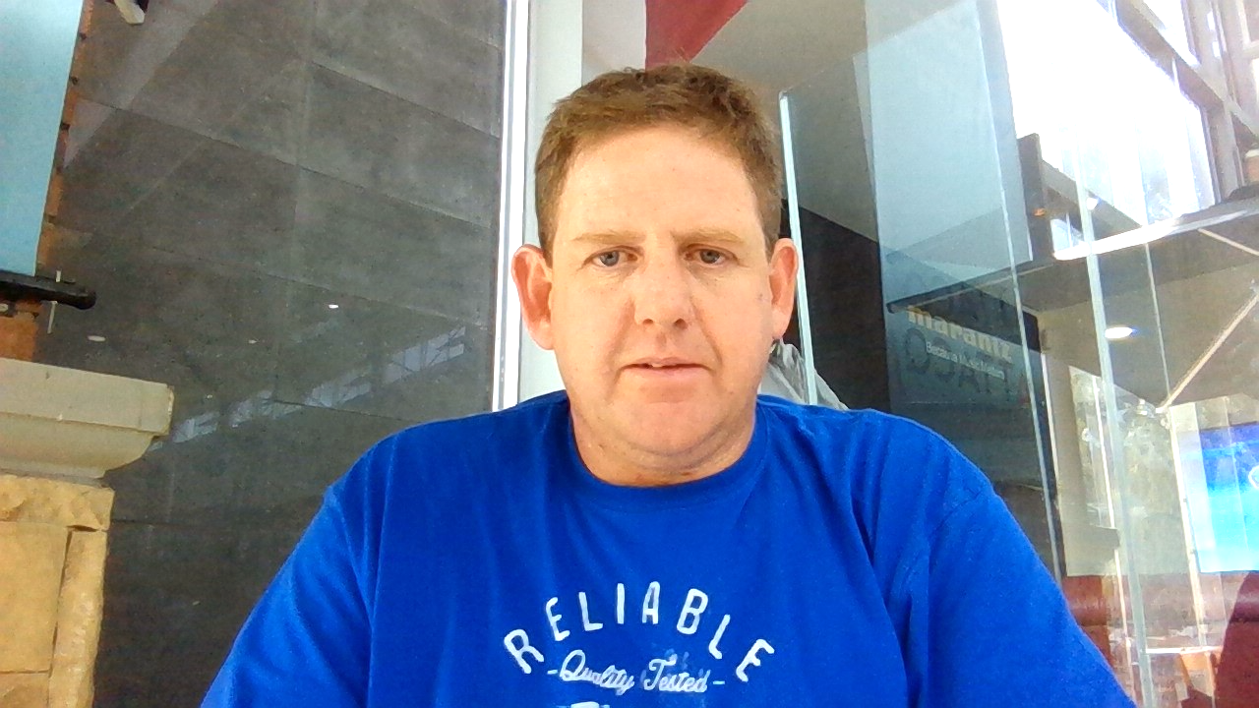
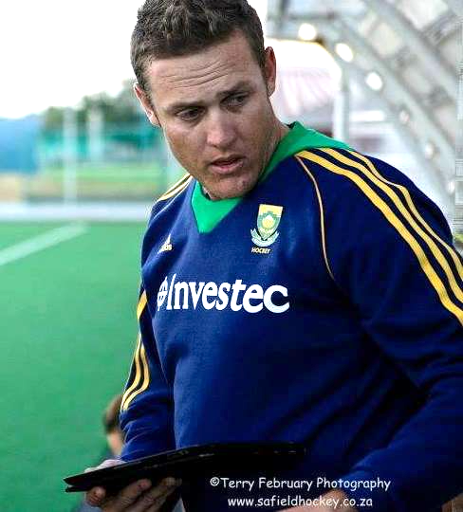
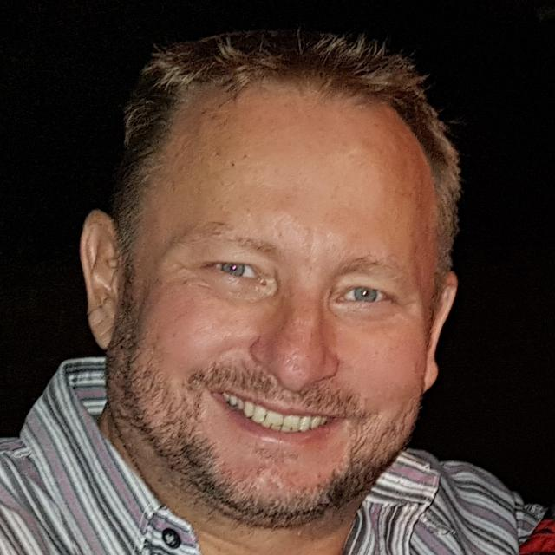
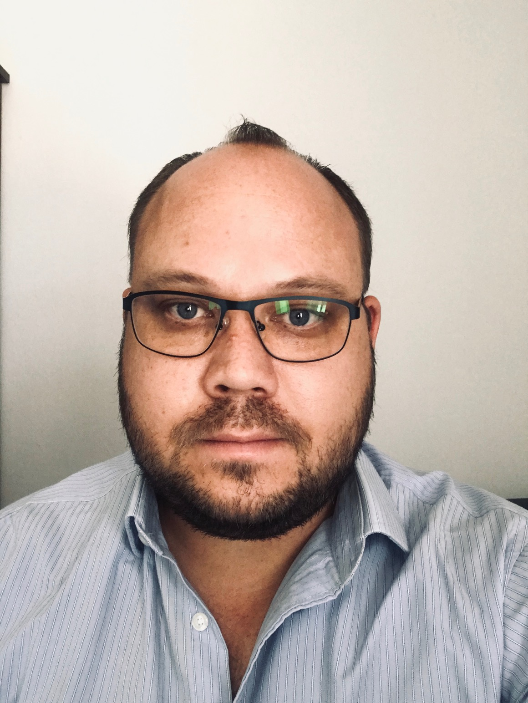
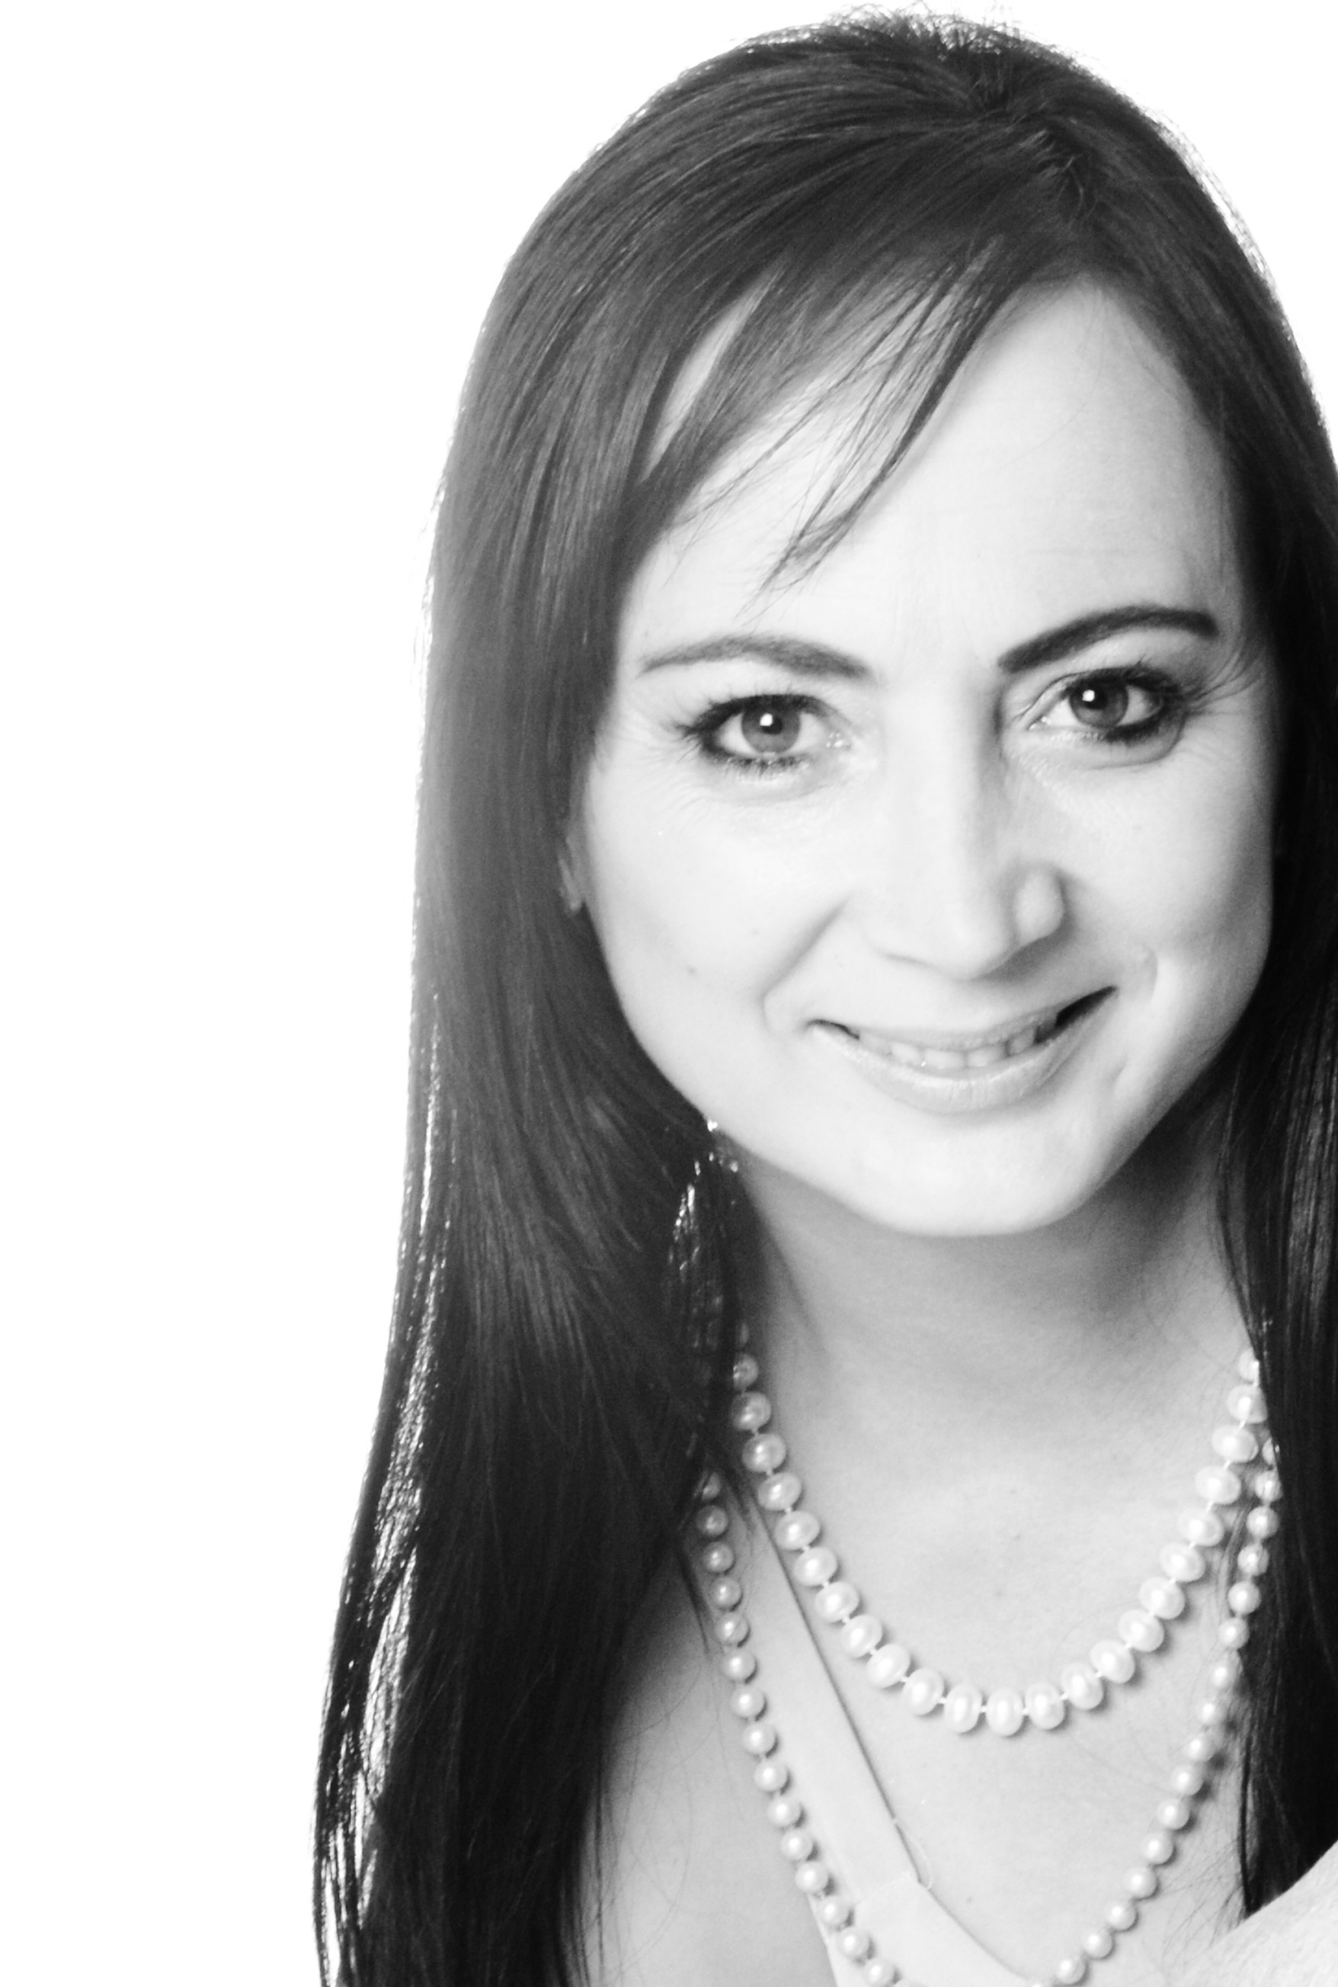
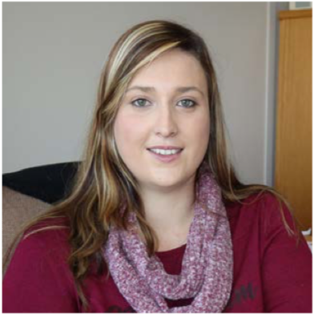
Value of the project to the individual
With the visits at SAVF Carletonville, I knew we could give them HOPE. To build an effective self-sustainable vegetable garden, through an aquaponic system was a new adventure. To teach them, through the aquaponic vegetable garden system, they can be independent. The enthusiastic and buy-in from management means that 80% of the project was successful even before we started.
To create hope of independency was inspiring.
My wish is that this project will give them dignity.
Value – “ You are the most important project you will ever work on, looking back takes you nowhere, looking forward gives you a chance”. Make a difference !
What I have learned – You never know it all, talents & skills is all around you and should be used to compliment, not breakdown.
It was a real shock to see the need of others and how we could make a small project go a long way.
I am now more thankful and grateful for what I have and that I can share the knowledge and experiences provided by the course with others and make an impact in their lives.
Implementing that which we have learned in a service sector on a critical area and making an impact for the long term.
Working with a motivated Management group, whom are organized and focusing on a common goal for SAVF.
Impacting lives of other through business principles and processes was both humbling and inspirational
Working together while making our hands dirty had an unexpected and team building outcome;
Seeing the less fortunate has made me realise how blessed we are and that we should do more to assist the people in need (especially the children);
I was inspired by Suzette Oosthuizen for her effort on how she serves the community – always positive and with a smile.
Small things in life we take for granted are another man's joy when received. Just a little help to those less fortunate can bring joy at an abundance.
This project for me is / was a great privilege and an eye-opener towards what I perceived as “making a change” I realized that even a small gesture can have a huge impact. Together in collaboration and with the right culture this improvement will have a long lasting effect, therefore, lesson learnt: “Small changes make a huge difference”
Being part of a community can make us feel like we are part of something greater than ourselves and having a sense of community unites us.

Slide 17

Value of the project to the group
We identified a basic necessity for critical operations as simple as food would make an enormous impact.
In order for the organization to survive food could be produced with limited resources and good operations management to ensure sustainability and continuity.
Planning, design, layout and process management would form critical parts to the success of this project – “simpler is smarter, success will be in the details”
Operations management can be applied easily implemented, passed over and processes continued post the project for the to reap the rewards.
We could save them money, make them money and help lay a foundation that could allow them to develop the area more and reap more rewards. These rewards may not only be the product, but the process of teaching others skills or even the therapeutic value that the participants may gain and distract them from their past and provide them a new future.
BRAIN POWER TROOPERS

