Slide 1
Theme 2: Cost flow in a manufacturing Business
Mr. Oarabile manyaapeLo
Chartered Account (SA)
Registered auditor (SA)

Slide 2
Cost Classification
Why are performing a classification?
General Classification of manufacturing costs | To determine Period Cost Vs Product costs | Classification for cost prediction | Classification for assigning costs to cost objects | Cost classification for decision making | Classification of Inventory on financial statements
1. Direct Materials | 1. Product Cost | 1. Fixed Costs | 1. Direct Costs | 1. Differential costs and Revenue | 1. Raw Materials
2. Direct Labour | 2. Period Cost | 2. Variable Cost | 2. Indirect Costs | 2. Opportunity Cost | 2. Work in Progress
3. Manufacturing Overheads |  |  |  | 3. Sunk Cost | 3. Finished Goods
Non Manufacturing Costs
1. Selling or Admin costs

Slide 3
General Cost classification
Direct Materials – Materials that form an integral part of the finished product and can be easily and conveniently traced to the final product.
  Such as the Paper and Glue used at the Envelope Factory.
Direct Labour – The cost of labourer that can be physically and easily be traced to a product
  Such as the wages paid to employees folding the envelopes
Manufacturing overheads – All indirect materials and indirect labour are classified as manufacturing overheads. These are essentially cost that cannot be physically or conveniently traced to the final product.
  Such as the Rent for the factory, the electricity used to provide lighting in the factory etc.

Slide 4
Prime Cost Vs Conversion Cost
Direct Materials
+
Direct Labour
+
Manufacturing Overheads
Prime Cost
Conversion cost

Slide 5
Period Cos Vs Product Cost
Absorption Costing
Direct Material
Direct Labour
Manufacturing Overhead
Product Cost
Direct Costing
Direct Material
Direct Labour
Manufacturing Overhead
Product Cost
Period Cost
NB!! Product costs first go to inventory and are only expensed when goods are sold

Slide 6
Product Cost Vs Period Cost
Product costs can include Direct Material, Direct Labour and Manufacturing Overheads
Period costs will consist of all non manufacturing expenses plus manufacturing overheads if a direct costing approach is adopted
Finished goods
Cost of Good Sold
Expense
Sale
Balance
Sheet
Income
Statement
Income
Statement

Slide 7
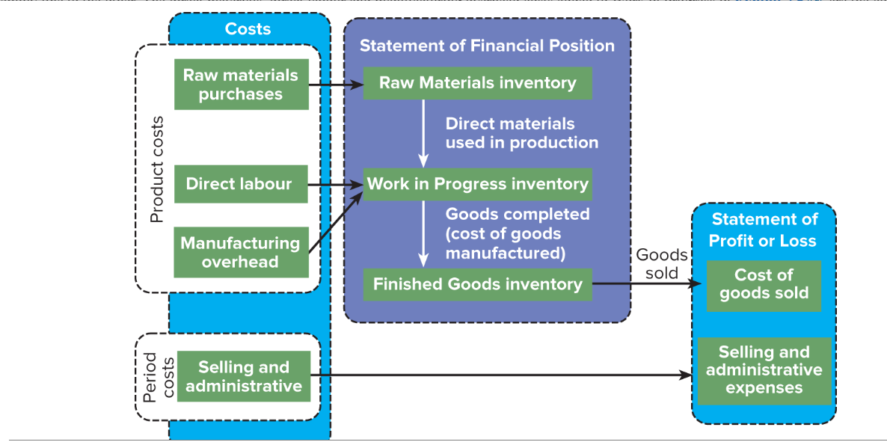
Cost flow in a manufacturing Business

Slide 8
Cost Classification for cost prediction:
Variable costs
Variable costs – Incurred every time when a product is manufactured
Total cost of paper used
Cost of paper per envelope
Envelopes produced
Envelopes produced

Slide 9
Classification for cost prediction:
Fixed Costs
Total fixed costs remain constant, however fixed cost per unit will be reduced as production quantities increase
Rent expense per envelope
Total Rent expense
Number of Envelopes
Envelopes produced

Slide 10
Classification by object
The split between direct and indirect costs enables management accountant to prepare customised reports of production costs by:
  Product
  Product line
  Customer
  Organizational sub units etc

Slide 11
Classification Decision making
Differential Revenue – The difference in revenue between two alternatives.
Differential cost – A difference in revenue between two alternatives.
Example: Tlokwe Local Municipality would like to purchase envelopes for the distribution of the their monthly accounts to all residents, however they require the logo of the municipality to be printed on the envelopes.
They are prepared to pay R3.50 per envelope, where we normally sell envelopes for R2,50. An additional R0,05 will be incurred on labour costs per envelope and the ink costs will be R0,45 per envelope.

Slide 12
Classification for Decision Making
Differential revenue = R3,50 – R2,50 = R1,00 per unit additional revenue
Differential cost / Additional cost = R0,45 + R0,05 = R0,50
Therefore when considering whether it will be worth it or not to invest the additional effort, once will consider net impact of accepting the offer, which will be an additional profit of R0,50 per envelope.
Only the difference between
alternatives are relevant for decision making

Slide 13
Classification for Decision Making
Opportunity Cost – The potential benefit that is given up when alternative is selected over another.
Example – If we reject the offer from the municipality because we normally charge an additional R2,00 per envelope for printing. What is the (missed) opportunity cost.
  The additional profit of R0,50 per envelope would be the opportunity cost of not accepting the offer

Slide 14
Classification for Decision Making
Sunk Costs - Sunk costs cannot be changed by any decision. They are not differential costs and should be ignored when making decisions.
Example – We purchased a printer 5 years ago for R10 000 specifically to enable our factory to print images on envelopes. Should this cost be considered when determining whether the offer by the municipality is acceptable
The R10 000 paid for the printer is a sunk cost because it cannot be changed by the decision at hand. It is therefore not a relevant cost for decision making

Slide 15
Cost of Sales – Merchandising Business
Opening Stock
+ Purchases
- Closing Stock
= Cost of goods sold

Slide 16
Cost of Sales – Manufacturing business
Raw materials | Work in progress | Finished goods
Opening stock | Opening Stock | Opening Stock
+Purchases | + Transferred from Raw materials | +Production
- Closing stock | + Direct Labour | - Closing Stock
= Raw Materials Used in Production (transferred to WIP) | + Manufacturing Overheads | = Cost of goods sold
 | - Closing Stock
 | = Production (Transfer to finished goods)**
**aka Cost of goods manufactured

Slide 17
Cost of Good sold – Manufacturing Business
Opening Stock Finished goods + Production – Closing Stock finished good = Cost of goods sold

Slide 18
Assignment
Theme 1 and Theme 2 on Connect – Closing date 22/08/2020 for both

