Slide 1
Theme 4 – Process Costing
Oarabile manyaapelo CA(SA) RA
20387350@nwu.ac.za

Slide 2
Job Costing Vs Process Costing
Each product or job is unique. (Built in cupboard, tailored suits, Dentures etc.
Direct materials, labour and overhead costs according to its own unique features
Job Costing
Processing
Costing
Many units of a single, homogeneous product flow evenly through a continuous production process.
One unit of product is indistinguishable from any other unit of product.
Each unit of product is assigned the same average cost.

Slide 3
Process Costing
Process costing systems accumulate the cost of each process, then average these costs across all units produced.
Used by businesses that mass-produce one product or a small range of almost identical products
  Involves a number of processes that are performed repetitively
  Used by oil refineries, food processors, manufacturers of tobacco, chemicals and paper
  Also used by producers of repetitive services — routine services

Slide 4
Similarities between job-order and process costing
The same basic purposes.
Both systems maintain and use the same basic manufacturing accounts.
The flow of costs through the manufacturing accounts is basically the same.

Slide 5
Differences Between Job-Order and Process Costing
Job order costing | Process costing
Many jobs are worked during the period. | A single product is produced either on a continuous basis or for a long period of time. All units of product are identical.
Costs are accumulated by individual jobs. | Costs are accumulated by departments.
Job cost sheet is the key document. | Department production report is key document of accumulation and disposition of costs by a department.
Unit cost computed by job. | Unit costs are computed by department on production report.

Slide 6
Jobs Costing Flow
Costs are traced and
applied to individual
jobs in a job-order
cost system.
Direct material
Direct labour
WIP of the JOB
Finished Goods
Cost of Sales
Manufacturing Overhead

Slide 7
Process Costing flow
Costs are traced and applied to departments in a process cost system.
Direct material
Direct labour
WIP of processing department
Finished Goods
Cost of Sales
Manufacturing Overhead

Slide 8
What is a Processing Department?
Any location in an organization where materials, labour or overhead are added to the product.
The activities performed in a processing
department are performed uniformly on all
units of production.
Furthermore, the output of
a processing department must be
homogeneous.

Slide 9
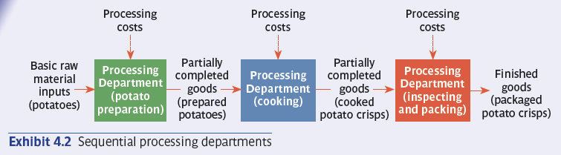
Sequential processing

Slide 10
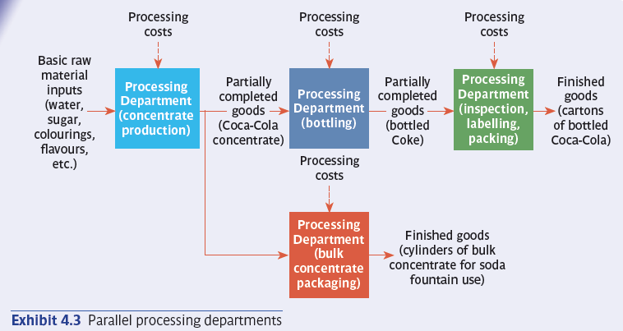
Parallel Processing

Slide 11
Process Cost Flow
Direct materials
Work in Process Dept A
Finished product from one department used as raw materials in the next dept
Direct labour
Work in Process Dept B
Manufacturing
overhead

Slide 12
Department A - Cost Flow
Work in Progress
Department A
Work in Progress
Department B
Direct Materials
Transferred to Dept. B
Transfer from Dept A
Finished Goods
Direct labour
Direct Materials
Applied Overhead
Direct labour
Applied Overhead

Slide 13
Equivalent Units of Production
Equivalent units are partially complete and are part of work in progress stock. Partially completed products are expressed in terms of a smaller number of fully completed units.

Slide 14
Equivalent Units of Production
Two half completed products are equivalent to one completed product.
+
=
So, 10 000 units 70 percent complete
are equivalent to 7 000 complete units.

Slide 15
Equivalent Units
For the current period, Jones started 15 000 units but completed only 10 000 units, leaving 5 000 units in process 30 percent complete. How many equivalent units of production did Jones produce?
a. 10 000
b. 11 500
c. 13 500
d. 15 000

Slide 16
Equivalent Units
Equivalent Units produced = (10 000 units x 100/100) + (5 000units x 30/100)
= 10 000 units + 1 500units
= 11 500 units

Slide 17
Calculating and Using Equivalent Units of Production
cost per equivalent unit for the period
Cost for the period
=
Equivalent units of production for the period
Now assume that Jones incurred R27 600 in production costs for the 11 500 equivalent units of production. What was Jones’ cost per equivalent unit for the period?

Slide 18
cost per equivalent unit for the period
=
Cost for the period
R27 600
Equivalent units of production for the period
=
11 500 units
=
R2.40

Slide 19
Equivalent Units of Production –
Weighted Average Method
 | Physical units | Material Equivalent units | Conversion cost equivalent units
Opening stock – 300 units – 100% complete for Materials 40% complete Conversion cost This is work already done in the previous month that we need to be completed in the current month | 300 | 300 | 120
Opening stock – 300 units @ 100% complete Materials and 40% complete in terms of conversion. Work done in the current month on products which were started in the previous month. This is a reflection of the additional equivalent units of work done in order to complete work which was already started in the previous month | 300 | 0 | 180
5400 units started and completed These units have been started from scratch and were completed during the current period | 5400 | 5400 | 5400
Closing stock WIP - 900 units started but completed Materials 100% -Convestion 60% | 900 | 900 | 540
Equivalent Production Units |  | 6 600 | 6 240
Units completed and transferred to finished goods

Slide 20
Equivalent Units of Production –
Weighted Average Method
Step 1 – Analyse the physical flow of units
Physical units completed and transferred out
Physical units in beginning WIP
Physical units in ending WIP
Physical units started

Slide 21
Equivalent Units of Production –
Weighted Average Method
Step two – Calculate Equivalent Units
  The equivalent units in beginning WIP are not identified separately; this is a key feature of weighted average cost method
Step three - calculate the unit costs
The cost per equivalent unit for direct material is the total direct material (conversion costs) costs divided by the total equivalent units
Under the weighted average method, the cost per equivalent unit is based on the total costs incurred, including the cost of beginning WIP
Step four - analyse the total costs
Cost of units transferred to the next production process, or to finished goods
Cost of production remaining in WIP

Slide 22
Production Report Example
Work in progress, May 1: 200 units
Materials: 50% complete. R 3 000
Conversion: 30% complete. R 1 000
Units started into production in May: 5 000
Units completed and transferred out in May: 4 800
Costs added to production in May
Materials cost R 74 000
Conversion cost R 70 000
Work in progress, May 31: 400 units
Materials 40% complete.
Conversion 25% complete.

Slide 23
Calculation of Equivalent Units
 | Physical Units | Material | Conversion costs
Equivalent units already in opening stock | 200 | 100 | 60
Work in Progress 1 May 2020 50% complete Materials 30% complete overheads Additional work done to complete the opening stock | 200 | 100 | 140
Started And completed ( 4800 -200) Of the 4800 units that were completed 200 were started in the previous month | 4 600 | 4 600 | 4 600
Closing Stock WIP 30 May 2020. 400 units 40% Complete Materials Conversion 25% Started but not completed | 400 | 160 | 100
Equivalent Units produced |  | 4 960 u | 4 900u

Slide 24
Calculation of cost incurred to make the equivalent units
Calculation of total cost to manufacture the equivalent units produced | Material Cost | Conversion costs
Work in Progress 1 May 2020 Cost brought forward with opening stock Costs incurred in the prior month | R3 000 | R1 000
Costs incurred in the current month | R74 000 | R70 000
Total Cost incurred to make the equivalent units | R77 000 | R71 000
Calculation of cost per equivalent unit | Material Cost | Conversion Cost
Total cost incurred to make equivalent units | R77 000 | R71 000
Equivalent units produced | 4 960 units | 4 900 units
Cost per equivalent unit | R15,52 | R14.49

Slide 25
Valuation of stock using weighted average cost method
 | Direct Materials | Conversion Cost | Total Cost
Units completed and transferred (200+ 4600) | R74 527 | R69 551 | R144 078
Units started and not completed (160u Mat/ 100u OH) | R2 483 | R1 449 | R3 932

