Slide 1
Unit 7 cont’d
TM Tools: Roadmapping

Slide 2
Technology Roadmapping
The primary role of TRM is to aid technology management and planning.
In a business environment, TRMs are used to clarify the plan for the progression of a good, connecting commercial strategy to the development of the product features.
The approach was originally developed by Motorola more than 25 years ago, to support integrated product-technology planning.
Since then the technique has been adapted and applied in a wide variety of industrial contexts, at the company and sector levels.

Slide 3
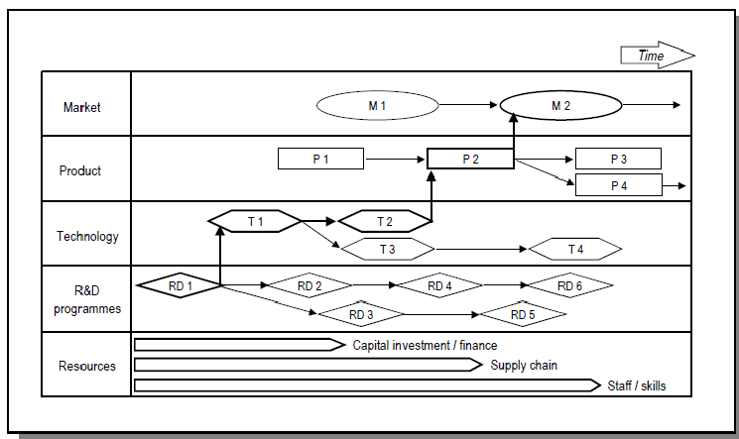
TRM Generally
TRM generally comprises of multi-layered time-based charts that enable technology developments to be aligned with market trends and drivers.
The generic roadmap is a time-based chart, comprising a number of layers that typically include both commercial and technological perspectives.

Slide 4
Uses of TRM
A technology roadmap is a plan that matches short-term and long-term goals with specific technology solutions to help meet those goals.
It is a plan that applies to a new product or process, or to an emerging technology.
Uses of TRM
It helps reach a consensus about a set of needs and the technologies required to satisfy those needs
It provides a mechanism to help forecast technology developments
It provides a framework to help plan and coordinate technology developments

Slide 5
Technology Roadmapping Process
The process conducts three phases: preliminary activities, the development of the roadmap, and the follow-up activities phase.
Because the process is too big for one model, the phases are modelled separately.
In the models no different roles are made; this is because everything is done by the participants as a group.

Slide 6
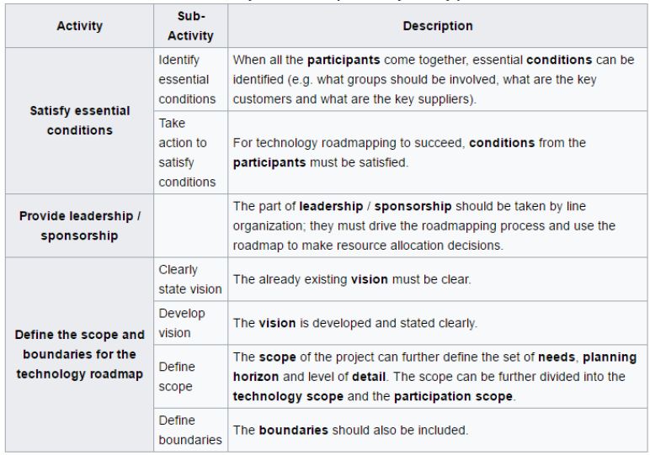
Phase 1: Preliminary phase

Slide 7
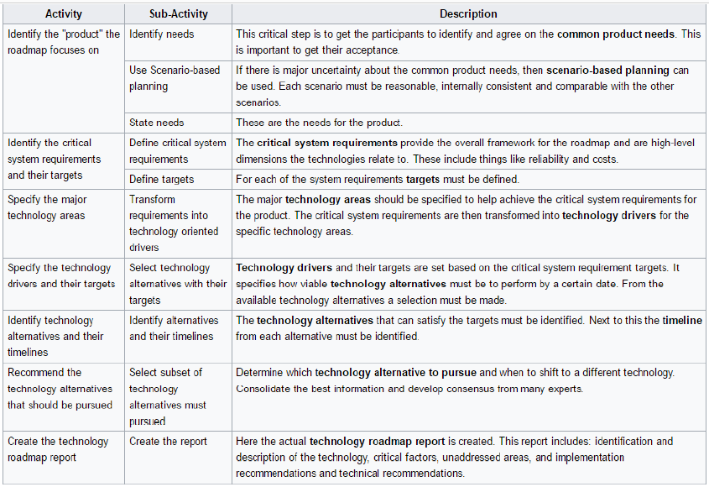
Phase 2: Development phase

Slide 8
Phase 3: Follow-up activity phase
This is the moment when the roadmap must be critiqued, validated and hopefully accepted by the group involved in any implementation.
This requires a plan developed using the technology roadmap.
Next, there must be a periodical review and update point, because needs from the participants and the technologies evolve.

Slide 9
TRM Application Areas(1)
Product Planning
Example
A Philips roadmap, where the approach has been widely adopted.
The example shows how roadmaps are used to link planned technology and product developments.

Slide 10
TRM Application Areas(2)
2. Service/capability Planning
Example
A Post Office roadmap used to investigate the impact of technology developments on the business.
This roadmap focuses on organizational capabilities as the bridge between technology and the business, rather than products.

Slide 11
TRM Application Areas(3)
3. Strategic Planning
Example
A roadmap format developed using TPlan to support strategic business planning.
The roadmap focuses on the development of a vision of the future business, in terms of markets, business, products, technologies, skills, culture, etc.
Gaps are identified, by comparing the future vision with the current position, and strategic options explored to bridge the gaps.

Slide 12
TRM Application Areas (4)
4. Long-range Planning
Example
A roadmap developed within the US Integrated Manufacturing Technology Roadmapping (IMTR) Initiative (one of a series).
This example focuses on information systems, showing how technology developments are likely to converge towards the ‘information driven seamless enterprise’ (a ‘nugget’).

Slide 13
TRM Application Areas (5)
5. Knowledge asset-planning
Example
This form of roadmap has been developed by the Artificial Intelligence Applications Unit at the University of Edinburgh, enabling organizations to visualize their critical knowledge assets, and the linkages to the skills, technologies and competences required to meet future market demands

Slide 14
TRM Application Areas (6)
6. Programme Planning
Example
A NASA roadmap (one of many) for the Origins programme, used to explore how the universe and life within it has developed.
This particular roadmap focuses on the management of the development programme for the Next Generation Space Telescope (NGST), showing the relationships between technology development and programme phases and milestones.

Slide 15
TRM Application Areas (7)
7. Process Planning
Example
A type of technology roadmap, developed using T-Plan to support product planning.
Focusing on the knowledge flows that are needed to facilitate effective new product development and introduction, incorporating both technical and commercial perspectives

Slide 16
TRM Application Areas (8)
8. Integration Planning
Example
A NASA roadmap7, relating to the management of the development programme,
Focusing on ‘technology flow’, showing how technology feeds into test and demonstration systems, to support scientific missions.

Slide 17
TRM Format(1)
1. Multiple layers
Example
A Philips roadmap, showing how product and process technologies integrate to support the development of functionality in future products.

Slide 18
TRM Format(2)
2. Bars
Example
The ‘classic’ Motorola roadmap, showing the evolution of car radio product features and technologies.
Motorola has subsequently developed roadmapping to new levels, with roadmaps now forming part of corporate knowledge and business management systems, supported by software and integrated decision support systems.

Slide 19
TRM Format(3)
3. Tables
Example
A tabulated roadmap, including both product and technology performance dimensions

Slide 20
TRM Format(4)
4. Graphs
Example
roadmap showing how a set products and technologies co-evolve.

Slide 21
TRM Format(5)
5. Pictorial representations
Example
A Sharp roadmap, relating to the development of products and product families, based on a set of liquid crystal display technologies.

Slide 22
TRM Format(6)
6. Flow charts
Example
A NASA roadmap11, showing how the organization’s vision can be related to its mission, fundamental scientific questions, primary business areas, near-, mid- and long-term goals, and contribution to US national priorities.

Slide 23
TRM Format(7)
6. Single layer
Example
The Motorola roadmap, type ‘2’ above, is an example of a single layer roadmap, focusing on the technological evolution associated with a product and it’s features.
This form is a subset of type ‘1’, focusing on a single layer of the multiple layer roadmap.
While less complex, the disadvantage of this type is that the linkages between the layers are not generally shown.

Slide 24
TRM Format(8)
8. Text
Example
The Agfa ‘white papers’ support understanding of the technological and market trends that will influence the sector.

Slide 25
TRM T-Plan ‘fast-start’ approach
T-Plan approach aims to:
1. Support the start-up of company-specific TRM processes.
2. Establish key linkages between technology resources and business drivers.
3. Identify important gaps in market, product and technology intelligence.
4. Develop a ‘first-cut’ technology roadmap.
5. Support technology strategy and planning initiatives in the firm.
6. Support communication between technical and commercial functions.
The T-Plan process supports the rapid initiation of roadmapping in the business comprises two main parts:
a. Standard approach, for supporting product planning.
b. Customized approach, which includes guidance on the broader application of the method, incorporating many of the techniques included in the standard approach.

Slide 26
Challenges to overcome
Keeping the roadmap alive
Roll-out

Slide 27
15 mins break

Slide 28
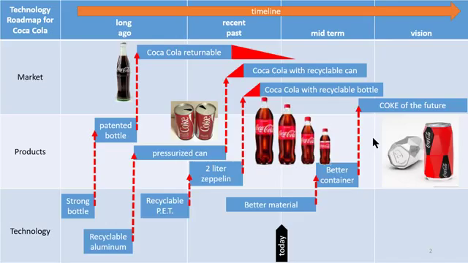
Technology Roadmap Storytelling

Slide 29
Thank you!

