Slide 1


Technology Management MBAB821
Staying afloat within the 4IR Era
Presented by
Dr Makaziwe (CSIR/Department of Communications and Digital Technologies)
Facilitated by Kaizer
collaboration
agility
innovation
impactful
integrity
visionary

Slide 2




What is an industrial revolution?
When there are major changes in...
Industry
Economy
Transportation
Society (social structure)
The way we work, buy
and sell things
The way we travel
The way we live
It’s usually new ways of thinking and doing and new technologies that cause the change to happen.

Slide 3



Number of industrial revolutions so far?
3
And we are now starting number 4. It is changing...
The way we work, buy
and sell things
The way we travel
The way we live
4th Industrial Revolution

Slide 4
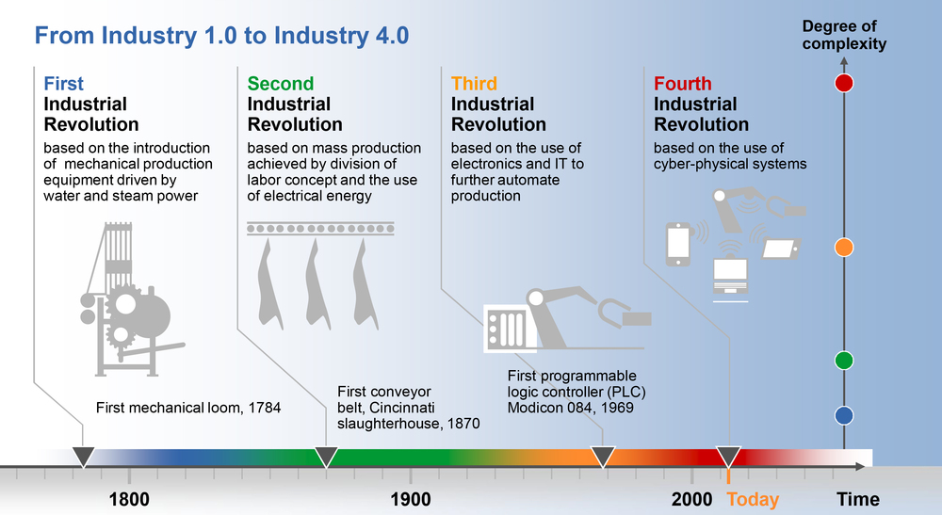
HEADING: 2030 COVFEFE

Slide 5
HEADING: 2030 COVFEFE

Slide 6
HEADING: 2030 COVFEFE

Slide 7
HEADING: 2030 COVFEFE

Slide 8

4th Industrial Revolution
What’s happening?
Different technologies are coming together
(convergence)
This is bringing different areas together
Physical
Digital
Biological
This affects social & economic sectors
The way we work, buy
and sell things
The way we travel
The way we live

Slide 9
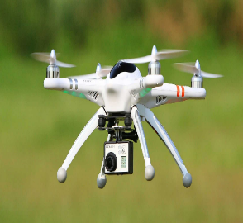
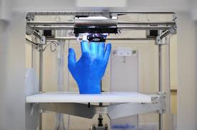
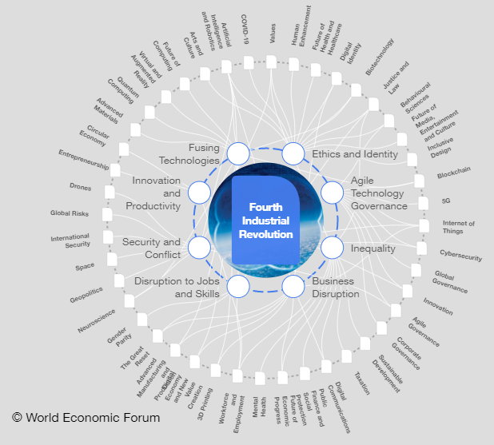

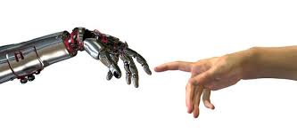

Slide 10

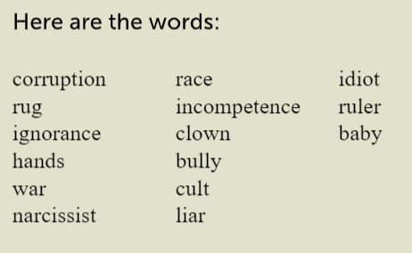
3min – BrainHQ Challenge

Slide 11
How many words did you rewrite correct?
Be innovative and execute quickly

Slide 12
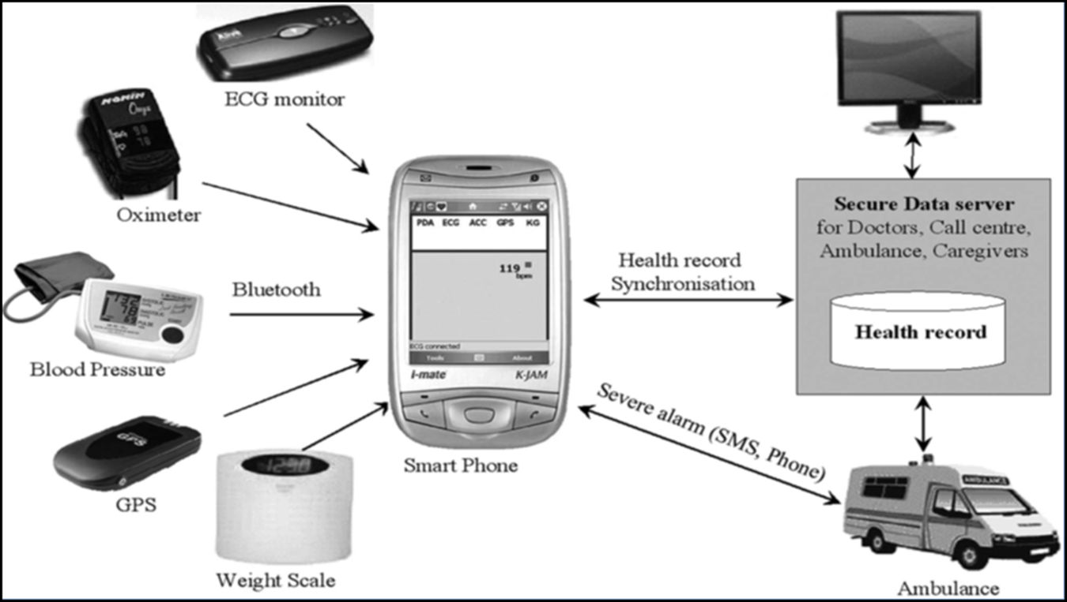
The 4IR is in your pocket

Slide 13


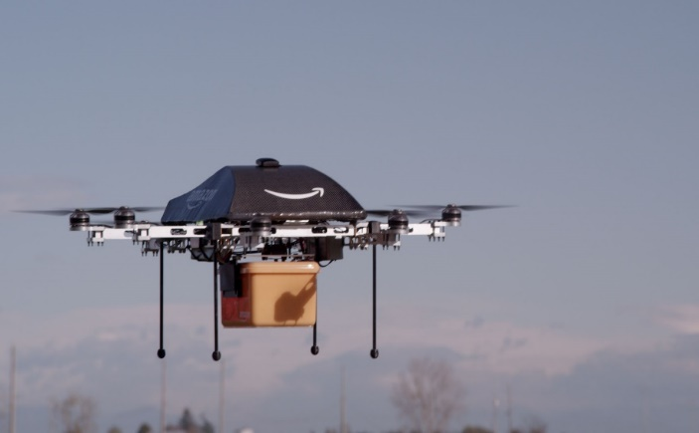



Changes for Better
Education and access to information
The social media revolution has given everyone a voice
Online shopping and delivery - Are already redefining convenience and the retail experience.
Advances in biomedical sciences can lead to healthier lives and longer life spans.

Slide 14

Changes for Worse
Innovations in robotics and automation can lead to lost jobs
Artificial intelligence, robotics, bioengineering, leads to creation on mass destruction weapons.
Social media intensify the social divide (increase cyber-bullying, hate speech, and spreading false stories.)

Slide 15
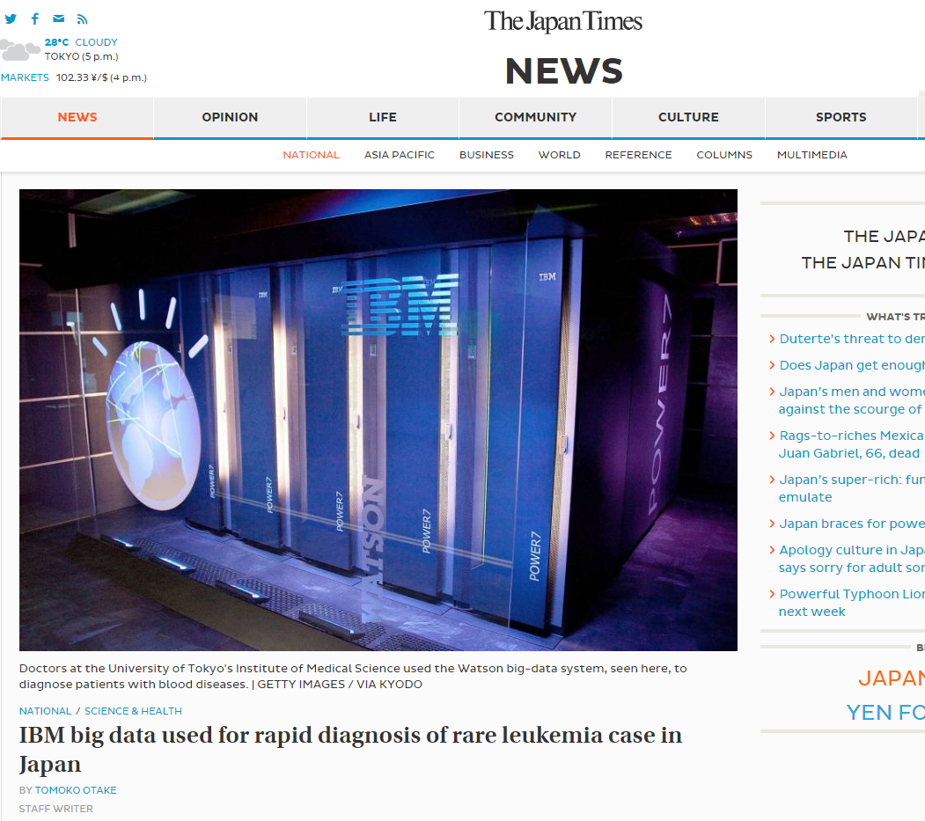
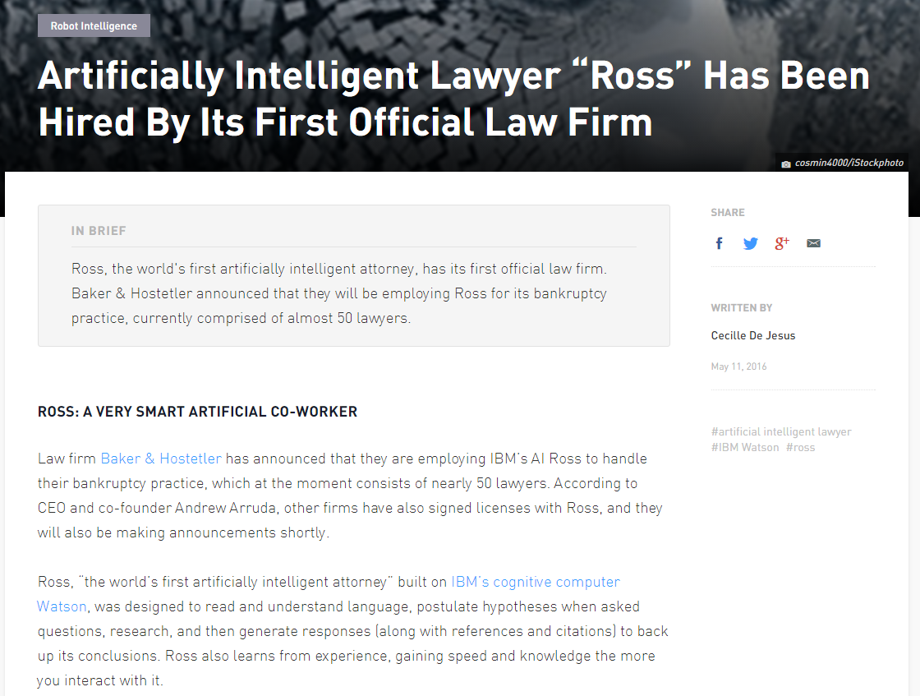
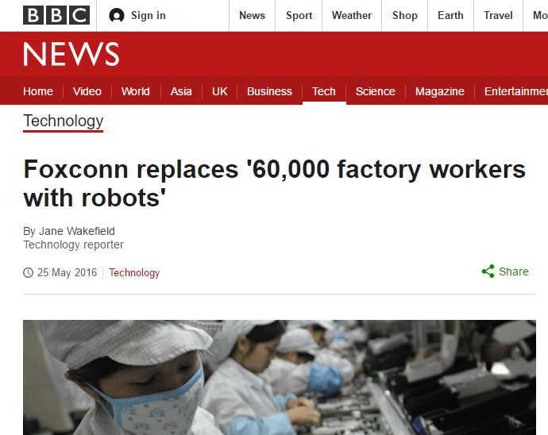

Slide 16


4IR is disruptive & affects everything
All industries are being impacted by this disruption
We have to consider:
Focus on developing skills
Defining new governance models for the 4IR
Based on partnerships across all stakeholders.
  This will be necessary to ensure it is a sustainable revolution.

Slide 17
Critical skills needed
Critical thinking
Communication
Collaboration and teamwork
Complex problem solving
Creativity
Emotional intelligence
Global awareness
Financial, economic, business and entrepreneurial literacy
Civic literacy
Health literacy
Environmental literacy
Computational thinking
Judgement and decision making
Service orientation
Negotiating
Cognitive flexibility
Influence curriculum
Influence approaches to
teaching & learning
New skills and competencies required

Slide 18











•
–
–
–
–
–
–
–
–

Slide 19







•
•

Slide 20





















•
•
•

Slide 21













•
–
–
–
–
–

Slide 22




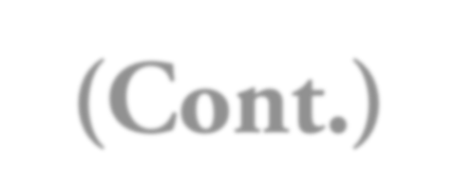







•
–
–
–
–
–

Slide 23




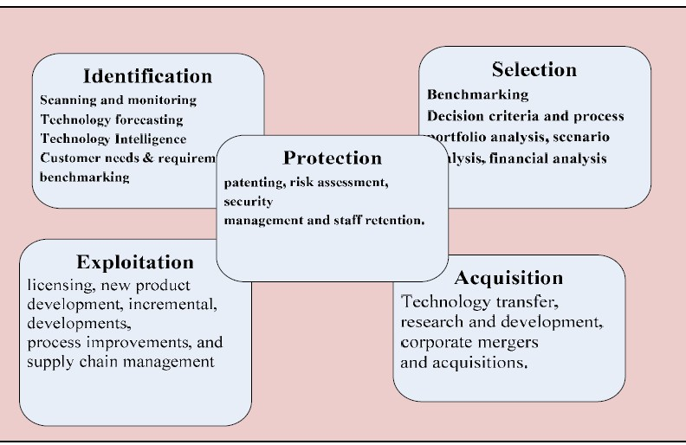
Gregory’s (1995) five step model

Slide 24


•
•
•
•
•
•
•
•
•
•
•

Slide 25
The course in context
Objective of the course:
  To teach the student how to use and manage technology for ultimate success
How will this be achieved?
  Digitization & Innovation will be discussed in detail
  Specific new technologies will be discussed
  Review specific case studies (Prescribed book)
  Class discussions of the abovementioned cases
  Group presentations
Contact
  1 session during the study school
  8 contact sessions

Slide 26
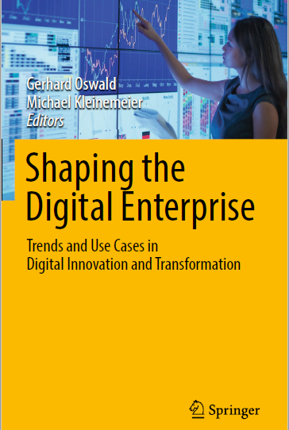
Prescribed book available on efundi under resources

Slide 27
The course in context - continued
To pass the course you have to:
  Hand in assignments and demonstrate participation in class activities:
    Individual assignment – 50%
    Group assignments – 50%
    The above contributes to 50% of final mark
  PoE/Online Exam/Case Study – 50% continuation to final mark
    Take home/Open book – 4 hours
    Based on one or two of the cases discussed during the semester

Slide 28
The course in context - continued
Who am I:
  Dr Nkanyiso Ndlovu preferred name Kaizer
  PhD in Computer Science/ Master in Business Administration
  Java & CCNA/CCNP certfied
  Very interested in ICT4D, Big Data, Wireless Sensor Networks
  Hobbies: Watching soccer EPL – An Arsenal FC fan
  Email: 35181680@nwu.ac.za

Slide 29
The course in context - continued
Code of conduct:
  Avoid being late for class – we are already behind
  Always attend class – make arrangements if it is impossible to attend
  A class register will be maintained
  Only one discussion during lectures
  I encourage teamwork and group discussions
  Work hard – the course will be challenging!
  Enjoy yourself!

Slide 30
Individual assignment
          TOTAL 100 points.

Slide 31
GROUP assignment
          TOTAL 100 points.
          Class group assignments that would contribute to the final mark during different lectures

Slide 32
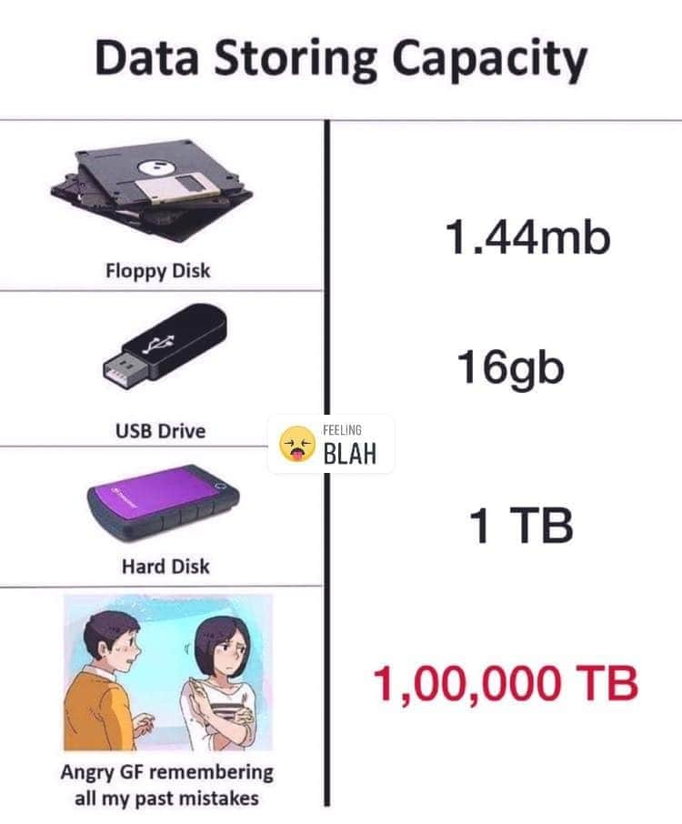
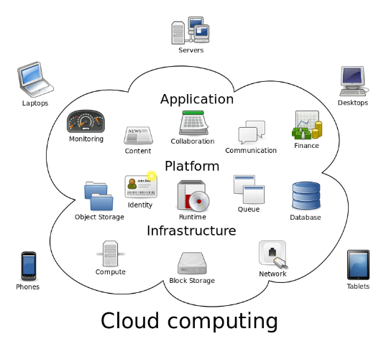
BACKUP YOUR WORK

Slide 33
Examination – important points
Point 1: The online exam is 4 hours and it is open book
Point 2: The exam will draw on all the case studies discussed in class
Point 3: Use diagrams where possible – you will be credited for this
Point 4: Answer questions in point form/ be brief and to the point – elaborate discussion will be penalised
Point 5: If I cannot read your handwriting you will loose points for obvious reasons
Point 6: Watch the time – a 10 point question should use 10% of the time, e.g. 10% of 4 hours – 24 minutes
Point 7: If you attend class and you participate the exam question will NOT be a surprise
Point 8: Total exam marks = 100

Slide 34
Logistics
Each group to supply me with the following information:
  Group name
  Each group member: Name, Student number, contact details

Slide 35
T H A N K Y O U
Baie dankie
KE A LEBOGA

