Slide 1



MBAC811
NWU Business School
Prof Ronnie Lotriet
Making the Most of your Course Tools

Slide 2
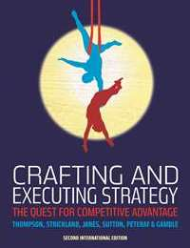
Connect® is Required for this course
MBAC811
1st Semester 2021
Crafting and Executing Strategy
Janes
– includes Connect with SmartBook

Slide 3


What is Connect®?
What are my purchase options?
How do I register?
How can I get support?

Slide 4


What is Connect®?
Connect is an online home for all your course resources.
Assignments
Adaptive eBook
Study Tools

Slide 5
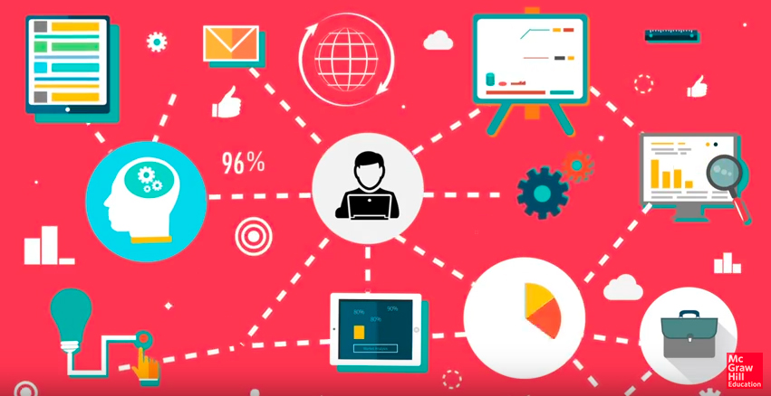


Connect includes SmartBook
SmartBook identifies what you know and don’t know and then tailors the study session to your knowledge gaps, creating an adaptive and personalized experience.
Notes:
https://www.youtube.com/watch?v=vHS2DMZUrtA

Slide 6



Purchase Options
OPTION 1
OPTION 2
• Connect: digital only
• Connect + print textbook
+
Visit the bookshop and purchase a standalone Connect code or purchase online
Access:
Assignment & Coursework
SmartBook
  Visit your bookshop and purchase a shrink-wrap bundle, consisting of a hardcopy textbook as well as Connect Access code

Slide 7

How to Register

Slide 8
How to Register
1. Copy and paste the below URL into your browser.
http://connect.mheducation.com/class/r-lotriet-overview-of-strategy

Slide 9
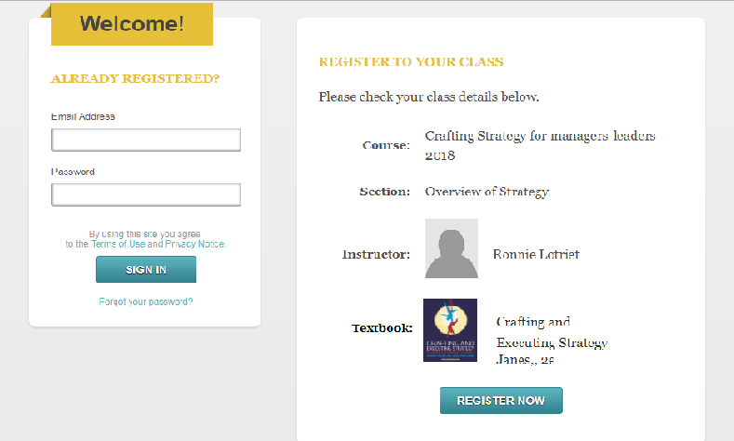
How to Register
Click on Register now.
Enter your email address.
IF
You have used the system before it will recognise your email and
ask for a password
3. Click submit

Slide 10
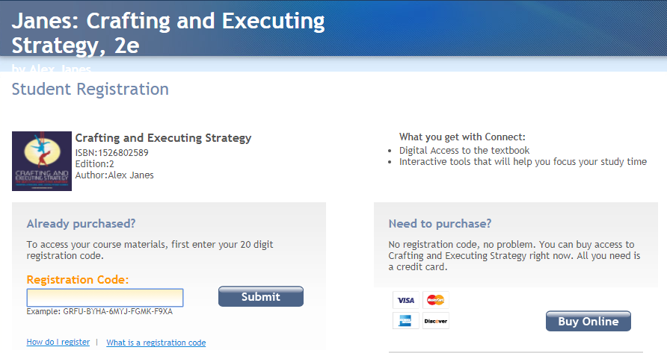
How to Register
Option 1 - enter your code purchased
Option 2 – purchase online

Slide 11
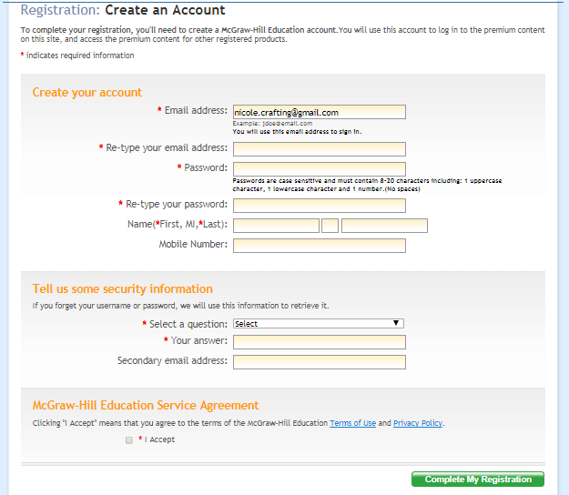
How to Register
Complete the registration form

Slide 12
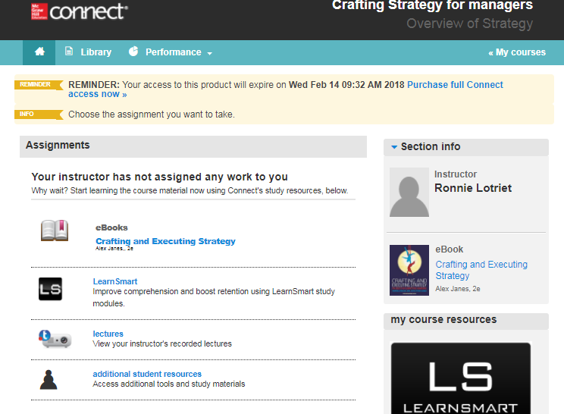
Welcome to Connect

Slide 13
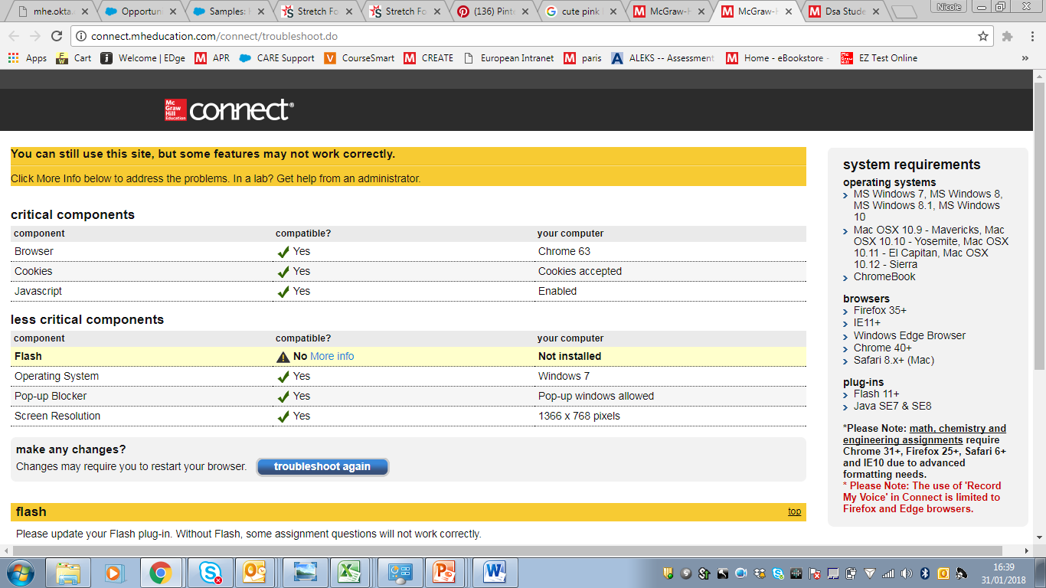
Ensure your device is compatible – bottom of Connect – click on troubleshooting

Slide 14
Support
Need help? Connect with
McGraw-Hill Education
SAsupport@mheducation.com
Please include in your email:
Course you are doing
Description of error or photo of error message

