Slide 1
ENTREPRENEURSHIP
MBAD823
Prof Stéphan van der Merwe
Contact Session 4, 2021

Slide 2


ENTREPRENEURSHIP 2021

Slide 3
Introduction to Entrepreneurship
Entrepreneurial mind and fit
Idea generation
Design thinking
Lean start-up & Agile development
Entrepreneurial process
Feasibility & planning
Family businesses
Women entrepreneurship
Corporate entrepreneurs
Logic & Effectuation
Social entrepreneurship
Entrepreneurial ecosystems
Managing the business
PREDICTIVE VS.
CREATIVE LOGIC

Slide 4
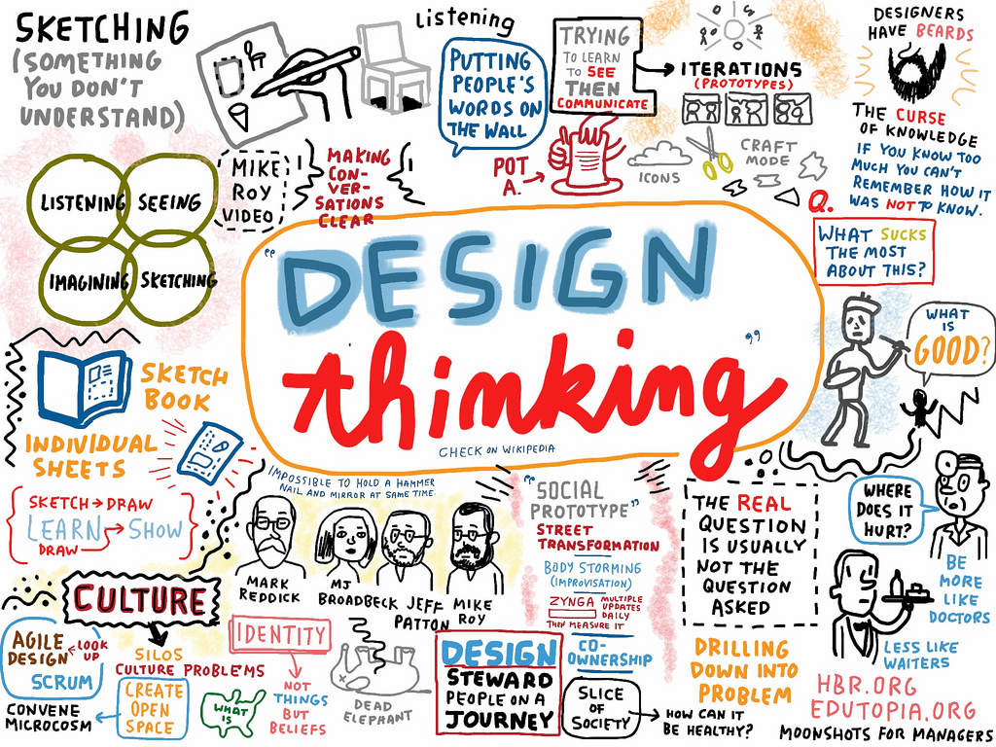
DESIGN THINKING – PART 1

Slide 5
DESIGN THINKING
CONTEXTUALISATION

Slide 6
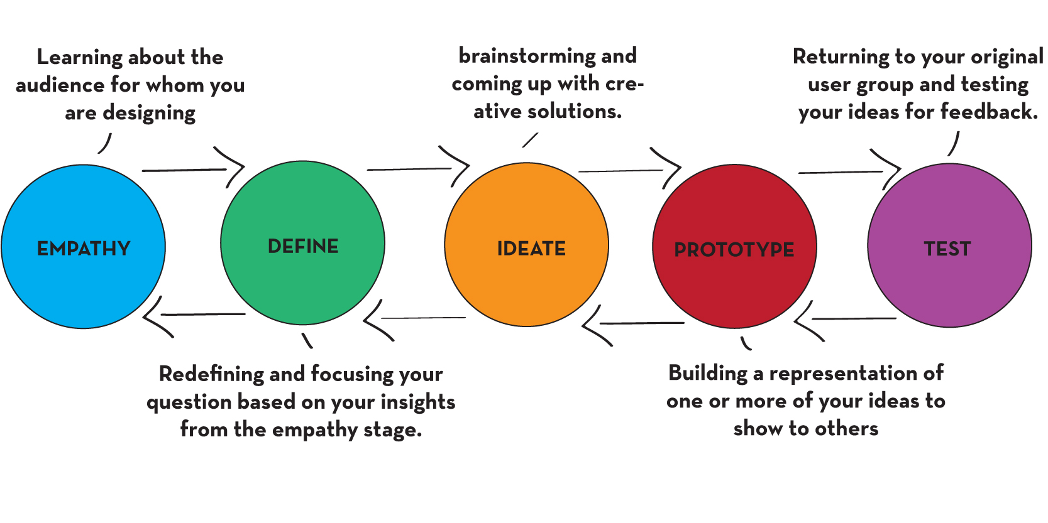
DESIGN THINKING DEFINED
Human-centered process that can lead to new forms of value.
Design thinking encourages the creation of new opportunities.
It’s a methodology that demands practice.

Slide 7
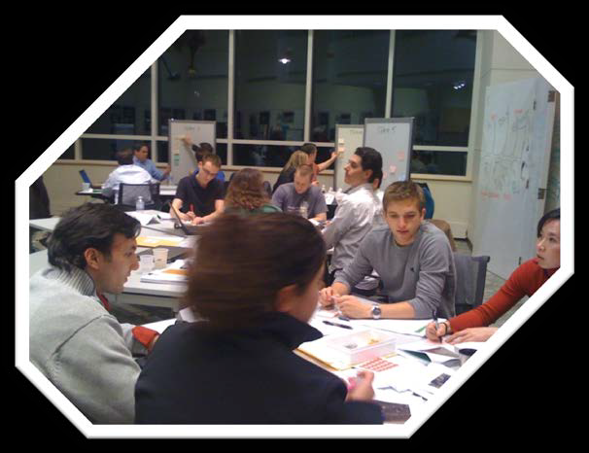

LEARNING OBJECTIVES
Practice design thinking and see connections to entrepreneurship.
Develop ideas to enhance the entrepreneurship education experience of students.
Play and have fun!

Slide 8

HUMAN-CENTERED APPROACH
Start here
Desirability
Viability
Feasibility
Source: IDEO Human Centered Design Toolkit
Final solution should be at the intersection

Slide 9
UNDERSTANDING HUMAN BEHAVIOUR
Piano stairs - TheFunTheory.com - Rolighetsteorin.se

Slide 10


DESIGN THINKING PROCESS
Opportunity Spaces
Brainstorming
Idea Shaping
DIVERGENCE
CONVERGENCE
WHAT’S THE PROBLEM?
HOW CAN WE
MAKE IT BETTER?
Inspiration (Empathize)
Ideation (Create)
Implementation (Test)
HOW MIGHT WE SOLVE THE PROBLEM?
Framing design challenge
Observation
Insight Development
Prototype
Experiment
Learn
Repeat

Slide 11

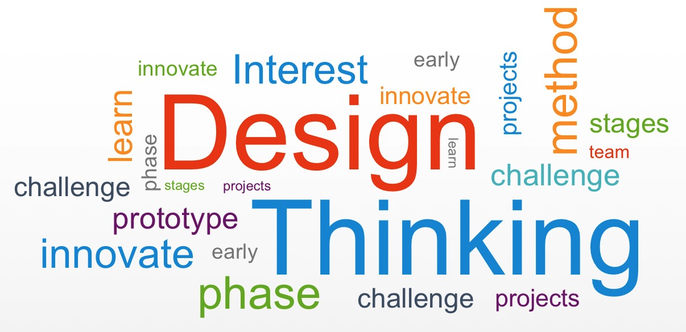
DESIGN THINKING PROCESS

Slide 12
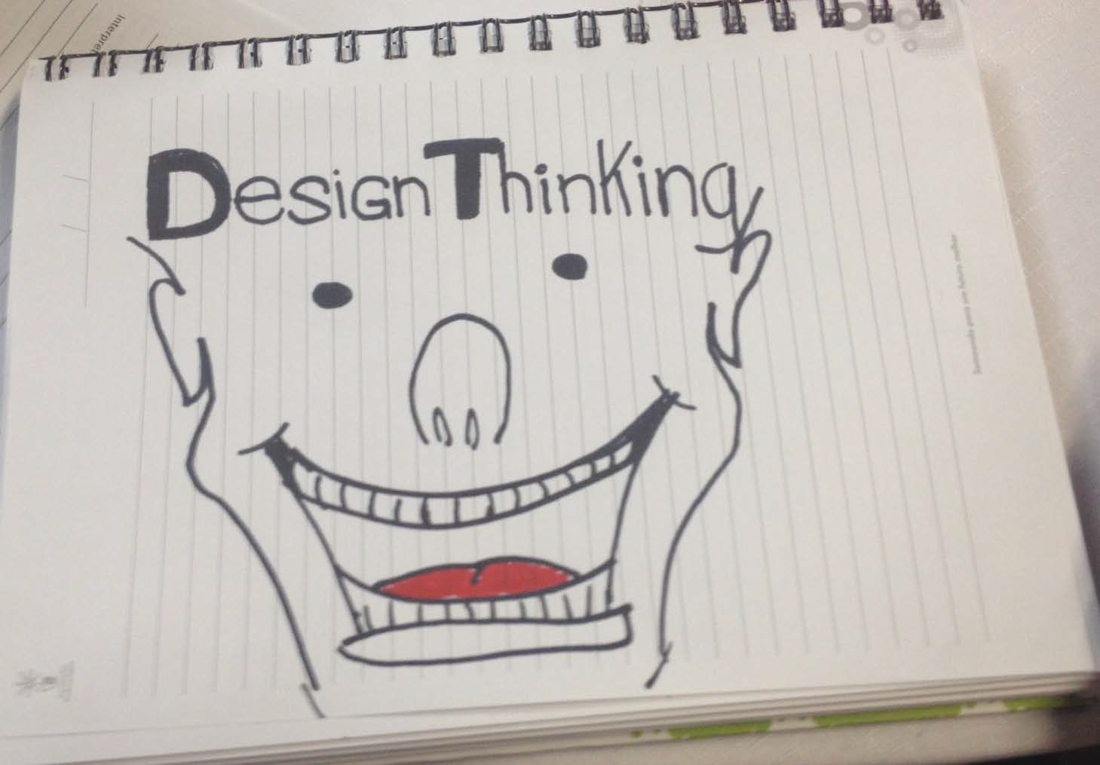
ARE YOU READY?

Slide 13
DESIGN THINKING
PHASE 1:
FRAMING AND UNDERSTANDING THE CHALLENGE

Slide 14
DESIGN THINKING PROCESS
Opportunity Spaces
Brainstorming
Idea Shaping
DIVERGENCE
CONVERGENCE
WHAT’S THE PROBLEM?
HOW CAN WE
MAKE IT BETTER?
Inspiration (Empathize)
Ideation (Create)
Implementation (Test)
HOW MIGHT WE SOLVE THE PROBLEM?
Framing design challenge
Observation
Insight Development
Prototype
Experiment
Learn
Repeat

Slide 15


BEGIN WITH FRAMING A
DESIGN CHALLENGE
Framed in human terms (desirability).
Broad enough to allow you to uncover unexpected areas of value.
Narrow enough to be manageable.
?

Slide 16
TYPICAL ENTREPRENEURSHIP COURSES
BEFORE 1990 & TODAY?
Before 1990 | Today
Are you an entrepreneur? | Are you an entrepreneur?
How to start or run a new or small business | How to start or run a new or small business
Business plan | Business plan
Growing a small/new business | Growing a small/new business
Most courses
Are electives
Case method
dominates
All courses
Are electives
Case method
dominates

Slide 17

THE BOTTOM LINE…
Entrepreneurship education has not changed much over 30 years!

Slide 18
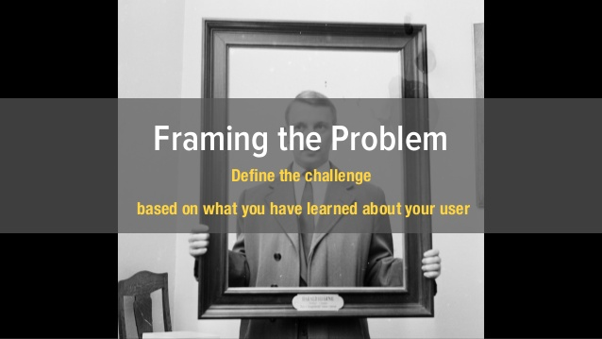
BEGIN WITH FRAMING A
DESIGN CHALLENGE
?

Slide 19


ENTREPRENEURSHIP EDUCATION DESIGN CHALLENGE
Framed in human terms (desirability)
Broad enough to allow you to uncover unexpected areas of value
Narrow enough to be manageable
How might we enhance the entrepreneurship education experience of students?

Slide 20
DESIGN THINKING PROCESS
Opportunity Spaces
Brainstorming
Idea Shaping
DIVERGENCE
CONVERGENCE
WHAT’S THE PROBLEM?
HOW CAN WE
MAKE IT BETTER?
Inspiration (Empathize)
Ideation (Create)
Implementation (Test)
HOW MIGHT WE SOLVE THE PROBLEM?
Framing design challenge
Observation
Insight Development
Prototype
Experiment
Learn
Repeat

Slide 21

DESIGN THINKING REQUIRES ACTION-BASED, QUALITATIVE RESEARCH
Observation
Shadowing
1:1 Interviewing
Self documentation
Group interviewing

Slide 22

OBSERVATION IS AT THE CORE OF DESIGN THINKING
Why: To identify needs NOT solutions
Who: All scholars/ students
How: AEIOU (Activities, Environment, Interactions, Objects, Users) Framework

Slide 23
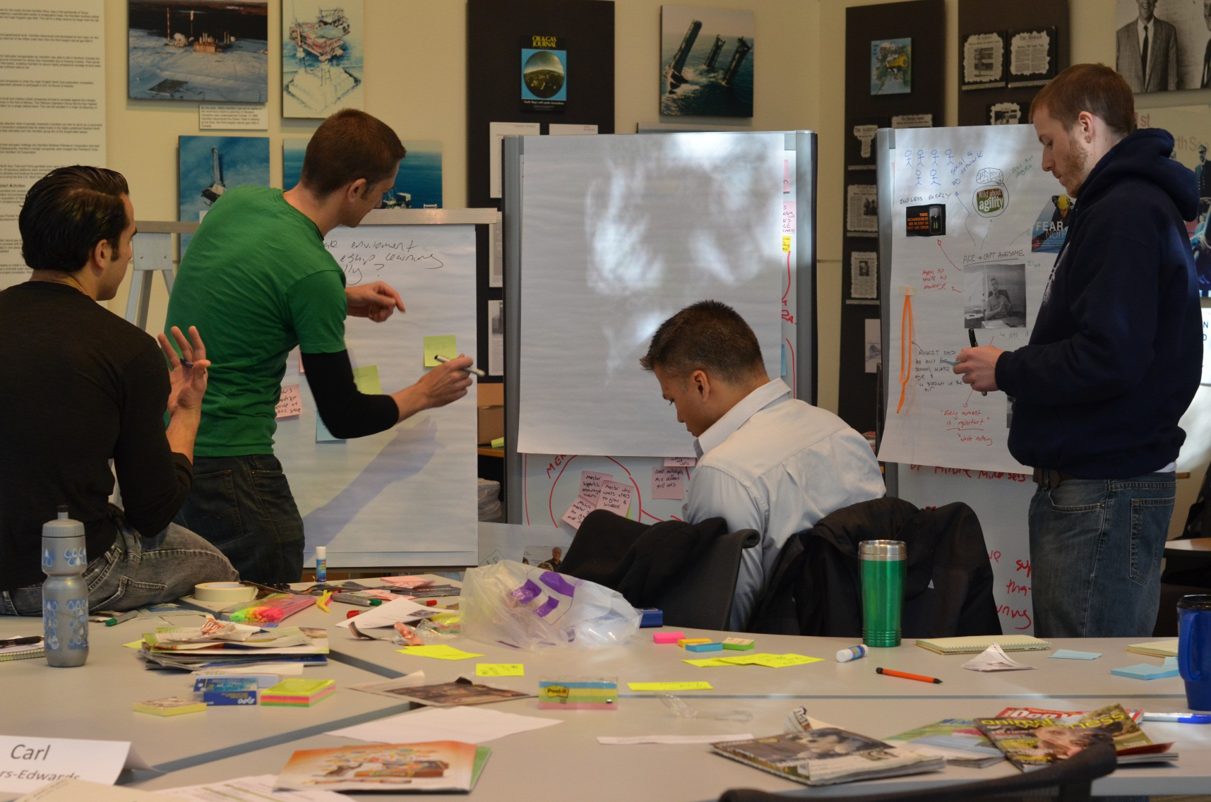
EXAMPLE: WHAT DO YOU OBSERVE?

Slide 24

A E I O U OBSERVATION FRAMEWORK
• Activities WHAT ARE PEOPLE DOING?
• Environment HOW ARE PEOPLE USING THE ENVIRONMENT? WHAT IS THE ROLE OF THE ENVIRONMENT?
• Interactions DO YOU SEE ANY ROUTINES? DO YOU OBSERVE SPECIAL INTERACTIONS
BETWEEN PEOPLE? BETWEEN PEOPLE & OBJECTS?
• Objects WHAT’S THERE AND BEING USED OR NOT USED? DESCRIBE ENGAGEMENT
WITH OBJECTS
• Users WHO ARE THE USERS? WHAT ARE THEIR ROLES? LOOK FOR EXTREME USERS

Slide 25

OBSERVATION PRACTICE 2
Activities
Environment
Interactions
Objects
Users

Slide 26

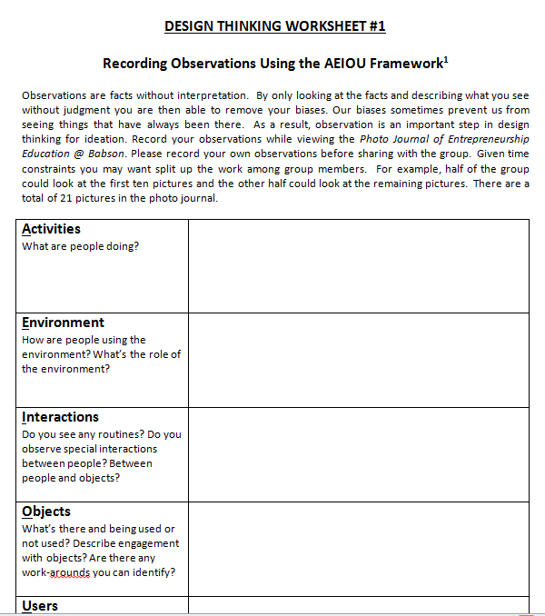

EXERCISE 1: OBSERVATION
Record your observations from the photo journal using worksheet #1

Slide 27
DESIGN THINKING PROCESS
Opportunity Spaces
Brainstorming
Idea Shaping
DIVERGENCE
CONVERGENCE
WHAT’S THE PROBLEM?
HOW CAN WE
MAKE IT BETTER?
Inspiration (Empathize)
Ideation (Create)
Implementation (Test)
HOW MIGHT WE SOLVE THE PROBLEM?
Framing design challenge
Observation
Insight Development
Prototype
Experiment
Learn
Repeat

Slide 28
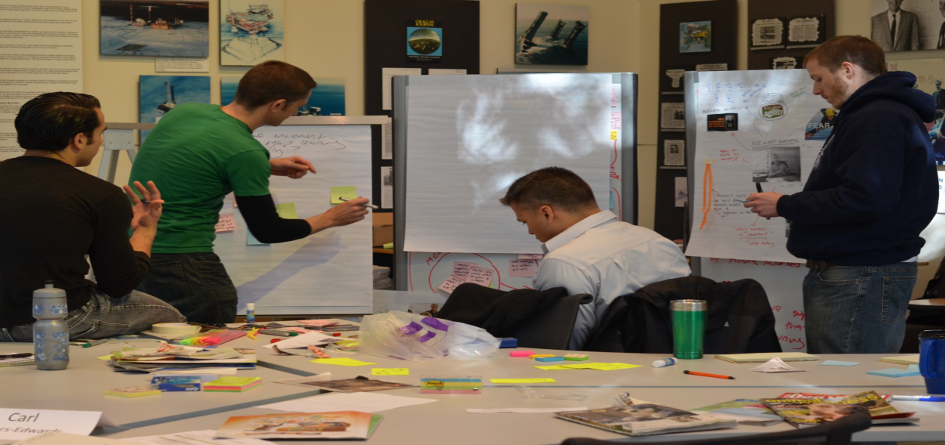

WHAT IS AN INSIGHT?
Observation:
Students are working in a team outside of a traditional classroom.
Insight:
Students often appear more engaged in learning outside of a traditional classroom.
Observation:
People are using the escalator.
Insight:
People opt for convenience over health.

Slide 29
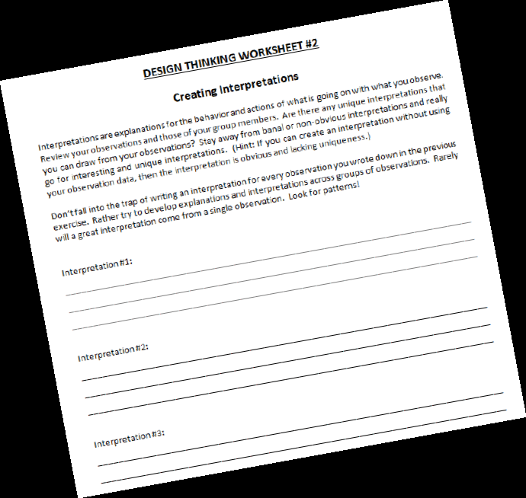
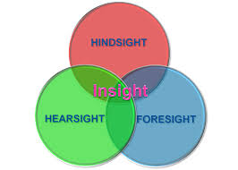
EXERCISE 2: CREATE INSIGHTS
Develop insights based on observations

Slide 30
EXERCISE 3: CHOOSE YOUR BEST INSIGHT
Revisit all insights
& record ONE on your flipchart
(agree on your most interesting and non-obvious interpretation)

Slide 31
DESIGN THINKING PROCESS
Opportunity Spaces
Brainstorming
Idea Shaping
DIVERGENCE
CONVERGENCE
WHAT’S THE PROBLEM?
HOW CAN WE
MAKE IT BETTER?
Inspiration (Empathize)
Ideation (Create)
Implementation (Test)
HOW MIGHT WE SOLVE THE PROBLEM?
Framing design challenge
Observation
Insight Development
Prototype
Experiment
Learn
Repeat

Slide 32
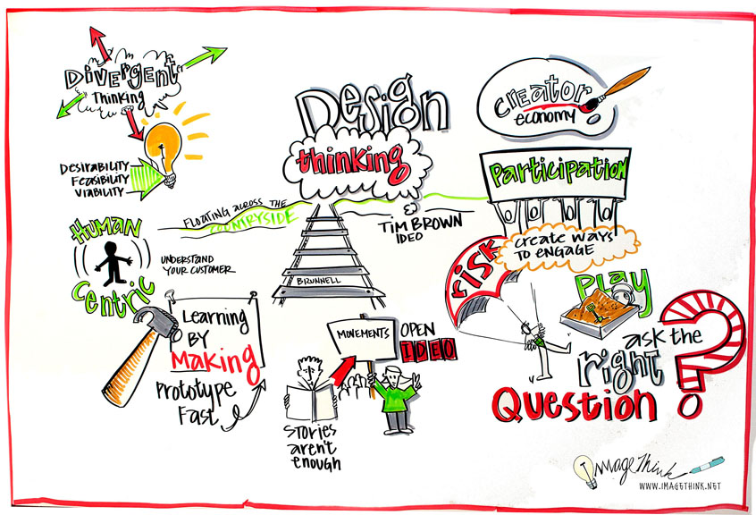
Thank you!!!

Slide 33

DESIGN THINKING – PART 2

Slide 34
Introduction to Entrepreneurship
Entrepreneurial mind and fit
Idea generation
Design thinking
Lean start-up & Agile development
Entrepreneurial process
Feasibility & planning
Family businesses
Women entrepreneurship
Corporate entrepreneurs
Logic & Effectuation
Social entrepreneurship
Entrepreneurial ecosystems
Managing the business
PREDICTIVE VS.
CREATIVE LOGIC

Slide 35
DESIGN THINKING
PHASE 2:
IDEATION

Slide 36
DESIGN THINKING PROCESS

Slide 37
DESIGN THINKING PROCESS
Opportunity Spaces
Brainstorming
Idea Shaping
DIVERGENCE
CONVERGENCE
WHAT’S THE PROBLEM?
HOW CAN WE
MAKE IT BETTER?
Inspiration (Empathize)
Ideation (Create)
Implementation (Test)
HOW MIGHT WE SOLVE THE PROBLEM?
Framing design challenge
Observation
Insight Development
Prototype
Experiment
Learn
Repeat

Slide 38

IDENTIFY OPPORTUNITY SPACES
Insight
Opportunity Spaces
How might we enhance
the entrepreneurship
education experience
of students?
Students often appear more engaged in learning
outside of a traditional
classroom.
Co-curricular activities
New types of classrooms
Student Engagement

Slide 39
OPPORTUNITY SPACE
Insight
Opportunity Spaces
Students often appear more engaged in learning
outside of a traditional
classroom.
Co-curricular activities
An area in which new ideas can be developed
It’s NOT a solution or an idea
It’s your “idea playing field” – the boundaries for your ideation
New types of classrooms
Student Engagement

Slide 40
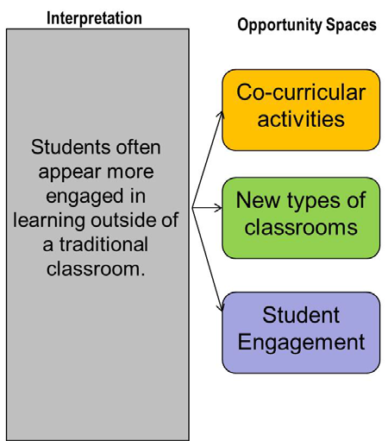

EXERCISE 4: OPPORTUNITY SPACES
What’s your opportunity space for your insight?
Exercise 4:
Choose your favourite space

Slide 41
DESIGN THINKING PROCESS
Opportunity Spaces
Brainstorming
Idea Shaping
DIVERGENCE
CONVERGENCE
WHAT’S THE PROBLEM?
HOW CAN WE
MAKE IT BETTER?
Inspiration (Empathize)
Ideation (Create)
Implementation (Test)
HOW MIGHT WE SOLVE THE PROBLEM?
Framing design challenge
Observation
Insight Development
Prototype
Experiment
Learn
Repeat

Slide 42

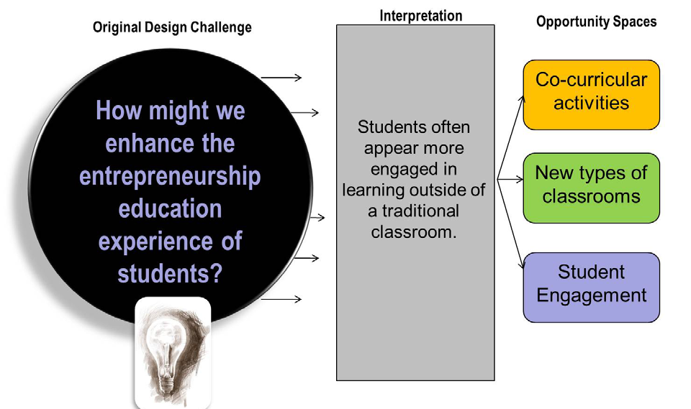

CREATE BRAINSTORMING QUESTION
Brainstorming Question
How might we enhance the education of entrepreneurship students through co-curricular activities?

Slide 43

EXERCISE 5: IDENTIFY THE BRAINSTORMING TOPIC
Brainstorming Question
?
Record YOUR group’s particular brainstorming questions?

Slide 44

THE BRAINSTORMING PROCESS

Slide 45



WARM UP EXERCISE

Slide 46




QUANTITY YIELDS QUALITY
Keep going when you think you are tapped out!
Do not go with your early ideas – least innovative

Slide 47
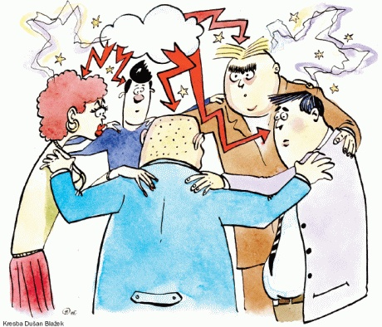

RULES FOR BRAINSTORMING
One idea at a time
Defer judgment
Encourage wild ideas
Build on the ideas of others – “yes, and”
Stay focused on the topic
Be visual
One conversation at a time
Go for quantity

Slide 48
EXERCISE 6: BRAINSTORM
Brainstorm as many ideas as possible to answer your brainstorming question.
One idea at a time
Defer judgment
Encourage wild ideas
Build on the ideas of others – “yes, and”
Stay focused on the topic
Be visual
One conversation at time
Go for quantity

Slide 49

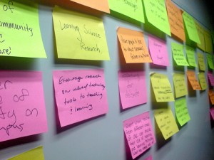
FOUR BASIC STEPS (1/4)
The first step involves individuals working on their own noting their ideas on Post-Its – one idea per Post-It.
When ready they stick their Post-Its onto a flip chart and review them as a group.
Duplicates are resolved and new ideas that arise are added as new Post-its.

Slide 50
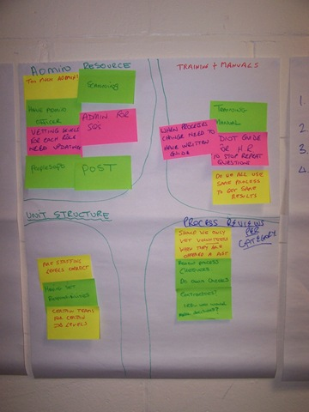
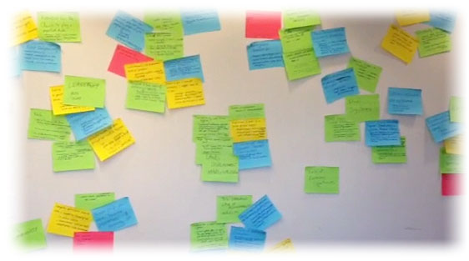
FOUR BASIC STEPS (2/4)
For the second step, the group discussion widens with a view to cluster the ideas into common themes.
The Post-Its are picked off and moved around to form collections or clusters of ideas.
When happy, a boundary could be drawn around these clusters. The group can also label the clusters.

Slide 51
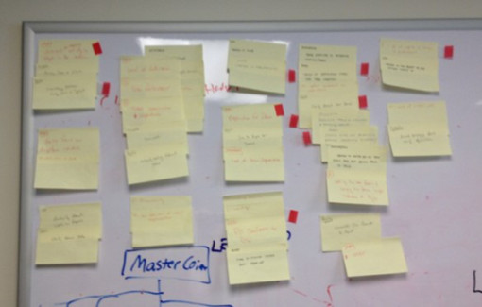

FOUR BASIC STEPS (3/4)
For the third step, the group have to choose their favourite or best cluster of ideas.
Each team member gets three votes.
Individually then, choose your top 3 ideas.
Use the stickers.
Identify then the ONE idea with the most votes.

Slide 52
FOUR BASIC STEPS (4/4)
For the fourth step, the group have to further refine their idea and start working towards the implementation phase.

Slide 53
DESIGN THINKING PROCESS
Opportunity Spaces
Brainstorming
Idea Shaping
DIVERGENCE
CONVERGENCE
WHAT’S THE PROBLEM?
HOW CAN WE
MAKE IT BETTER?
Inspiration (Empathize)
Ideation (Create)
Implementation (Test)
HOW MIGHT WE SOLVE THE PROBLEM?
Framing design challenge
Observation
Insight Development
Prototype
Experiment
Learn
Repeat

Slide 54
“IDEA SPACE” FOR IDEA SHAPING
It is ok to have your feet on the ground, but your eyes should be on the
big blue sky. Try some space exploration and re-enter with a more
attractive, bigger blue sky
“Spaced out ideas”
Grazy, laughable, whacky, supernatural, magical, nonsensical, absurd, ludicrous
Forward-looking, novel, different, unique, exciting, risky, fresh, progressive, thought-provoking
Blue Sky ideas
Grounded ideas
Safe, incremental, obvious, imitable, plain, predictable

Slide 55
“IDEA SPACE” FOR IDEA SHAPING
Grazy, laughable, whacky, supernatural, magical, nonsensical, absurd, ludicrous
“Spaced out ideas”
Elephant in the room
Forward-looking, novel, different, unique, exciting, risky, fresh, progressive, thought-provoking
Blue Sky ideas
Sensa-button
Programmable alarm
Safe, incremental, obvious, imitable, plain, predictable
Grounded ideas

Slide 56


Slide 57
“IDEA SPACE” FOR IDEA SHAPING
It is ok to have your feet on the ground, but your eyes should be on the
big blue sky. Try some space exploration and re-enter with a more
attractive, bigger blue sky
Grazy, laughable, whacky, supernatural, magical, nonsensical, absurd, ludicrous
“Spaced out ideas”
Teleport to decision
consequence
Forward-looking, novel, different, unique, exciting, risky, fresh, progressive, thought-provoking
Blue Sky ideas
Video game
Safe, incremental, obvious, imitable, plain, predictable
Grounded ideas
Video cases

Slide 58



EXERCISE 7: IDEA SPACE
In this exercise, the group have to choose one of the idea space categories (i.e. blue sky) to shape your idea into an implementable opportunity to solve the design thinking challenge - How might we enhance the entrepreneurship education experience of students?
Work on your favourite idea chosen in step 3 of the brainstorming exercise.

Slide 59
DESIGN THINKING
PHASE 3:
IMPLEMENTATION

Slide 60
DESIGN THINKING PROCESS

Slide 61
DESIGN THINKING PROCESS
Opportunity Spaces
Brainstorming
Idea Shaping
DIVERGENCE
CONVERGENCE
WHAT’S THE PROBLEM?
HOW CAN WE
MAKE IT BETTER?
Inspiration (Empathize)
Ideation (Create)
Implementation (Test)
HOW MIGHT WE SOLVE THE PROBLEM?
Framing design challenge
Observation
Insight Development
Prototype
Experiment
Learn
Repeat

Slide 62
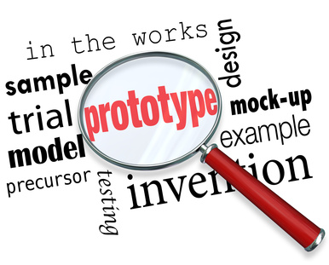
WHAT IS PROTOTYPING?

Slide 63

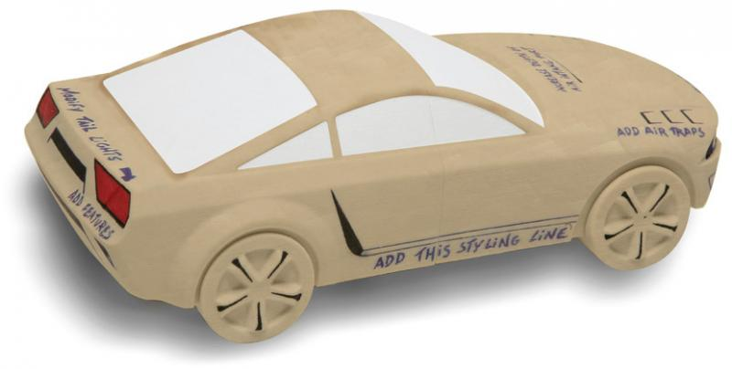
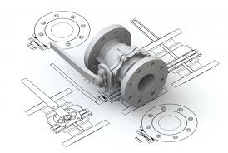
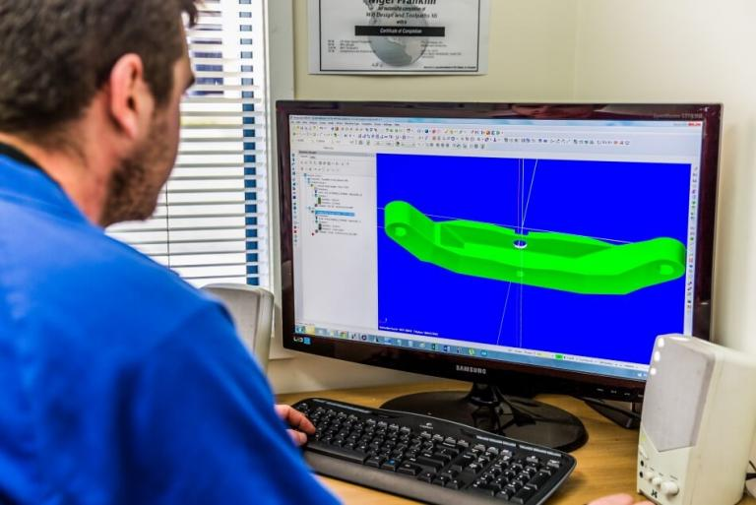
DIFFERENT FORMS OF PROTOTYPING

Slide 64
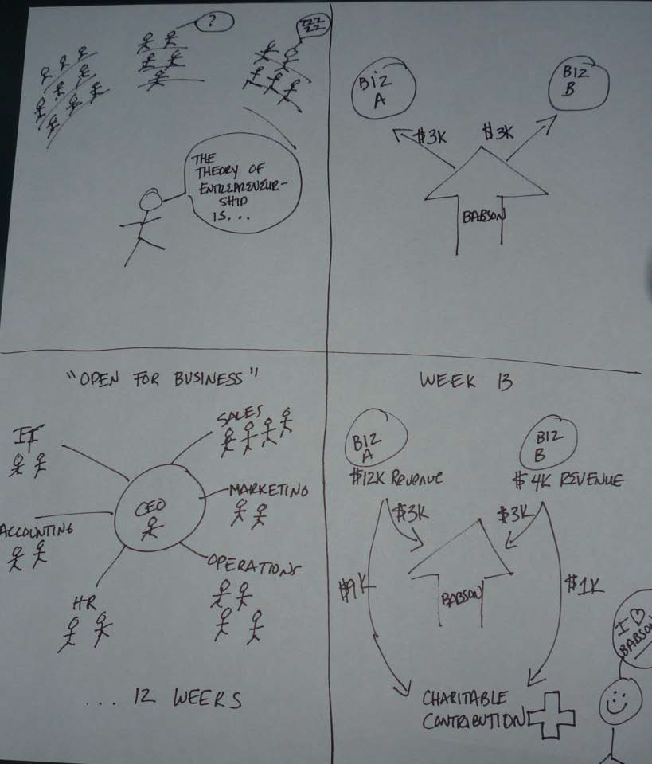

STORYBOARDING AS A FORM
OF PROTOTYPING
Shared understanding
Identify gaps
Basis for market testing

Slide 65
EXAMPLE STORYBOARD
Brainstorming topic:
How might we create a more realistic view of entrepreneurship for students working in a classroom environment?
Idea:
Course/module where students required to start a business

Slide 66
EXERCISE 8: STORYBOARD
Draw a storyboard of your favourite idea (the one with the highest number of votes)
Artistic ability is not required!

Slide 67
DESIGN THINKING PROCESS
Opportunity Spaces
Brainstorming
Idea Shaping
DIVERGENCE
CONVERGENCE
WHAT’S THE PROBLEM?
HOW CAN WE
MAKE IT BETTER?
Inspiration (Empathize)
Ideation (Create)
Implementation (Test)
HOW MIGHT WE SOLVE THE PROBLEM?
Framing design challenge
Observation
Insight Development
Prototype
Experiment
Learn
Repeat

Slide 68
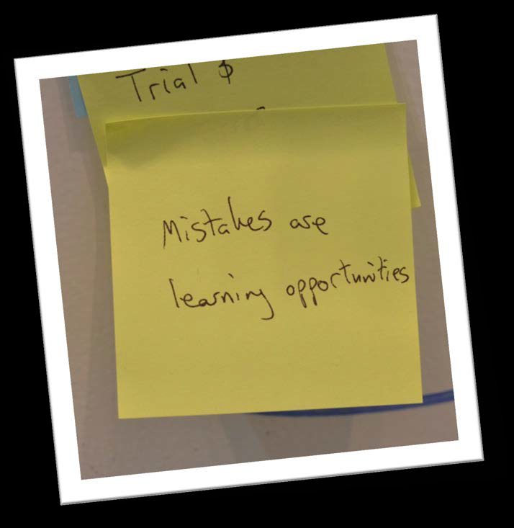
EXPERIMENTING
Experimentation is iterative
Early market tests
Determine what you want to test
Test, learn, repeat with next-level experiment

Slide 69

EXERCISE 9: DEVELOP AN EXPERIMENT
Design an early experiment to test part of your idea. The cost of the experiment cannot exceed R100
What question do you want to answer?
What hypothesis are your testing?
What action(s) will you take to answer the question?
Important:
An experiment does not test the WHOLE idea. Experiments test assumptions you have made about the idea.

Slide 70
DESIGN THINKING PROCESS
Opportunity Spaces
Brainstorming
Idea Shaping
DIVERGENCE
CONVERGENCE
WHAT’S THE PROBLEM?
HOW CAN WE
MAKE IT BETTER?
Inspiration (Empathize)
Ideation (Create)
Implementation (Test)
HOW MIGHT WE SOLVE THE PROBLEM?
Framing design challenge
Observation
Insight Development
Prototype
Experiment
Learn
Repeat

Slide 71

DESIGN THINKING PROCESS
Opportunity Spaces
Brainstorming
Idea Shaping
DIVERGENCE
CONVERGENCE
WHAT’S THE PROBLEM?
HOW CAN WE
MAKE IT BETTER?
Inspiration (Empathize)
Ideation (Create)
Implementation (Test)
HOW MIGHT WE SOLVE THE PROBLEM?
Framing design challenge
Observation
Insight Development
Prototype
Experiment
Learn
Repeat

Slide 72

Thank you!!!

Slide 73

DESIGN THINKING –
THE ROCKET PITCH

Slide 74
Introduction to Entrepreneurship
Entrepreneurial mind and fit
Idea generation
Design thinking
Lean start-up & Agile development
Entrepreneurial process
Feasibility & planning
Family businesses
Women entrepreneurship
Corporate entrepreneurs
Logic & Effectuation
Social entrepreneurship
Entrepreneurial ecosystems
Managing the business
PREDICTIVE VS.
CREATIVE LOGIC

Slide 75
DESIGN THINKING
THE ROCKET PITCH

Slide 76
PREPARATION
DESIGN THINKING AND ROCKET PITCH

Slide 77

THE ROCKET PITCH EVENT
Enhancing the Entrepreneurship Education Experience

Slide 78
THE ROCKET PITCH EVENT
Rocket Pitch:
Syndicate groups will rocket pitch their new, innovate “learning experience” that was developed during the Design Thinking lectures.
You will have 8 minutes to present your PowerPoint slides! You will be timed and asked to stop presenting if you exceed the allotted time. Each presentation will be followed by a 2-minute Q&A period.
Group Rocket Pitches must include the following:
Clear articulation of the idea
What problem does it solve in ……
How does it work?
What resources are needed to implement?
What value does it bring to ……
A short implementation plan with actionable steps

Slide 79

Thank you!!!

Slide 80
LEAN STARTUP

Slide 81
Introduction to Entrepreneurship
Entrepreneurial mind and fit
Idea generation
Design thinking
Lean start-up & Agile development
Entrepreneurial process
Feasibility & planning
Family businesses
Women entrepreneurship
Corporate entrepreneurs
Logic & Effectuation
Social entrepreneurship
Entrepreneurial ecosystems
Managing the business
PREDICTIVE VS.
CREATIVE LOGIC

Slide 82

THE LEAN STARTUP

Slide 83
STRUCTURE OF THIS SESSION
The lean startup defined.
The lean startup process.
Principles of lean startup.
The lean startup process.
The lean canvas.

Slide 84
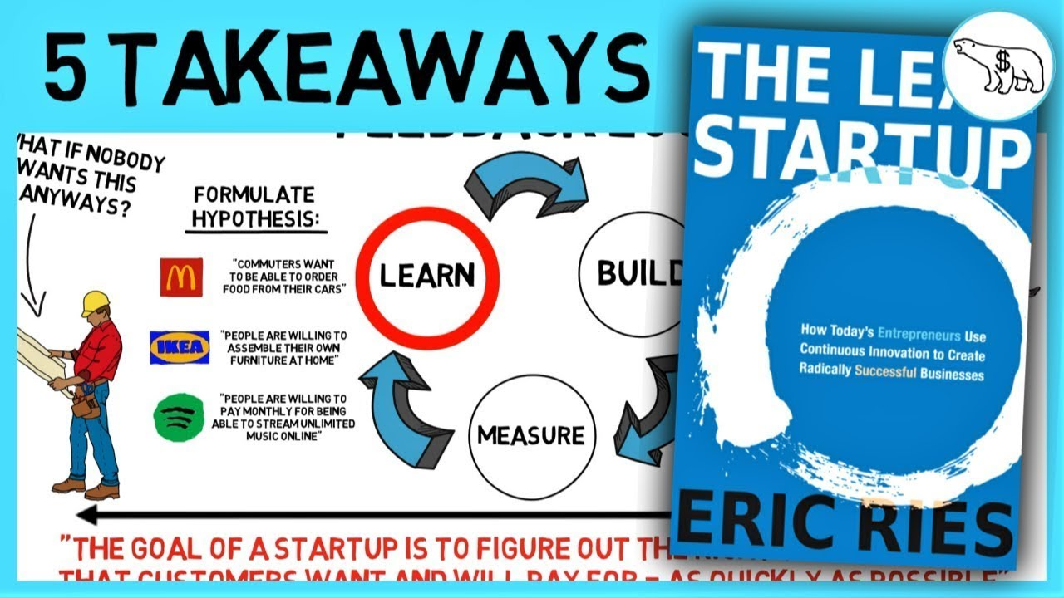
THE LEAN STARTUP

Slide 85
LEAN STARTUP DEFINED (1/2)
Lean startup is a methodology for developing businesses and products that aims to shorten product development cycles and rapidly discover if a proposed business model is viable.
This is achieved by adopting a combination of business-hypothesis-driven experimentation, iterative product releases, and validated learning.
A lean startup is a method used to found a new company or introduce a new product on behalf of an existing company. The lean startup method advocates developing products that consumers have already demonstrated they desire so that a market will already exist as soon as the product is launched.

Slide 86
LEAN STARTUP DEFINED (2/2)
What is a startup pivot?
A pivot is essentially a shift in business strategy to test a new approach regarding a startup's business model or product after receiving direct or indirect feedback, and it's one of the fundamental concepts of lean startup methodology.
When you switch customers and industries, you're pivoting. So, for mobile/web development, give yourself six months from when you originally start/pivot to evaluate how you're doing. You can do a lot of iteration within an industry without pivoting.

Slide 87
THREE STEPS OF LEAN STARTUP DEFINED
The three steps of lean startup are:
FIND the business idea
EXECUTE the business idea.
VALIDATE the business idea.
Source: Kelly Schreider (2017)

Slide 88
FIND THE BUSINESS IDEA
When choosing a business idea to execute with the Lean Startup Methodology, it is important to consider whether or not the problem that your product will solve is important enough for customers to want to purchase it.
Finding a business idea can be tricky, so it is important to pay attention to problems people are facing in everyday life. Customers must be actively searching for a solution to the problem in order for your product to gain traction.

Slide 89

EXECUTE THE BUSINESS IDEA
Next, you will build your product – your Minimum Viable Product (MVP). The MVP is a version of the product you wish to build that will allow your team to easily collect the most data about your potential customers and their feedback on the product as possible.
Some proponents of the Lean Startup Methodology suggest taking a “Kickstarter Approach” with your product – that is, begin selling your product before it is finished being built in order to create brand awareness and drive up interest in your product while raising funds for your Lean Startup (example BigBelly, refer to the Jim Poss case study).

Slide 90
VALIDATE THE BUSINESS IDEA (1/2)
Product validation is a key step in building a successful Lean Startup. In this step, it is time to experiment with your business idea in the real world. Test your MVP with real customers in the marketplace – early adopter or otherwise – to see if your idea is viable and to gather information that you can analyse. Use this data to decide if you should continue to build your product, tweak your product, or pivot your business strategy.
If the results from testing your MVP in the marketplace are mostly positive, continue to build your product using your original strategy while incorporating feedback from testers.

Slide 91
VALIDATE THE BUSINESS IDEA (2/2)
If the results from testing your MVP in the marketplace are positive and negative, tweak your product and/or business strategy in order to make your product better meet the wants and needs of your customers.
If the results from testing your MVP in the marketplace are mostly negative, it is time to pivot your product and/or business strategy. This will require a dramatic shift in your method and work to adapt your vision to meet the wants and needs of your customers. In some cases, mostly negative feedback will suggest that a Lean Startup should exit the marketplace altogether.

Slide 92
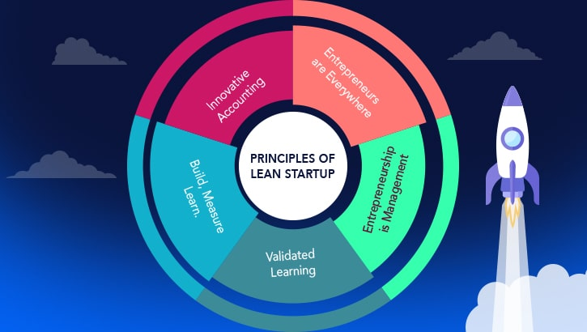
PRINCIPLES OF LEAN STARTUP DEFINED

Slide 93
PRINCIPLES OF LEAN STARTUP DEFINED
The five principles of lean startup are:
Entrepreneurs are everywhere.
Entrepreneurship is management.
Validated learning.
Innovation accounting.
Build-Measure-Learn.
Source: Kelly Schreider (2017)

Slide 94
PRINCIPLES OF LEAN STARTUP
Entrepreneurs are everywhere
There are many types of entrepreneurs and startups. Tons of opportunities exist that entrepreneurs can take advantage of to build a successful business.
Entrepreneurship is management
Startups need management just like any company. However, lean startups have a unique type. Having flexible, learning oriented management makes for a successful lean startup.
Validated learning
Lean startups primarily serve customers with their products. They adapt to the needs of the target market by learning exactly what it is that customers want. Through experimentation, they find what works best.

Slide 95
PRINCIPLES OF LEAN STARTUP
Innovation accounting
Lean startups keep detailed records of tests and analysis to figure out what works best. They gauge progress on the amount learned about the innovation rather than the amount of new work created.
Build-Measure-Learn
Lean startups hit the ground running by building the simplest product that does what it should, called the Minimum Viable Product (MVP). This goes through rigorous evaluation through tests and user feedback to collect data on how targeted users accept the product. If it works, then they learn from the feedback and make it better in an iterative process.
Source: Kelly Schreider (2017)

Slide 96
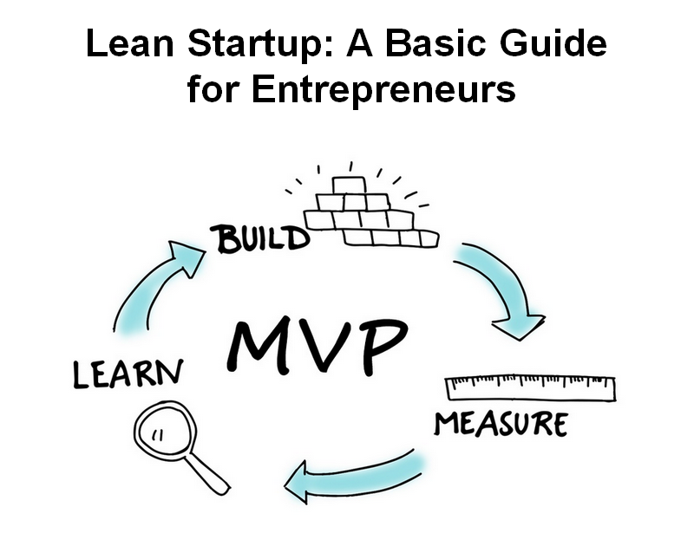

Slide 97
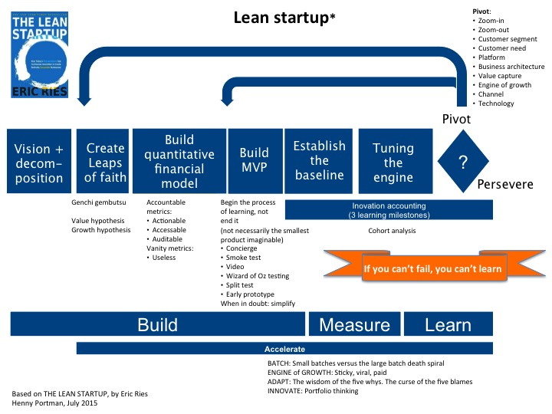
THE LEAN STARTUP PROCESS

Slide 98
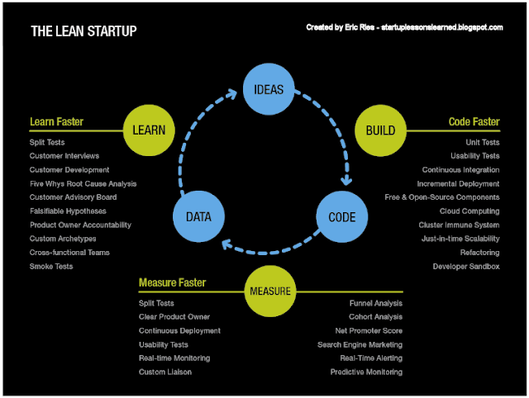

Slide 99
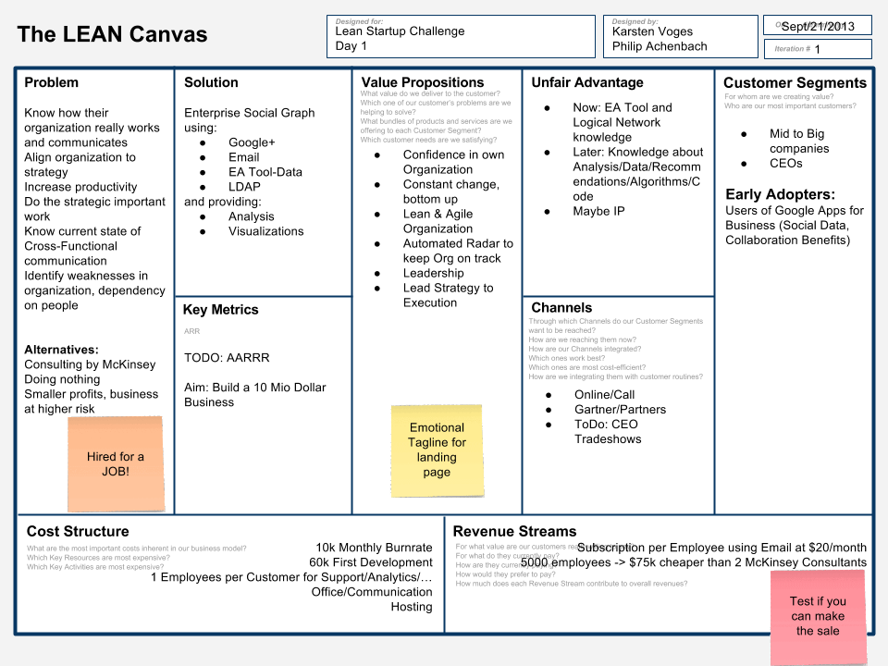
THE LEAN CANVAS (1/2)

Slide 100
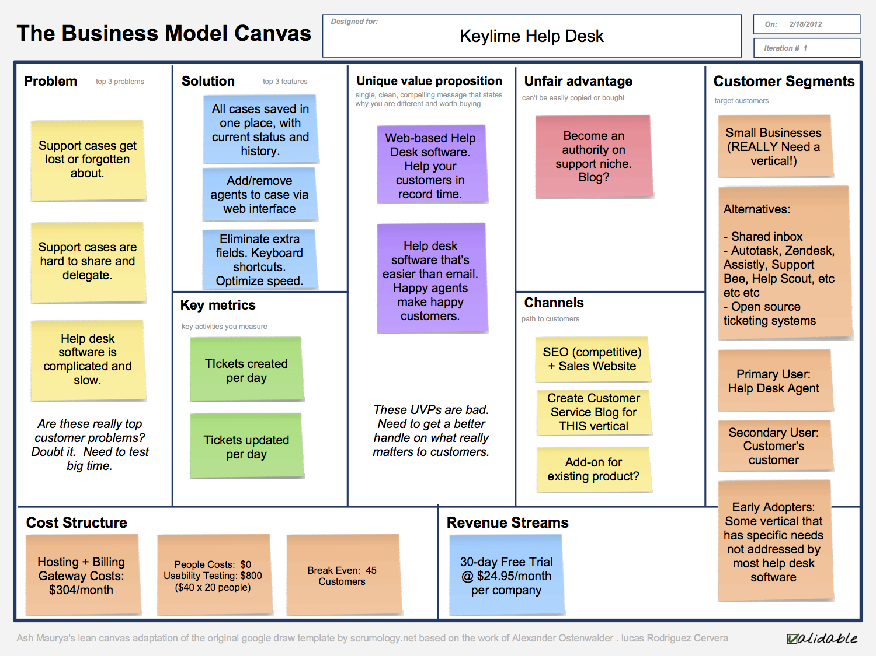
THE LEAN CANVAS (2/2)

Slide 101
APPLICATION OF LEAN STARTUP DEFINED
How can entrepreneurs and managers apply the principles of lean start-up?

Slide 102
AGILE DEVELOPMENT

Slide 103
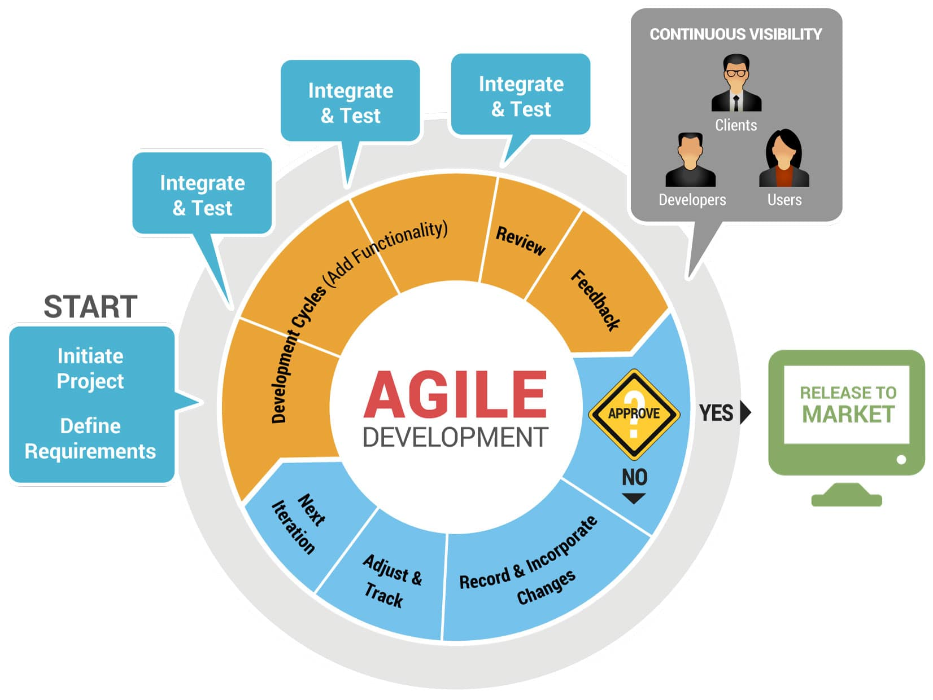
AGILE DEVELOPMENT

Slide 104
STRUCTURE OF THIS SESSION
Agile development defined.
Benefits of agile development.
The agile wheel.
Integrating the methods.

Slide 105
AGILE DEVELOPMENT DEFINED
Agile software development refers to software development methodologies cantered round the idea of iterative development, where requirements and solutions evolve through collaboration between self-organizing cross-functional teams. ... Scrum and Kanban are two of the most widely used Agile methodologies.
Scrum is a framework for Agile software development. ... The term 'Scrum' was first used by Hirotaka Takeuchi and Ikujiro Nonaka in their ground-breaking 1986 paper “The New Product Development Game“. They borrowed the name from the game of rugby to stress the importance of teams in complex product development.

Slide 106
AGILE DEVELOPMENT DEFINED
Kanban is a lighter weight process that applies many of the Lean and Agile values as well as a subset of the Scrum values and principles but there are also some fundamental differences. Kanban focuses on visualization, flow, and limiting work in progress. ... It also means that many of the Scrum rituals not used.

Slide 107
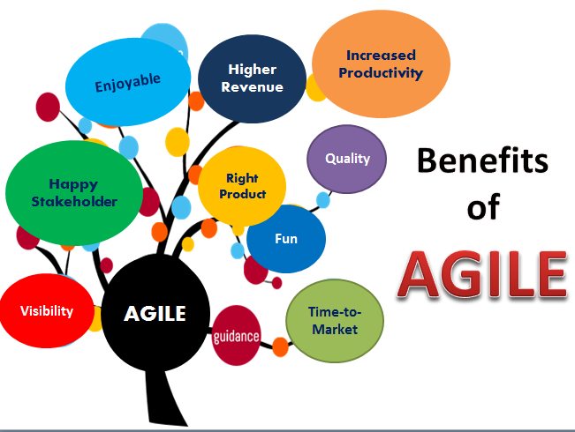
BENEFITS OF AGILE DEVELOPMENT

Slide 108
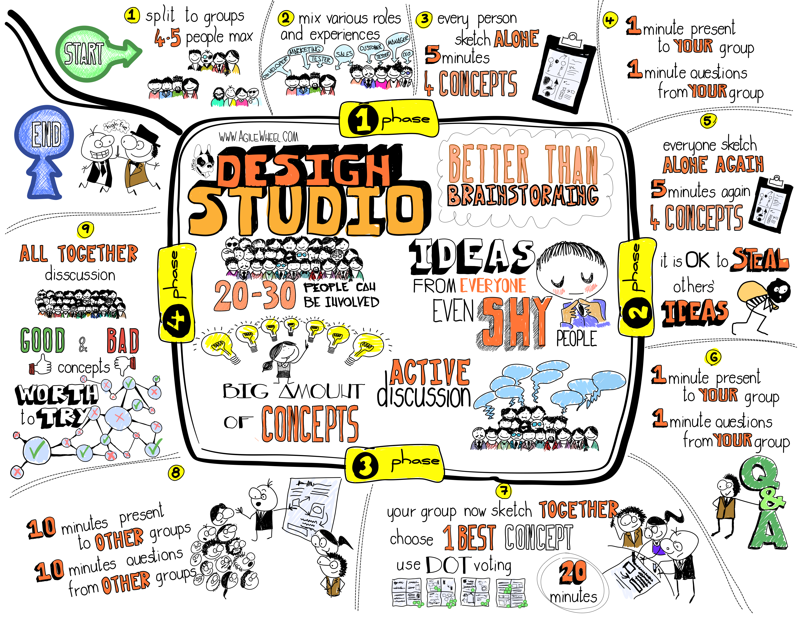
THE AGILE WHEEL (VS. BRAINSTORMING)

Slide 109
APPLICATION OF AGILE DEVELOPMENT
How can entrepreneurs and managers apply the principles of agile development?

Slide 110
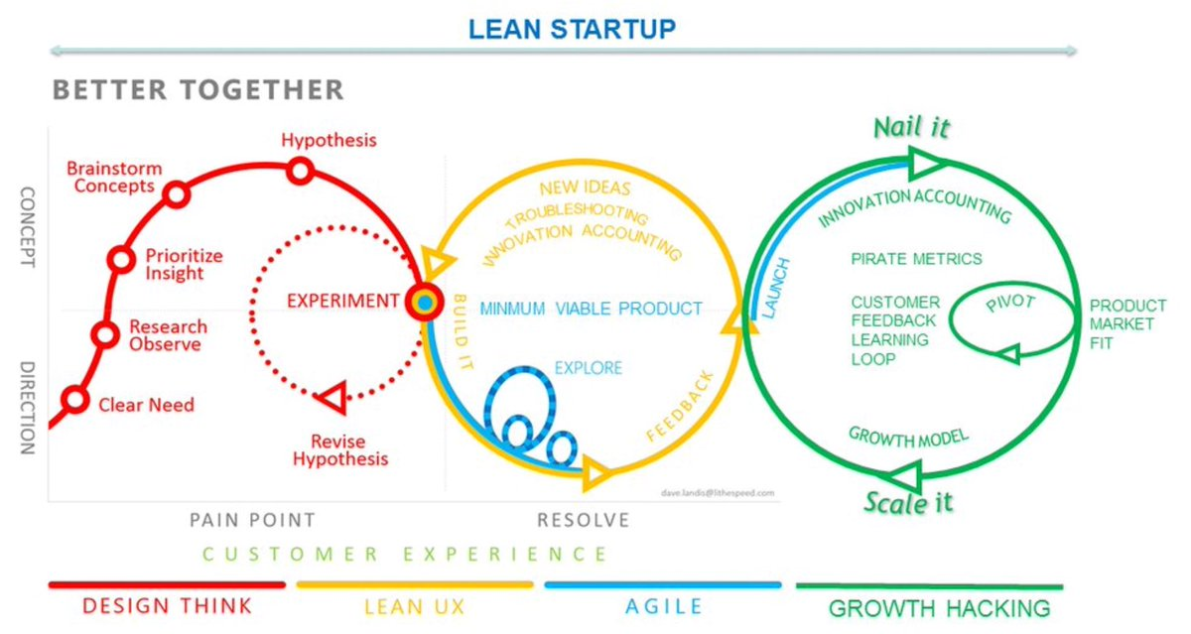
INTEGRATING THE METHODS
LEAN STARTUP VS. AGILE

Slide 111
LEAN STARTUP VS. AGILE
In short, Lean methodology is a way of optimizing the people, resources, effort, and energy of your organization toward creating value for the customer. It is based on two guiding tenets, continuous improvement and respect for people.
Lean Startup combines agile and lean with customer development.
Lean Startup tests the product against the market.
The key concern of Agile is to avoid creating a product that doesn't work.
The key concern of Lean Startup is to avoid creating a product that people don't need.

Slide 112
INTEGRATING THE METHODS
Refer to the article “Why the lean start-up changes everything”, published by Steve Blank in the Harvard Business Review (May 2013).

Slide 113
Thank you

