Slide 1
RESEARCH METHODOLOGY
MBAA 874
Prof Stéphan van der Merwe
Study unit 4 – Research design & Methods

Slide 2


RESEARCH METHODOLOGY 2021

Slide 3

RESEARCH DESIGN AND METHODS

Slide 4
STRUCTURE OF THE SESSION
Introducing the basic concepts
Defining research design and methods
Measurement
Introducing the research onion
Example for a quantitative research design and methodology (applying the research onion)
Content of the Research Methodology section
Types of research design
Level of analysis
Applying the content of the study unit
Reference list

Slide 5
OUTCOMES OF STUDY UNIT 4
After completing the study unit, you should be able to:
Demonstrate the foundations of business research methodology and methods and plan a research design suitable for the problem statement.
Critically evaluate the business research process and distinguish between qualitative and quantitative research.
Select an appropriate research design, sampling method, as well as data collection and analysis methods to support the research question/hypothesis.
Develop and propose a research design, sampling method, data collection and analysis based on the problem statement and research questions/hypotheses.
Applying the Research Onion by Saunders to explain the research design.

Slide 6
INTRODUCING THE BASIC CONCEPTS

Slide 7
COMPONENTS IN THE COMPLETION OF THE RESEARCH PROJECT
Remember that in completing a research project you, the student, are doing three things:
You should acquire knowledge about the research topic and write the literature review and formulate the research objectives and question(s).
You should apply the theory of research methods to address the research objectives and question(s).
You need to know how to write in a scientific manner.

Slide 8
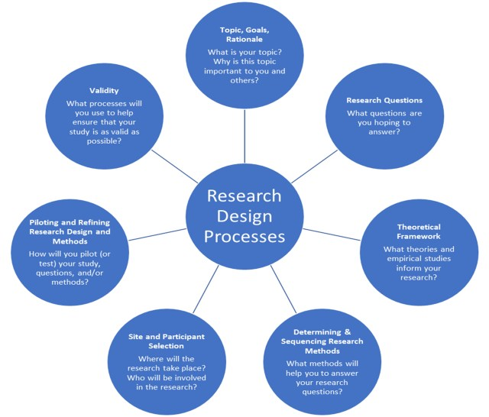
COMPONENTS IN THE RESEARCH DESIGN

Slide 9
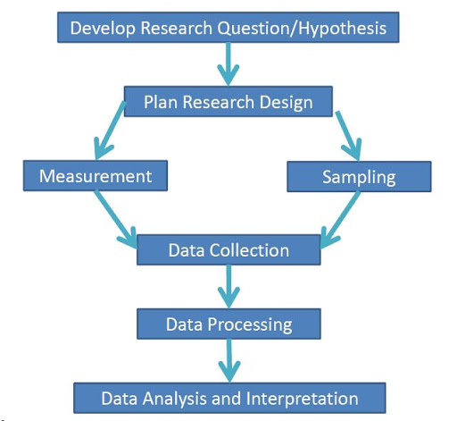
FLOW DIAGRAM OF THE BASIC RESEARCH PROCESS

Slide 10
RESEARCH TOPIC AND RESEARCH TITLE
There are various research processes written up in research methods textbooks.
Ultimately all research processes typically deal with how students should do the following:
Define a research problem - usually done by doing a detailed literature study.
Formulate research question(s)s and/or objective(s).
Show how data will be gathered.
Explain how data should be analysed.
Draw conclusions and answer the initial research question(s) or objective(s).

Slide 11
THE DIFFERENCE BETWEEN DATA AND INFORMATION
Take note that when referring to research methods in this presentation, we refer to how data will be gathered and used.
Therefore, make sure that you understand the difference between information and data.
Typically, everything we read would be information, data would be characters, symbols or numbers on which operations will be performed.

Slide 12
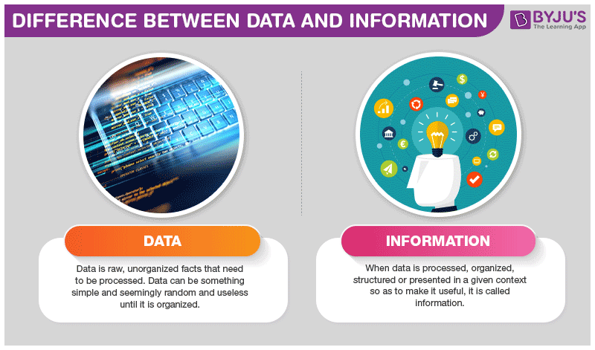

Slide 13
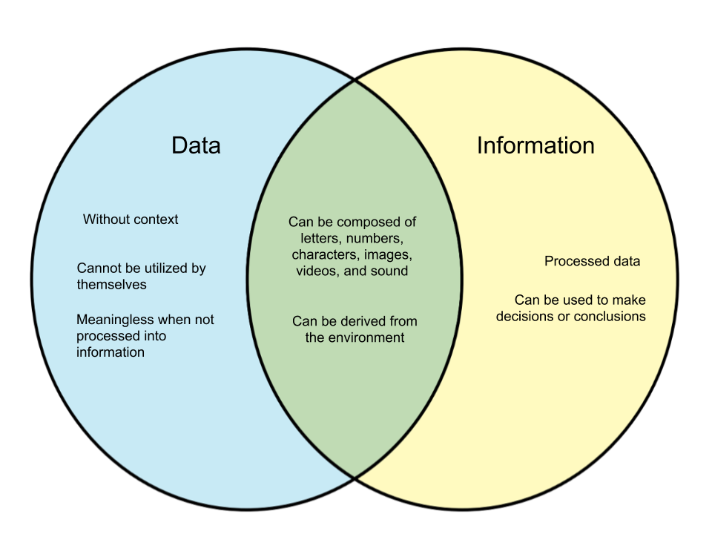
THE DIFFERENCE BETWEEN DATA AND INFORMATION

Slide 14

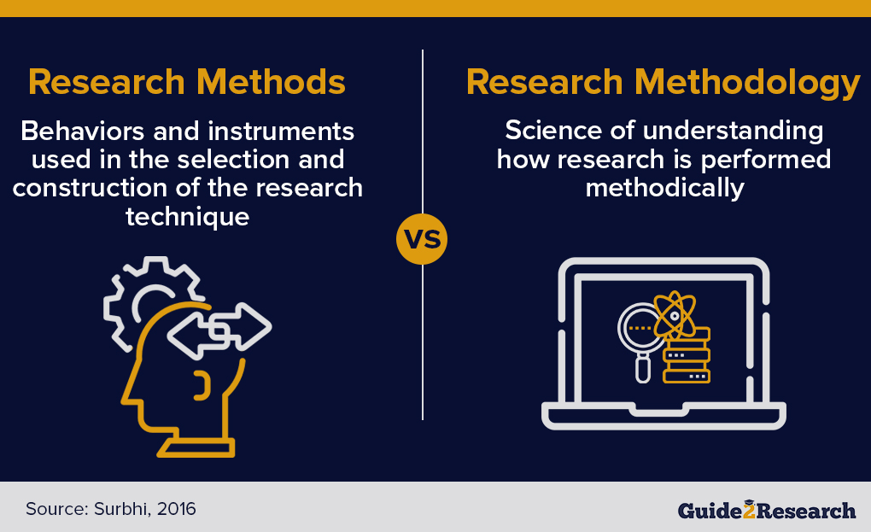
THE FOCUS IS ON THE RESEARCH METHODS
Remember, for purposes of this presentation, we are not talking about research methodology.
These slides only pertain to the method of getting data and using data for research purposes.

Slide 15
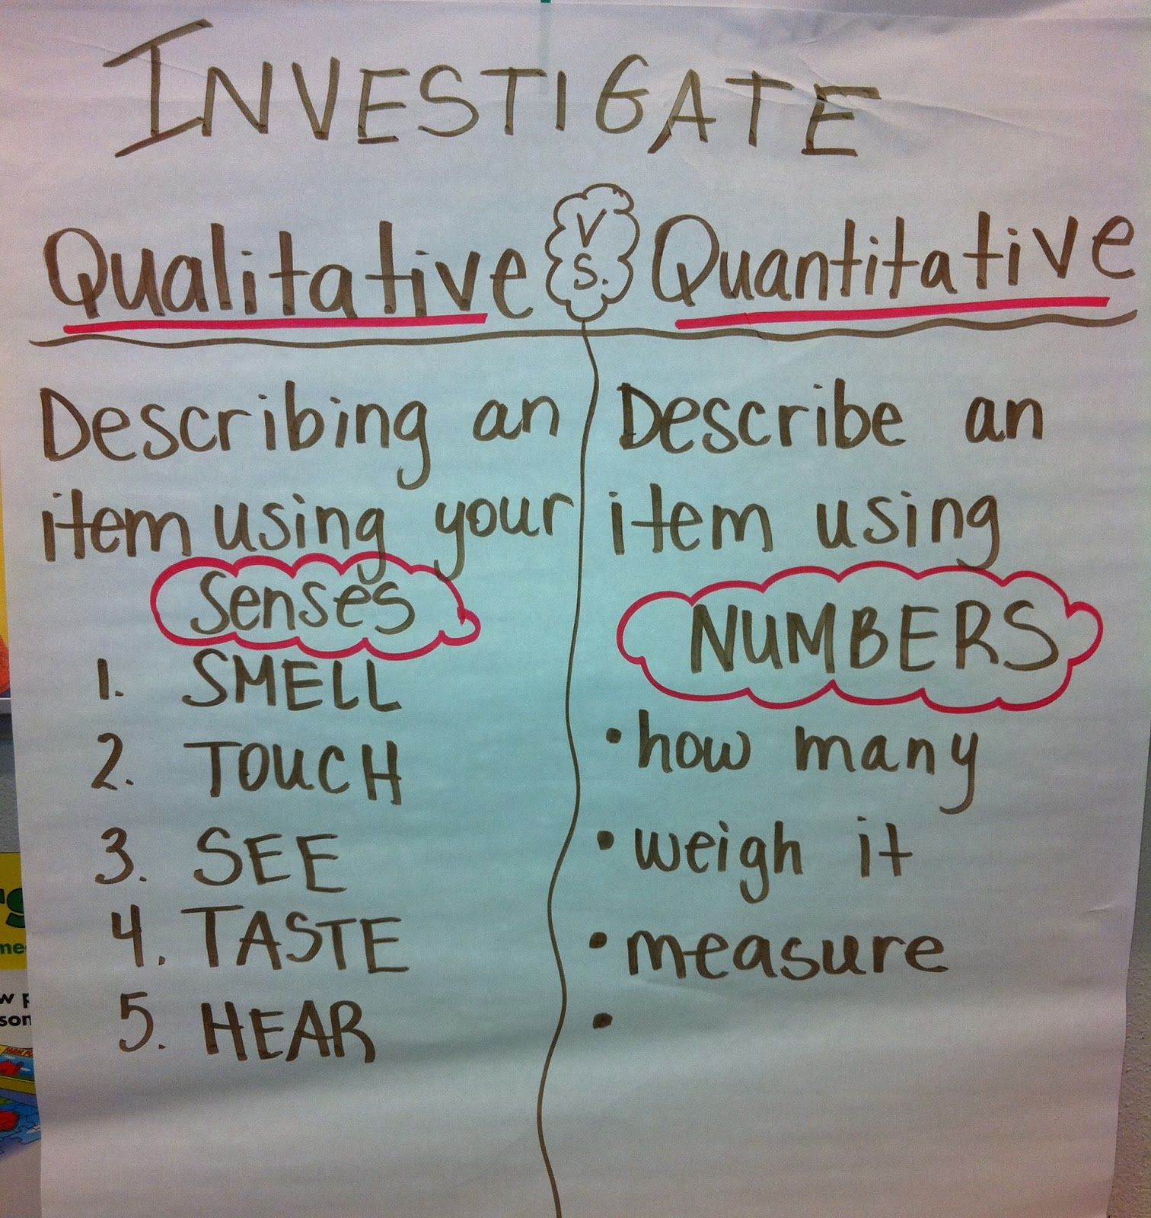
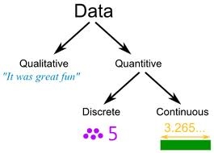
THE DIFFERENCE BETWEEN QUALITATIVE AND QUANTITATIVE DATA
Qualitative data describe qualities or characteristics. It is usually in the form of words, symbols or pictures.
The term quantitative data refers to data that are expressed in numbers.

Slide 16
QUANTITATIVE RESEARCH
Quantitative research is a way of collecting numerical data which then can be converted in useable statistics.
Quantitative research uses measurable data to formulate facts and uncover patterns in research.
Common methods are surveys (questionnaires).
In Entrepreneurship, I could use, for instance, surveys to assess the relationship between entrepreneurial orientation and business performance (test hypotheses).

Slide 17
QUALITATIVE RESEARCH
Qualitative research is used to gain a deeper understanding of the subject.
Qualitative research helps to develop ideas or hypothesis.
It is used to uncover trends in thoughts or opinions.
Common methods used are individual interviews, focus groups and observations.
In Entrepreneurship, I could use interviews to get peoples true opinions on the challenges they are facing.

Slide 18
DEFINING RESEARCH DESIGN AND METHODS

Slide 19
DEFINING RESEARCH DESIGN
The research design refers to the overall strategy that you choose to integrate the different components of the study in a coherent and logical way, thereby, ensuring you will effectively address the research problem.
The research design constitutes the blueprint (gameplan) for the collection, measurement, and analysis of data.
Research design is the framework of research methods and techniques chosen by a researcher.
The research design explains the type of research (experimental, survey, correlational, semi-experimental, review) and also its sub-type (experimental design, research problem, descriptive case-study).

Slide 20

DEFINING RESEARCH METHODS
A research method is a technique for collecting data. The choice of the research method reflects decisions about the type of instruments or techniques to be used.
Research methods are procedures for collecting and analysing data.
Common research methods include surveys, experiments, interviews and observations.
(Bryman et al., 2014:100)

Slide 21
RESEARCH DESIGN (1)
When we talk about research design we often refer to getting or obtaining data (collection of data).
We can get data from existing databases, which is often referred to as secondary data.
Secondary data are readily available, whereas primary data should be gathered from scratch.
When gathering either secondary or primary data, stay in line and do not mix up the methods (be very careful when using a mixed-method approach).
(Refer to Gerber, 2021)

Slide 22
RESEARCH DESIGN (2)
When gathering data from scratch one needs to consider the method used, the measurement instrument, as well as how a sample of the target population will be obtained.
One would consider method, measurement and sampling for gathering both primary quantitative and primary qualitative data.
Always stay in line – do not mix up quantitative and qualitative methods.
[The example of the “plans” that we had to compile at the Agricultural College.]

Slide 23
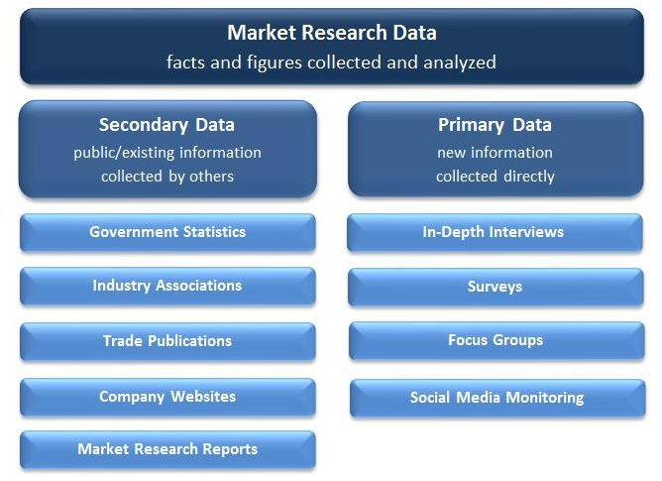
THE DIFFERENCE BETWEEN PRIMARY AND SECONDARY DATA

Slide 24
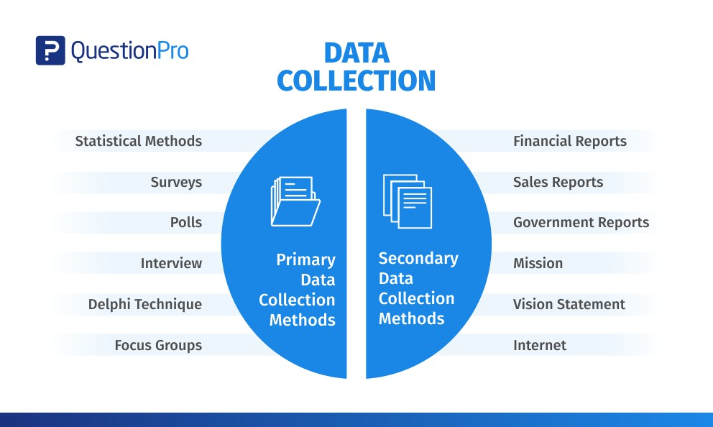

Slide 25
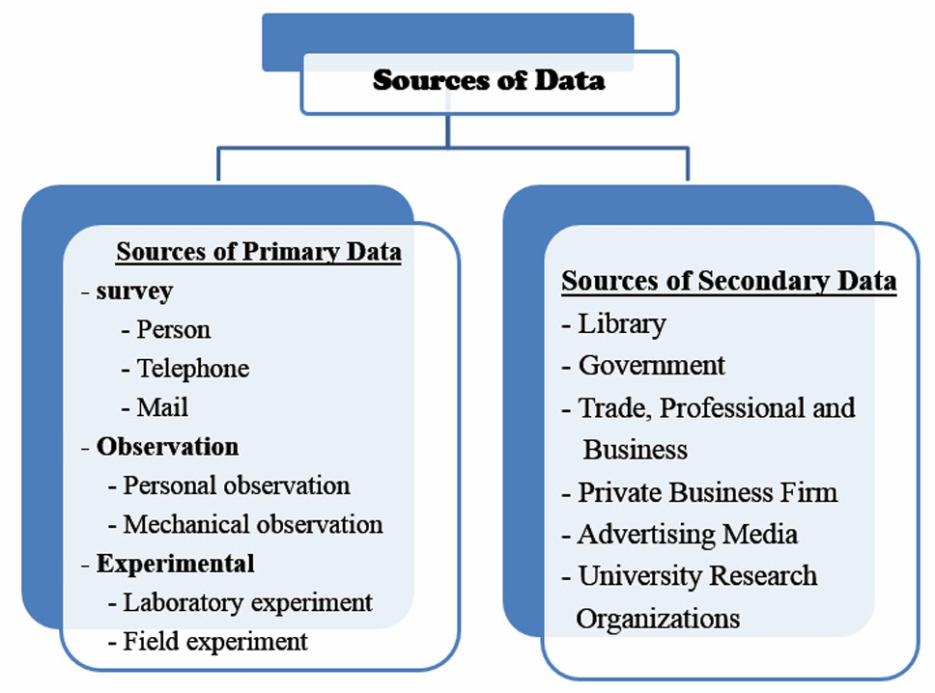

Slide 26
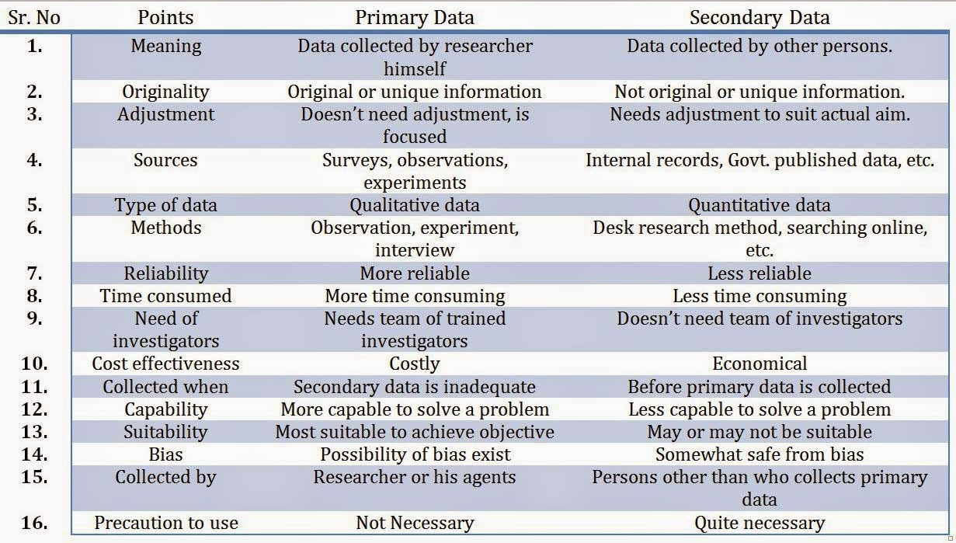
THE DIFFERENCE BETWEEN PRIMARY AND SECONDARY DATA

Slide 27
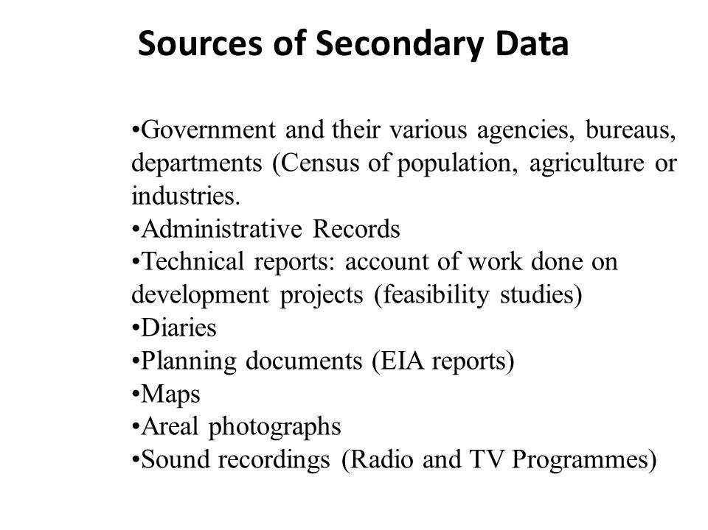

OBTAINING SECONDARY DATA
When obtaining secondary data, one should identify the secondary data source and explain the reliability and validity of the data set.

Slide 28
OBTAINING PRIMARY DATA (1)
In gathering primary data one should keep in mind what type of data, primary quantitative or primary qualitative data, should be gathered.
In gathering primary quantitative data, surveys (questionnaires) is a common method to use.
In gathering qualitative data there are many methods that one can use.
The four most popular methods typically used by postgraduate students include (1) semi-structured interviews, (2) in-depth interviews, (3) observation, and (4) focus groups.
(Refer to Gerber, 2021)

Slide 29
CHOOSE THE MOST
APPROPRIATE METHOD
Once it is clear what type of data you will need for your study think about what method is more appropriate in obtaining your data.
Once you have decided, find a good research methods textbook so that you can familiarise yourself with your chosen method.
The prescribed textbook, Research methodology: Business and management contexts (Bryman et al., 2014) is an excellent textbook. It is comprehensive, applied to the South African context, and affordable).

Slide 30
MEASUREMENT

Slide 31


MEASUREMENT
In science valid/credible measurement instruments are used to gather data.
Instruments can be used to quantify or qualify constructs.
Examples of measurement instruments:
Questionnaire
Discussion (interview) guide
Eye tracker
Scanner

Slide 32
MEASUREMENT
When we talk about measurement in research design, we refer to how data will be quantified and or qualified.
We would typically use a questionnaire when gathering quantitative data, and we will use an interviewer manual (interview guide) when we need to gather qualitative data.
In dealing with measurement in postgraduate research it is often useful to consult your supervisor.
You may also want to consult validated instruments that are available in, for example, scientific journals.
[It is better to use validated questionnaires and not to develop your own questionnaire.]

Slide 33
LINKING RESEARCH DESIGN TO THE OBJECTIVES
The research design determines the structure of the investigation in order to attain answers to the research objectives. The research design is therefore a preliminary blueprint necessary for conducting research (Aaker, Kumar, Leone and Day, 2013:73).
Consequently, the appropriate design depends on the research aims and the required data in attaining the said aims. Kapoor and Kulshrestha (2010:31) as well as Malhotra (2010:103) identify three major research designs: namely exploratory research (which primarily involves qualitative data); causal research; and descriptive research (both of which primarily involve quantitative data). [Venter, 2021]

Slide 34
INTRODUCING THE RESEARCH ONION

Slide 35
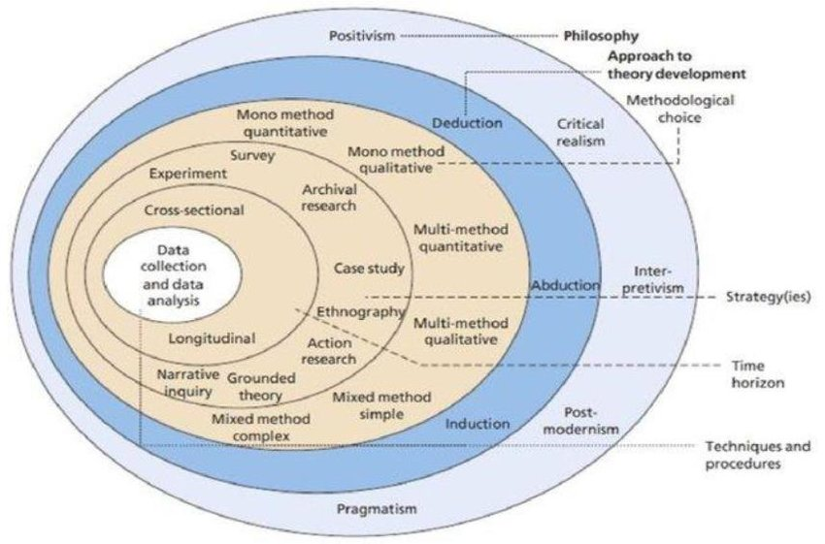

RESEARCH ONION
[Source: Saunders et al. (2016:164)]

Slide 36
LAYER 1: PARADIGM/PHILOSOPHY (1)
The research paradigm or philosophy is the foundation of any study as it describes the set of beliefs the research is built upon. It forms a basis of the research by delineation of ontology (the nature of reality), epistemology (the nature, sources of knowledge or facts), axiology (the values, beliefs and ethics of the research).
A research paradigm is a set of fundamental and taken for granted assumptions which underwrite the frame of reference, mode of theorising and ways of working in which a group operates.
[Refer to Chapter 5: Formulating the research design (Saunders et al., 2019)].

Slide 37

LAYER 1: PARADIGM/PHILOSOPHY (2)
Five major paradigms exist for management and business research: positivism, critical realism, interpretivism, postmodernism and pragmatism.
Three paradigms are relevant for most of the research projects:
Positivism (quantitative research)
Interpretivism (qualitative research)
Pragmatism (applicable mostly to mixed methods)
[Refer to Chapter 4: Understanding research philosophy and approaches to theory development (Saunders et al., 2019)].

Slide 38
LAYER 2: APPROACH TO THEORY DEVELOPMENT
Your research approach is the broader method you’ll use for your research, inductive or deductive.
It’s important to clearly identify your research approach as it will inform the decisions you take in terms of data collection and analysis in your study.
Inductive approaches entail generating theories from research, rather than starting a project with a theory as a foundation (qualitative research). Deductive approaches, on the other hand, begin with a theory and aim to build on it (or test it) through research (quantitative research) (Saunders et al., 2019)

Slide 39
DEDUCTIVE APPROACH
The deductive approach is when a hypothesis is developed from an already existing theory.
They start with a social theory that they found compelling then tests its implications with data.
They move from a more general level to a more specific on.
A deductive approach to to research is the one that people typically associate with scientific investigation.
The researcher studies what others have done, reads existing theories and then test hypothesis that emerge from these theories.
The researcher uses a quantitative approach.

Slide 40
INDUCTIVE APPROACH
An inductive approach to research is where a researcher begins by collecting data that is relevant to the topic of interest.
Once a considerable amount of data has been collected, the researcher will then take time out from data collection, stepping back to gets a bird’s eye view of the data.
At this stage, the researcher looks for patterns in the data, working to develop a theory that could explain those patterns.
The researcher uses a qualitative approach.

Slide 41
LAYER 3: METHODOLOGICAL CHOICE
The methodological choice determines the use of quantitative and qualitative methods or various mixtures of both (mixed method).

Slide 42
WHAT IS QUANTITATIVE RESEARCH? (1)
Quantitative research is a research strategy that focuses on quantifying the collection and analysis of data.
It is formed from a deductive approach where emphasis is placed on the testing of theory, shaped by positivists philosophies.
It is associated with the natural, social and applied sciences.
The quantitative research strategy promotes the objective empirical investigation of observable phenomena to test and understand relationships.
This is done through a range of quantifying methods and techniques, reflecting on its broad utilization as a research strategy across differing academic disciplines (Wikipedia, 2020).

Slide 43
WHAT IS QUANTITATIVE RESEARCH? (2)
The objective of quantitative research is to develop and employ mathematical models, theories, and hypotheses pertaining to phenomena.
The process of measurement is central to quantitative research because it provides the fundamental connection between empirical observation and mathematical expression of quantitative relationships.
Quantitative data is any data that is in numerical form such as statistics, percentages, among others.
The researcher analyses the data with the help of statistics and hopes the numbers will yield an unbiased result that can be generalized to some larger population (Wikipedia, 2020).
Preferred statistical software – IBM SPSS.

Slide 44
WHAT IS QUALITATIVE RESEARCH? (1)
Qualitative research relies on data obtained by the researcher from first-hand observation, interviews, questionnaires, focus groups, participant-observation, recordings made in natural settings, documents, and artefacts.
The data are generally non-numerical.
Qualitative research is primarily subjective in approach as it seeks to understand human behaviour and reasons that govern such behaviour.
It normally follows an inductive approach that is a systematic procedure for analysing qualitative data in which the analysis is likely to be guided by specific evaluation objectives.
It is subjective because the researcher should interpret the data.
It is informed by constructivism and interpretivism (Wikipedia, 2020).

Slide 45
WHAT IS QUALITATIVE RESEARCH? (2)
Qualitative methods include ethnography, grounded theory, discourse analysis and interpretive phenomelogical analyses.
Most MBA-studies are exploratory descriptive studies utilising thematic analysis described by Creswell.
Qualitative research methods have been used in sociology, anthropology, political science, psychology, social work, and educational research.
Qualitative researchers study individuals' understanding of their social reality (Wikipedia, 2020).
Preferred Computer-Assisted Qualitative Data Analysis Software (CAQDAS) – ATLAS.ti, Nvivo.

Slide 46
LAYER 4: STRATEGY
The research strategy to collect and analyse the data, i.e.:
Experiment
Survey
Archival research
Case study
Ethnography
Action research
Grounded theory
Narrative inquiry.
(Saunders et al., 2019)

Slide 47
LAYER 5: TIME HORIZONS
The time horizon simply describes how many points in time you plan to collect your data at. The time horizons layer defines the time frame for the research:
Cross-sectional or short term study, involving collection of data at a specific point of time.
A longitudinal time horizon refers to the collection of data repeatedly over a long period of time in order to compare data.
(Saunders et al., 2019)

Slide 48
LAYER 6: TECHNIQUES AND PROSEDURES
Techniques and procedures include data collection and analysis – the use of primary/secondary data, choosing sample groups, developing questionnaire content, preparing interviews, etc.

Slide 49
EXAMPLE FOR A QUANTITATIVE RESEARCH DESIGN AND METHODOLOGY SECTION

Slide 50
EXAMPLE OF PRESENTING THIS PART:
RESEARCH METHODOLOGY [MAIN HEADING]
RESEARCH METHODOLOGY
This study was conducted in two phases. First, a literature review was conducted of the studies on agriculture in South Africa to clearly understand the black commercial farming sector. This was followed by an empirical study examining the success factors experienced by black commercial farmers in the North West province
[Source: Peach, 2015:9, 10].

Slide 51
EXAMPLE OF PRESENTING THIS PART:
RESEARCH METHODOLOGY [SUB-HEADING]
Literature review (secondary research) [Example 1]
The literature review involves collecting secondary data that has already been gathered and analysed for the purpose of a previous study and is available to use and reference (Boone & Kurtz, 2015:316; Strüwig & Stead, 2013:82). Therefore, secondary data analysis is the analysis of data that was originally collected, recorded and analysed by another researcher for a unique primary purpose, other than that of the current research (Collis & Hussey, 2014:59; Doolan & Froelicher, 2009:203; Strüwig & Stead, 2013:82). This secondary data is useful to researchers should they be unable to personally acquire applicable primary data, which is a frequent occurrence (Doolan & Froelicher, 2009:205).
In order to achieve the primary and secondary research objectives of this study, a comprehensive literature review will be conducted to investigate the nature and importance of family and non-family SMEs in global economies in general, and in South Africa in particular, as well as the nature and importance of innovation in these entities. The secondary data used for the literature review will be obtained by consulting various academic sources and relevant published citations, which were sourced using several online academic databases [provide more detail here if needed]. The relevant secondary data acquired, will provide a detailed theoretical background to introduce the research topic and offered the means required to derive the conceptual model for the study, as depicted in Figure 1.1 [insert here the conceptual model if applicable.].

Slide 52
EXAMPLE OF PRESENTING THIS PART:
RESEARCH METHODOLOGY [SUB-HEADING]
Literature review (secondary research) [Example 2]
The first phase of the research methodology was the literature review. The purpose of the literature review was to familiarise the reader with entrepreneurship, the history of women entrepreneurs, the timeline of women entrepreneurs and their contribution.
It emphasises the importance of women entrepreneurs in history, their importance now and on the economy. Furthermore, the literature review gives a background of the known general challenges that women have faced even though they have proven to be capable entrepreneurs.
Google scholar, google, NWULIB and Ebcohost were used as sources of information.
The sources include:
Journals.
Publications.
Dissertations and papers on the subject.
Books.
News and internet articles.

Slide 53
EXAMPLE OF PRESENTING THIS PART:
RESEARCH METHODOLOGY [SUB-HEADING]
[Comment: Tell the reader whether you will be using a positivistic paradigm and a quantitative methodology (theoretical model will then be tested by means of a large-scale empirical study) or a interpretivist paradigm and qualitative methodology (doing interviews with an interview guide) (Venter, 2021).] [Utilise the Research Onion proposed by Saunders et al. (2016) to structure this section.]
Example:
2. Empirical research (primary research)
Primary data comprises information and statistics that are collected, analysed and interpreted for the sole purpose of the research study at hand (Grimsley, 2017). The primary data required for this current study will be collected by means of an empirical investigation of family and non-family SMEs in South Africa.
The research design of the empirical investigation for this study involves determining the research paradigm, methodological approach, methodological choice, methodological strategy, time horizon and data collection and analysis techniques that are to be used. Each of these will be briefly introduced in the sections to follow (Venter, 2021).
[Refer to Venter (2021) – presentation on 2 July 2021]

Slide 54
EXAMPLE OF PRESENTING THIS PART:
RESEARCH PARADIGM
2.1 Research paradigm
A research paradigm is based on people’s philosophies and their assumptions about the world around them, which influence the methods that they use to conduct research (Collis & Hussey, 2014:43; Johnson & Christensen, 2014:31). While various research paradigms exist, the positivistic and interpretivist paradigms are the most dominant two in the fields of social and management sciences (Collis & Hussey, 2014:43). The positivistic research paradigm assumes that the world is objective and negates the influence of the researcher by seeking facts and, applying logic and reasoning to ensure that precision is achieved when examining the relationships among variables (Collis & Hussey, 2014:43; Gravetter & Forzano, 2012:158). On the other end of the research spectrum, the interpretivist research paradigm uses subjective experiences to understand human behaviour and relies on the personal views of the participants to develop a theory (Collis & Hussey, 2014:50; Wahyuni, 2012:71).
Due to the nature of the objectives of this study and the need to test hypotheses accurately and precisely in an objective manner, a positivistic research paradigm will be adopted for this study. [Refer to Venter (2021) – presentation on 2 July 2021]

Slide 55
EXAMPLE OF PRESENTING THIS PART:
METHODOLOGICAL APPROACH
2.2 Methodological approach
The methodological approach could be described as the process through which research is conducted and the logic that is used throughout this process (Collis & Hussey, 2014:67). In management research, the methodological approach can either be deductive or inductive (Zalaghi & Khazaei, 2016:24). Deductive research falls under the positivistic research paradigm and entails the development of research hypotheses using existing literature as a basis, that are subsequently tested through an empirical investigation using deductive reasoning (Mukherji & Albon, 2014:14; Saunders, Lewis and Thornhill, 2016:74). Alternatively, inductive research occurs in the interpretivist research paradigm and involves developing a novel theory by means of observing reality and collecting primary data, without the consideration of existing theories (Morgan, 2014:1049; Saunders et al., 2016:74).
As this study has adopted a positivistic research paradigm and tests predetermined hypotheses, it will follow the deductive methodological approach.
[Refer to Venter (2021) – presentation on 2 July 2021]

Slide 56
EXAMPLE OF PRESENTING THIS PART:
METHODOLOGICAL CHOICE
2.3 Methodological choice
According to Antwi and Hamza (2015:220), researchers must determine whether the nature of their research will be quantitative or qualitative. Quantitative research is associated with the positivistic research paradigm and its main purpose is to use numerical data collected from large samples and statistical analyses to test the hypothesised relationships between two or more variables (Albers, 2017:217; Wiid & Diggines, 2013:860). Qualitative research is associated with the interpretivist research paradigm and focuses more on the subjective views and beliefs of a small sample (Heath, 2007:27; Wiid & Diggines, 2013:87). Detailed information is obtained to allow for a deeper understanding of the subject under investigation and generate a theory (Wiid & Diggines, 2013:87).
Considering the nature and objectives of this study, quantitative research was considered as the most suitable methodological choice for this research.
[Refer to Venter (2021) – presentation on 2 July 2021]

Slide 57
EXAMPLE OF PRESENTING THIS PART:
METHODOLOGICAL STRATEGY
2.4 Methodological strategy
Once the research paradigm, approach and choice have been decided, the data collection technique, also known as the methodological strategy, must be selected (Bryman & Bell, 2015:100). In terms of quantitative research, surveys are the most used means of collecting data (Koenig & Schultz, 2016:14). Surveys usually take the form of a closed-ended or open-ended questionnaire (Bryman & Bell, 2011:54; Gupta & Gupta, 2011:73). Should the questions be predetermined by the researcher, the questionnaire is structured in nature (Gupta & Gupta, 2011:73). In addition, if the respondents are able to complete the questionnaire at their own discretion and in their own time, it is known as a self-administered questionnaire (Babbie, 2016:268).
Owing to the nature of this study, an online survey strategy was adopted, which uses a close-ended, structured and self-administered questionnaire to gather primary data for the purpose of this study.
[Refer to Venter (2021) – presentation on 2 July 2021]

Slide 58
EXAMPLE OF PRESENTING THIS PART:
TIME HORIZON
2.5 Time horizon
According to Melnikovas (2018:34), a time horizon describes the period of time over which a study occurs. Longitudinal studies take place over an extended period of time, in which study participants are questioned on multiple occasions (Collis & Hussey, 2014:64; Zikmund, Babin, Carr & Griffin, 2013:196). Alternatively, cross-sectional studies occur over the short-term and serve to examine the data received from the study participants at a single moment in time (Bryman & Bell, 2011:53; Collis & Hussey, 2014:63).
This study takes the form of a cross-sectional study, as the investigation will occur over a single period of time in the short-term.
[Refer to Venter (2021) – presentation on 2 July 2021]

Slide 59
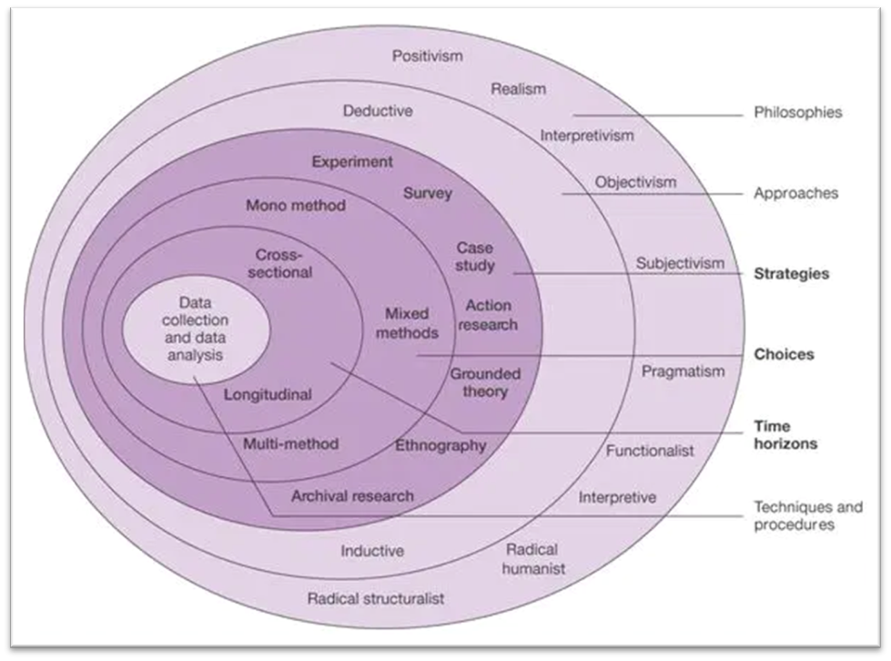
EXAMPLE: RESEARCH DESIGN
Layer | Selection
Research philosophy and paradigm | Positivism. The ontological position of realism. Empirical evidence will be gathered, analysed, and formulated in the form of a theory that explains the effect of the independent variables on the dependent variables (Rehman & Alharthi, 2016:53-54). Paradigm of objectivism and critical realism (Levers, 2013:2).
Research approach | Deductive. Theoretical structure is developed and then tested by empirical observation (Welman et al., 2010:28).
Research strategy | Structured survey. Provides a quantitative or numeric description of trends, attitudes, or opinions of a population by studying a sample of that population (Cresswell & Cresswell, 2021:12).
Choice of research | Mono method. Quantitative research is an approach for testing objective theories by examining the relationship among variables (Creswell & Cresswell, 2021:4).
Time horizon of research | Cross-sectional. At a moment in time (Cresswell & Cresswell, 2021:149).
Technique and procedure | Research survey (Creswell & Creswell, 2021:12) uploaded in electronic format on a survey platform. Full population sampling method which is probability sampling.
The research onion (Saunders, 2007:102)
The theories that would be tested in this study, is that corporate entrepreneurship leads to performance (Elgharbawy & Abdel-Kadar, 2016:778; Ziyae & Sadeghi, 2021:113), and that entrepreneurial orientation leads to performance (Lee & Chu, 2017:213).
Source: Botha (2021)
Notes:
When considering the research onion by Saunders the research methodology in short for this research centers around the following:
A positivist philosophy would be used – and a paradigm of objectivism and critical realism.
The approach would be deductive, and the theories that would be tested……read block.
A structured survey would be used as mono-method, and quantitative research, cross sectional, being at a moment in time.
The research survey will be uploaded in electronic format and the sample that will be used from the population would be total population sampling, which is purposive and part of non-probability sampling, - it is regarded as representative of the whole population. The population would be the compliance officers within SA banks as part of the Bankseta would be used (1232 as at 2020 as per the Bankseta). The researcher has access to the list of skills development facilitators of the banks within the Bankseta, and they have access to all the compliance officers within their banks. The survey will thus be sent by skills development facilitators to their compliance officers.

Slide 60
USE AND ADAPT THE EXAMPLES
Please feel free to use and adapt these examples so that they would apply to your study.
It could help you to write up your research design in the methods section of your assignment in an appropriate manner.
[Be aware of plagiarism!!!]

Slide 61
Take note that you can also use the Research Onion to structure the Research Design and Methods section of your proposal concerning a qualitative research approach.
Some sections apply to qualitative research, and you can adapt other sections for the qualitative research approach.

Slide 62
PRESENTING THE REST OF THE METHODOLOGY SECTION
2.6 Data collection and data analysis techniques
The following sub-headings are applicable here:
Study population and sampling (refer to Module 5)
Designing the measuring instrument (refer to Module 6 & 7)
Obtaining (collecting/gathering) data (refer to Module 6 & 7)
Data or statistical analysis (refer to Module 6, 7, 8)
Reliability and validity of the measuring instrument (refer to Module 6 & 7) [Trustworthiness)]
Ethical considerations
[Take note that you have to continue with the numbering. I will provide examples how to write up this part as well.]

Slide 63
THE TYPES OF RESEARCH DESIGN

Slide 64
Take note that I will not discuss this section in detail during this presentation.
Kindly refer to the prescribed textbook.

Slide 65
TYPES OF RESEARCH DESIGN
Experimental
Cross-sectional
Longitudinal
Case study
Comparative
[Refer to the prescribed textbook (Bryman et al., 2015).]

Slide 66
EXPERIMENTAL DESIGN ELEMENTS
Random assignment of subjects to experimental and control groups.
Pre-testing of both groups.
Independent variable manipulated; all other variables held constant.
Post-testing of both groups.
Computation and analysis of group differences.
Comparison.
(Bryman et al., 2014:101, 105)

Slide 67
THREATS TO INTERNAL VALIDITY
Subjects may become sensitized to ‘testing’.
Other (non-experimental) events may have caused the changes observed (‘history’).
People change over time in any event (‘maturation’).
Non-random ‘selection’ could explain differences.
‘Ambiguity about the direction of causal influence’ because sometimes the temporal sequence is unclear.
(Bryman et al., 2014:102)

Slide 68
BEYOND INTERNAL VALIDITY
Additional criteria to internal validity may be applied.
For example:
  Did the experimental manipulation really work?
  Is the research externally valid?
  Is the research replicable?
(Bryman et al., 2014:102, 103)

Slide 69
THREATS TO EXTERNAL VALIDITY
Interaction of selection and treatment
Interaction of setting and treatment
Interaction of history and treatment
Interaction effects of pretesting
Reactive effects of experimental arrangements
(Bryman et al., 2014:102)

Slide 70
DESIGNS RELATED TO EXPERIMENTAL DESIGN
Laboratory experiment: An experiment taking place in a laboratory or in a manipulated, controlled setting.
Quasi-experiment: A study that has certain characteristics of experimental designs but that do not fulfil all the internal validity requirements.
(Bryman et al., 2014:54)

Slide 71
EVALUATING EXPERIMENTAL DESIGN
To establish whether an organisational intervention has achieved its anticipated goals.
In-depth understanding of the context and diverse viewpoints of the stakeholders.
Usually quasi-experimental.
Experimental design elements, as well qualitative research approaches may be used.
(Bryman et al., 2014:105)

Slide 72
CROSS-SECTIONAL DESIGN
Data collected on more than one case and at a single point in time.
The aim of a cross-sectional design is to collect a body of quantitative or quantifiable data in connection with two or more variables.
May also involve qualitative data.
Variables examined to detect patterns of association.
Qualitative research often involves a form of cross-sectional design, e.g. unstructured or semi-structured interviewing.
(Bryman et al., 2014:106, 108)

Slide 73
… AND SURVEY RESEARCH?
A cross-sectional design to collect data mainly by questionnaire or by structured interview on more than one case and at a single point in time.
The aim of survey research is to collect a body of quantitative or quantifiable data in connection with two or more variables.
Variables examined to detect patterns of association.
(Bryman et al., 2014:107)

Slide 74
EVALUATING CROSS-SECTIONAL RESEARCH
Reliability and measurement validity are not connected to the design, as such.
Replicability will be high as long as the researcher specifies all the procedures.
Internal validity is weak, because co-relations are much more likely to be found than causality.
External Validity will be strong if the sample is truly random.
Ecological Validity may be compromised by the instruments used.
(Bryman et al., 2014:107)

Slide 75
LONGITUDINAL DESIGN
Survey of the same sample on more than one occasion.
Typically used to map change in business and management research.
Two types:
  Panel study
  Cohort study
(Bryman et al., 2014:109)

Slide 76
EVALUATING LONGITUDINAL RESEARCH
Very similar to cross-sectional research designs
Special problems:
  Attrition
  Knowing when is the right time for next data collection
  Panel conditioning effect
(Bryman et al., 2014:110)

Slide 77
CASE STUDY DESIGN
Detailed and intensive analysis of unique features of one case – idiographic approach.
For example a specific person, event, organization or community.
Often involves qualitative research.
The case is the focus of interest in its own right – location/setting just provides a background.
Types of case: critical, unique, extreme, revelatory, exemplifying
Widely used in business research.
(Bryman et al., 2014:110-112)

Slide 78
EVALUATING CASE STUDY RESEARCH
The biggest issue concerns external validity, because it is impossible to generalise the findings.
Many case-writers argue, though, that the point of the research is to examine particulars rather than attempt to generalise.
Cases may be extended longitudinally or through a comparative design.
(Bryman et al., 2014:112, 113)

Slide 79
COMPARATIVE DESIGN
Using the same methods to compare two or more meaningfully contrasting cases.
Can be qualitative and/or quantitative.
Often cross-cultural, international comparisons – Key concept 6.7.
Includes multiple case studies.
Problems, e.g.:
  translating research instruments
  finding comparable samples
  different cultures in one country
(Bryman et al., 2014:64, 65)

Slide 80
EVALUATING COMPARATIVE DESIGN
Identical to cross-sectional design.
Multiple-case study improves theory building: shows circumstances in which a particular theory will or will not hold.
The comparison may suggest concepts that are relevant to an emerging theory.
Criticism: researcher tends to pay less attention to the specific context and more to the contrasts between cases.
(Bryman et al., 2014:115)

Slide 81
LEVEL OF ANALYSIS

Slide 82
LEVEL OF ANALYSIS
What is the primary unit of measurement and analysis?
For example:
  Individuals
  Groups
  Organisations
  Societies
(Bryman et al., 2014:116)

Slide 83
BRINGING RESEARCH APPROACH AND RESEARCH DESIGN TOGETHER
Both quantitative and qualitative approaches can be used in any of the research designs covered in this study unit.
Business research designs often use a combination of quantitative and qualitative methods (but not often used on the MBA mini-dissertation level).
Increasingly, research that combines quantitative and qualitative approaches is referred to as mixed methods research.
(Bryman et al., 2014:117)

Slide 84
APPLYING THE CONTENT OF THE STUDY UNIT

Slide 85
APPLYING THE CONTENT OF THIS STUDY UNIT:
ASSIGNMENT 2
Research approach and design [5 marks]
6. Describe the research approach that will be followed in the study. | Explain whether the study will be qualitative, quantitative or mixed-method in nature. Why? Motivate. | /3
7. Describe the research design of the study. | Will the study be experimental, cross-sectional or longitudinal? Why? Elaborate. In the case of longitudinal research, also provide the time intervals between the data points. Will the study be inductive or deductive in design? Explain. | /2

Slide 86
APPLYING THE CONTENT OF THIS STUDY UNIT:
ASSIGNMENT 2
Take note the Research Approach and Design section (Assignment 2) is applicable to both Option 1 (Research with human participants) and Option 2 (Research with NO human participants) of the assignment.

Slide 87
REFERENCE LIST
Botha, M.D. 2021. Developing a framework to evaluate compliance training by investigating the relationship between corporate entrepreneurship and success factors within South African banks. Potchefstroom: North-West University. (PhD-thesis proposal).
Bryman, A., Bell, E., Hirschsohn, P., Dos Santos, A., Du Toit, J., Masenge, A., Van Aardt, I. & Wagner, C. 2014. Research methodology: Business and management contexts. Cape Town: Oxford University Press.
Gerber, C. 2020. Research methodology and assignment: Preliminary reading. Cape Town: University of Stellenbosch Business School.
Gerber, C. 2021. Research design. Cape Town: University of Stellenbosch Business School (Presentation at the NWU Business School MBA Research Day on 2 July 2021.)
Peach, Y. 2015. An investigation of the success factors of black commercial farmers in the North West province. Potchefstroom: North-West University. (MBA Mini-dissertation).

Slide 88

REFERENCE LIST
Saunders, M., Lewis, P. & Thornhill, A. 2016. Research methods for business students. 7th ed. Harlow, UK: Pearson.
Saunders, M., Lewis, P. & Thornhill, A. 2019. Research methods for business students. 8th ed. Harlow, UK: Pearson.
Venter, E. 2021. Quantitative research: Data collection, data analysis and writing up. Port Elizabeth: Nelson Mandela University (Presentation at the NWU Business School MBA Research Day on 2 July 2021.)

Slide 89
Thank you

