Slide 1
RESEARCH METHODOLOGY
MBAA 874
Prof Stéphan van der Merwe
Study unit 6 – Quantitative research: Data collection

Slide 2


RESEARCH METHODOLOGY 2021

Slide 3

QUANTITATIVE DATA COLLECTION

Slide 4
STRUCTURE OF THIS SESSION
Understanding the fundamentals
Types of data
Collecting demographic data
Collecting data to test the hypotheses
Fundamentals of surveys (questionnaires)
Example of a questionnaire
Other considerations
Applying the content
Reference list

Slide 5
OUTCOMES OF STUDY UNIT 6
Select an appropriate research design, sampling method, as well as quantitative data collection and analysis methods to support the research question/objectives/hypothesis.
Develop and propose a research design, sampling method, quantitative data collection and analysis based on the problem statement and research questions/objectives/hypotheses.

Slide 6
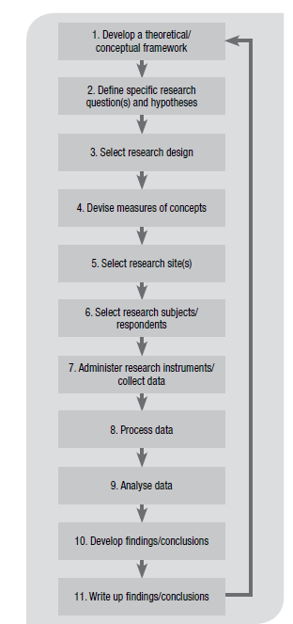

PROCESS OF QUANTITATIVE RESEARCH

Slide 7
INTRODUCTION
Think about data analysis at an early stage in the research process.
Decisions about methods and sample size affect the kinds of analysis you can do.
(Bryman et al., 2014:312)

Slide 8
UNDERSTANDING THE FUNDAMENTALS

Slide 9
DIFFERENCE BETWEEN A THEORETICAL AND CONCEPTUAL FRAMEWORK
The theoretical framework in a study is based on an existing theory or theories (e.g., a theory of motivation).
The conceptual framework, on the other hand, is something you can develop yourself based on this theory.

Slide 10
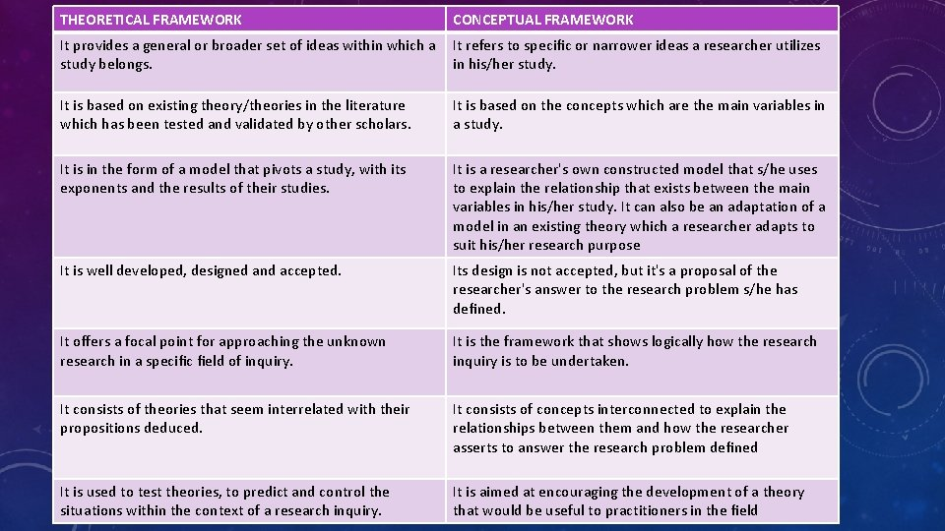
DIFFERENCE BETWEEN A THEORETICAL AND CONCEPTUAL FRAMEWORK

Slide 11
WHAT IS A CONSTRUCT AND A VARIABLE?
A construct is the abstract idea, underlying theme, or subject matter that one wishes to measure using survey questions. Constructs exist in the human brain and are not directly observable.
Intelligence, motivation, anxiety, and fear are all examples of constructs. In psychology, a construct is a skill, attribute, or ability that is based on one or more established theories.
Constructs are conceptualised at the theoretical (abstract) plane, while variables are operationalised and measured at the empirical (observational) plane.

Slide 12
DEPENDENT AND INDEPENDENT VARAIABLES
A dependent variable is a variable whose value will change depending on the value of another variable, called the independent variable.
You can think of independent and dependent variables in terms of cause and effect: an independent variable is the variable you think is the cause, while a dependent variable is the effect.
In an experiment, you manipulate the independent variable and measure the outcome in the dependent variable.

Slide 13
OTHER VARIABLES
A moderating variable is a type of variable that affects the relationship between a dependent variable and an independent variable.
A mediator variable is the variable that causes mediation in the dependent and the independent variables. In other words, it explains the relationship between the dependent variable and the independent variable.
A latent variable is a variable that cannot be observed. The presence of latent variables, however, can be detected by their effects on variables that are observable. Most constructs in research are latent variables.

Slide 14
TYPES OF DATA

Slide 15
THE TYPE OF DATA DOES MATTER
Four different types of quantitative data reflect different levels of measurement – nominal, ordinal, interval and ratio.
Why does this matter?
Well, because different statistical methods and techniques require different types of data. For example, some techniques work with categorical data (such as nominal or ordinal data), while others work with numerical data (such as interval or ration) – and some work with a mix.

Slide 16
CATEGORICAL AND/OR
NUMERICAL DATA
When you are collecting survey data (or, really any kind of quantitative data) for your research project, you’re going to land up with two types of data: categorical and/or numerical. These reflect different levels of measurement.

Slide 17
CATEGORICAL DATA
Categorical data is data that reflect characteristics or categories. For example, categorical data could include variables such as gender, hair colour, ethnicity, coffee preference, among others.
In other words, categorical data is essentially a way of assigning numbers to qualitative data (e.g. 1 for male, 2 for female, and so on).
Within categorical data, there are two levels of data, nominal and ordinal.

Slide 18
CATEGORICAL DATA:
WHAT IS NOMINAL DATA?
As we’ve discussed, nominal data is a categorical data type, so it describes qualitative characteristics or groups, with no order or rank between categories.
Examples of nominal data include:
Gender, ethnicity, eye colour, blood type
Brand of refrigerator/motor vehicle/television owned
Political candidate preference, shampoo preference, favourite meal
In all of these examples, the data options are categorical, and there is no ranking or natural order. In other words, they all have the same value – one is not ranked above another. So, you can view nominal data as the most basic level of measurement, reflecting categories with no rank or order involved.

Slide 19
CATEGORICAL DATA:
WHAT IS ORDINAL DATA?
Ordinal data is the same as nominal data in that it is looking at categories, but unlike nominal data, there is also a meaningful order or rank between the options. Here are some examples of ordinal data:
Income level (e.g. low income, middle income, high income)
Level of agreement (e.g. strongly disagree, disagree, neutral, agree, strongly agree)
Political orientation (e.g. far left, left, centre, right, far right)
As you can see in these examples, all the options are still categories, but there is an ordering or ranking difference between the options. You can not numerically measure the differences between the options (because they are categories, after all), but you can order and/or logically rank them. So, you can view ordinal as a slightly more sophisticated level of measurement than nominal.

Slide 20
NUMERICAL DATA
Numerical data, on the other hand, reflects data that are inherently numbers-based and quantitative in nature.
Examples: age, height, weight.
In other words, these are things that are naturally measured as numbers (i.e. they are quantitative), as opposed to categorical data (which involves assigning numbers to qualitative characteristics or groups).
Within numerical data, there are two levels of data, interval and ratio.

Slide 21
NUMERICAL DATA:
WHAT IS INTERVAL DATA? (1)
Interval data are a numerical data type. In other words, it is a level of measurement that involves data that is naturally quantitative (is usually measured in numbers).
Specifically, interval data has an order (like ordinal data), plus the spaces between measurement points are equal (unlike ordinal data).
Examples of interval data:
Credit scores (300 – 850)
GMAT scores (200 – 800)
IQ scores
The temperature in Fahrenheit

Slide 22
NUMERICAL DATA:
WHAT IS INTERVAL DATA? (2)
Importantly, in all of these examples of interval data, the data points are numerical, but the zero point is arbitrary. For example, a temperature of zero degrees Fahrenheit does not mean that there is no temperature (or no heat at all) – it just means the temperature is 10 degrees less the 10. Similarly, you cannot achieve a zero credit score or GMAT score.
In other words, interval data is a level of measurement that is numerical (and you can measure the distance between points), but that does not have a meaningful zero point – the zero is arbitrary.
Interval-type data offers a more sophisticated level of measurement than nominal and ordinal data, but it’s still not perfect.

Slide 23
NUMERICAL DATA:
WHAT IS RATIO DATA? (1)
Ratio-type data is the most sophisticated level of measurement. Like interval data, it is ordered/ranked and the numerical distance between points is consistent (and can be measured). But what makes it the king of measurement is that the zero point reflects an absolute zero (unlike interval data’s arbitrary zero point). In other words, a measurement of zero means that there is nothing of that variable.
Here are some examples of ratio data:
Weight, height, or length
The temperature in Kelvin (since zero Kelvin means zero heat)
Length of time/duration (e.g. seconds, minutes, hours)

Slide 24
NUMERICAL DATA:
WHAT IS RATIO DATA? (2)
In all of these examples, you can see that the zero point is absolute. For example, zero seconds quite literally means zero duration.
Similarly, zero weight means weightless. It’s not some arbitrary number. This is what makes ratio-type data the most sophisticated level of measurement.
With ratio data, not only can you meaningfully measure distances between data points (i.e. add and subtract) – you can also meaningfully multiply and divide.
For example, 20 minutes is indeed twice as much time as 10 minutes. You couldn’t do that with credit scores (i.e. interval data), as there’s no such thing as a zero credit score. This is why ratio data is king in the land of measurement levels.

Slide 25
WHY DOES IT MATTER?
The reason it’s important to understand the levels of measurement in your data – nominal, ordinal, interval and ratio – is because they directly impact which statistical techniques you can use in your analysis.
Each statistical test only works with certain types of data. Some techniques work with categorical data (i.e. nominal or ordinal data), while others work with numerical data (i.e. interval or ratio data) – and some work with a mix.
While statistical software like SPSS or R might “let” you run the test with the wrong type of data, your results will be flawed at best, and meaningless at worst.
The takeaway – make sure you understand the differences between the various levels of measurement before you decide on your statistical analysis techniques. Even better, think about what type of data you want to collect at the survey design stage (and design your survey accordingly) so that you can run the most sophisticated statistical analyses once you’ve got your data.

Slide 26
COLLECTING DEMOGRAPHIC DATA

Slide 27
EXAMPLES OF DEMOGRAPHIC DATA
Age
Gender (could be sensitive – add an option for “other”)
Race (sensitive)
Campus, Faculty, School, Unit, Position (affiliation)
Senior generation, younger generation (father, mother, son, daughter)
Highest academic qualification
Number of permanent employees
Turnover of the business (could be sensitive)
Industry (use the Standard Industry Classification (SIC))
Age of the business
Legal status of the business

Slide 28
DEMOGRAPHIC DATA AND
INFORMED CONSENT
Asking for consent: The following information is needed to help us with the statistical analysis of the data for comparisons among different interest groups (be more specific here). We appreciate your help in providing this important information.
Only for profiling: The purpose of collecting the demographic data is to form a profile of the participants and the participating organisations and will not be used to make comparisons between groups or for further statistical analyses.
[Refer to the example of the questionnaire included.]
+

Slide 29
COLLECTING DATA TO TEST HYPHOTHESES

Slide 30
PRIMARY OBJECTIVE
Investigating the relationship between entrepreneurial orientation and the success of small and medium-sized businesses.

Slide 31
THE CONTENT OF THE QUESTIONNAIRE
An attractive “title” page.
Cover letter (Informed consent).
Section gathering demographic data.
Section(s) measuring the variables.
[Note that this questionnaire was developed by Lotz (2009) and published by Lotz and Van der Merwe (2013).]

Slide 32
THE INDEPENDENT VARIABLES

Slide 33

DEFINITION OF THE CONSTRUCT: ENTREPRENEURIAL ORIENTATION
Entrepreneurial orientation (EO) refers to a business’ strategic orientation, one which captures the specific entrepreneurial aspects of decision-making styles, methods and practices. The entrepreneurial orientation construct consists of five independent dimensions, namely autonomy, innovativeness, risk-taking, pro-activeness and competitive aggressiveness.

Slide 34

ITEMS MEASURING AUTONOMY
I have enough autonomy in my job without continual supervision to do my work.
Our organisation allows me to be creative and try different methods to do my job.
Employees in our organisation are allowed to make decisions without going through elaborate justification and approval procedures.
Employees in our organisation are encouraged to manage their own work and have flexibility to resolve problems.
I seldom have to follow the same work methods or steps while performing my major tasks from day to day.

Slide 35

ITEMS MEASURING INNOVATIVENESS (1/2)
Our organisation regularly introduces new services/products/ processes.
Our organisation places a strong emphasis on new and innovative products/ services/processes.
Our organisation has increased the number of services/products offered during the past two years.
Our organisation is continually pursuing new opportunities.
Over the past few years, changes in
our processes, services and product lines
have been quite dramatic.

Slide 36
ITEMS MEASURING INNOVATIVENESS (2/2)
In our organisation there is a strong relationship between the number of new ideas generated and the number of new ideas successfully implemented.
Our organisation places a strong emphasis on continuous improvement in products/service delivery/processes.
Our organisation has a widely held belief that innovation is an absolute necessity for the organisation's future.
Our leaders seek to maximise value
from opportunities without constraint to
existing models, structures or resources.

Slide 37

ITEMS MEASURING RISK-TAKING
When confronted with uncertain decisions, our organisation typically adopts a bold posture in order to maximise the probability of exploiting opportunities.
In general, our organisation has a strong inclination towards high-risk projects.
Owing to the environment, our organisation believes that bold, wide-ranging acts are necessary to achieve the organisation’s objectives.
Employees are often encouraged to take calculated risks concerning new ideas.
The term ‘risk-taker’ is considered a positive attribute for employees in our organisation.

Slide 38

ITEMS MEASURING PRO-ACTIVENESS
Our organisation is very often the first to introduce new products/services/processes.
Our organisation typically initiates actions that competitors respond to.
Our organisation continuously seeks out new products/ processes/services.
Our organisation continuously monitors market trends and identifies future needs of customers.

Slide 39

ITEMS MEASURING COMPETITIVE AGGRESSIVENESS
In dealing with competitors our organisation typically adopts a very competitive undo-the-competitor "posture.
Our organisation is very aggressive and intensely competitive.
Our organisation effectively assumes an aggressive posture to combat trends that may threaten our survival or competitive position.
Our organisation knows when it is in danger
of acting overly aggressive (this could
lead to erosion of our organisation’s
reputation or to retaliation by our
competitors).

Slide 40
THE DEPENDENT
VARIABLES

Slide 41
ITEMS MEASURING BUSINESS GROWTH
Our business has experienced growth in turnover over the past few years.
Our business has experienced growth in profit over the past few years.
Our business has experienced growth in market share over the past few years.
The competitive position of our business has improved over the past few years.

Slide 42
ITEMS MEASURING BUSINESS DEVELOPMENT
AND IMPROVEMENT
The effectiveness (doing the right things) of our business has improved over the past few years.
The efficiency (doing things right) of our business has improved over the past few years.
In our business, employees are viewed as the most valuable asset of the business.
Our employees are highly committed to our business.
The moral (job satisfaction) of our employees has improved over the past few years.
The image (stature) of our business, relative to our competitors, has grown over the past few years.
During difficult economic periods, investments in research and development/innovative projects continue and no significant financial cuts are made.

Slide 43
CONCEPTUAL FRAMEWORK

Slide 44
CONCEPTUAL FRAMEWORK/MODEL

Slide 45
HYPOTHESES (1)
H^{1a}: There is a significant relationship between Autonomy in the business environment and Business growth in the participating small and medium-sized businesses.
H^{1b}: There is a significant relationship between Autonomy in the business environment and Business development and improvement in the participating small and medium-sized businesses.
H^{2a}: There is a significant relationship between the implementation of Innovativeness in the business environment and Business growth in the participating small and medium-sized businesses
H^{2b}: There is a significant relationship between the implementation of Innovativeness in the business environment and Business development and improvement in the participating small and medium-sized businesses

Slide 46
HYPOTHESES (2)
H^{3a}: There is a significant relationship between the practice of Risk-taking in the business environment and Business growth in the participating small and medium-sized businesses
H^{3b}: There is a significant relationship between the practice of Risk-taking in the business environment and Business development and improvement in the participating small and medium-sized businesses
H^{4a}: There is a significant relationship between the existence of Pro-activeness in the business environment and Business growth in the participating small and medium-sized businesses
H^{4b}: There is a significant relationship between the existence of Pro-activeness in the business environment and Business development and improvement in the participating small and medium-sized businesses

Slide 47
HYPOTHESES (3)
H^{5a}: There is a significant relationship between the Competitive aggressiveness of the business and Business growth in the participating small and medium-sized businesses
H^{5b}: There is a significant relationship between the Competitive aggressiveness of the business and Business development and improvement in the participating small and medium-sized businesses

Slide 48
OPERATIONALISATION OF VARIABLES

Slide 49
OPERATIONALISATION OF EO VARIABLES (1/2)
Autonomy refers to employees being encouraged to manage their own work without continual supervision and being allowed flexibility to be creative and try different methods to do their jobs.
Innovativeness refers to the regular introduction of new products/ services/processes, the increase in the number of service or product offerings during the past few years and the extent to which these new products/services/processes have been dramatic within the past few years.
Risk-taking refers to the organisation having a strong inclination towards high risk projects and when confronted with uncertainty, the organisation typically adopts a bold posture to maximise the probability of exploiting opportunities.

Slide 50
OPERATIONALISATION OF EO VARIABLES (2/2)
Pro-activeness refers to a posture of anticipating and acting on future wants and needs in the marketplace, thereby creating a first-mover advantage vis-à-vis competitors.
Competitive aggressiveness refers to an organisation’s propensity to directly and intensely challenge its competitors to improve their position in the marketplace.

Slide 51
OPERATIONALISATION OF THE BUSINESS SUCCESS VARIABLES
Business growth refers to growth in profits, turnover, market share and the competitive position of the business over the past few years.
Business development and improvement refers to highly committed employees viewed as the most valuable asset of the business and the improvement of job satisfaction, image of the business, efficiency and effectiveness over the past few years with continued investments in research and development/innovative projects even during difficult economic periods.

Slide 52
USE AND ADAPT THE EXAMPLES
Please feel free to use and adapt these examples so that they would apply to your study.
It could help you to write up your research design in the methods section of your assignment in an appropriate manner.
[Be aware of plagiarism!!!]

Slide 53
FUNDAMENTALS OF SURVEYS AND QUESTIONNAIRES

Slide 54
Take note that this section provides the theory and fundamentals of the collection of quantitative data.
Refer to the prescribed textbook (Bryman et al., 2014).

Slide 55
WHAT IS A SELF-COMPLETION QUESTIONNAIRE?
Also called a self-administered questionnaire.
No interviewer present.
Respondent writes answers on form.
Returned to researcher or deposited for collection.
Usually postal questionnaires.
Can be distributed in person or by email.
(Bryman et al., 2014:191)

Slide 56
COMPARING SELF-COMPLETION QUESTIONNAIRES WITH STRUCTURED INTERVIEWS
Self-completion questionnaires tend to:
  Have fewer open questions.
  Have easier to follow designs.
  Be shorter, to reduce ‘respondent fatigue’.
(Bryman et al., 2014:192)

Slide 57
ADVANTAGES OF SELF-COMPLETION QUESTIONNAIRES
Cheaper and quicker to administer (to widely dispersed populations).
No interviewer effects or variability.
Convenience for respondents.
(Bryman et al., 2014:192)

Slide 58
DISADVANTAGES OF SELF-COMPLETION QUESTIONNAIRES
Can not probe or prompt.
Can mainly ask questions that respondents will perceive as important to them.
Few open-ended or complex questions.
The respondent can see the whole questionnaire before answering (question order effects).
Can not ensure that the ‘right’ person answers.
Can not collect additional data.
Respondent fatigue if too many questions.
Excludes people with limited literacy skills.
Greater risk of missing data.
Lower response rates.
(Bryman et al., 2014:192)

Slide 59
TIPS TO IMPROVE RESPONSE RATES TO POSTAL QUESTIONNAIRES
Response rate could be regarded as an indicator of the validity of findings, but validity also depends on other factors while statistical techniques can address shortcomings.
Response rates can be improved by e.g.:
  Writing a good covering letter.
  Including a stamped addressed envelope.
  Issuing reminders.
  Using shorter and well-designed questionnaires.
  Giving clear instructions.
  Using a layout attractive to the respondent.
(Bryman et al., 2014:192)

Slide 60
EMAIL SURVEYS
‘Embedded’ surveys have their questions appearing as part of the email message.
‘Attached’ surveys have separate questionnaires available for down-loading.
Embedded questionnaires are easier to complete and return to the researcher.
Attached questionnaires can be made more attractive in appearance, can be better organised and use more question types.
But, ‘embedded’ tends to have a higher rate of response. (although the response pattern may not vary between the two types). (Bryman et al., 2014:290)

Slide 61
WEB SURVEYS (1)
Web surveys work by inviting respondents to a website link.
They can be made to appear much more attractive than other types of survey, in appearance and design:
  Questionnaires can be designed so that filter questions (for example, ‘if yes, go to question 12, if no go to question 14’) can be programmed to skip automatically to the next appropriate question.
  Or so that only one question ever appears on the screen.
  Or so that respondents can scroll down and look at all questions in advance.
(Bryman et al., 2014:290)

Slide 62
WEB SURVEYS (1)
Respondents’ answers can be automatically programmed to download into a database, eliminating the coding chore.
The researcher needs to be skilled in the use of HTML or else use one of the many software questionnaire design packages available.
Survermonkey is an example of this kind of software.
Other examples are QuestionPro and Google Forms.
(Bryman et al., 2014:292)

Slide 63
ADVANTAGES OF ONLINE SURVEYS VERSUS POSTAL QUESTIONNAIRE SURVEYS
Low cost
Faster response
Attractive formats
Mixed administration
Unrestricted reach
Fewer unanswered questions
Better response to open questions
Better data accuracy, especially in web surveys
Refer to the tips and skills
(Bryman et al., 2014:293, 294)

Slide 64
DISADVANTAGES OF ONLINE SURVEYS VERSUS POSTAL QUESTIONNAIRE SURVEYS
Low response rate
Restricted to online populations
Requires motivation
Confidentiality and anonymity issues
Multiple replies
Refer to the tips and skills (pp. 293-294)
(Bryman et al., 2014:293-294)

Slide 65
TIPS IN DESIGNING A SELF-COMPLETION QUESTIONNAIRE
Use an uncluttered layout:
  neither too short and cramped nor too long and bulky
Aim for clear presentation:
  variety of font sizes, bold print, italics, and CAPITAL letters can be used
  but be consistent
Arrange fixed questions vertically:
Less confusing to read
Questions can be distinguished from answers
Respondent is less likely to make a mistake
Questionnaire is easier to pre-code (Bryman et al., 2014:195)

Slide 66
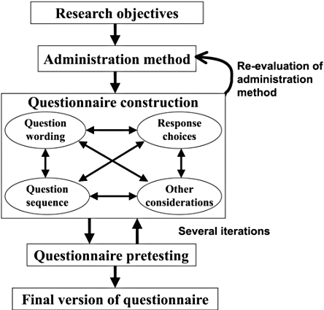

Slide 67
FORMATTING A LIKERT SCALE
In the next set of questions, you are presented with a statement.
You are being asked to indicate your level of agreement or disagreement with each statement by indicating whether you: Strongly Disagree (SD), Disagree (D), are Undecided (U), Agree (D), or Strongly Agree (SA).
Please indicate your level of agreement by circling the appropriate response:
23. My job is like a hobby to me.
SD D U A SA (or on a scale ranging from 1 – 5)
24. My job is usually interesting enough to keep me from getting bored.
SD D U A SA
(Bryman et al., 2014:191)

Slide 68
GIVE CLEAR INSTRUCTIONS
HOW TO RESPOND
How to indicate choice of answer:
  a tick, a circle, an underline…?
If more than one answer can be given:
  sometimes you might want the respondent to select a number of possibilities from a list.
  (Bryman et al., 2014:196)

Slide 69
KEEP QUESTIONS AND ANSWERS TOGETHER
Never spread a question over two pages
Locate the answers alongside each corresponding question, particularly for questions involving Likert scales.
(Bryman et al., 2014:197)

Slide 70
OPEN QUESTIONS
  Advantages:
Respondents answer in their own terms
Answers not suggested
Allow for new, unexpected responses
Exploratory - generate fixed answer questions
  Disadvantages:
Time-consuming for interviewer and respondent
Difficult to code
More effort required from respondent
  (Bryman et al., 2014:199)

Slide 71
CLOSED QUESTIONS
  Advantages:
Quicker and easier to complete (better response rate and less missing data)
Easy to process data (pre-coded)
Easy to compare answers (intercoder reliability)
  Disadvantages:
Restrictive range of answers: no spontaneity; irritation value
Difficult to make fixed choice answers exhaustive
Respondents may interpret questions differently
  (Bryman et al., 2014:197)

Slide 72
TYPES OF QUESTIONS
Personal factual questions
Factual questions about others
Informant factual questions
Attitudes
Beliefs
Normative standards and values
Knowledge of a subject
(Bryman et al., 2014:253)

Slide 73
DESIGNING QUESTIONS (1)
General rules:
Remember your research questions
Decide exactly what you want to find out
Imagine yourself as a respondent
  How would you answer the questions?
  Identify any vague or misleading questions
(Bryman et al., 2014:204)

Slide 74
DESIGNING QUESTIONS (2)
  Things to avoid:
Ambiguous terms: ‘often’, ‘regularly’, ‘frequently’
Long questions
Double-barrelled questions: there may be different answers to each part
Very general questions: they lack a frame of reference
Leading questions: they hint at a preferred response
Asking two questions in one
Negative terms: ‘not’, ‘never’ - especially double negatives
Technical terms (jargon and acronyms)
(Bryman et al., 2014:206)

Slide 75
DESIGNING QUESTIONS (3)
  Things to make sure of:
Do the respondents have the requisite knowledge?
If you just want a yes/no answer, have you given more possibilities?
Have you an equal number of positive and negative responses to a question to avoid bias?
Are you relying too much on the respondent’s memory?
Have you thought through whether you should include “don’t know” options?
(Bryman et al., 2014:207)

Slide 76
PILOTING AND PRE-TESTING QUESTIONS
Check that the research instrument works:
  Gain practice in using the interview schedule
  Does each question flow smoothly on to the next?
  Identify vague, confusing or uncomfortable questions
  Remove any questions that receive uniform responses
  Determine adequacy of instructions.
Open questions can generate fixed choice answers for closed questions in the main research
Be careful that people who help with your pilot study are not included in the final sample
(Bryman et al., 2014:209)

Slide 77
USING EXISTING QUESTIONS/INSTRUMENTS
Common practice in survey research
Questions have already been piloted
Known properties of reliability and validity
Helps you to draw comparisons with other studies
(Bryman et al., 2014:210)

Slide 78
EXAMPLE: DESIGNING THE MEASURING INSTRUMENT
Designing the measuring instrument
A measuring instrument (see Annexure C) in the form of an online, closed-ended, self-administered and structured questionnaire has been designed to collect the primary data needed to achieve the objectives of this study. The items that constitute the questionnaire were sourced from existing literature or were created by the researcher based on additional literature consulted. The questionnaire consists of two sections. Section A focuses on acquiring the demographic information of the respondents and their businesses by means of multiple-choice questions. Section B makes use of a seven-point Likert scale in which the respondents are able to indicate their level of agreement with statements measuring the independent variables (Financial resources, Human resources and leadership, Information and knowledge, Entrepreneurial orientation, Market orientation and Organisational culture) and the dependent variables (Innovation output and Perceived financial performance) of the study.
[Refer to Venter, 2021 – MBA Research Day C.]

Slide 79
EXAMPLE: DATA COLLECTION
Data collection
Due to the online nature of the study, the questionnaire will be distributed to the respondents via email. The researcher, research supervisor and four honours students at Nelson Mandela University will distribute emails to possible respondents. In addition to asking for their participation, the cover letter (see Annexure B) will also be displayed as a part of the email message that was sent to the respondents and presented the purpose of the study, ethical matters and instructions to complete the questionnaire. The cover letter contains a link to the online questionnaire, which will be facilitated by the Nelson Mandela University’s online survey tool. Once the questionnaire is accessed, the first page consists of an informed consent form (see Annexure E), which requires the respondents to accept the conditions of the study and offer their informed consent before gaining access to the full questionnaire.
[Refer to Venter, 2021 – MBA Research Day C.]

Slide 80
USE AND ADAPT THE EXAMPLES
Please feel free to use and adapt these examples so that they would apply to your study.
It could help you to write up your research design in the methods section of your assignment in an appropriate manner.
[Be aware of plagiarism!!!]

Slide 81
VALIDITY AND RELIABILITY

Slide 82
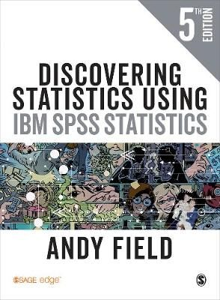
VALIDITY AND RELIABILITY OF THE INSTRUMENT
Validity refers to whether the measuring instrument measures what it was designed to measure. Reliability refers to the ability of the measuring instrument to produce the same results under the same conditions (Field, 2009:11, 12).
[Read more about the two aspects.]
[The textbook by Andy Field (Discovering statistics using SPSS) is an excellent source. The book is written in layman’s English and is a fun read. Believe me, Andy’s book makes statistics fun.]

Slide 83
WHAT DOES RELIABILITY MEAN?
Stability:
Is the measure stable over time?
e.g., test–retest method
Internal reliability:
Are the indicators consistent?
e.g., split-half method
Inter-observer consistency:
Is the measure consistent between observers?
(Bryman et al., 2014:36)

Slide 84
WHAT DOES VALIDITY MEAN?
Does the indicator measure the concept?
It does if it has:
  Face validity (right for the concept?)
  Concurrent validity (supported by a relevant criterion today?)
  Predictive validity (likely to be supported by a relevant criterion tomorrow?)
  Construct validity (are useful hypotheses produced?)
  Convergent validity (supported by results from other methods?)
(Bryman et al., 2014:38)

Slide 85
RELEVANCE TO MEASUREMENT
Are instruments:
  Reliable (i.e. consistent and stable)
  Valid (i.e. do they really reflect the concept they are supposed to be measuring)?
(Bryman et al., 2014:39)
[We will later on discuss trustworthiness – the term used for qualitative studies.]

Slide 86
EXAMPLE OF A QUESTIONNAIRE

Slide 87
THE CONTENT OF THE QUESTIONNAIRE
An attractive “title” page.
Cover letter (Informed consent).
Section gathering demographic data.
Section(s) measuring the variables.
[Note that this questionnaire was developed by Lotz (2009) and published by Lotz and Van der Merwe (2013).]

Slide 88
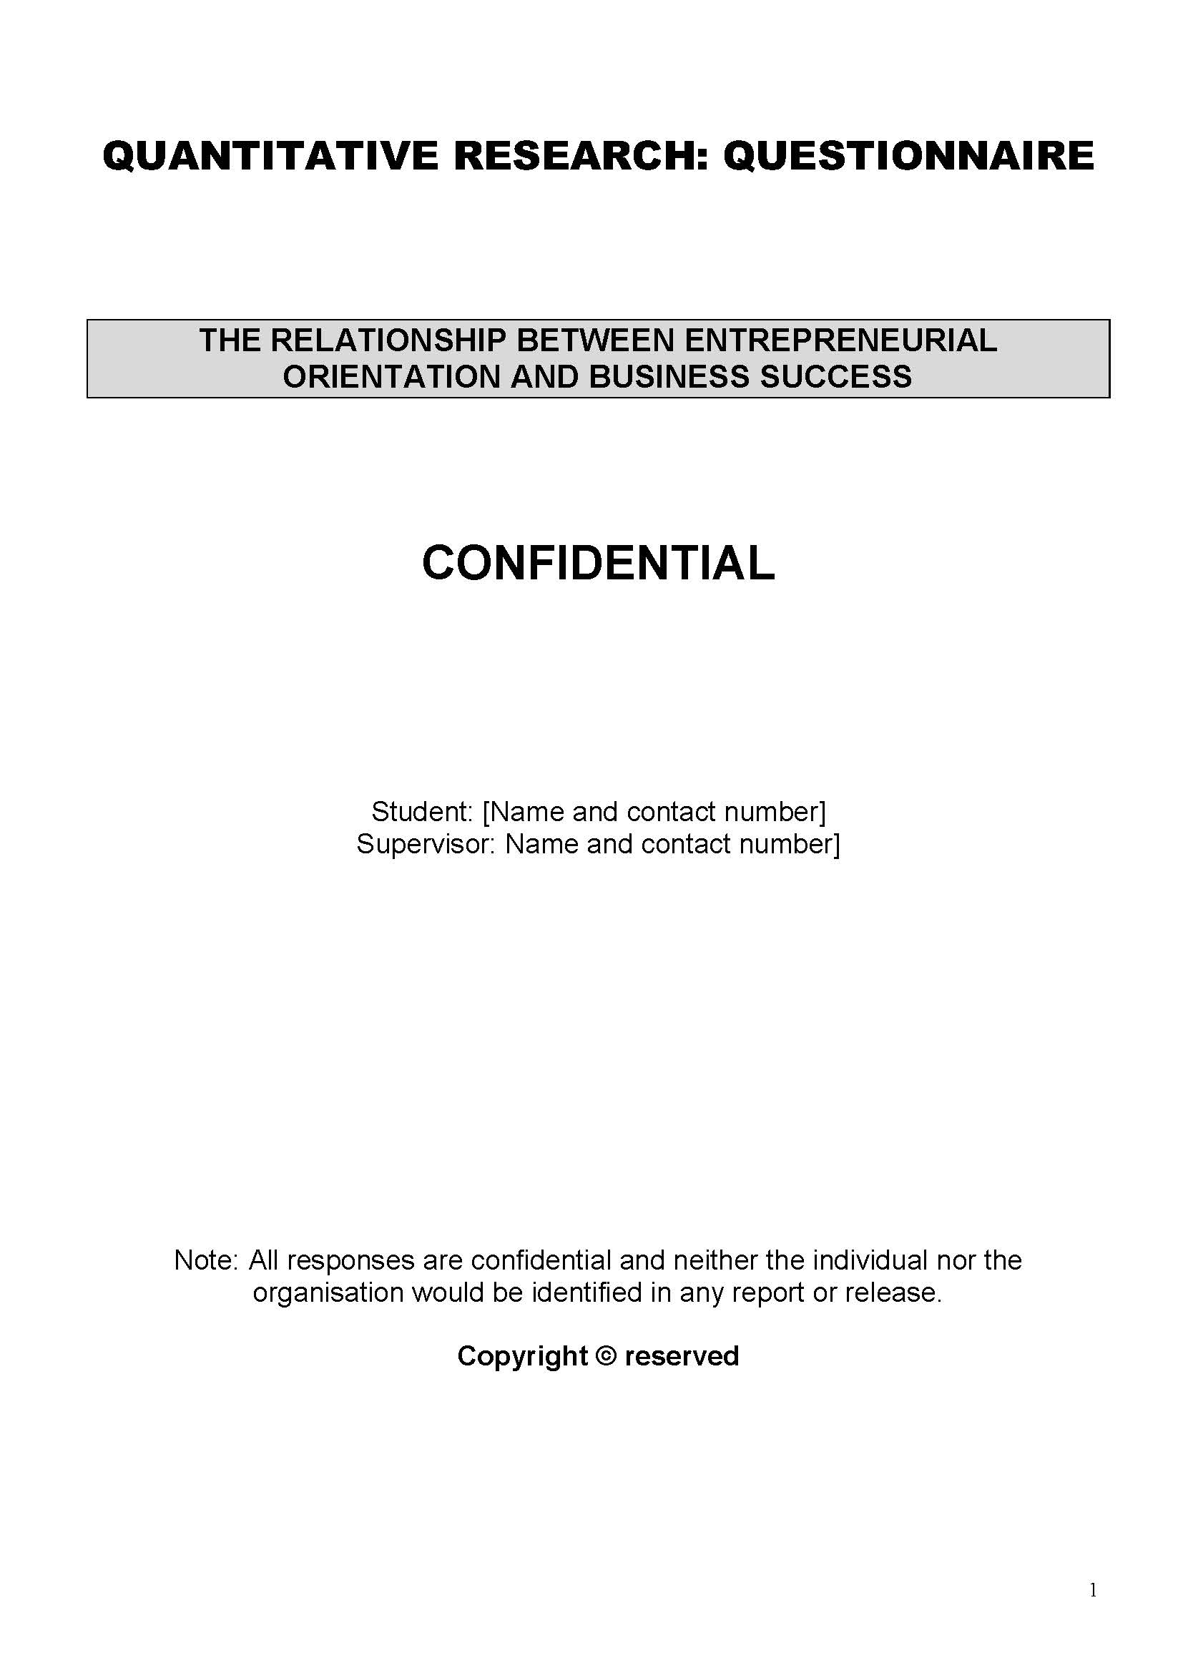
EXAMPLE: TITLE PAGE

Slide 89
EXAMPLE: COVER LETTER
My name is Baile Sebetlele and I am an MBA student at the NWU Business School, North-West University. This study aims to assess the relationship between entrepreneurial orientation and the success of SMME's in selected townships in the Gauteng province in South Africa.
Thank you for your willingness to participate in the study. Your participation is voluntary. You do not have to answer any questions you do not want to answer. If at any time you do not want to continue completing the questionnaire, you may stop. Your time and involvement are profoundly appreciated. It will take you 20 minutes to complete the questionnaire.
The questionnaires will be hand-delivered to you during the tender meetings. The researcher will gather the completed questionnaires and no one else will handle the questionnaires. The completed questionnaires will be captured and analysed by the Statistical Consultation Services at the North-West University. The data will be safeguarded with password protection and all hard copies of the questionnaires or statistical analyses will be destroyed after three years.
The researcher will ensure that all results will be kept confidential, and no ethical guidelines will be breached. Only the researcher, the supervisor and statistician will have access to the data being captured. After the specified timeframe, the data collection process will end and the statistical analysis will commence, which will take place scientifically and ethically.
Limited biographic information will be collected with the purpose to form a profile of the participants but will not be used to make comparisons between groups or for further statistical analyses. If at a subsequent date, biographical data were relevant to a publication, a separate release form would be sent to you.
Your input is of great value to this research, and I appreciate your help in providing this information. I would be grateful if you would sign this form on the line provided below to show that you have read and agree with the contents. Please return it with the completed questionnaire.

Slide 90
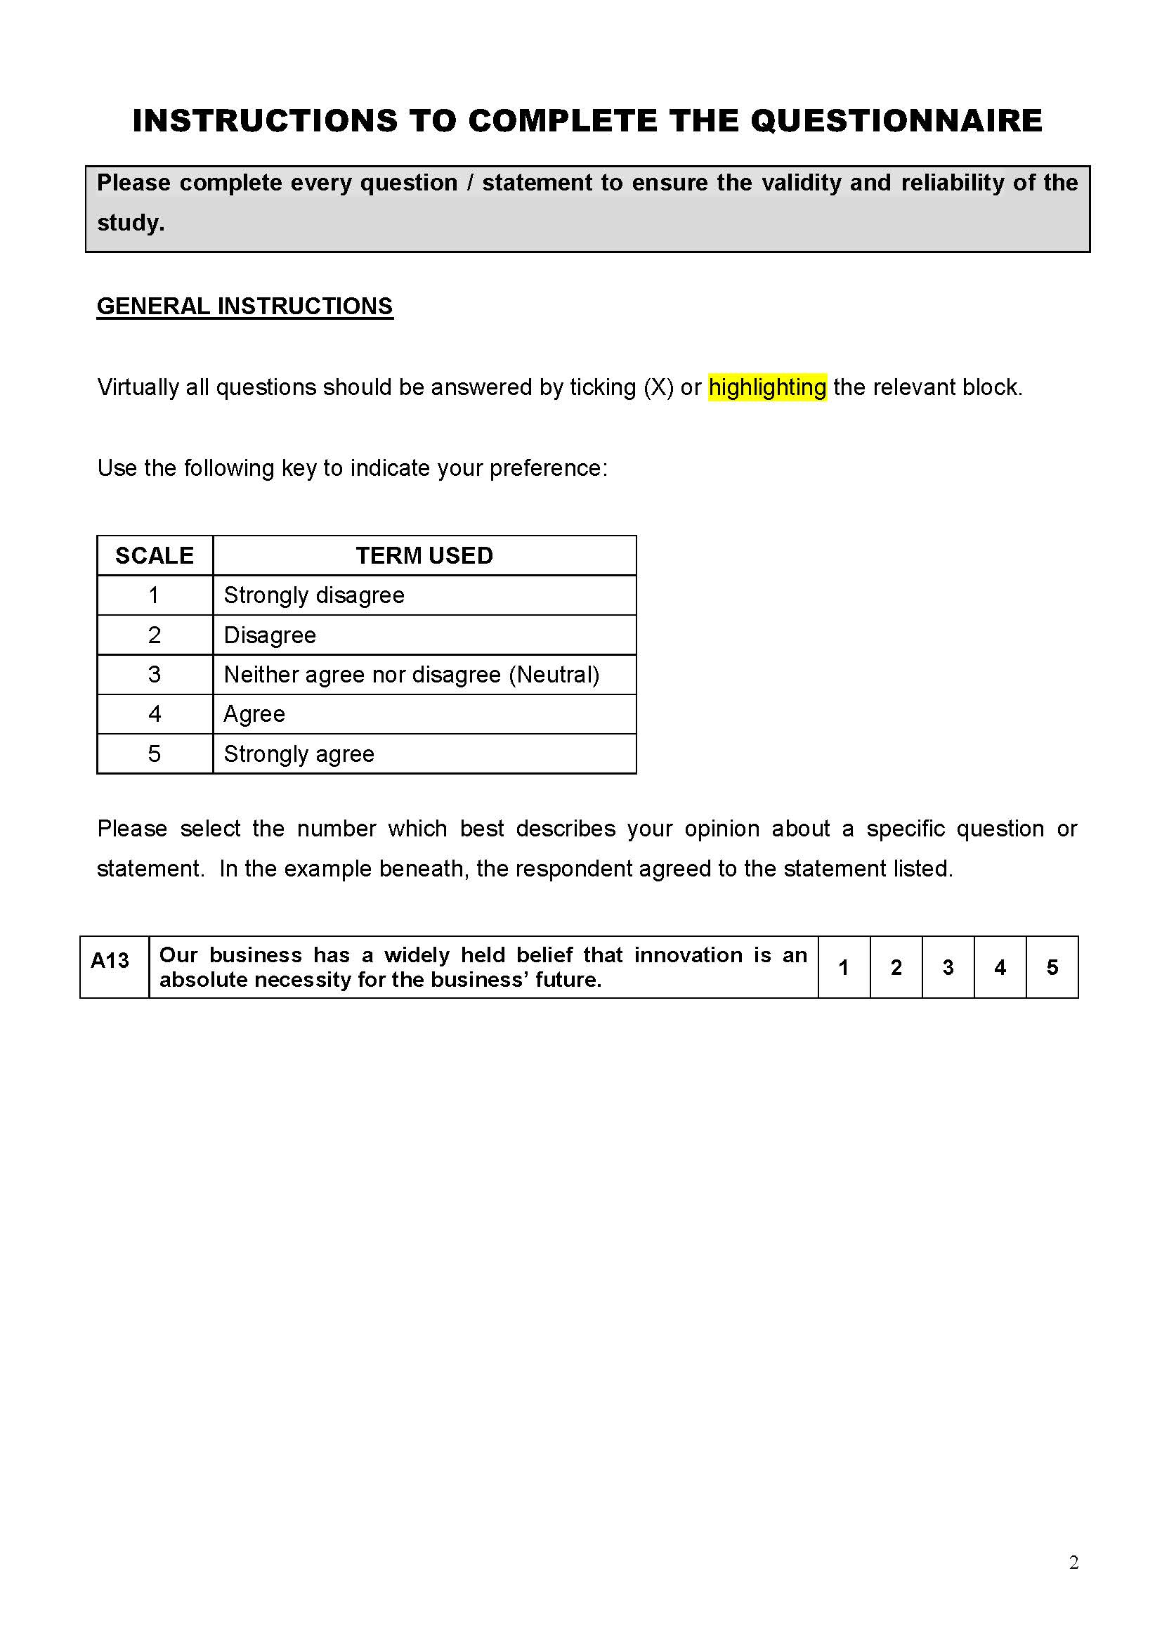
INSTRUCTIONS

Slide 91
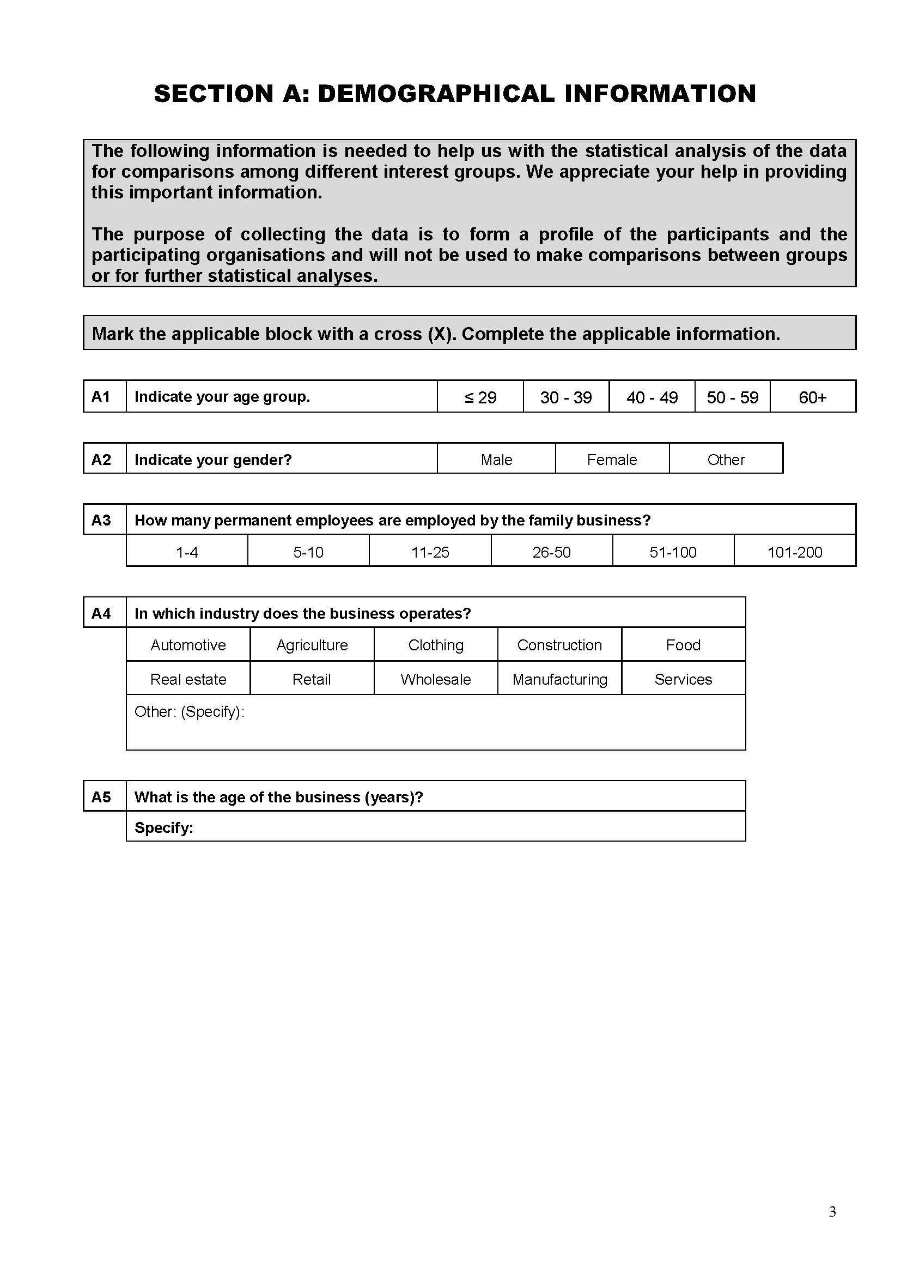
EXAMPLE:
GATHERING DEMOGRAPHIC DATA

Slide 92
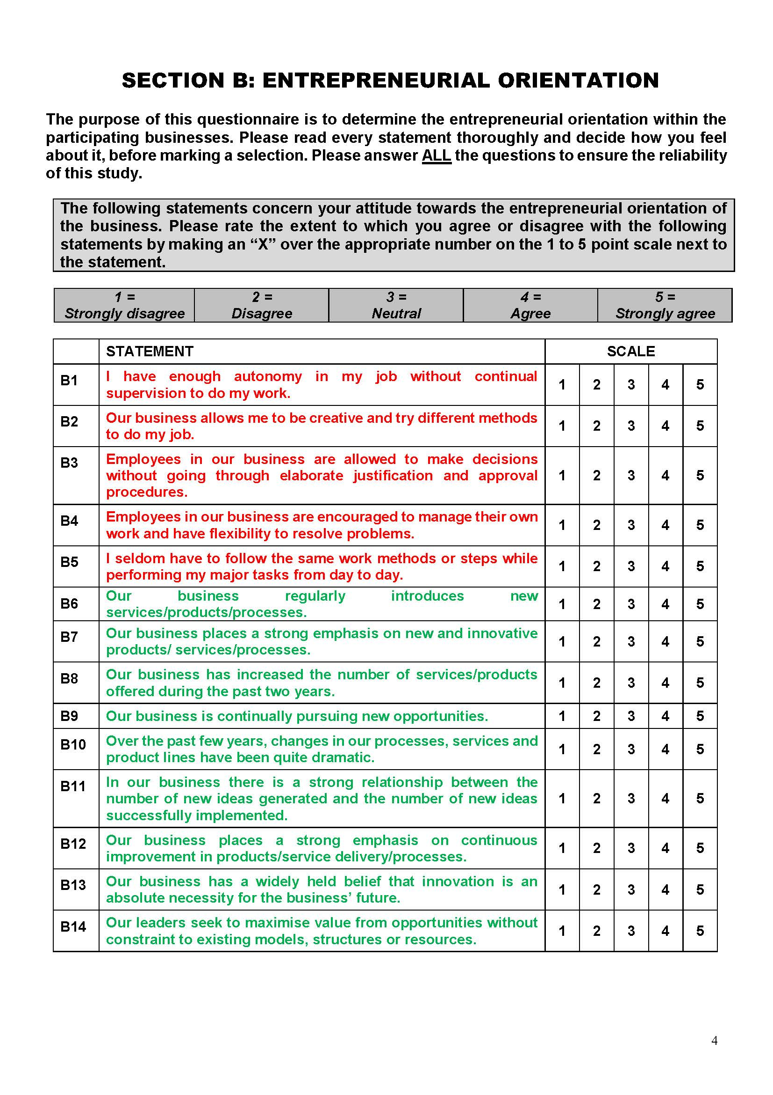
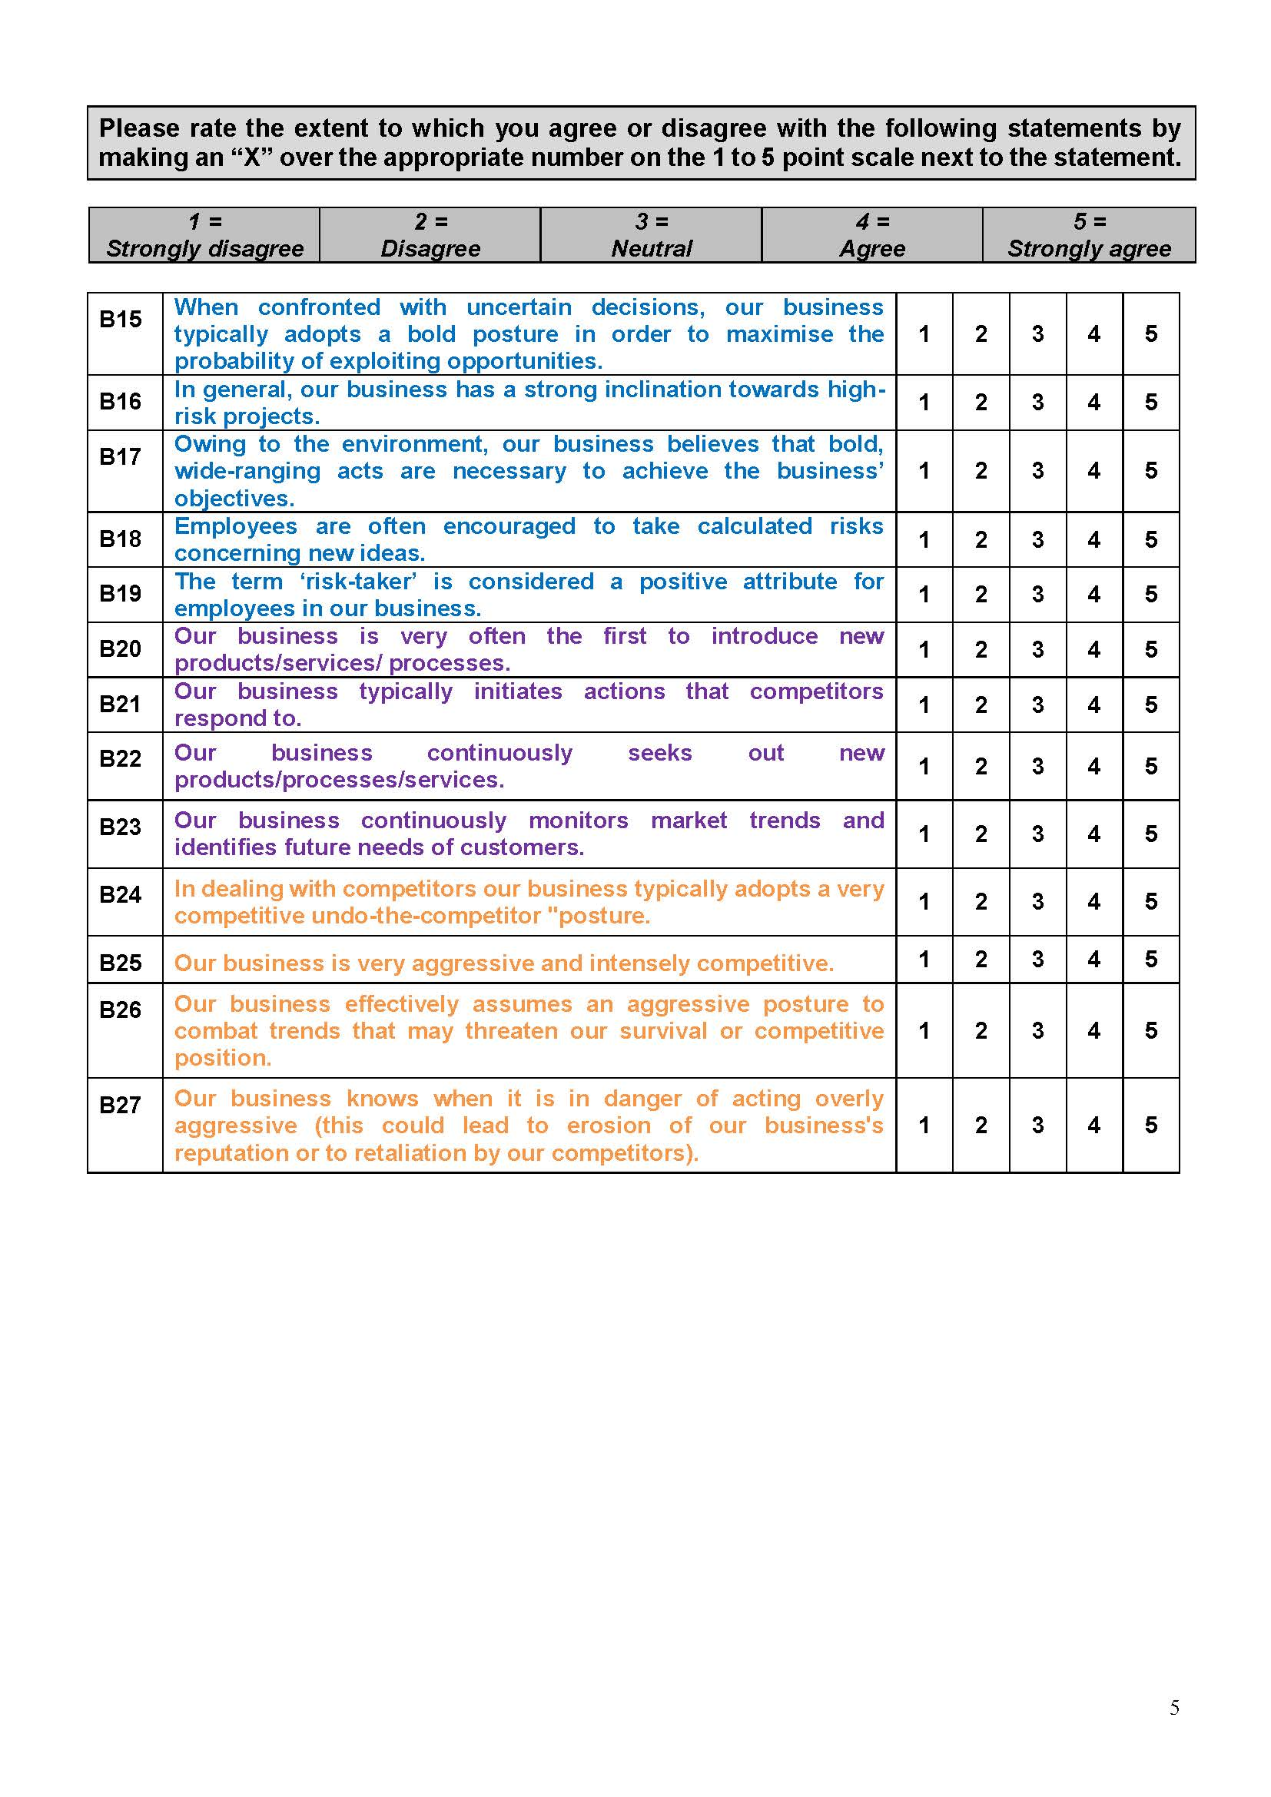
EXAMPLE:
MEASURING THE VARIABLES (1/2)

Slide 93
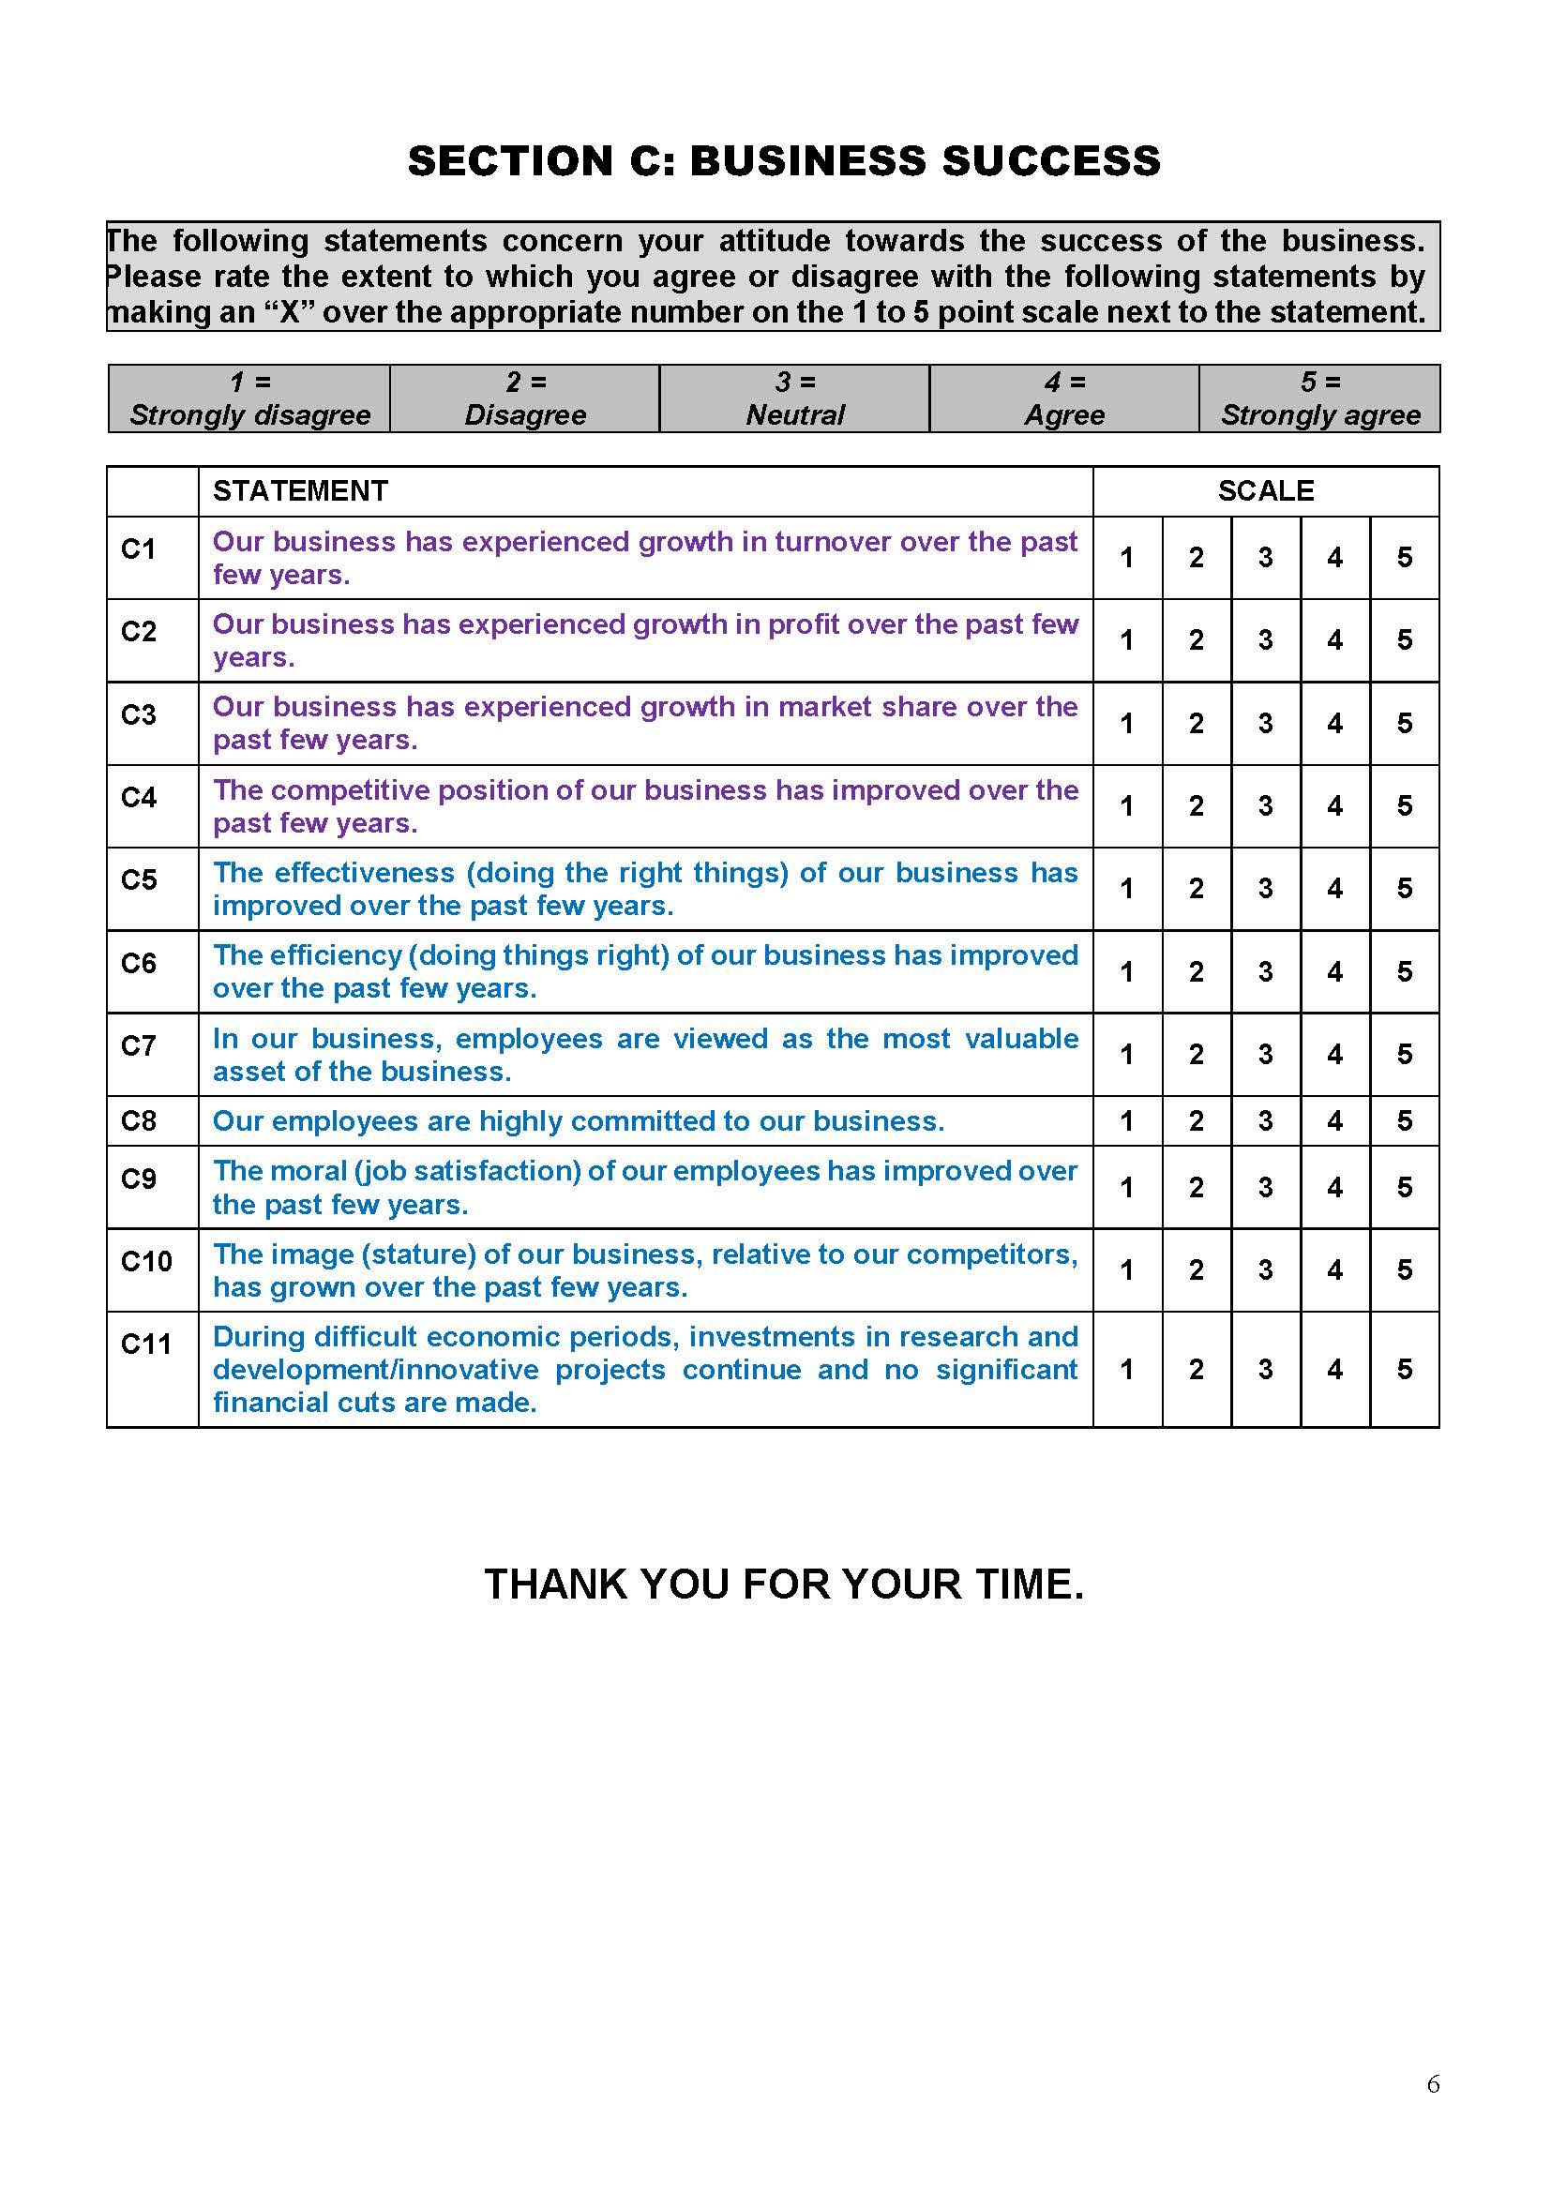
EXAMPLE:
MEASURING THE VARIABLES (2/2)

Slide 94
OTHER CONSIDERATIONS

Slide 95
YOUR RESEARCH QUESTIONS AND HYPOTHESES (1)
The nature of your research questions and research hypotheses will heavily influence which statistical methods and techniques you use.
If you’re just interested in understanding attributes of your sample (as opposed to the entire population), then descriptive statistics are probably all you need.
For example, if you just want to assess means (averages) and medians (centre points) of variables in a group of people.

Slide 96
YOUR RESEARCH QUESTIONS AND HYPOTHESES (2)
If your research questions are investigating an entire population, looking to understand differences between groups or relationships between variables, then you’ll likely need both descriptive statistics and inferential statistics.
Therefore, its really important to get very clear about your research aims and objectives, and more importantly, your research questions and hypotheses before you start looking at which statistical techniques to use. Don not try to shoehorn a specific statistical technique into your research just because you like it or have some experience with it.

Slide 97
EXAMPLE: DATA ANALYSIS
For the purpose of this study, the primary data collected from the research questionnaire will be captured in a spreadsheet using Microsoft Excel. The data analysis procedures will commence with the determination of validity and reliability using an exploratory factor analysis (EFA) and Cronbach’s alpha coefficients, respectively.
Next, descriptive statistics such as the mean, standard deviation and frequency distributions were undertaken, followed by inferential techniques including Pearson’s product moment correlation coefficients, a t-test, Analysis of Variance (ANOVA) tests and multiple regression analyses.
[Descriptive statistics include three distinct concepts, such as the mean, standard deviation and frequency distribution (Wiid & Diggines, 2013:248).
With inferential statistics, you take data from samples and make generalisations about a population. This means taking a statistic from your sample data and using it to say something about the population parameter. It allows you to make predictions (inferences) from the data.]
[Refer to Venter, 2021 – MBA Research Day C.]

Slide 98
INFORMED CONSENT IN QUANTITATIVE STUDIES
Will respondents be informed on what the purpose of the study is?
Is participation in the study voluntary?
Have you included the estimated time to complete the questionnaire?
Can the respondents withdraw from the study if they wish to do so?
Are respondents informed that the data will be used for research purposes (research project, publication)?
Have you included how the data will be safeguarded or protected?
How will confidentiality and/or anonymity be maintained in the study?
Will respondents be rewarded or given incentives? If yes, elaborate on the nature of the reward/incentive and the process to be followed.

Slide 99
EXAMPLE OF AN INFORMED CONSENT LETTER (1)
INFORMED CONSENT TO PARTICIPATE IN A SURVEY
My name is Baile Sebetlele and I am an MBA student at the NWU Business School, North-West University. This study aims to assess the relationship between entrepreneurial orientation and the success of SMME's operation in selected townships in the Gauteng province in South Africa. This study forms part of a mini-dissertation to be submitted in partial fulfilment of the requirements for the degree Master of Business Administration at the North-West University. It is an internationally accredited degree that requires adherence to strict ethical standards as a prerequisite to conducting this research.
Thank you for your willingness to participate in the study. Your participation is voluntary. You do not have to answer any questions you do not want to answer. Limited demographic information will be collected with the purpose to form a profile of the participants and the participating organisations, but will not be used to make comparisons between groups or for further statistical analyses.
If at any time you do not want to continue completing the questionnaire, you may stop. Your time and involvement are profoundly appreciated. It will take you 20 minutes to complete the questionnaire.
The questionnaires will be hand-delivered to you during the tender meetings. The researcher will gather the completed questionnaires in person and no one else will handle the questionnaires. The completed questionnaires will be captured and analysed by the Statistical Consultation Services at the North-West University. The data will be safeguarded with password protection and all hard copies of the questionnaires or statistical analyses will be destroyed after three years.

Slide 100
EXAMPLE OF AN INFORMED CONSENT LETTER (2)
The researcher will ensure that all results will be kept confidential and no ethical guidelines will be breached. Only the researcher, the supervisor and statistician will have access to the data being captured, but your name will not be revealed at any stage of the data collection, data analyses and the discussion of the results of the study.
The study has been approved by the Scientific Committee of the NWU Business School. The Chair of the Scientific Committee is Prof Christoff Botha. He can be reached at 018 299 1672 and his email address is christoff.botha@nwu.ac.za.
Ethical clearance has been obtained by the Faculty of Economic and Management Sciences Ethics Committee (EMS-REC) and the following ethical clearance number is allocated: [Put in number here]. The Chair of the Ethical Committee is Prof Mark Rathbone. He can be reached at 018 299 1356 and his e-mail address is mark.rathbone@nwu.ac.za.
The supervisor of the thesis is Professor Stephan Van der Merwe. He can be reached at 018 299 1414
(Email address: stephan.vandermerwe@nwu.ac.za) for further questions or concerns about the research project.
Your input is of great value to this research and I appreciate your help in providing this information.
Sincerely,
BAILE SEBETLELE
NWU Business School
North-West University, Potchefstroom

Slide 101
USE AND ADAPT THE EXAMPLES
Please feel free to use and adapt these examples so that they would apply to your study.
It could help you to write up your research design in the methods section of your assignment in an appropriate manner.
[Be aware of plagiarism!!!]

Slide 102
ETHICAL CONSIDERATIONS IN QUANTITATIVE STUDIES
Ethical issues anticipated before beginning the proposed study
(i.e., selection of worthy topic, non-intrusive topic).
Ethical issues anticipated before beginning the proposed study
(i.e., recruitment and accessing of site).
Ethical issues anticipated during data collection (i.e., informed consent).
Ethical issues anticipated during data analysis (i.e., competence).
Ethical issues anticipated when reporting, sharing, and storing data (especially when organisations have access to the data)
(i.e., peer review also matters here).
Provide ways in which to mitigate ethical risks during each phase of the proposed study.
How are you going to comply with the relevant issues concerning the POPIA Act? [Refer to the slides by Leoni van der Vaart.]

Slide 103
THE SHAPE OF THE DATA
Another important factor is the shape of the data – in other words, does it have a normal distribution (i.e. is it a smooth bell-shaped curve, centred in the middle) or is it very skewed to the left or right.
Again, different statistical techniques work for different shapes of data – some are designed for symmetrical data while others are designed for skewed data.
Yet another reminder of the importance of descriptive statistics!

Slide 104
APPLYING THE CONTENT

Slide 105
APPLYING THE CONTENT OF THIS STUDY UNIT:
ASSIGNMENT 2
Recruitment of potential participants and data collection [15 marks]
15. Describe the nature of the recruit-ment of potential participants. [Note that good ethical conduct and the POPIA Act are guiding the actions in this regard.] | Explain the following: Who will have contact with the participants? What will be communicated? How will this be communicated? What will the role of the researcher(s) and participants be? | /5
16. Describe in as much detail as possible the nature of the data you intend to collect. Explain whether the data will be in the form of questionnaires, interviews and focus groups. | If you are using questionnaires, please indicate whether these will be existing questionnaires or self-developed instruments, and please include the concept questionnaire(s) in this assignment. Also, provide proof of the reliability and validity of the questionnaires. When using interviews, provide the concept interview questions you intend to ask the participants. | /5

Slide 106
APPLYING THE CONTENT OF THIS STUDY UNIT:
ASSIGNMENT 2
17. Explain the process through which you intend to collect your data. | Explain how you intend to gather the data (for example, will you deliver questionnaires by hand or email/how you will contact the individuals for interviews/how you plan on obtaining your financial or other information). | /5

Slide 107
APPLYING THE CONTENT OF THIS STUDY UNIT:
ASSIGNMENT 2
Data analysis [15 marks]
18. Describe in as much detail as possible how you will analyse your data by indicating the data analysis techniques and methods you will use. Also provide details regarding possible software programs to be used (where applicable). | If you are analysing quantifiable questionnaire data, indicate the statistical procedures and tests you will apply in your data analysis in line with research objectives. For qualitative data (e.g. interviews), indicate the method and process you will follow to analyse your textual data in line with research objectives. Indicate the software programs to be used (where applicable). | /10
19. Explain the process that you will follow to ensure the rigour of the research. | Explain how you will build in the reliability and validity (quantitative research) and trustworthiness (qualitative research) of your data and findings. | /5

Slide 108
APPLYING THE CONTENT OF THIS STUDY UNIT:
ASSIGNMENT 2
Ethical issues and informed consent [10 marks]
20. Describe in as much detail as possible how you will deal with the ethical issues in the study. | Explain the following: Ethical issues anticipated before beginning the proposed study (i.e., selection of worthy topic, non-intrusive topic). Ethical issues anticipated before beginning the proposed study (i.e., recruitment and accessing of site). Ethical issues anticipated during data collection (i.e., informed consent). Ethical issues anticipated during data analysis (i.e., competence). Ethical issues anticipated when reporting, sharing, and storing data (especially when organisations have access to the data) (i.e., peer review also matters here). Provide ways in which to mitigate ethical risks during each phase of the proposed study. How are you going to comply with the relevant issues concerning the POPIA Act? | /5

Slide 109
APPLYING THE CONTENT OF THIS STUDY UNIT:
ASSIGNMENT 2
21. Provide detail on how informed consent to participate in the study will be sought. | Explain the following: Will participants be informed on what the purpose of the study is? Is participation in the study voluntary? Can the participants withdraw from the study if they wish to do so? Are participants informed that the data will be used for research purposes (research project, publication)? How will confidentiality and/or anonymity be maintained in the study? Will participants be rewarded or given incentives? If yes, elaborate on the nature of the reward/incentive and the process to be followed. | /5

Slide 110
APPLYING THE CONTENT OF THIS STUDY UNIT:
ASSIGNMENT 2
Technical aspects [10 marks]
22. Technical aspects. | Layout (font, spacing, headings, logical flow) Language (grammar, sentences, spelling). Referencing – NWU Referencing Guide (2020, Harvard) (in-text and reference list). | /5
23. Application of the technical care sheet. | Refer to the technical care sheet and indicate whether you followed all the guidelines. Marks will be allocated for comprehensive, correct and honest ticks. Include the signed care sheet as an appendix. | /5

Slide 111
APPLYING THE CONTENT OF THIS STUDY UNIT:
ASSIGNMENT 2
Take note the applicable Ethical issues and the Technical aspects are applicable to both Option 1 (Research with human participants) and Option 2 (Research with NO human participants) of the assignment.

Slide 112
REFERENCE LIST
Bryman, A., Bell, E., Hirschsohn, P., Dos Santos, A., Du Toit, J., Masenge, A., Van Aardt, I. & Wagner, C. 2014. Research methodology: Business and management contexts. Cape Town: Oxford University Press.
Field, A. 2009. Discovering statistics using SPSS. 3rd ed. Thousand Oaks, CA: SAGE.
Gerber, C. 2020. Research methodology and assignment: Preliminary reading. Cape Town: University of Stellenbosch Business School.
Jansen, D. 2020. Nominal, ordinal, interval & ratio data. Levels of measurement: Explained simply. Gradcoach.
Jansen, D. & Warren, K. 2020. Quantitative data analysis 101: The lingo, methods and techniques, explained simply. Gradcoach.

Slide 113
REFERENCE LIST
Lotz, H.M. 2009. An assessment of the determinants of corporate entrepreneurship in agricultural businesses: An integrated framework. Potchefstroom: North-West University. (PhD-thesis.)
Lotz, H.M. & Van der Merwe, S.P. 2013. An investigation of the influence of entrepreneurial orientation on the perceived success of agribusinesses in South Africa. South African Journal of Business Management, 44(1):15-32.
Sebetlele, PBC. 2020. An assessment of the relationship between entrepreneurial orientation and business performance in small businesses in selected townships. Potchefstroom: North-West University. (MBA Mini-dissertation).

Slide 114
REFERENCE LIST
Venter, E. 2021. Quantitative research: Data collection, data analysis and writing up. Port Elizabeth: Nelson Mandela University (Presentation at the NWU Business School MBA Research Day on 2 July 2021.)

Slide 115
Thank you

