Slide 1
RESEARCH METHODOLOGY
MBAA874
Prof Stéphan van der Merwe
Study unit 8 – Writing up the proposal

Slide 2


RESEARCH METHODOLOGY 2021

Slide 3

WRITING UP THE PROPOSAL

Slide 4
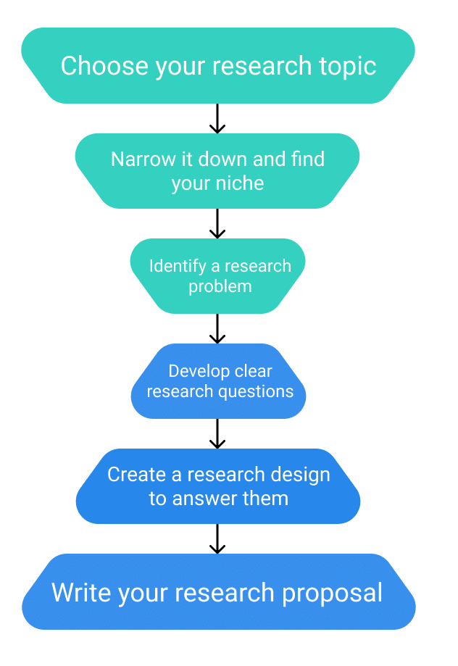
THE COMPONENTS OF A
RESEARCH PROPOSAL
Title and title page
Table of contents
Introduction & background
Definition of key terms & literature review
Problem statement
Research objectives/questions
Scope of the study (delimitations)
Research design and methods
Demonstrating research rigour (validity/reliability)
Research ethics
Contribution of the study
Limitations of the study
Layout of the study and timeframe
Reference list

Slide 5
THE CONTENT OF THE RESEARCH PROPOSAL

Slide 6
TITLE PAGE
Refer to the title page loaded on the eFundi site.
This is also the official title page for the mini-dissertation (just replace “Proposal” with “Mini-dissertation”).

Slide 7
TABLE OF CONTENTS
Include a Table of Contents (remember to include the page numbers).

Slide 8
PROPOSED CONTENT OF THE PROPOSAL
Introduction
Background to the study (optional)
Literature review (including Definition of the terms).
Problem statement
Research objectives
5.1 Primary objective (one primary objective)
5.2 Secondary objectives (3-5 secondary objectives)
Research questions (optional – could be a duplication – discuss with your supervisor)

Slide 9
PROPOSED CONTENT OF THE PROPOSAL
Scope of the study (delimitations – could be optional)
7.1 Field of the study
7.2 Sector/industry/business under investigation
7.3 Geographical demarcation
Research design and methods (Research methodology)
8.1 Literature review
8.2 Empirical study (see next slide)

Slide 10
PROPOSED CONTENT OF THE PROPOSAL
8.2 Empirical study
8.2.1 Research paradigm
8.2.2 Research approach
8.2.3 Methodological choice
8.2.4 Research strategy
8.2.5 Time horizon
8.2.6 Study population and sampling
8.2.7 Designing the measuring instrument
8.2.8 Collection of data
8.2.9 Statistical analysis
8.2.10 Reliability and validity (trustworthiness)

Slide 11
PROPOSED CONTENT OF THE PROPOSAL
Ethical considerations
Contribution of the study
Limitations of the study
Layout of the study (chapters)
Timeframe (table and/or Gantt chart)
Reference list

Slide 12
TIPS OF WRITING UP YOUR RESEARCH
Start early!
Be persuasive.
Get feedback.
Avoid sexist, racist, and disablist language.
Stay neutral in terms of your political beliefs.
Structure your writing:
  Title page – acknowledgements - table of contents – abstract – introduction - literature review - research methods – results – discussion – conclusion – appendices – references

Slide 13
MORE EXAMPLES OF WRITING UP THE RESEARCH PROPOSAL

Slide 14
DESIGNING THE QUESTIONNAIRE

Slide 15
EXAMPLE: DESIGNING THE INTRUMENT
The survey questionnaire will be drawn up from the following measuring instruments:
  A shortened version of the corporate entrepreneurship assessment instrument initially designed by Hornsby et al. (2002: 264-265), adapted, and tested by Strydom (2013:134), will be used as a basis to measure corporate entrepreneurship.
  The survey questionnaire developed by Lotz and Van der Merwe (2013:187) will be used as a basis in order to measure entrepreneurial orientation.
  The success factors of compliance training would be drawn up from the literature study to be undertaken. Classical authors, namely Kirkpatrick (1996:55-56), Phillips (1996:20) and Garvin et al. (2008:109) would be used. The research questionnaire of Botha (2012) will be used as a basis.
[Source: Botha, 2021]

Slide 16
STATISTICAL ANALYSIS

Slide 17
EXAMPLE: STATISTICAL ANALYSIS
Babbie and Mouton (2001:237) state that data gathered by a research process must be analysed and interpreted to conclude the research with the achievement of the study objectives.
Data collected will be statistically analysed to realise the objectives of the study. The North-West University Statistical Consultation Service will be approached to assist to capture and analyse the completed questionnaires. The acquired data will be analysed using descriptive analyses, Cronbach Alfa coefficients and multiple linear regression analyses, as recommended by (Babbie, 2013:56). The presentation of the findings will be through the use of tables and graphs.
[Source: Sebetlele, 2020]

Slide 18
EXAMPLE: PHASES OF THE THEMATIC ANALYSIS
Phase | Description of the process
Familiarising yourself with the data | Verbal data need to be transcribed first. Then read and re-read the data while noting down initial ideas.
Generating initial codes | Systematically code interesting features of the data and collect data relevant to each code.
Searching for themes | Sort codes in potential themes and gather all relevant data for each theme.
Reviewing themes | Check if the themes work in relation to the coded extracts and the entire data set, then make a thematic map of the analysis.
Defining and naming themes | Refine the specifics of each theme. Name and define each theme.
Producing the report | Produce a scholarly report of the analysis by selecting vivid, compelling extract examples that relate to the research question and the literature.
Source: Braun and Clarke (2006:87)

Slide 19
CONTRIBUTION OF THE STUDY

Slide 20
EXAMPLE: CONTRIBUTION OF THE STUDY
Theoretical contribution - research would add value to the body of knowledge relating to corporate entrepreneurship within the compliance industry in the banking sector in South Africa as well as to investigate the relationship between corporate entrepreneurship and success factors of compliance training (how to evaluate compliance training).
Practical contribution – existing training success frameworks have been used for many years, and are dated. The framework developed to evaluate compliance training, may be used within compliance departments associated with the Compliance Institute of South Africa that has expressed interest in the research. This research will also focus on steps that may be taken to enhance those corporate entrepreneurship and entrepreneurial orientation constructs most strongly correlated with the success of compliance training.
Industry contribution – This research may lead to the incorporation of the compliance training evaluation methods into a training standards document to be drafted for the compliance industry, setting out evaluation methods to be used for compliance training specifically, that may be used globally. [Source: Botha, 2020].

Slide 21
LIMITATIONS OF THE STUDY

Slide 22
EXAMPLE: LIMITATIONS OF THE STUDY
Even though this study will contribute to the available body of literature on women entrepreneurs, the study does have limitations. These limitations will provide opportunities for future researches. More collection of data can be made from other provinces and other African countries as future contributions.
The main limitation of this study will be the geographical demarcation and the type of sampling used which is a non-probability sampling. The merit of this type of sampling is the simplicity, the convenience and low cost for this study.
Furthermore, as the study will focus on women entrepreneur in South Africa only, particularly in the Gauteng province, the study may not be a good representation of the whole of South Africa. The study does not aim to generalize the findings to the population but to gauge the nature of the phenomenon.
[Source: Moetsi, 2020]

Slide 23
EXAMPLE: LIMITATIONS OF THE STUDY
The most significant limitation of this study was the geographical demarcation. By focusing only on Central South Africa, this study may not be representative of the greater South Africa. Especially if it is taken into consideration that the Western Cape is the province with the most craft beer breweries with 70 breweries (Craftbru, 2019), which are almost half of the craft breweries in South Africa.
[Source: Van der Merwe, 2019]

Slide 24
LAYOUT OF THE STUDY

Slide 25
EXAMPLE: LAYOUT OF THE STUDY
Chapter 1
Introduction
Chapter 2
Literature review
Chapter 4
Empirical study
Chapter 5
Conclusions and recommendations
Chapter 3
Research methodology

Slide 26
TIME FRAME

Slide 27
EXAMPLE: TIME FRAME
THE RESEARCH PLAN
Task Name | Duration
Apply for ethical clearance and complete nature and scope of study | 30 days
An in-depth literature review on entrepreneurship, intrapreneurship and CE and EO | 61 days
Assess success factors via literature study | 61 days
Creation of measuring instruments | 45 days
Complete empirical research methodology and electronic platform | 90 days
Send out questionnaires | 15 days
Awaiting results received back | 92 days
Send surveys for statistical analysis and analyse results | 91 days
Interpret statistical analysis and complete research findings and results | 90 days
Write conclusions and recommendations | 92 days
Close out for submission and writing of article for journal | 122 days
TOTAL | 789 days
Source: Botha (2021)

Slide 28
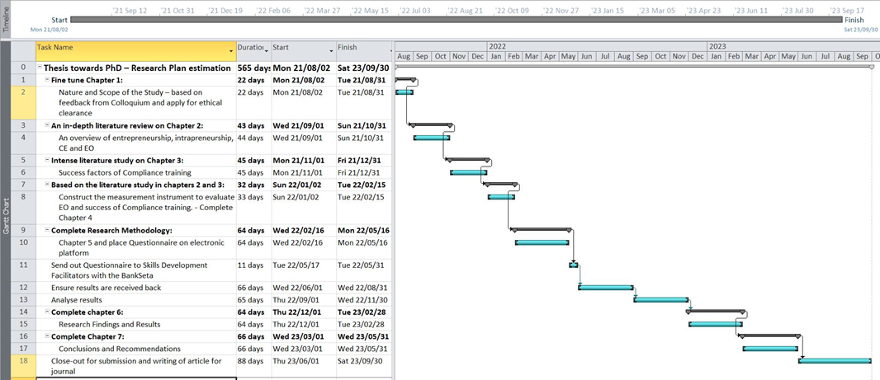
EXAMPLE: GANTT CHART
Source: Botha (2021)

Slide 29
USE AND ADAPT THE EXAMPLES
Please feel free to use and adapt these examples so that they would apply to your study.
It could help you to write up your research design in the methods section of your assignment in an appropriate manner.
[Be aware of plagiarism!!!]

Slide 30
REFERENCES
Botha, M.D. 2021. Developing a framework to evaluate compliance training by investigating the relationship between corporate entrepreneurship and success factors within South African banks. Potchefstroom: North-West University. (PhD-thesis proposal).
Braun, V. & Clarke, V. 2006. Using thematic analysis in psychology. Qualitative Research in Psychology, 3(2):77-101.
Bryman, A., Bell, E., Hirschsohn, P., Dos Santos, A., Du Toit, J., Masenge, A., Van Aardt, I. & Wagner, C. 2014. Research methodology: Business and management contexts. Cape Town: Oxford University Press.
Gerber, C. 2016. Research methodology and assignment: Preliminary reading. Cape Town: University of Stellenbosch Business School.
Hattingh, M. 2020. Exploring the challenges and opportunities of gap year institutions in selected provinces in South Africa. Potchefstroom: North-West University. (MBA Mini-dissertation proposal).

Slide 31
REFERENCES
Moetsi, RE. 2020. Exploring the unique challenges facing women entrepreneurs in Gauteng. Potchefstroom: North-West University. (MBA Mini-dissertation).
Polori, KL. 2021. Exploring networking between women entrepreneurs in the business environment in South Africa. Potchefstroom: North-West University. (MBA Mini-dissertation).
Saunders, M.N.K., Lewis, P. & Thornhill, A. 2019. Research methods for business students (Chapter 4). 8th ed. Harlow, UK: Pearson.
Sebetlele, PBC. 2020. An assessment of the relationship between entrepreneurial orientation and business performance in small businesses in selected townships. Potchefstroom: North-West University. (MBA Mini-dissertation).

Slide 32
REFERENCES
Sigauke, T. 2020. Exploring the success factors of affluent women entrepreneurs in South Africa. Potchefstroom: North-West University. (PhD-Thesis).
Van der Merwe, SP. (Jnr). 2019. An exploratory study of the challenges and opportunities facing the craft beer industry in central South Africa. Potchefstroom: North-West University. (MBA Mini-dissertation).
Venter, E. 2021. Quantitative research: Data collection, data analysis and writing up. Port Elizabeth: Nelson Mandela University (Presentation at the NWU Business School MBA Research Day on 2 July 2021.)

Slide 33
ASSIGNMENT 2: OPTION 2: RESEARCH WITH NO HUMAN PARTICIPANTS

Slide 34
APPLYING THE CONTENT OF THIS STUDY UNIT:
ASSIGNMENT 2
REQUIREMENT | NOTES | MARKS
Title, problem statement and study objectives [15 marks]
1. Provide the revised research title of the study. | State the revised title based on feedback, reflections and assignment 1. | /2
2. Add or provide the revised introduction and background to the research study. | State the current or revised introduction and background to the study based on feedback, adding the headings and reflections. | /5
3. Provide the revised problem statement. | State the revised problem statement based on feedback, reflections and assignment 1. | /5
4. Provide the revised primary and secondary research objectives. | State the revised primary and secondary objectives based on feedback, reflections and assignment 1. | /3

Slide 35
APPLYING THE CONTENT OF THIS STUDY UNIT:
ASSIGNMENT 2
Preliminary literature review [10 marks]
5. Provide the updated preliminary literature review. | Present the revised and updated preliminary literature review based on feedback, reflections and assignment 1 (maximum 1 000 words). | /10
Research approach and design [5 marks]
6. Describe the research approach that will be followed in the study. | Explain whether the study will be qualitative, quantitative or mixed-method in nature. Why? Motivate. | /3
7. Describe the research design of the study. | Will the study be experimental, cross-sectional or longitudinal? Why? Elaborate. In the case of longitudinal research, also provide the time intervals between the data points. Will you follow an inductive or deductive design? Explain briefly. If you are estimating a model, specify the model to be estimated. Justify the variables you are including. | /2

Slide 36
APPLYING THE CONTENT OF THIS STUDY UNIT:
ASSIGNMENT 2
Data source [30 marks]
8. Describe the nature of the data/information that will be used in the study. | Explain the nature of the data/information used in the study (content analysis, a systematic review or other secondary data). Where will the data/information be sourced from? Is this data/information publicly available? If using secondary data – how many observations are available? E.g. Weekly time-series data on stock market prices ranging between 2010 and 2020. Or: Panel data on countries’ GDP for 20 developing countries between 1990 and 2019. If estimating a model, will your observations allow for enough degrees of freedom, given the model you would like to estimate? | /10

Slide 37
APPLYING THE CONTENT OF THIS STUDY UNIT:
ASSIGNMENT 2
9. Describe whether the study will require permission from a gatekeeper/entity/organisation to access the data/information? | Will the study require permission from a gatekeeper/entity/organisation? If yes, explain the nature of the access required. | /5
10. In the case of using secondary data, describe how data will be obtained from the source. | Explain in full the following: How will the data be obtained from the source (the process of getting access to the data)? Is it clear how the source from which you are collecting data from has obtained their data? Is it a reliable source? E.g. StatsSA uses consumer surveys to obtain data on consumer prices in the economy and provide access to full methodology papers on their website so that it is possible to verify the exact method used to generate data. | /15

Slide 38
APPLYING THE CONTENT OF THIS STUDY UNIT:
ASSIGNMENT 2
Data analysis [20 marks]
11. Describe in as much detail as possible the data analysis and further processing of data. | Explain the data analysis or further processing of data by referring to the following: Indicating the data analysis techniques and methods to be used. Indicate the formulas or other techniques to be used to draw conclusions from your data. Also provide details regarding possible software programs to be used (where applicable). | /15
12. Explain the process that you will follow to ensure the rigour of your research. | Explain how you will build in the reliability and validity (quantitative research) and trustworthiness (qualitative research) of your data and findings. | /5

Slide 39
APPLYING THE CONTENT OF THIS STUDY UNIT:
ASSIGNMENT 2
Ethical issues [10 marks]
13. Describe in as much detail as possible how you will deal with the ethical issues in the study. | Explain in full the following: Ethical issues anticipated before beginning the proposed study (i.e., selection of worthy topic, non-intrusive topic). Ethical issues anticipated before beginning the proposed study (i.e., the source of the data, public available data). Evaluating ethical issues during the collection of the data be used (i.e., ethics approval, consent, POPIA Act). Ethical issues anticipated during data analysis (i.e., competence of the researcher). Ethical issues anticipated when reporting, sharing, and storing data (especially when organisations have access to the data) (i.e., peer review also matters here). Provide ways in which to mitigate ethical risks during each phase of the proposed study. Explain how you will comply with the applicable issues in the POPIA Act. | /10

Slide 40
APPLYING THE CONTENT OF THIS STUDY UNIT:
ASSIGNMENT 2
Technical aspects [10 marks]
14. Technical aspects. | Layout (font, spacing, headings, logical flow) Language (grammar, sentences, spelling). Referencing – NWU Referencing Guide (2020, Harvard) (in-text and reference list). | /5
15. Application of the technical care sheet. | Refer to the technical care sheet and indicate whether you followed all the guidelines. Marks will be allocated for comprehensive, correct and honest ticks. Include the signed care sheet as an appendix. | /5

Slide 41
Thank you

