Slide 1
Lean and
Maintenance & Reliability
Johan Jordaan
Classroom slides – 2021 - Contact 7 - MBAA 812

Slide 2
Study School
1
Designing operations
Introduction (1)
Operations Strategy (2)
Project management (3)
Product & service design (5)
Process strategy (7)
2
7
Location (8)
Maintenance
(17)
Classroom
Optimising operations
Layout (9)
Lean (16)
Application
Insight
MBAA812 Roadmap
Understanding
6
3
Quality (6)
People in operations (10)
Workplace
Community
Theory of constraints (7)
MRP & ERP systems (14)
Managing operations
5
4
Scheduling (15)
Planning (13)
Forecasting (4)
Inventory (12)
Supply chain management (11)

Slide 3
Outcomes for today's contact
OUTCOMES OF TODAY
Have a clear picture of lean operations and maintenance.
Be able to understand the essence of maintenance and lean
Show that you can apply these concepts in real-life organisations
The last pieces of the puzzle are on the board

Slide 4
The essence of lean
The seven wastes
Respect for people
Over-processing
Over-production
Waiting
Defects
Inventory
Motion
Transport
(Talent)
Culture change
Get all involved
Empower within boundaries

Slide 5
What is waste?
Do not be confused between Lean waste and scrap.
Waste is any unnecessary use of resources.
Distinguish between Lean principles (customer-centric, respect for people, cut out waste) and Lean tools (VSM, 5S, twenty keys, etc.)
Lean and Six sigma dovetail very wall:
  Lean addresses improved process throughput and flow
  Six Sigma addresses improved quality
Notes:
3

Slide 6
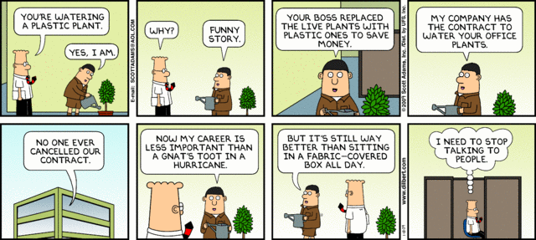

Slide 7
Videos
https://www.youtube.com/watch?v=v2KN8CCfu_E&t=31s
https://www.youtube.com/watch?v=W5i36ZRXlkY&t=11s
https://www.youtube.com/watch?v=AUPji7L9aSs&t=41s
https://www.youtube.com/watch?v=UlIGI3laGAo

Slide 8
20 Keys ®: A practical lean improvement scheme
Key 1: Cleaning and Organizing
Key 2: Rationalizing the System/MBOs
Key 3: Improvement Team Activities
Key 4: Reducing Inventory
(Shortening Lead Times)
Key 5: Quick Changeover Technology
Key 6: Manufacturing Value Analysis
(Methods Improvement)
Key 7: Zero Monitor Manufacturing
Key 8: Coupled Manufacturing
Key 9: Maintaining Equipment
Key 10: Time Control and Commitment
Key 11: Quality Assurance System
Key 12: Developing Your Suppliers
Key 13: Eliminating Waste (Treasure Map)
Key 14: Empowering Workers to Make Improvements
Key 15: Skill Versatility and Cross Training
Key 16: Production Scheduling
Key 17: Efficiency Control
Key 18: Using Information Systems
Key 19: Conserving Energy and Materials
Key 20: Leading Technology and Site Technology

Slide 9
Important to remember?
Lean, ToC, people orientation, TQM, maintenance orientation and other operations issues are culture issues

Slide 10
Specific questions raised by you
Link between Lean and quality?
Is it expensive to implement Lean?
How can I move to JIT if my suppliers cannot?
Can all organisations get lean? / Lean in services
Does Lean entail restructuring?
Lean in specific sectors

Slide 11
Lean in different sectors
Issue | Manufacturing | Services | Sales | Government
What we want to optimise | Flow in production | Efficiency of service | Customer orientation | Efficiency of service
People issue | Leaning is culture change | Focus on customer need | All interface staff involved | Political effect on culture
Is JIT applicable? | YES | Service is per def JIT | Only in process, not in inventory | As per service
Interface issues | Get suppliers and workers involved | Staff is the process. Get them on board | Get suppliers and customers on board | Get all stakeholders on board
Cost | Low to high | Low | Low | Low
Change management issues | Critical | Critical | Critical | Critical
Achieving lean | Total view, implement stepwise | Start small | Processes, not inventory | Political decision
Cultural

Slide 12
Study group exercise
In breakaway rooms, create a poem / song that highlights the essence of lean operations. You have 7 minutes.
When you finish, I want you to perform it in the main class.
The essence
  Value from a customer perspective
  Eliminate all wasteful activities
  Respect for people (a culture change)
Here is my attempt:

Slide 13
The LEAN rap
Hey bro, if you know what I mean
I say: hey bra, that it’s cool to be lean
So if you want to succeed you must acquire the taste
Of a lean organisation that cuts out all waste
I tell you that waste comes in forms that we know,
So if you will allow me I maybe can show
That a lean kind of business is manufacturing heaven
And the wastes can be numbered from one down to seven

Slide 14
The LEAN rap (2)
The first type is real, it’s called overproduction,
so if you make too much, try a little reduction
The second is motion, so if you’re wasting space
just pull out your finger and remodel the place.
The third is so stupid, even I could have said
that waiting of product in line kills you dead
Stock is the one that you never could think,
cause if you have too much of the stuff then you sink .

Slide 15
The LEAN rap (3)
Number five uses diesel, we call it transport so that
Every month’s month-end, your budget falls short
Number six (you are right, only two left to go)
is that over-processing will make your plant slow.
The last is the one that makes customers sad,
‘cause when you buy a defect, it sure makes you mad
So cut out these seven and make us some money,
and your life at the job will be sweeter than honey.

Slide 16
The LEAN rap (4)
So let us repeat all the wastes that we know
You shouldn’t be scared, this verse is real slow
You all must repeat so that you don’t forget
The seven big wastes that we try to reset
Let’s start with the o’s, there are two of this goose
over-processing and over-produce,
Waiting, defects and inventory too
Motion and transport sound sim’lar to you

Slide 17
The LEAN rap (5)
So what is the issue of this bloody song?
It’s this: you must take all your people along,
Cause lean is not just about throughput or speed
It’s giving the client what they really need.
The tools only help you improve what you do
So just put yourself in the customer’s shoe
Then work on the wastes I have listed before
Respecting your people will open the door.

Slide 18
See you back in 5 minutes for the last theme
Time for a biological break
Maintenance and reliability

Slide 19
Different maintenance paradigms
Run to failure
Prevent failure
Decide not to service your car and to replace engine if it breaks
Preventive maintenance: Service your car regularly Motor plan
Reliability centred maintenance: Set schedule based on failure rates You don't replace your timing belt every service
Condition monitoring: Plant tells you when it needs a service: BMW: Warns you when you need a service

Slide 20
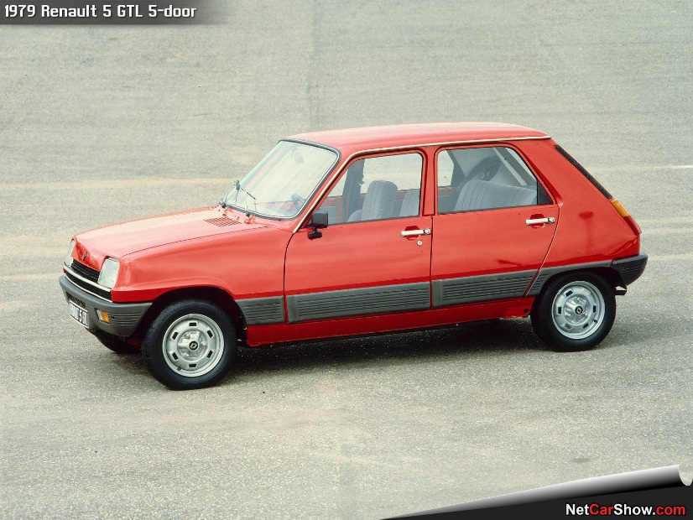
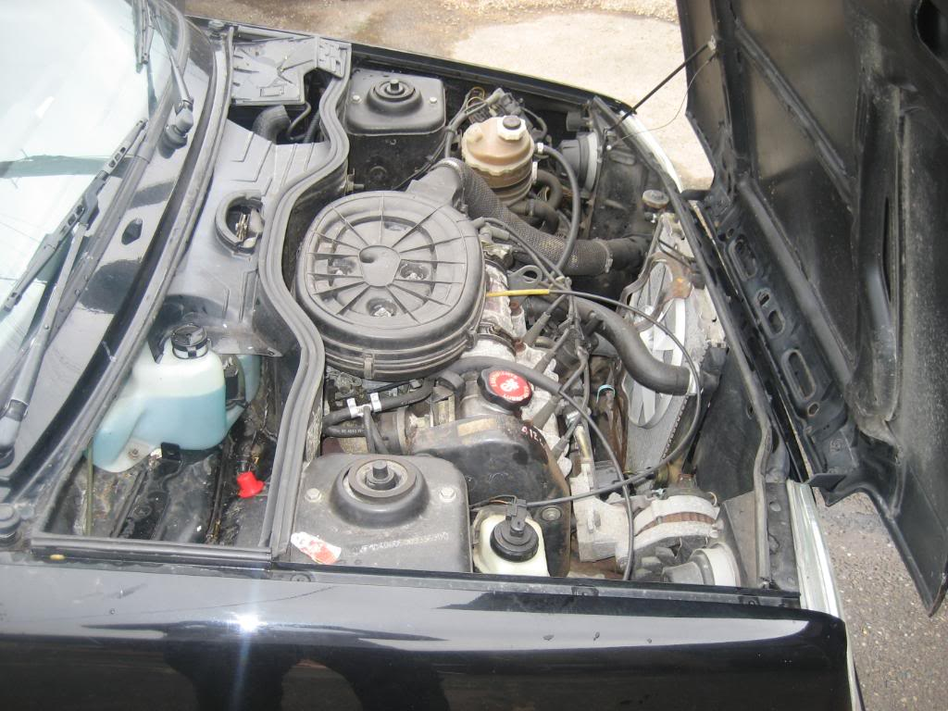
Run to failure
When?
  Running at full capacity
  Have parallel systems available
  Often old equipment
  Cumbersome to repair (Renault 5)
  FMEA (Failure mode and effect analysis)
Risks
  Eskom: danger of total collapse
  Failing at a bad time
Advantages
  When you lose more by stopping

Slide 21
Preventive maintenance
Service your equipment when it suits you
  Plant shutdowns during low demand season
  Maize farmers service their equipment in the growth season (April)
Advantages
  Facilitates proper planning
  Cheaper life cycle cost
  Less crisis management
Risks
  If it isn't broken, why fix it? (Cost)

Slide 22
Maintenance Costs
Total costs
Traditional View
Preventive maintenance costs
Costs
Breakdown maintenance costs
Maintenance commitment
Optimal point (lowest
cost maintenance policy)

Slide 23
Maintenance Costs
Total costs
Full cost of breakdowns
Costs
Full Cost View
Preventive maintenance costs
Maintenance commitment
Optimal point (lowest
cost maintenance policy)

Slide 24
Health care parallel
Run to fail: Go to doctor when you are getting ill
Preventive maintenance: Go for periodic check-up, take your vitamins, exercise
Reliability centred maintenance: Start going for check-ups at 50
Condition monitoring: Cancer bra with sensors

Slide 25
Mathematical issues
You can (should!) calculate the probability of failure of any equipment
Backup systems increase reliability of any system (see next slides)

Slide 26
Reliability Example
R₁
R₂
R₃
.90
.80
.99
R_{s}
Reliability of the process is
R_{s} = R₁ x R₂ x R₃ = .90 x .80 x .99 = .713 or 71.3%
(Chance of failure 100- 71.3 = 38.7%)

Slide 27
Redundancy Example
A redundant process is installed to support the earlier example where R_{s} = .713
R₁
R₂
R₃
Reliability has increased from .713 to .94
0.90
0.80
0.90
0.80
0.99
= [.9 + .9(1 - .9)] x [.8 + .8(1 - .8)] x .99
= [.9 + (.9)(.1)] x [.8 + (.8)(.2)] x .99
= .99 x .96 x .99 = .94
Chance of failure 100% – 94% = 6%

Slide 28
Service organisations
Building maintenance
Vehicle maintenance.
How often to you (personally!) backup your data?
Sharpen the saw. (Do you maintain/refresh your knowledge / skills / intellectual capital?)

Slide 29
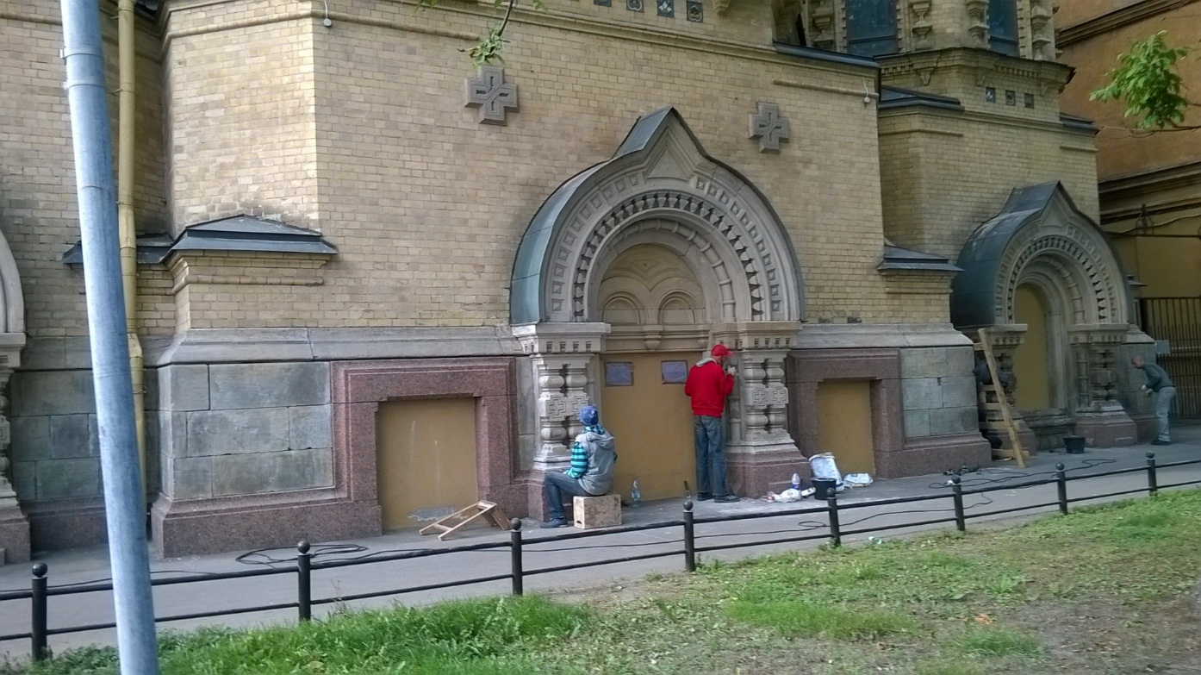
Russia: Maintenance mentality

Slide 30
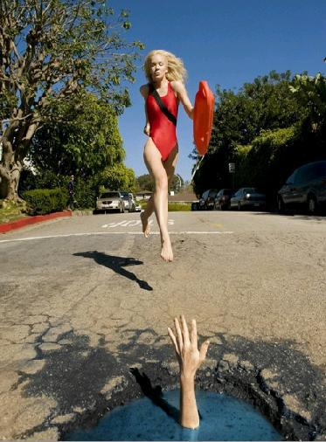
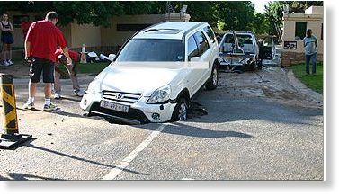
South Africa: Run-it-down mentality

Slide 31
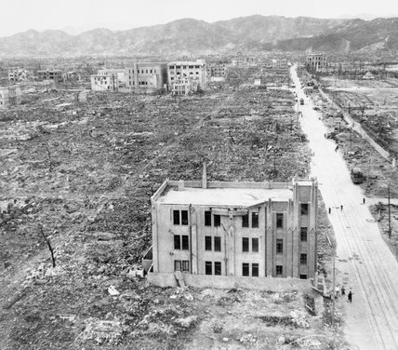
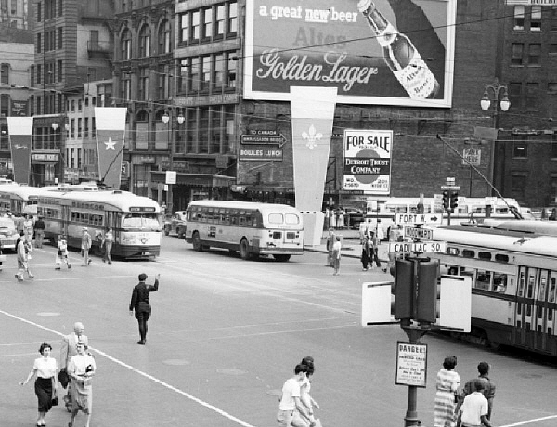
Hiroshima 1945
Detroit 1945

Slide 32
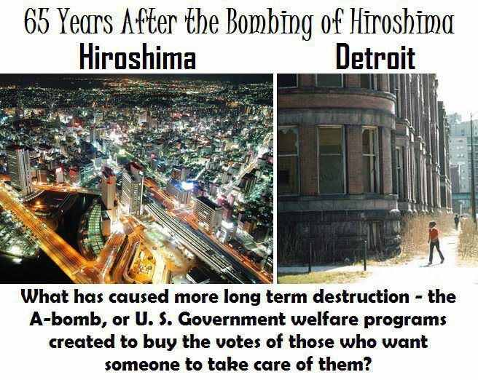
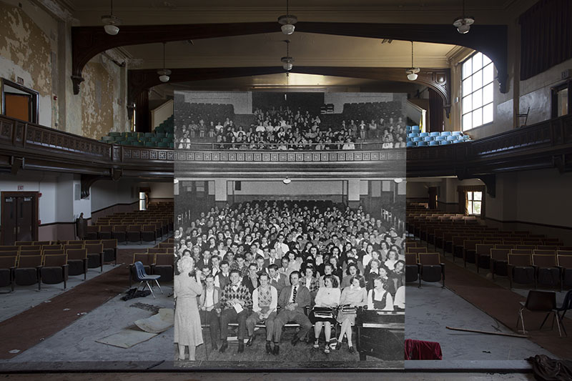
Maintenance vs Decay

Slide 33
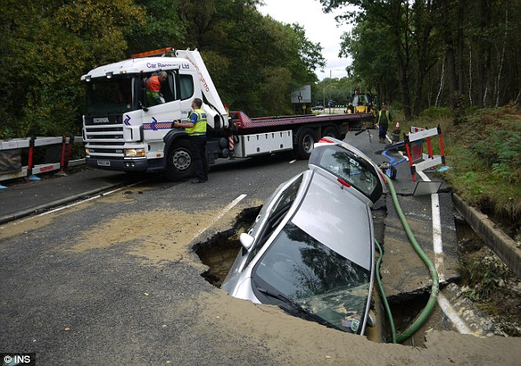
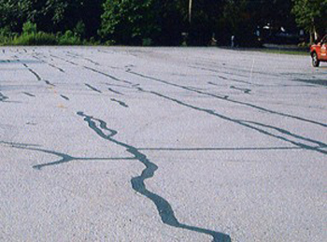
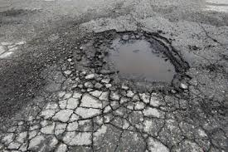
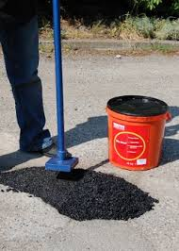
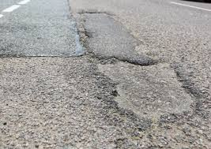
Potholes: Comparing preventive vs breakdown maintenance
Preventive maintenance
Breakdown maintenance
Once-off costs
Prevents further decay
Unsightly
Can be done without much disruption
Costly
Disrupting
Often disintegrate afterwards
Consider downstream costs
Other examples
Dentistry / orthodontic repairs
Transnet recapitalisation
Buildings

Slide 34
Opportunities galore
In a crisis things are done differently, but crises allow exceptional performance
Covid-19 has shown us where the cracks in our system are
Opportunity to repair them
Opportunity to be listened to

Slide 35
Reflection (Chat column)
Let me tell you a story of what lean operations really means
What did you learn for / during this lesson? State the two most important things
What is there that you still don't understand about the topic?
How did you experience the whole process of the long assignment?
Any other comments?

Slide 36
The Race

Slide 37
Once upon a time there was a South African rowing team

Slide 38
South Africa and Japan agreed to have an annual rowing race. Each team should consist of 8 men.

Slide 39
Both teams worked really hard to get in the best shape. The day the race started, both teams were in similar condition…
The Japanese won by one mile
FINISH

Slide 40
The mood in the South African team was really close to freezing point. Top management decided to win the race the next year. So they established a team of analysts to observe the situation and recommend an appropriate solution.

Slide 41
After several detailed analyses, the team found out that the Japanese had 7 rowers an only one captain

Slide 42
The South African team had 7 captains, but only one rower

Slide 43
Facing such a critical scenario, management showed an unexpected wisdom: They hired a consulting company to restructure the South African team

Slide 44
After several months, the consultants came up with the conclusion that there were too many captains and too few rowers in the South African team. A solution was proposed based on this analysis: The structure of the South African team has to be changed!

Slide 45
As of today there will be only 4 captains, led by 2 managers , one senior manager, with one rower.
Besides that they suggested to improve the rower’s working environment and to give him higher competencies

Slide 46
FINISH
The next year the Japanese won by 2 miles

Slide 47
The South African team immediately fired the rower from the team, based on his unsatisfactory performance

Slide 48
However, a bonus award was paid to management for the strong leadership the whole team showed during the preparation phase

Slide 49
The consultants, who were well remunerated, prepared a new analysis which showed that the strategy was good, the motivation was OK, but the analysis tool had to be improved.
Currently the South African team is designing a new boat

Slide 50

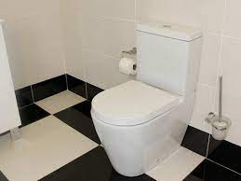
Next session
Study School
1
Designing operations
Divide into B/A room of 3 or 4 groups each (randomly chosen).
Present your community project to your breakaway room and give marks to the other groups. (1 hour)
Biological break
Smaller B/A rooms in your study groups : Give marks to the OTHER groups (15 minutes)
Return to main room for semester wrap-up (30 minutes)
Answer questions on fina PoE
Study group leader e-mail score sheets to me before end of day
Introduction (1)
Operations Strategy (2)
Project management (3)
Product & service design (5)
Process strategy (7)
Room 1
Room 2
2
7
Location (8)
Maintenance
(17)
Classroom
Optimising operations
Layout (9)
Lean (16)
Application
Insight
MBAA812 Roadmap
Understanding
6
3
Quality (6)
Room 4
Room 3
People in operations (10)
Workplace
Community
Theory of constraints (7)
MRP & ERP systems (14)
Managing operations
5
4
Scheduling (15)
Planning (13)
Forecasting (4)
Inventory (12)
Supply chain management (11)
https://depositphotos.com/235834676/stock-illustration-man-making-business-presentation-in.html
https://www.ctm.co.za/white-mondo-toilet-bottom-entry-product.html

