Slide 1
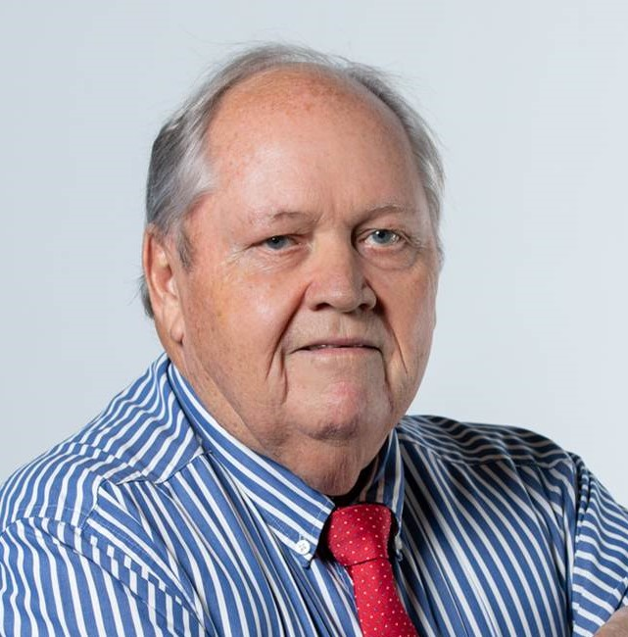
Faculty of Economic and
Management Sciences
STRATEGIC THINKING
The Company Project
Proff. Tommy du Plessis
January 2021

Slide 2
Outcomes of Contact 1
Selection of Company
Writing a case study - Discussion
Flip Class (Break-away Rooms)
  Methodology of Consultations
  Strategic Planning Sessions
  Mission and Vision Analysis

Slide 3
Selection of Company
  Type (Profit/Non Profit)
  Size of Company (Small/Medium/Large), (Number of Employees), etc
  Functions (Operations, Marketing, Financial, HR,)
  How long in existence
  Relationship with Study Group
  Letter to Company

Slide 4
Case Study
  Format:
    Introduction
    Background/History
    Strategic decisions made in the past in respect of:
      Operations
      Marketing
      Finance
      Human Resources
      Other
    Sketch current situation

Slide 5
Flip-Class
  Methodology of Consultations: How could you apply the principles discussed on your Company Project?
  Strategic Planning: Looking at the hand-out, what elements would you add to the practical application of Strategic Planning?
  Mission and Vision: Compare the handout (What is the Difference between a Mission Statement and a Vision Statement – Alessio Bresciani) with the Mission and Vision Statements of:
    ABSA
    Kumba
    Pick and Pay
    Edcon
    KWV
    SAB

Slide 6
Flip-Class
  Methodology of Consultations: How could you apply the principles discussed on your Company Project?

Slide 7
Flip-Class
    Strategic Planning: Looking at the hand-out, what elements would you add to the practical application of Strategic Planning?

Slide 8
Flip-Class
  Mission and Vision: Compare the handout (What is the Difference between a Mission Statement and a Vision Statement – Alessio Bresciani) with the Mission and Vision Statements of:
    ABSA
    Kumba
    Pick and Pay
    Edcon
    KWV
    SAB

