Slide 1


GLR Transfer to NWPTB
Business Case
March 2021
Prof LTB Jackson
Virtual presentation
29 March 2021
16:00

Slide 2
Mandate
Project Definition
Develop a comprehensive business case with clearly outline the following:
Business problem or opportunity
Benefits to relevant stakeholders
Risk to relevant stakeholders
Costs including investment appraisal
Technical solutions
Timescale
Impact on operations
Organisational capability to deliver the project outcomes

Slide 3
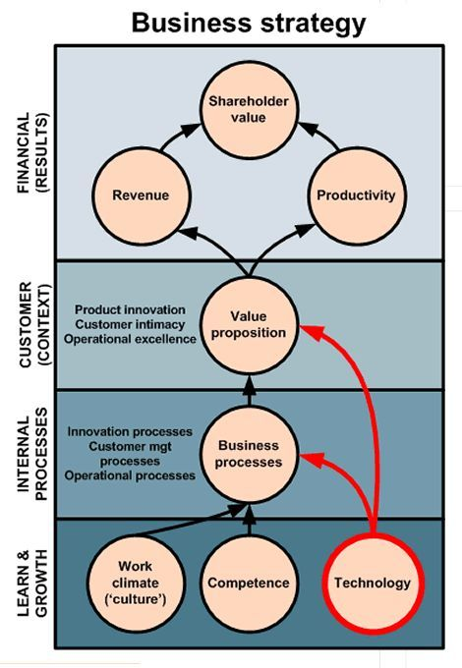
Models For strategic analysis: Balance score card

Slide 4
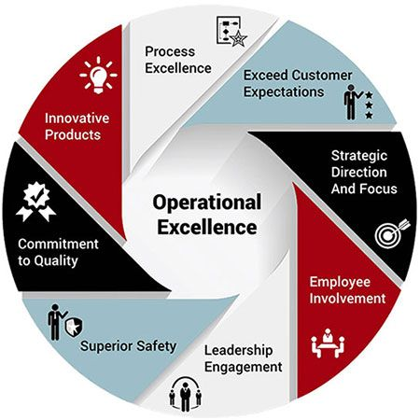
Models for strategic analysis: Operational excellence

Slide 5
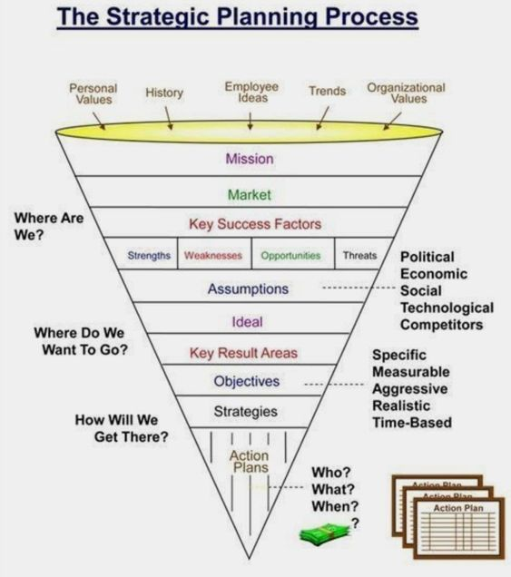

Slide 6
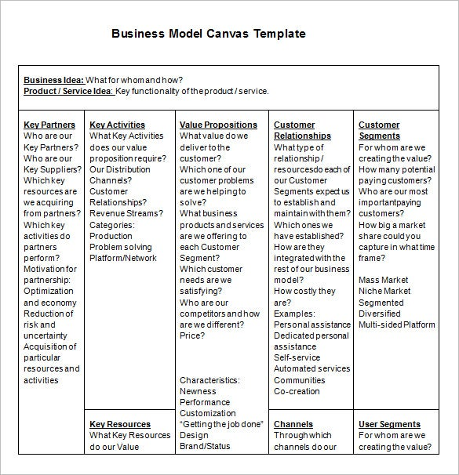
Our approach: Strategic Analysis

Slide 7
Methodology: Data gathering
Annual reports, financial statements, company documents and reports were perused for information.
External reports on the entities (PWC, GTAC, Treasury)
Interviews were also conducted with
current and present ACEO’s of NWDC and GLR, as well as with
individual resorts and lodge managers via Teams.
Self -developed questionnaires were also utilised to canvas information regarding internal capabilities, competence and internal value chains.

Slide 8
Structure of the report
Executive summary
External analysis
Global risk analysis
Pestle analysis
Industry analysis
Porters five force
Competitor analysis
Internal analysis
Core capabilities
Core competence analysis
Value chain analysis
VRIO analysis
SWOT and Integrated SWOT analysis
Risk analysis
Financial analysis
Proposed strategy
Current realities
Possible future realities
Implementation
Change management
What next
Conclusion

Slide 9
Business case: Our Approach Document structure
Section A: Existing Situation
Introduction
  Background and History – 6 / CP 21/22 - 6
  Existing Business Model Canvas
    North West Parks & Tourism Board
    Golden Leopard Resorts
Section B: External Analysis
  Global Risk Analysis
  Industry Analysis
  Porter’s Five Forces
  Competitor Analysis
  Pestle Analysis
Section C: Internal Analysis
  Core Capabilities
  Core Competence Analysis
  Internal Value Chain Analysis
  Analysis of Culture
  Risk Analysis
  Integrated Swot Analysis
  Financial Analysis
Section D: Proposed Strategy
Strategic Foresight
  Current reality
  Possible Future reality
  Develop Strategic options and choices
Develop new Business Model
  Infrastructure
    Key Activities:
    Key Resources:
    Key Partners
  Offering
    Value Proposition:
  Customers
    Customer Segments:
    Channels:
    Customer Relationship:
  Finances
    Cost Structure:
    Revenue Streams:
Plan and Implement Strategy
  KPA / Key activities / End outcomes = deliverables / Responsible office

Slide 10
Business model canvas
  Infrastructure
    Key Activities
    Key Resources
    Key Partners
  Offering
    Value Proposition
  Customers
    Customer Segments
    Channels
    Customer Relationship
  Finances
    Cost Structure
    Revenue Streams

Slide 11
External analysis
Global Risk Analysis
Pestle Analysis
Industry Analysis
Porter’s Five Forces
Competitor Analysis

Slide 12
External Analysis
Global Risk Analysis
Economic
Environmental
Geopolitical
Social
Technological
Trends 202

Slide 13
External Analysis
Global Risk Analysis
Economic Global economic recession Global inequalities Low economic growth Food security The Green economy Government austerity measures | Environmental Global warming Climate change Pouching syndicates Deforestation Water shortages Conservation regulations Restrictions: carbon omissions | Geopolitical Global Terrorism Multilateral agreements Bricks agreements The rise of China The demise of the USA as global power Geopolitical tensions African Union developments
Social The buying power: middle class The efficacy of the vaccines Lock downs International travel restrictions Land claims / restoration The evolving nature of traditional leadership Changing customer preferences | Technological Artificial intelligence The use of robotics Roll out of 5G Virtual gatherings ITC advancements Virtual reality advances Global / virtual currencies Smart cities | General 2021 Trends Tourism as a driver for GDP Reaction to Covid-19 social distance and isolation The need for quarantine sites The importance of on national heritage or conservation sites Discontent with the “rat race”

Slide 14
External Analysis
Pestle Analysis
Political
Instability in the political landscape, particularly over the last two years.
Political interference has been commonplace in the South African public sector
Economical
Possible rise in tourism activity
Socio-Cultural
Increasingly young population that is unemployed whilst skilled workers approaching retirement
Technological
The internet of things and other technologies are presenting new value streams and revolutionising old ones.
Legal
Changing reguations legislative frameworks
Environmental
Rise in popularity of eco-tourism and cultural-tourism

Slide 15
External Analysis
Industry Analysis
Define the relevant Industry
Identify the participants and segment them into groups
Assess the underlying drivers of each competitive force
Determine the overall industry structure
Analyse changes in each force
Identify aspects of structure that might be influenced
Industry trends

Slide 16
External Analysis: Industry Analysis
  Define the relevant Industry
    What products are part of this Industry?
    What products are part of another distinct Industry?
    What is the geographic scope of competition?
  Identify the participants and segment them into groups
    The buyers and buyer groups?
    The supplier and supplier groups?
    The competitors? (national and regional)
    The substitutes?
    The potential entrants?
  Assess the underlying drivers of each competitive force
    Determine which competitive forces within the Industry are strong and which are weak and why?

Slide 17
External Analysis: Industry Analysis
  Determine the overall industry structure
    Why is the level of profitability (of the Industry) what it is?
    What are the controlling forces for profitability?
    Is the Industry analysis consistent with actual long-run profitability?
    Are more profitable players better positioned in relation to the five forces?
  Analyse changes in each force
    Analyse recent and likely future changes in each force, both positive and negative.
  Identify aspects of structure that might be influenced
    Identify aspects of the Industry structure that might be influenced by competitors, by new entrants or by the particular company(ies) or itself

Slide 18
External Analysis: Industry Analysis
  Industry trends
  In what Industry do we play?
  Is its definition perhaps to constricting?
  In what other permutations can we creatively redefine our Industry?
  What are the challenges and rivalries in this Industry?
  What are some of the key trends that we observe here?
  Are there any threats of disinter-mediating Industries?
  Are there any threats (now and in the future) from current players or new entrants into this Industry?
  Are there changes in the Industry rules that will make things difficult in the future?
  What conventions exist in this Industry that we can possibly capitalise on?
  Can we find opportunities to expand the pool of value created by this Industry?
  How can we shift our relative bargaining power in this Industry?
  What are the opportunities for doing this?
  How can we be more competitive in our current Industry?
  Can we compete in other Industries through substitute products and services that can add or improve value, based on some of our current skills?

Slide 19
External Analysis
Industry Analysis
Task | Main concern | Focus
Define the relevant Industry | What products are part of this Industry? | Hotels, motels, caravan parks, guest houses, B&B’s, restaurants, take-aways, caterers, safaris, travel agencies, time sharing, game parks, historical and cultural sites
 | What is the geographic scope of competition? | North West Province, Free State, Gauteng, Mpumalanga, Limpopo, Botswana
Identify the segment in the industry | What segments of the industry are important for us? | Accommodation, conference venues, wedding venues, events, transport, food and beverage, game drives,
Assess the underlying drivers of each competitive force | Efficiency of human resources | Training / development / innovation orientation / customer focus / quality conscious
 | Control over finance | Asset or facility maintenance / cash flow / cost conscious / integrated IT support system /
 | Continuous improvement | Process and product innovation / cost reduction / value added activities
 | Operations | Streamlining of processes / quality focus / customer experiences / safety / cost effective
 | Marketing | Segment and product focus / use of IT, social media / press (electronic and print)
 | Data quality and record keeping | Integrated IT support system / just in time procurement

Slide 20
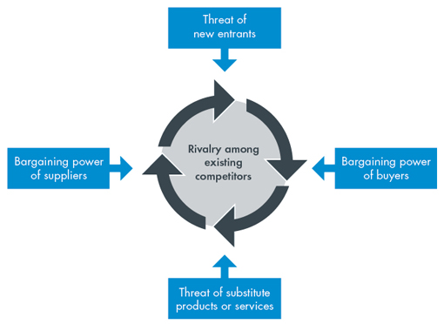
External Analysis:
Porters Five Forces
Threat of substitute products
  Substitutes available
  Substitute price
  Cost of substitutes
  Product uniqueness
Bargaining power of suppliers
  Switch cost
  Supplier price increases
  Quality of suppliers
  Access to suppliers
  Quality and skill level
Bargaining power of buyers
  Size of buyers
  Ease of switch
  Cost of switch
  Buyers price dictating
  Market saturation
  Brand recognition
Rivalry among competing firms
  Price wars
  Quantity competitors
  Quality and skill level
  Competitive advantage
  Demographic concentration
  Customer loyalty
  Value added services
Threats of New Entrants
  Ease of entry
  Entry cost
  Sector regulations
  Market competitiveness
  Demography
  Market accessibility
  Customer relations
  Research and Development
What benefits does Porter’s Five Forces analysis provide?
Five forces analysis helps organisations to understand the factors affecting profitability in a specific industry, and can help to inform decisions relating to:
whether to enter a specific industry;
whether to increase capacity in a specific industry; and
developing competitive strategies

Slide 21
External Analysis: Porters Five Forces

Slide 22
External Analysis: Porters Five Forces

Slide 23
External Analysis:
Competitor Analysis
Key considerations about competitor scope:
Who are our real competitors?
What is our market share in this Industry vs Rest?
What is the risk of new entrants to this market?
Are we seeing other players enter or leave the market?
Key considerations about competitor strategies or aspirations:
In which areas of the value chain are competitors prominent?
What are their strategies and are they making investments to expand their activities across the value chain?
What value propositions are they offering and what competitive advantage do they enjoy as a result of it?
Do we or they offer a subsector focus? If so, why?
Key consideration about competitor capabilities:
What are the capabilities and resources of the other players?
What are their resource strengths and weaknesses?
Who is the strongest and why?

Slide 24
External Analysis:
Competitor Analysis
Competitor | Stars | Google Rating | Expedia Rating | Hotels Rating | Price
The Kingdom Resort | 4 | 4.2/5 | 4.2/5 | 8.5/10 | R 1161 (2)
Dikhololo Brits | 3 | 4.1/5 | 4.2/5 | 8.6/10 | R 1316 (2)
Bagatla | 3 | 3.8/5 | 3.7/5 | 7.4/10
Manyane | 3 | 3.8/5 | 3.8/5 | 7.4/10 | R 1390 (2)
Competitor | Stars | Google Rating | Expedia Rating | Hotels Rating | Price
Madikwe River Lodge | 3 | 4.8/5 | 4.3/5 | 8.9/10 | R 10 840 (2)
Madikwe Safari Lodge | 5 | 4.7/5 | 5/5 |  | R 18 496 (2)
Kwa Maritane Bush Lodge | 4 | 4.5/5 | 4.4/5 | 8.9/10 | R 4 449 (2)
Thakudu River Camp | 4 | 4.4/5 | 4.5/5 | 9.3/10 | R 5 531 (2)

Slide 25
External Analysis: Competitor Relative Analysis
Step 1: List the industry key success factors and other relevant measures of competitive strengths required to be a successful competitor in the Industry
Step2: Rate the company you are analysing on each of the above factors. (1= weak capability; 10=very strong capability)
Step 3: Summate the individual ratings to get an overall measure of competitive strength.
Step 4: Based on overall ratings, determine overall competitive position of rivals relative to the company you are rating.

Slide 26
External Analysis: Competitor Relative Analysis - Examples of Critical Success Factors
Training and education.
Quality data and reporting.
Management commitment, customer satisfaction.
Staff Orientation.
Role of the quality department.
Communication to improve quality, and.
Continuous improvement.
Strategic Focus
  (Leadership, Management, Planning)
People
  (Personnel, Staff, Learning, Development)
Operations
  (Processes, Work)
Marketing
  (Customer Relations, Sales, Responsiveness)
Finances
  (Assets, Facilities, Equipment)

Slide 27
Internal analysis
Core Capabilities
Core Competence Analysis
Internal Value Chain Analysis
VRIO Analysis
Swot Analysis
Integrated Swot Analysis
Risk Analysis
Financial Analysis

Slide 28
Internal analysis
Core Capabilities
General Core capabilities
Physical Resources
Financial Resources
Human Capital Resources
Organisational Resources
Tourism core capabilities
Core resources and attractors,
Support factors and resources,
Management of destinations, and
Determinants of quality

Slide 29
Internal Analysis: Core Capabilities

Slide 30
Internal Analysis: Core Capabilities

Slide 31
Internal Analysis
Critical Success Factors

Slide 32


Slide 36
Internal analysis: Kay’s Framework
Distinctive Capabilities
Reputation:
  Organizations should strive to develop an image that fosters faith and loyalty from customers.
  An organization’s bottom line is heavily dependent on its reputation because
    customers make purchasing decisions based on product and service reviews,
    a practice that becomes increasingly common with technological advancement.
  A company’s reputation cannot be easily replicated by other businesses in the market,
    because of unique experiences that led to the creation of that reputation.
  More specifically, even if a company can create a similar product,
    a competitor cannot steal an organization’s brand identity.
Architecture:
  The way that a business is organized is specific to that company and can act as a source of competitive advantage, provided that it is valuable to the business.
  This structure not only includes the organization’s hierarchy, but also includes relationships that the organization has with suppliers, customers and its employees.
  Although competitors might share clients or suppliers, the relationships the organization builds with these individuals are unique.
Innovation:
  Innovative organizations that keep up with cutting edge trends are shown to be the most profitable.
  Specifically, because these organizations are aware of customer needs and values, they can remain ahead of their competitors.
  Constant monitoring of the direction of the market is critical because trends will fade once other organizations start to replicate once-innovative products.
  Remaining innovative also helps to improve an organization’s reputation because customers look favourably on companies that make positive change in the market.
  This can also help to support a business when other companies catch on to these trends.

Slide 37
Internal analysis:
Core Competence Analysis
Core competencies are capabilities that form the basis and source of competitive advantage for a company over its rivals.
  Core competences are built over time in an organisation as part of internal strategizing processes.
By emphasising core competencies in the development of organisational strategies,
  companies develop a capacity to compete primarily on the foundation of firm-specific differences and features
  within a context of an ever-changing competitive environment.
The core competence “candidates” identified should normally meet the following criteria:
  It should create significant customer value.
    The key feature of a core competence is that it is visible to customers and it contributes to meeting the diverse needs of end-users;
  It should be unique and meet the criteria of a valuable resource in terms of inimitability, durability, appropriability and substitutability.
    In other words, as a core capability, a product or service should not be easy to imitate, should be durable, should be appropriate for what it is intended for and it should not be easy to substitute; and
  It should have perceived benefits for a variety of end-products, services or even users and is therefore leverageable.
    A core competence s therefore not restricted to one product or market but can be cross-used in a variety of products and markets.
Identify, Describe and Motivate the Core and Distinctive Competences of the Organisation in terms of
  Customer Value
  Uniqueness
  Perceived Benefits for different customer segments

Slide 38
Internal analysis:
Internal Value Chain Analysis
Activities, costs and assets …
Supply Chain Management
  associated with procurement. (Examples: Material handling, Inspection, Inventory control (receiving, storing of consumables). Sourcing also includes sourcing of Fixed assets.
Operations
  associated with transforming “supplies” into final product or service. (Examples: Production, assembly. Packaging. Equipment maintenance, Facilities, Quality assurance and environmental protection
Logistics
  related to collecting, storing and physical distribution of the end product to buyers.
Marketing and Sales
  used to create awareness and means through which customers can purchase products and services. (Examples are advertising and promotional campaigns, selecting, developing and supporting sales force, market research and planning)
After-sales Services
  designed to enhance or maintain the value of the product or service.
Technology Development
  completed to enhance and develop a firm’s products.
Human Capital Management
  involved with recruiting, hiring, training. Developing and compensating all types of personnel. It includes Labour relations activities.
Company Infrastructure
  related to general management, accounting and finance, legal and regulatory affairs, safety and security, information technology and communication, strategic partnership and alliance management, stakeholder and engagement management and other overhead functions.

Slide 39
Internal Analysis
Value
Chain Analysis

Slide 42
VRIO Test summary
Resources | Value | Rare | Inimitable | Organised | Competitive Advantage
Infrastructure | Yes | No | No | Yes | Low
Workforce management | No | No | No | No | Low
Business model | No | Yes | No | Yes | Low
Location | Yes | Yes | Yes | Yes | Medium

Slide 43
Swot Analysis
Strengths | Weaknesses | Opportunities | Threats
Consistent flow of enquiries/leads Strong trade show presence Flexible pricing and quick response to enquiries Attraction Brand awareness Pricing (value for money) | Poor IT environment Limited capacity Reactive sales strategy Limited social media presence Pay as you go marketing Delay in executing planned activities Lack of cohesion | Integrated sales and marketing systems Brand awareness campaigns Vitrual marketing programs Focus the GLR budget on priority programs that drives revenue Strategic alliance with third party websites Creation of new markets Revised tariff structure Growing brand | Competition from neighbouring resorts and lodges Market and sales systems not synergised Vulnerable customer base if there is no brand messaging Negative perception in the market Unilateral decisions by stakeholders that affect the GLR business

Slide 44
Integrated SWOT Analysis
Resource strengths
Resource weaknesses
Market & industry opportunities
Market & industry threats

Slide 45
Integrated Swot Analysis
The main Internal strengths are
the unique locations,
the wide provincial footprint,
the variety of products and services and the tourism grading standards.
These elements should be exploited to the fullest extent.
The main Internal weaknesses are:
Strategy and operational weaknesses;
IT infrastructure;
Facilities and Infrastructure at the resorts; and
Marketing and Sales.
External opportunities are ample but the viability of each one should be determined by management.
External threats are not within managements sphere of influence, but they should be noted, and a plan of action should be readily available once the signals of any threat is evident.
Financial challenges;

Slide 46
Internal analysis:
Internal Risk Analysis
Operational agility
  Operational agility consists of factors like ability to and speed of responding to customer demands;
  Flexibility of internal processes and systems to accommodate external changes;
  Innovation capacity to drive new processes;
  Product and service offerings (new of revised); and
  Ability to foster internal cooperation between different role-players and entities to create new combinations.
Customer reach
  It includes appropriate physical and digital channels to deliver the offerings to targeted customers in a user-friendly way that delights users and build the brand.
  It includes the capacity to service different customer segments.
Cost competitiveness
  This refers to all primary and secondary internal processes to support the strategic choices of a company
  Cost-competitive processes drive pricing decisions as well as future investment decisions
Stakeholder confidence
  Stakeholder confidence is created by the combined effects of management and employees.
  Transparency on major risks and the proactive mitigation initiatives to manage them, should be part of governance practices in the form of integrated reports, management briefings and other communications to all stakeholders (investors, regulators, customers, communities, interest groups as well as employees).
Potential Sources of Internal Risks
  Is the company making profit? (If it cannot be explained, the business model is a risk area).
  Have different accounting methods “created” these profits?
  How sustainable are these profits?
  What are the key dependencies?
  What happens if the no.1 customer leaves?
  Do the board, shareholders and regulators understand the risk?
  Can the company survive three to six bad months?
  What happens if key talent resigns?

Slide 47
Internal Risk analysis
Risk | Features
Operational agility | The Group as well as the individual resorts do not have the operational agility (e.g. ability to and speed of responding to customer demands) due to regulations regulating SOE’s (e.g. supply chain management principles) Internal process and systems are not agile enough to accommodate external changes Innovation capacity to drive new process is low Product and service offerings are limited (new ones are not added nor revised) The group’s ability to foster internal cooperation between different role-players and entities to create new combinations of offerings is low
Customer reach | Inappropriate or lack of physical and digital channels to deliver the offerings to targeted customers in a user-friendly way that delights users and build the brand Capacity to service different customer segments are not exploited
Cost competitiveness | Primary and secondary internal processes to support the strategic choices of a company Cost-competitive processes drive pricing decisions as well as future investment decisions
Stakeholder confidence | Stakeholder confidence is not created by the combined effects of management and employees. Transparency on major risks and the proactive mitigation initiatives to manage them, are not part of governance practices in the form of integrated reports, management briefings and other communications to all stakeholders (investors, regulators, customers, communities, interest groups as well as employees).
Potential sources of internal risk | Sustainability of the entities Delipidated infrastructure No maintenance budget Cash flow problems (struggling to pay wages) Legacy debt Silo mentality Unskilled and incorrectly placed employees Policies are still not relevant and despite having reviewed some of the company policies, others still need to be reviewed in the 2018/2019 financial year Low staff morale due to uncertainty regarding Shareholder financial support

Slide 48
Internal Analysis: Financial Analysis
Profitability ratios
Liquidity ratios
Leverage ratios
Activity ratios
Other ratios

Slide 49
Financial Position
The Gross Profit Margin is less than 90 % over the past four years and this is far below the Industry standard of ± 95%
The Return on Assets (ROA) is negative. Similar resorts realise an average of 15%+. This ratio places serious doubt on the viability of the businesses if it should be continued to be managed in its existing format.
The Return on Equity (ROE) also calculates negative ratios and this is an indicator to the Shareholders that the businesses are not viable in its present form. Normally Shareholders of companies would expect of at least 20% to 25% on their equity invested.
The Current Ratio is another indicator that the businesses have serious liquidity problems. Currently the ratios are below 10% whereas well managed companies have a standard of at least 50%.
Both the Total Debt to Assets and the Total Debt to Equity ratios indicate that these businesses are seriously over-trading (the excessive use of outside capital and hence the high activity and application of own capital).

Slide 50
Current reality
Madikwe River Lodge
needs sales of R31 million per annum to reach break-even point
with an estimated required capital of R16.6 million;
Manyane Resort
requires revenue of R63.3 million per annum to break-even,
with an estimated required capital of R44.6 million;
Bakgatla Resort
requires revenue of R59.2 million per annum to break-even,
with an estimated required capital of R27.5 million.
The Group (GLR) will require
a total amount of R275 million to ensure sustainability.
This amount includes R172 million for working capital and
R103 million for capital expenditure.
The working capital includes SARS, AG costs, NWDC Loan account; Municipalities debts and Share block Levies.
The capital expenditure includes are Timeshare Units of the total of 55 units, property refurbishment at all the resorts and for ICT upgrades (see Table below

Slide 51
Current reality
Integrates IT system | R 15 000 000
Property refurbishment at Madikwe | R 16 600 000
Property refurbishments at Manyane | R 44 000 000
Property refurbishment at Bakgatla | R 27 000 000
Total | R 103 000 000
Table: Capital requirements for the GLR Group and its subsidiaries

Slide 52
Business: Madikwe River Lodge Product / service: Accommodation, Food & beverage, Game drives, Game walks, Bird watching
Key partners: Stakeholders: SARS National Department of Tourism North West Tourism Auditor General Unions/Employees Local Authorities/ Traditional leadership Civil society/Local community Media Individual guests Suppliers: Bidfood – Dry & Frozen Goods, Operating Equipment The Bush Deli – Fresh Produce, Dry & Frozen Goods Pick n Pay – Perishables & Fresh Produce Syferfontein Safaris – Meat Rogue General Supplies – Meat Vulindlela Truck Rentals – Vehicle Lease African Hotels & Adventures (AHA) – Sales & Marketing Gosekwang Trading – Waste/Refuse Removal EEP Construction – Laundry Service Micros South Africa – Front Office System Sage Pastel – Accounting System Derdepoort General Dealer – General Maintenance Services | Key activities Accommodation Food & beverage Game drives Game walks Bird watching Spar | Value proposition Accommodation Unique location Beautiful view Big 5 game reserve Game drives Qualified Field Guides Excellent Service Value for money Making sure that guest satisfaction is met at all times Special attention due to size Guided Bush Walks Star Gazing Bird Watching | Customer relationships Personal assistance Dedicated personal assistance Self-service Automated service Communication Co-creation | Customer segments Accommodation Restaurant Game drives Game walks Bird watching
 | Key resources Chalets Bar / dining hall Vehicle Curio shop Bar / kitchen Swimming pool Staff Offices Employee accommodation
 | Key resources Chalets Bar / dining hall Vehicle Curio shop Bar / kitchen Swimming pool Staff Offices Employee accommodation |  | Channels Social Media, Website, Travel Agents, Online Travel Agents, Tour Operators, Magazines, Trade Shows, Word of mouth | User segments Communities Families, Groups, Couples, International & Local guests

Slide 54
Implementation Strategy
Establishment of Workstream Task Teams
The Workstream Task Team’s main purpose will be to drive the process per workstream.
Their roles and responsibilities will include, but are not limited to:
Providing overall direction;
Supporting the implementation team;
Scheduling meetings / site visits with relevant stakeholders;
Resolving conflicts; and
Accepting milestone deliverables

Slide 55
Implementation Strategy
Establishment of Workstream Task Teams
Central to the success of delivering a project of this nature is effective mobilisation and planning arrangements at the outset.
The Workstream Task Teams will therefore be responsible for developing the following:
A detailed project plan and timetable for the process of coalition to consolidation;
Defining roles and responsibilities;
A list of stakeholder contacts for consultations and agreement with senior internal and external stakeholder involvement;
Communication sessions to be held with relevant stakeholders in consultation with the Change Management work stream;
A list of potential risks and mitigating actions.

Slide 56
Implementation Strategy
Workstreams
Areas for workstreams to consider
Assurance, Governance and Strategy
Adopt the vision, mission and strategy of the organisation
Setting of goals and key performance indicators
Align governance practices to King III i.e. define Board structures
Board scorecard
Delegation of authority in place
Functioning, internal audit unit
Post audit action plan (PAAP) monitoring
PFMA applications
Risk management
Approved policies in place
Approved standard operating procedures, with which the employees are familiar
Revision of incorporation documents

Slide 57
Implementation Strategy
Workstreams
Areas for workstreams to consider
Finance
Availability of up-to date financial information
Availability of management information packs to aide management with decision making process
Working capital management, including cash-flow forecasting, debtor and creditor management
Quantify the value of liability arrangements with creditors
Human Resources
Organisational structure
job descriptions
job evaluation
salary benchmarking
Staff competency
Performance management
HR Plan
Occupational health and safety
Development of HR Plan
Staff development
Staff migration
Ring-fence depreciation

Slide 58
Implementation Strategy
Workstreams
Areas for workstreams to consider
Systems (ICT)
Responsibilities for IT to be defined.
General control environment to be improved significantly
Alignment of systems in use at the organisation
Hardware and software upgrade
Business continuity
Infrastructure
Approved refurbishment plan, which includes timeframes and budget
Safety and security plan
Maintenance plan
Marketing, Communication and Change Management
Increased focus on the management of guest feedback receive (Public relations)
Re- branding and brand promotion
Usage of social media
Change office
Change agents

Slide 59
Change management strategy

Slide 60
Communicating change
1. Explain how change will unfold
What is it?
How will it affect me?
2. Discuss the need for change
The context
Who decided on the need for change?
Why the status quo cannot continue?
3. Establish the business case for change
Describe the future
Outline the benefits to the organisation, work unit, specific individuals
4. Determine the plan for change What are the new roles, expectations, responsibilities, relationships, skills, and performance measures?
How will the organisation support individuals to help them adapt to achieve these changes?

Slide 61
Communicating change
‘A dozen tips’
1 Specify the nature of the change
2. Explain why
3. Let staff know the scope of the change, including the good and bad news
4. Continually repeat the purpose of the change and how it will occur
5. Use graphics
6. Make the communication two-way
7. Target supervisors
8. Support change with new learning
9. Point to progress emanating from the change
10. Don’t limit communications to meetings and print
11. Institutionalise information flow about change
12. Model the change

Slide 62

What next?
Appointment of a project management unit for the transfer which will ensure that the implementation of the identified activities takes place as planned:
Appointment of an industry specialist;
Establishment of a steering committee comprising senior representation from GLR and NWPTB which will be the ultimate decision-making body and will be responsible for steering the project and resolving issues as required;
Identification of work stream leaders who will take responsibility for the implementation of the activities in each work stream – the work stream leaders should consist of Board Members or senior management of GLR;

Slide 63
What next?
A project office needs to be constituted that will focus on the following project support and administration:
  Development of detailed project plans to implement each activity identified in the implementation plan, using the following framework:
    Key performance area
    Key activities
    End outcomes = deliverables
    Responsible office
    Budget
  Monitoring of the implementation of the activities outlined in the turnaround plan;
  Proposals for different mechanisms for funding of these activities;
  Tools and systems for implementing and monitoring of the implementation of these activities;
  Periodic status reports;
  Identification of risks of project failure;

Slide 64

Conclusion
Dealing with the legacy debt (more than 80% of the debt are owned to other state institutions e.g. AG, local authorities, and NWDC). This should and be dealt with at the highest possible level because this is the single most significant risk to the going concern status of the Group;
Selling of all non-cash assets (shares in related industry ventures) not under the control of the Group or its board;
Establish actual capital requirements (funding quantum) for upgrade and refurbishment of the facilities as well as short term (1 Year) cashflow projections;
Train staff and management and start to manage the institutions;
Appoint a senior industry leader (3-year contract) as project leader to manage the project milestones and deliverables;
Establish and resource an infrastructure for support of the project leader;
Establish a Task Team with workstreams
Develop a structure fit for purpose: Head-office with individual entities operating independently (paying a contribution to carry head-office cost for proving shared services; and use tested change management models / frameworks to manage the process.

Slide 65
I Thank You For The Opportunity
Clarity seeking questions?
Comments?
Observations?

