Slide 1
Operations Management
Individual and Community Project
Kick-off meeting
MBAA 812
Johan Jordaan

Slide 2
Ethics of operations
Flash of genius – classroom scene
  Cut: Pirate copy
What is ethics?
Learning points from Steinhoff, Eskom, KPMG, Zondo commission

Slide 3
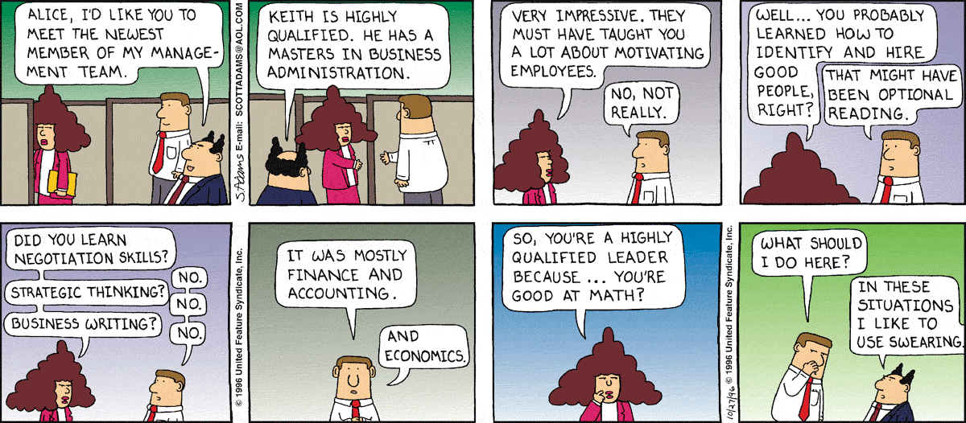
Dilbert, by Scott Adams
https://za.pinterest.com/pin/238268636508694973/

Slide 4
Rest of MBA
Work-related
Personal
Dependent variables
Cultural awareness
Independent variables
Moderating variables
Teamwork
Community (group) project
Problem-solving
Workplace (individual) project
Engagement
Learning
Communi-cation
Self-manage-ment
Classroom engagement
Other benefits
Critical thinking
Operations management
Make a difference
Attitudinal change

Slide 5
Individual project
Investigate four to six issues (themes) in your own organization
Recommend how to improve these issues

Slide 6
Group project
Select community organisation
Investigate their biggest operations needs
Make a sustainable difference
Get your hands dirty
Remember ethics principles

Slide 7
Your timeline
S
S
M
T
W
T
F
S
S
M
T
W
T
F
S
S
M
Contact session
Prepare
Investigate
Complete report
Individual and Community project
Hand in assignments
Contact session
14 June
Examination portfolio
2+ long ones (75%
of ind, participation, C4 and C7)
2 + presentations(33%
of Group participation)
Other contacts: short ones: (One page per theme, 20% of ind)

Slide 8
Preparation before each deadline
Go through my slide show on eFundi
(Go through HR&M slide shows and/or textbook chapters)
Contact with your organisation (if necessary)
Complete individual assignment (short or long)
Liaise with community organisation (group)
Complete group assignment (3 slides, when you choose to do so)
Hand in both before 23:55 on Wednesday

Slide 9
How your fortnight will look
ASAP after class: Go through theory slide show on eFundi: Prepare page 1 of assignment (template on eFundi).
NOTE: You only have to hand in two long assignments (Contact 4 and 7), plus 5 short ones, as well as 2 community assignments.
Find out how issue is managed at your company (for portfolio)
Prepare individual assignment
Visit community organisation
Prepare group assignment
Submit BEFORE 23:55 on Wednesday before class!!!!!

Slide 10
Proposal:
Implementing of specific processes
  Receive donations.
    Inventory.
    Bins.
    Hangers.

Slide 11
MRP systems
Current proses when a new client comes in
  Receive the client for interview.
  Depending on the process four different handwritten documents and opening of the file.
  Information stored at different places in the office.
  Data is difficult to access for statistical reasons.

Slide 12
Proposals
  Flow of information on file.
  Flow of information in the office.
  Implementing of Excel spreadsheets

Slide 13
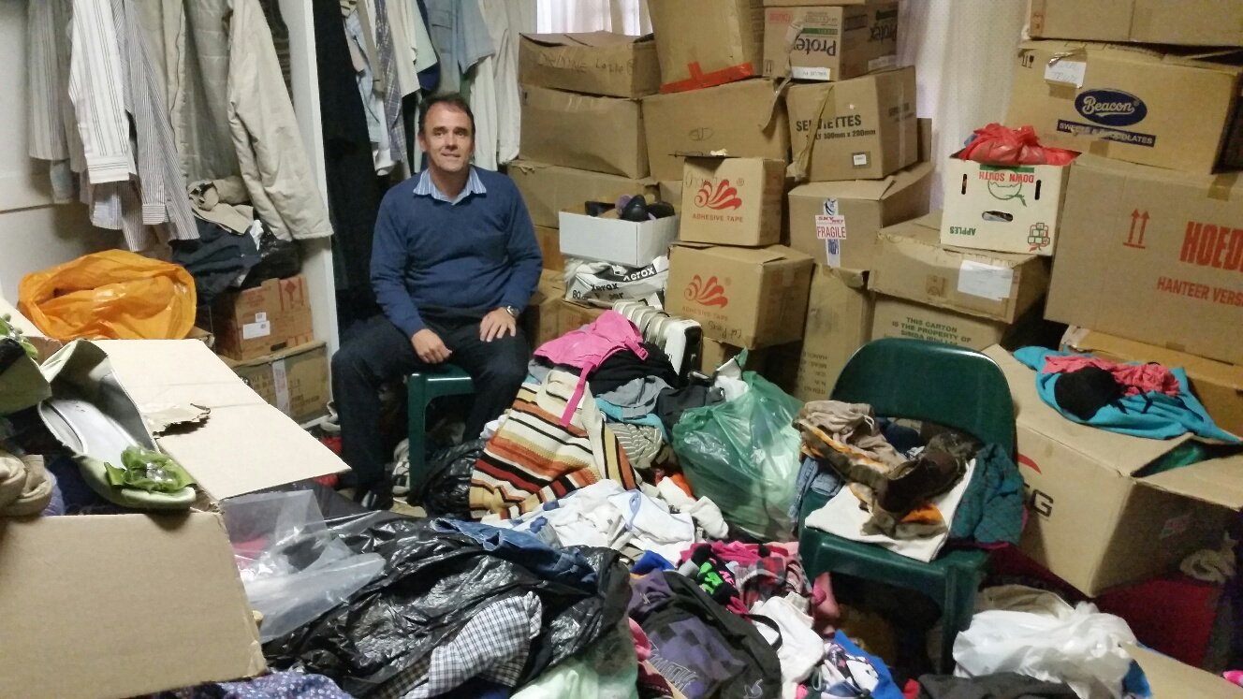
Before

Slide 14
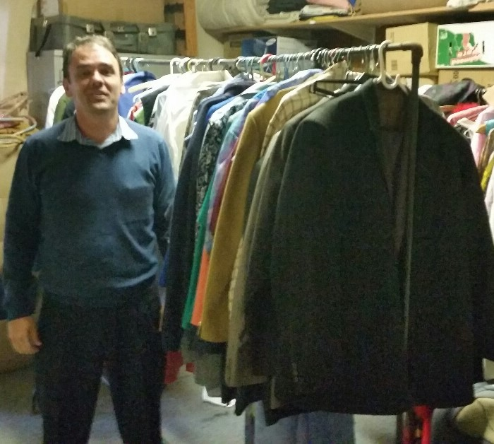
After

Slide 15
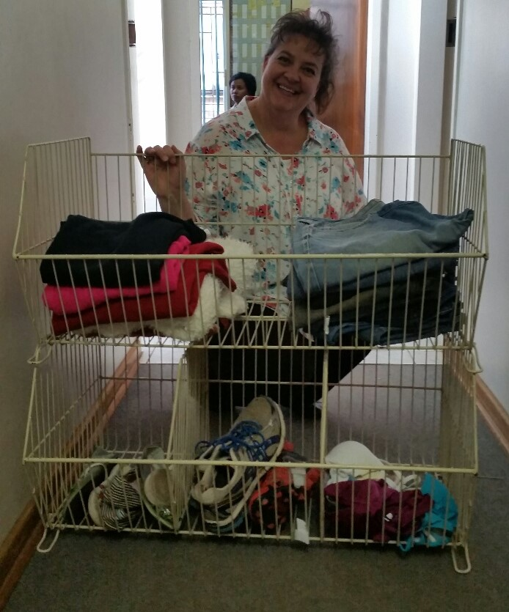
After

Slide 17
Template: Individual (MSWord)
Page 0
Surname and initials: …………………………………….…………………………………
Student number: …………………………………………..…………………………………
Individual submission: Contact session: ……………………………………………
Topic(s):………….………………………………………………………..…………………
Name of my organisation: ………..………..……………………...
Ppseudonym of my organisation: ………..………..……………………...
Pseudonym of business: …………………………………………………….…………….
Nature of business: ……………………………………...………………………………….
I declare that this submission is my own work:
……………………………………..
Signature of student

Slide 18
Template: Individual (Short assignments)
Page 1
Summary of the theory (Your own summary: One page per chapter).
What is there about the topic that I would like explained further in class?

Slide 19
Template: Individual
Page 2 (Long assignment, Contact 4 & 7)
Name and nature of business: ……………………………………...……………………….
How this theory is applied in the organisation at present

Slide 20
Template: Individual
Page 3 (Long assignment, Contact 4 & 7)
Proposals on improvement of this element of the organisation’s operations:

Slide 21
Template Group submission (PowerPoint)
Page 0
Group submission: Contact session: …………………
Name of syndicate group:…………………………………………………………………
Person submitting on behalf of group: …………………………………………………
Topic(s):……………………………………………………………………….………………
Name of community organisation: …………………………………….………………...
Nature of community work: ……………………………………………………………….
Nature of business venture: ………..…………………………………….………………
………………………..…………………………………………………………………………
Group members contributing
I declare that this submission is our own work: ……………………………………..
Signature of person
Name: | Student number:

Slide 22
Template Group PowerPoint
Page 1
Summary of the theory (Explanation to the community organisation).

Slide 23
Template Group
Page 2
Name of organisation: ………………………………...………………………………….
Analysis of how/whether this theory is applied in the organisation at present

Slide 24
Template Group
Page 3
Proposals on improvement of this element of the organisation’s operations:
Actual inputs we (can) make to assist organisation on these issues

Slide 25
My pledge
Individual assignment: I undertake to mark each assignment and give feedback before the next contact.
Group assignment: Every study group must hand in a group assignment three times during the semester – introduction plus two contact sessions (30%). I undertake to mark it before the next contact. You have to do a class presentation (30%) and hand in a final portfolio (30%) on all the relevant topics during contact 8.

Slide 26
Individual assignment submission
Electronic submission on eFundi before 23:55 on Wednesday night. Keep eFundi receipt. Hand in as pdf-files.
No hard copies, e-mail copies, cd, dvd, flash copies, facebook copies, dropbox, whatsapp copies, "tweetagram" copies, blah blah blah!!!!!!
    Document name: Surname-First name-Studentno-ind-contact#.docx
      (Example: Lincoln-Abe-12345678-ind-contact2.docx)

Slide 27
Mark allocation: Individual assignment (long)
Criteria for marking long individual assignment for contact sessions 4 and 7
1 | Content
1.1 | Summary of theory: (10)
1.2 | Application in your organisation (30)
1.3 | Suggestions for improvement (30)
2 | Critical thinking (10)
3 | Insight (10)
4 | Marker’s general impression – technical quality (10)

Slide 28
Total mark for individual assignment
Two full long submissions: 2 x 100 = 200
Multiply long total by 40%: 200 x 0.4 = 80
Five 1-page submissions: 5 x 10 = 50
Multiply short total total by 40%: 50 x 0.4 = 20
Total individual assignment mark: 80 + 20 = 100

Slide 29
Questions about individual assignment?
Suggestions about individual assignment
  Get permission from relevant manager (as high up as possible): Start with an interview about the company strategic objectives
  Find out which six themes are critical
  Use it to make yourself useful
  Use is to make yourself visible
  Do the analysis as well before every deadline
  Remember that you have to add a strategic angle in your final portfolio
  Do your final portfolio as you compile the information

Slide 30
Mark allocation
Criteria for marking group assignment (MBA)
1 (30%) | Marking of 3-page documents handed in during selected contact session. This includes:
1.1 | Understanding of the underlying theory
1.2 | Practical proposals to the community organisation
2 (30%) | The final report handed in during contact 8. Marks are awarded for:
2.1 | Operations principles used
2.2 | The difference made to the community organisation
3 (30%) | Peer rating of presentation during final contact session
4 (10%) | General quality

Slide 31
Select your organisation
Close to majority of group members
Operating some business in parallel to community work
At least ten people (full-time or part-time, volunteers or employees)
Willing to give you some time to engage
That you are passionate about
Willing to give honest feedback during and after project
Primary contact person

Slide 32
Handouts on eFundi and hard copies
Letter to employer (Afrikaans and English)
Registration of your own organisation
Letter to community partner (A & E)
Agreement with community partner (A & E)
Requirements for successful group project
Community project checklists

Slide 33
Checklist 1: Do we have a viable project?
Is there an organisation with an explicit need? Is their need in line with what we can offer? Does the organisation have (or want to start) a business venture? Are they keen / willing to accommodate us at least for the semester? Would we have at least some skills by the time we really get involved to make a difference? Would we be able to transfer skills to the organisation? Can we at least put some system in place that they need and that they do not have at present? Do we have a primary point of entry at the organisation? (our primary client) Is it logistically possible (not easy) to do the project? Will the project develop at least one skill for each team member? Does it excite you all?

Slide 34
Checklist 2: Is the project a guaranteed success?
Is there a committed champion in the team? Is everyone in the team aware what his/her specific role is in the project? Have they completed the registration and indemnity documents? Is the organisation willing to give feedback to the group/lecturer during and after the project? Have you diarised review meetings with the organisation before each contact session? Have you arranged a high impact award and celebration for the team and any others who contributed? Is there a symbol and title for the project? Have we considered all the ethical considerations? Is everyone prepared to do a presentation of what they discover and learn? Would you be able to write an article about the project that would benefit both the organisation and the NWU?

Slide 35
Checklist 3: Is the project sustainable?
Have we documented all the learning points for the organisation? Can we prove that we have transferred some skills/systems to the organisation that can continue for the next semester? Is there someone in the group willing to mentor the organisation further upon request (even over the phone)? Do we have a sustainability plan for the organisation? Does the organisation have a sustainability champion who will carry the flag for the project? Did the project change at least one team member’s attitude towards community work? Would they be able to continue the effort for at least six months without us? Do we have our photo/video journal and testimonial? Have you written an article about the project that would benefit both the organisation and the NWU?

Slide 36
Planning workshop: Community project
List possible organisations in your area
Phone them now!
Get agreement to discuss project with them
Get details of contact person(s)
Plan how you will tackle it (time management, who is your project driver, how to handle geographically dispersed groups, pitfalls, etc.)

Slide 37
My commitment
Weekly feedback before next contact session
Post marks on eFundi
Phone organisations, if you want me to
Write letters of recommendation, if needed
Consulting / facilitation where necessary
Absolute honesty when giving you feedback
Follow up on sustainability after projects

Slide 38
Before end of the week
See that you are a registered student: All submissions on eFundi!
Get your boss/employer's approval for individual assignment.
Find community organisation (group).
Get the strategic objectives of your organisation
Strategy for community organisation.

Slide 39
Project planning workshop
Sort out your study groups
In your groups, use this time to:
  Plan your project
  Contact the organisation and get their permission
  Sort out the logistics
  Ask me any difficult questions about the project
Also, about your individual assignment
  Get agreement from your organisation
  Ask me any difficult questions
  Sort out your registration: Else eFundi is off-limits

Slide 40


Slide 41
Thank you

