Slide 1

Lean operations
Johan Jordaan
MBAA812 – Operations Management

Slide 2
Study School
1
Designing operations
Introduction (1)
Operations Strategy (2)
Project management (3)
Product & service design (5)
Process strategy (7)
2
7
Location (8)
Maintenance
(17)
Classroom
Optimising operations
Layout (9)
Lean (16)
Application
Insight
MBAA812 Roadmap
Understanding
6
3
Quality (6)
People in operations (10)
Workplace
Community
Theory of constraints (7)
MRP & ERP systems (14)
Managing operations
5
4
Scheduling (15)
Planning (13)
Forecasting (4)
Inventory (12)
Supply chain management (11)

Slide 3
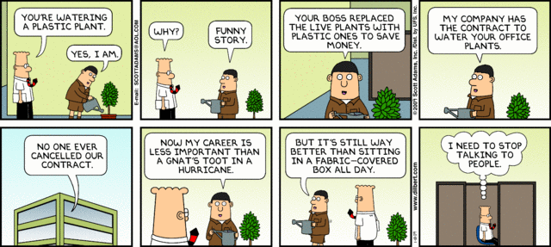

Slide 4
What is lean production?
Lean Production can be defined as an integrated set of activities designed to achieve high-volume production using minimal inventories (raw materials, work in process, and finished goods)
Lean Production also involves the elimination of waste in production effort
Lean Production also involves the timing of production resources (i.e., parts arrive at the next workstation “just in time”)
Good housekeeping (5 Ss)
Notes:
3

Slide 5
The Toyota Production System
Based on two philosophies:
  1. Elimination of waste
  2. Respect for people
Notes:
5

Slide 6
Elimination of Waste
Saw
Saw
Saw
Grinder
Grinder
Focused factory networks
Group technology
Heat Treat
3. Quality at the source
4. JIT production
Lathe
Lathe
Lathe
Press
Press
Press
5. Uniform plant loading
Grinder
1
2
Saw
Lathe
Lathe
Press
6. Kanban production control system
Heat Treat
7. Minimized setup times
Grinder
Saw
Lathe
A
B
Lathe
Press
Notes:
6
Lots of small specialised plants rather than one intergrated plant
See video
Stop process if something goes wrong TQM

Slide 8
Respect for People
Level payrolls
Cooperative employee unions
Subcontractor networks
Bottom-round management style
Quality circles (Small Group Involvement Activities or SGIA’s)
Notes:
21

Slide 9
The seven wastes
Over-processing
Over-production
Waiting
Defects
Inventory
Motion
Transport
(Talent)

Slide 10
Video: Lean manufacturing cell
Lean manufacturing cell

Slide 11
Implementing Lean
Link operations
Balance workstation capacities
Redesign layout for flow
Emphasize preventive maintenance
Reduce lot sizes
Reduce setup/changeover time
Notes:
23

Slide 12
Lean in Services (Examples)
Organize Problem-Solving Groups
Upgrade Housekeeping
Upgrade Quality
Clarify Process Flows
Revise Equipment and Process Technologies
Level the Facility Load
Eliminate Unnecessary Activities
Reorganize Physical Configuration
Introduce Demand-Pull Scheduling
Develop Supplier Networks
Notes:
30

Slide 13
The 5 Ss
Sort/segregate – when in doubt, throw it out
Simplify/straighten – methods analysis tools
Shine/sweep – clean daily
Standardize – remove variations from processes
Sustain/self-discipline – review work and recognize progress
Two additional Ss
Safety – build in good practices
Support/maintenance – reduce variability and unplanned downtime

Slide 14
Remove Variability
JIT systems require managers to reduce variability caused by both internal and external factors
Variability is any deviation from the optimum process
Inventory hides variability
Less variability results in less waste

Slide 15
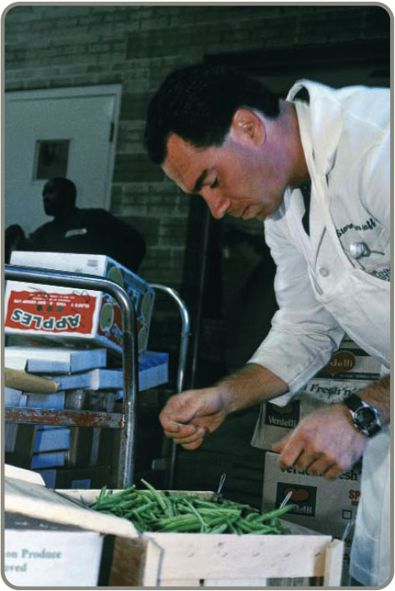
Just-In-Time (JIT)
Powerful strategy for improving operations
Materials arrive where they
are needed when they are
needed
Identifying problems and
driving out waste reduces
costs and variability and
improves throughput
Requires a meaningful
buyer-supplier relationship

Slide 16
Inventory
Inventory is at the minimum level necessary to keep operations running
JIT Inventory Tactics
Use a pull system to move inventory
Reduce lot sizes
Develop just-in-time delivery systems with suppliers
Deliver directly to point of use
Perform to schedule
Reduce setup time
Use group technology
Table 16.2

Slide 17
Reduce Lot Sizes
200 –
100 –
Q₁ When average order size = 200
average inventory is 100
Inventory
Q₂ When average order size = 100
average inventory is 50
Time
Figure 16.4

Slide 18
Lower Setup Costs
Holding cost
Sum of ordering and holding costs
Cost
T₁
Setup cost curves (S₁, S₂)
T₂
S₁
S₂
Lot size
Figure 16.5

Slide 19
Quality
Strong relationship
  JIT cuts the cost of obtaining good quality because JIT exposes poor quality
  Because lead times are shorter, quality problems are exposed sooner
  Better quality means fewer buffers and allows simpler JIT systems to be used

Slide 20
Individual Assignment
Download long and short assignment templates from eFundi
On the template, prepare a one-page summary of the theme
Make sure that I can determine whether you understand the contents from your summary
Submit on eFundi before midnight on the deadline (Wednesday night 23:55)
No
Did I cover all themes for this contact?
Long or short assignment?
Yes
Short (Contact 1,2,3,5 & 6)
Combine all the themes for this contact in one MSWord document (.docx)
SAVE AS: (# is the contact session number)
If all the themes are just theory summaries, save the document as Surname-Name-StudNo-Ind#-short.docx (Example:
Trump-Donald-12345678-Ind1-short.docx).
If at least one theme is a long one (i.e. has an analysis), save the document as
Surname-Name-StudNo-Ind#-long.docx (Example:
Trump-Donald-12345678-Ind1-long.docx)
Long (Contact 4 & 7)
SAVE
Prepare a one-page summary of how this issue is applied at your organisation
No
Did I cover all themes for this contact?
Yes
Prepare a one-page recommendation how this could be improved in your organisation
SAVE

