Slide 1
FINANCIAL REPORTING
CCMM 517 (Lesson 1: SU 1 + 2)
Dr MJ Botha

Slide 2
STUDY GUIDE: STUDY UNIT 1 AND 2
LESSON 1 CONSISTS OF:
Chapter 1 (p 1 – 20)
Chapter 2 (p 21 – 28) In textbook
Chapter 11 (p 175 – 182)
SU 1: Introduction and framework
SU 2: The accounting equation
The account (T-account)

Slide 3
SU 1: INTRODUCTION AND FRAMEWORK
DEFINITION OF ACCOUNTING??
GATHERING
IDENTIFYING (determine the nature of transactions)
MEASURING (determine the value of transactions)
RECORDING (record transaction in records)
REPORTING (report the financial results)
INTERPRETING (interpret the results)
BUSY WITH??
Financial information!!

Slide 4
WHAT IS THE PURPOSE OF ACCOUNTING???
THE PURPOSE OF ACCOUNTING IS TO……
provide financial information
regarding the economic activities
of an entity
to the users of financial statements
WHY???
Because financial information (AFS) is used by different users to make informed decisions

Slide 5
USERS OF FINANCIAL INFORMATION
INTERNAL USERS
Owners and shareholders
Managers
Employees
EXTERNAL USERS
Investors
Customers
Creditors / Suppliers
Competitors
SARS (government)
Community

Slide 6
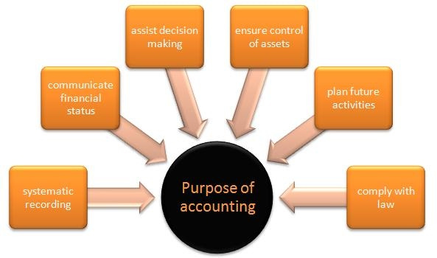
WHAT ACCOUNTING IS USED FOR…

Slide 7
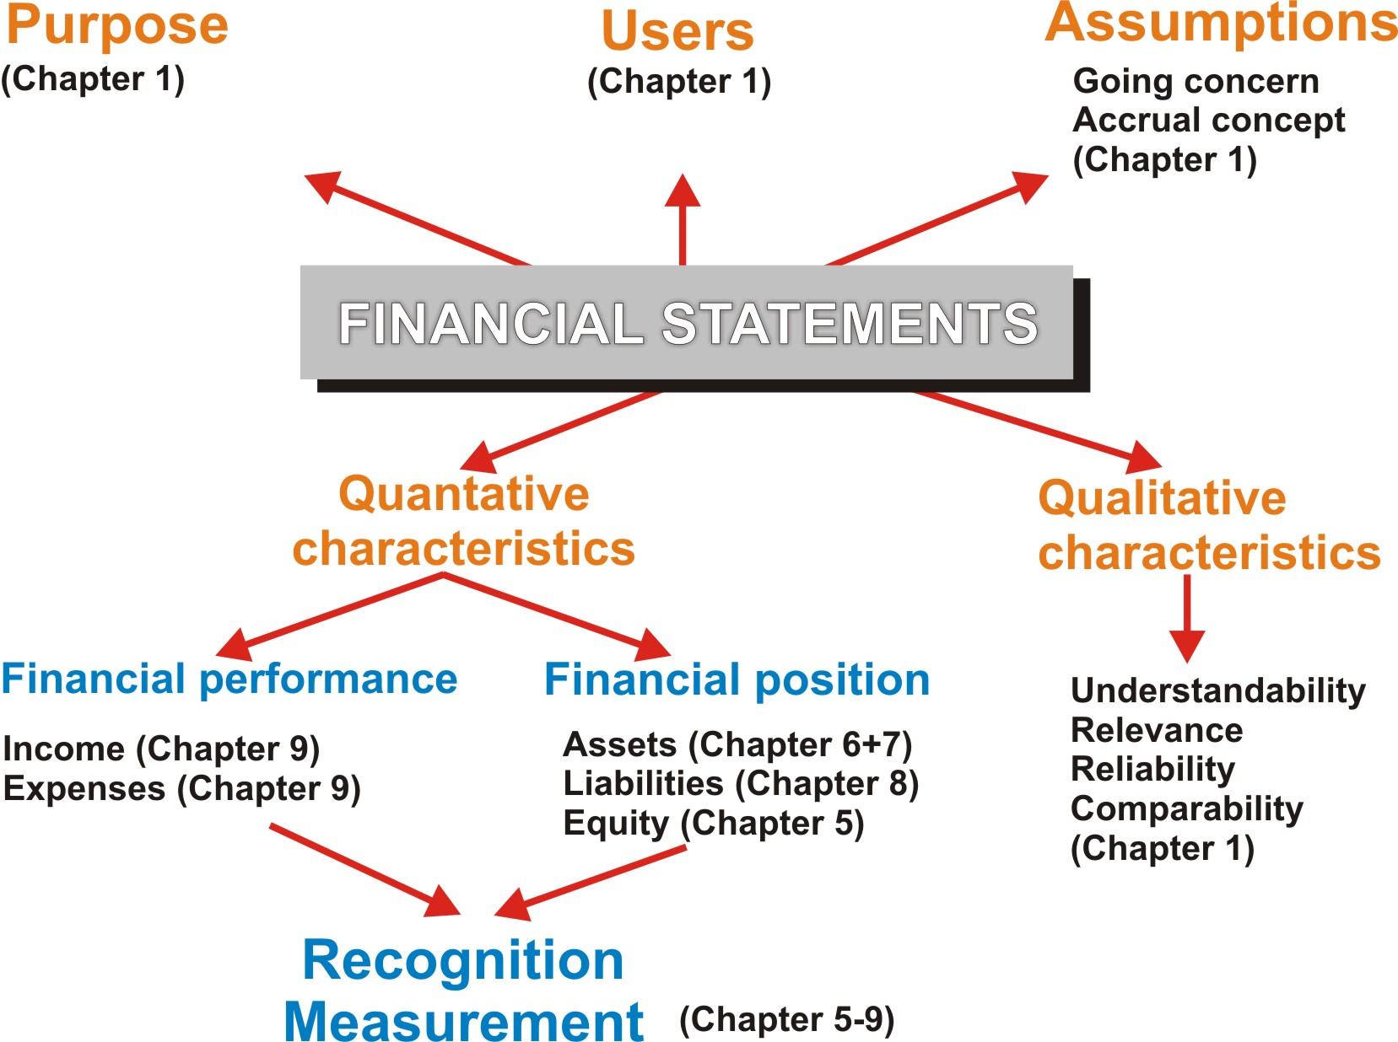
ACCOUNTING FRAMEWORK (p 10)

Slide 8
FINANCIAL STATEMENTS CONSISTS OF??
STATEMENT OF PROFIT OF LOSS AND OTHER COMPREHENSIVE INCOME
Income expenses net profit
Expenses income net loss
STATEMENT OF CHANGES IN EQUITY
Equity is the owner’s interest in the entity
Equity is with a net profit and capital
Equity is with a net loss and drawings

Slide 9
FINANCIAL STATEMENTS CONSISTS OF??
STATEMENT OF FINANCIAL POSITION
Discloses the ASSETS at the end of the fin period
Discloses the LIABILITIES at the end of the fin period
Assets liabilities owner’s equity / equity!!
STATEMENT OF CASH FLOW
Indicates the inflow and outflow of CASH during a specific period
NOTES TO THE ANNUAL FINANCIAL STATEMENTS

Slide 10
ELEMENTS OF ACCOUNTING
ASSETS
LIABILITIES
EQUITY
Capital (amount contributed by owner/s)
Drawings (amounts withdrawn by owner/s)
Income determines the profit or loss
Expenses

Slide 11
IMPORTANT ASSUMPTIONS
GOING CONCERN??
The business will not cease its operations in the foreseeable future
ACCRUAL CONCEPT??
Transactions are recorded when the transaction occurs, and not when the cash is received or paid
CHARACTERISTICS OF FINANCIAL STATEMENTS
Understandable, relevant, reliable, accurate, timeliness and faithful representation

Slide 12
TYPES OF ENTITIES
Sole trader 1
Partnership 2 – 20
Close corporations (CC) 1 – 10
Private company (Pty) Ltd 1 – 50
Public company (Ltd) unlimited
Non-profit organisations unlimited

Slide 13
INTEGRATED REPORTING
CAN SOMEONE TELL ME WHAT IS INTEGRATED REPORTING??
Integrated presentation of a company’s performance of both its finance and sustainability
Public companies in SA must compile an “integrated report”
Access an integrated report – for instance Anglo American and have a look (not only financial information)

Slide 14
SU 2: THE ACCOUNTING EQUATION
DO YOU STILL REMEMBER THE ELEMENTS OF AFS??
ASSETS, EQUITY AND LIABILITIES
WHAT IS THE ACCOUNTING EQUATION??
ASSETS = EQUITY + LIABILITIES
ASSETS
Possessions of the business (obtained from transaction)
Will yield future economic benefits for the business
Must distinguish between non-current and current assets

Slide 15
UNDERSTANDING THE DIFFERENT ACCOUNTS
ASSETS
NON-CURRENT ASSETS
Land and buildings
Vehicles
Equipment
CURRENT ASSETS
Debtors
Cash and cash equivalents (bank, petty cash)
Stock / Inventory
Accrued income
Prepaid expenses

Slide 16
UNDERSTANDING THE DIFFERENT ACCOUNTS
LIABILITIES
Debts of the business
Amounts payable by the business to a person or entity
Distinguish between non-current and current liabilities
NON-CURRENT LIABILITIES
Bank loan (mortgage bond)
CURRENT LIABILITIES
Creditors
Bank overdraft (Ct)
Accrued expenses
Prepaid income / Income received in advance

Slide 17
UNDERSTANDING THE DIFFERENT ACCOUNTS
EQUITY (OWNER’S EQUITY)
Claim that the owner/s have on the assets of the business, after the liabilities have been payed. Equity consists of:
CAPITAL
DRAWINGS
INCOME
INCREASES EQUITY:
Sales, services rendered, rent income, interest income, commission income
EXPENSES
DECREASES EQUITY:
Water and electricity, salaries and wages, telephone, rent expense, stationary etc.

Slide 18



SU 2.1: THE ACCOUNTING EQUATION
The Accounting Equation could also apply to a personal situation: Suppose you buy a car for R100 000, borrow R80 000 from the bank, and pay the rest yourself. Here’s the result:
ASSETS = EQUITY + LIABILITIES
R100 000 = R20 000 + R 80 000
Accounting Equation

Slide 19
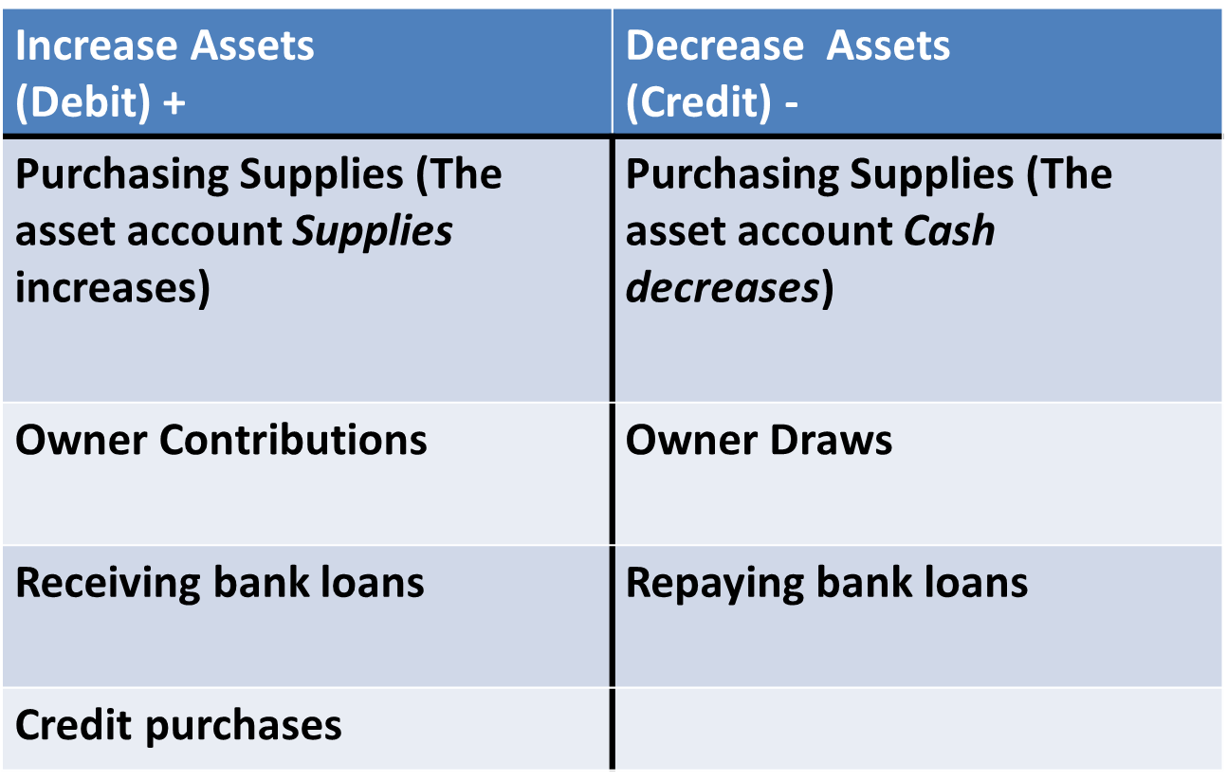
CHANGES IN ASSETS

Slide 20
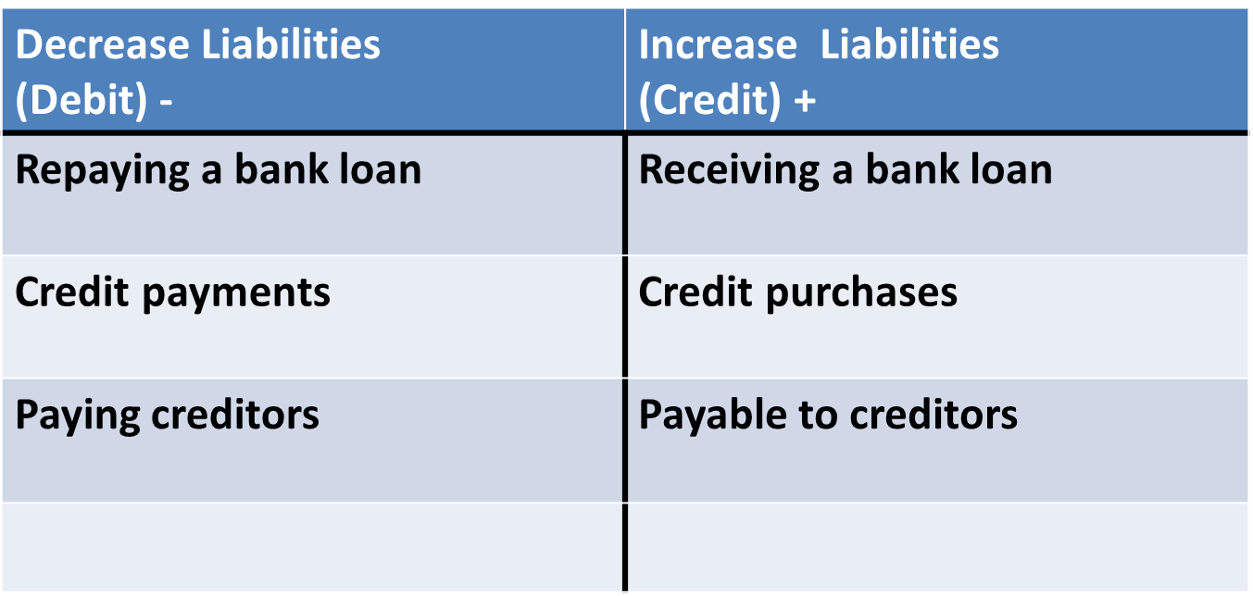
CHANGES IN LIABILITIES

Slide 21
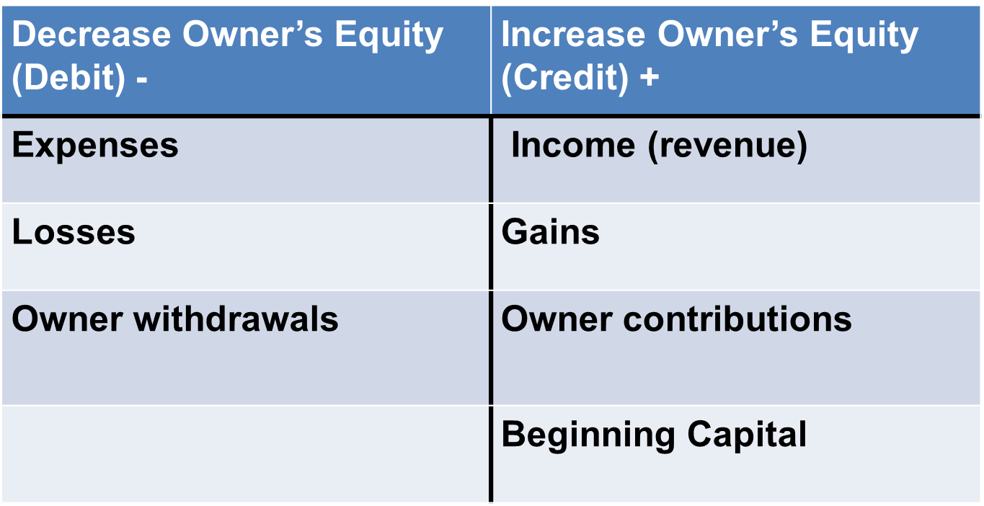
CHANGES IN EQUITY

Slide 22
CHANGES IN OWNER’S EQUITY
EQUITY is the OWNER’S CLAIM ON ASSETS
In a business EQUITY is composed of four parts that either increase or decrease equity:
- + -
INCREASE DECREASE INCREASE DECREASE
EQUITY
CAPITAL:
What the owner puts into the business
WITHDRAWALS:
What the owner takes out of the business
REVENUES:
What the company receives for sales
EXPENSES:
What the company pays to operate the business

Slide 23

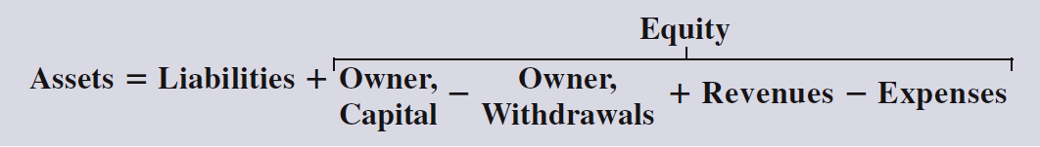

ACCOUNTING EQUATION
We can expand the accounting equation
to show all the equity components:
The accounting equation must always
BALANCE

Slide 24
RECORDING OF TRANSACTIONS IN THE ACCOUNTING EQUATION
FOR EVERY TRANSACTION:
There are at least two accounts involved
Identify each account: whether it is an asset, owner’s equity or liability account
One account will be debited and the other account will be credited (Double entry principle)

Slide 25
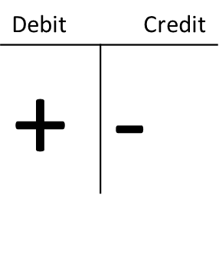
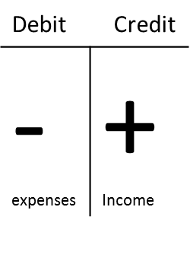
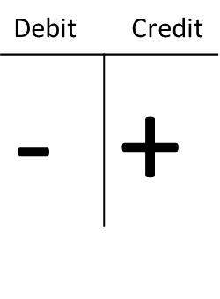
DOUBLE ENTRY PRINCIPLE (DEBITS/CREDITS) NB!!
Each transaction has a dual effect on the accounting equation (double entry principle)
There will be a debit and a credit entry
ASSETS = EQUITY + LIABILITIES

Slide 26
SU 2.2: THE ACCOUNT (GENERAL LEDGER)
THE ACCOUNTING CYCLE
Transaction
Pre-adjustment trail balance
Adjustments
Post-adjustment trail balance
Financial statements
General ledger
Source document
Journals

Slide 27
SU 2.2: THE ACCOUNT (GENERAL LEDGER)
ABC dealers
GENERAL LEDGER
DT |  |  |  | BANK |  |  |  |  | B5 |  | CT
Datum |  |  | Besonderhede | Fol | R | c | Datum |  | Besonderhede | Fol | R | c
2012 Feb |  | 1 | Kapitaal | J1 | 100 | 00 | 2012 Feb | 25 | Salarisse | J3 | 50 | 00
 |  |  |  |  |  |  |  | 28 | Saldo | o/b | 50 | 00
 |  |  |  |  | 100 | 00 |  |  |  |  | 100 | 00
2012 Mrt |  | 1 | Saldo | a/b | 50 | 00

Slide 28
SELF-STUDY AND HOMEWORK
SELF-STUDY
Chapter 11 (p 176)
Practical example 11.4 (nr 1 – 11) NB!
HOMEWORK
Study guide p 11 - 13
(Assessment: E GREEN)

Slide 29
Answer practical example 11.4 (p 176)
NR | Account DEBIT | Account CREDIT | ASSETS | EQUITY | LIABILITIES
1 | Bank | Capital | + 150 000 | + 150 000
2 | Office furniture | Bank | + 20 000 - 20 000
3 | Computer equipment | Creditors | + 7 000 |  | + 7 000
4 | Stationery | Bank | - 1 200 | - 1 200
5 | Bank | Sales | + 4 000 | + 4 000
6 | Debtors | Sales | + 3 000 | + 3 000
7 | Drawings | Bank | - 1 000 | - 1 000
8 | Purchases | Bank | - 2 000 | - 2 000
9 | Purchases | Creditors |  | - 5 000 | + 5 000
10 | Bank | Debtors | + 3 000 - 3 000
11 | Creditors | Bank | - 7 000 |  | - 7 000
 |  |  | 152 800 = | 147 800 + | 5000

