Slide 1
FINANCIAL REPORTING
CCMM 517 (Lesson 3: SU 5 + 6)
Dr MJ Botha

Slide 2
STUDY GUIDE: STUDY UNIT 5 + 6
LESSON 3 CONSISTS OF:
Chapter 5: Study guide p. 23, Textbook p. 87
Chapter 6: Study guide p. 29, Textbook p. 99
SU 5: Owner’s equity (Equity / Capital)
SU 6: Non-current assets
  Open on p 23 in the study guide and p 87 in textbook

Slide 3
WHAT MUST YOU KNOW ALREADY???
SU 1 – 4 (NB!!)
DUALITY CONCEPT (Double entry principle)
Each transaction has at least two accounts that are involved (One account will be debited and the other credited)
ACCOUNTS ARE CLASSIFIED IN THREE ELEMENTS
Assets
Liabilities
Equity (Capital, drawings, income and expenses)

Slide 4
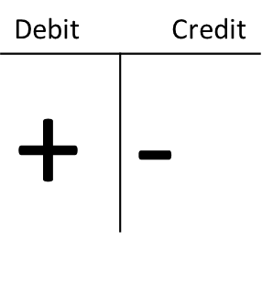
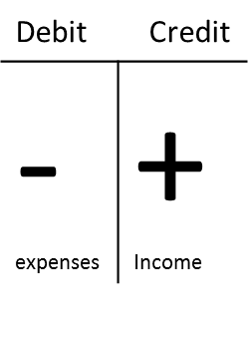
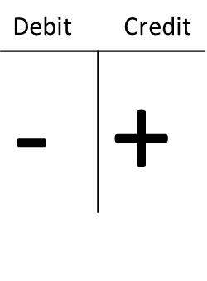
MAKE SURE YOU UNDERSTAND THIS….
Each transaction has a dual effect on the accounting equation (double entry principle)
There will be a debit and a credit entry
ASSETS = EQUITY + LIABILITIES

Slide 5
SU 5: OUTCOMES (p 87)
SU 5: CHAPTER 5
Define and discuss the following concepts:
  duality concept (E = B - L)
  capital (equity) and drawings
identify the relevant source documents
record the relevant transactions in the general journal and then post to the general ledger followed by the trial balance
identify the relevant accounts in the financial statements

Slide 6
EQUITY (OWNER’S EQUITY)
EQUITY (OWNER’S EQUITY)
Claim that the owner/s have on the assets of the business, after the liabilities have been payed. Equity consists of:
CAPITAL
DRAWINGS
INCOME
Increases equity:
Sales, services rendered, rent income, interest income, commission income
EXPENSES
Decreases equity:
Water and electricity, salaries and wages, telephone, rent expense, stationary etc.

Slide 7
EQUITY (OWNER’S EQUITY)
Income expenses net profit
Expenses income net loss
THE REASON FOR COMPILING A STATEMENT OF PROFIT AND LOSS AND OTHER COMPREHENSIVE INCOME (INCOME STATEMENT) IS TO……
IS TO DERERMINE THE PROFIT / LOSS BECAUSE:
PROFIT= INCREASES EQUITY!!!
LOSS = DECREASES EQUITY!!!

Slide 8
CHANGES IN OWNER’S EQUITY
EQUITY is the OWNER’S CLAIM ON ASSETS
In a business EQUITY is composed of four parts that either increase or decrease equity:
- + -
INCREASE DECREASE INCREASE DECREASE
EQUITY
CAPITAL:
What the owner puts into the business
WITHDRAWALS:
What the owner takes out of the business
REVENUES:
What the company receives for sales
EXPENSES:
What the company pays to operate the business

Slide 9
EQUITY
SELF STUDY
Go through practical example 5.1 (p. 89)
HOMEWORK
Do practical example 5.5 on p. 93

Slide 10
EQUITY OF COMPANIES (SU 5.2)
Study guide p. 26
The equity of companies are different because of the reason that shares are issued
CHARACTERISTICTS OF LIMITED (Ltd) COMPANIES??
Limited liability (legal entity on its own)
Must provide AFS to its shareholders and to the public
AFS must comply to IFRS and an auditor must be appointed
Companies lifetime is not bound to its shareholders

Slide 11
SU 6: OUTCOMES (p 99)
SU 6: CHAPTER 6
define and discuss the following concepts:
  assets, non-current assets, depreciation etc.
name and calculate the two depreciation methods
identify and discuss the steps to be followed when alienating (selling) non-current assets
journal entries to the general ledger = compile trial balance
identify the relevant accounts in the financial statements

Slide 12
NON-CURRENT ASSETS
WHAT ARE NON-CURRENT ASSETS?
Non-current assets are assets with a long life expectancy (more than one year)
Non-current assets are purchased for purposes other than trade or resale
EXAMPLES??
Land and buildings, vehicles, office equipment, furniture, machinery etc.

Slide 13
NON-CURRENT ASSETS
SOME OF THE MOST IMPORTANT QUESTIONS MANAGERS HAVE TO ANSWER WITH REGARDS TO NON-CURRENT ASSETS ARE????
What is the amount that should be invested into non-current assets??
How will the non-current assets be financed??
DECISIONS WITH REGARDS TO FINANCING????
This means what is the composition of the capital structure
How much own capital and how much foreign capital??

Slide 14
NON-CURRENT ASSETS
NON-CURRENT ASSETS ARE SHOWN IN THE STATEMENT OF FINANCIAL POSITION AS:
Property, plant and equipment
AND ALWAYS HAS A NOTE THAT INDICATES THE CALCULATIONS!!
WHICH CALCULATIONS CAN YOU THINK OF IN TERMS OF NON-CURRENT ASSETS??

Slide 15

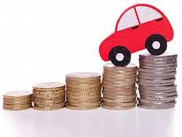
NON-CURRENT ASSETS
DEPRECIATION
With use, non-current assets lose
their value through “wear and tear”
Because non-current assets lose
their value they are depreciated,
BUT WHY??
To report on the true value of the
assets in the financial statements
(BOOKVALUE OR CARRYING
VALUE)

Slide 16
NON-CURRENT ASSETS (DEPRECIATION)
DEPRECIATION IS RECORDED AS FOLLOWS:
DT CT
Depreciation (expense) xxx
Accumulated depreciation on ….. xxx
(negative asset account)
BOOKVALUE OR CARRYING VALUE = ??
Cost price – accumulated depreciation
THERE ARE DIFFERENT METHODS TO CALCULATE DEPRECIATION!!!

Slide 17
METHODS TO CALCULATE DEPRECIATION
STRAIGHT-LINE METHOD (p. 101)
A fixed amount is written off each year, calculated as:
a fixed % or fixed amount over useful life of the asset
Keep the residual value in mind
Residual value = The value of the asset at the end of its useful life
FORMULA:
Depreciation amount / year = Cost price – residual value
Useful life
OR
Cost price – residual value % depreciation / annum

Slide 18
METHODS TO CALCULATE DEPRECIATION
REDUCING BALANCE METHOD (p. 101)
A decreasing amount is written off also calculated as a fixed %
Depreciation is calculated as a fixed % of the carrying value or book value of the asset
CARRYING VALUE = COST PRICE – ACCUMULATED DEPRECIATION
FORMULA:
Depreciation amount / year = Carrying value fixed %

Slide 19
PRO-RATA DEPRECIATION
WHAT IS PRO-RATA DEPRECIATION???
The FINANCIAL YEAR is very important!!!
Most businesses financial year is from the 1 March – 28 February
Depreciation is only written off for the portion of the year that the asset was AVAILABLE FOR USE
FORMULA:
Depreciation amount / year n
12
n = number of months available for use
SELF-STUDY:
Go through examples 6.1 – 6.3 (p. 101 – 103) NB!!

Slide 20
SALE (ALIENATION) OF NON-CURRENT ASSETS (p. 103)
Non-current assets become obsolete or out-dated and entities can decide to get rid of the asset by selling it
The sale must be recorded in the books and are simplified by using???
REALISATION ACCOUNT and PROFIT/LOSS ON SALE OF ASSET
FOLLOW THESE STEPS WHEN RECORDING THE SALE OF A NON-CURRENT ASSET (NB!!!!!) (p 104!!!)
Go through page 104 in the textbook AND examples 6.4 and 6.5 (NB!!!) and PRACTICAL EXAMPLE 6.4 (p 110-114)

Slide 21
SALE (ALIENATION) OF NON-CURRENT ASSETS (p. 104)
FOLLOW THESE STEPS:
Calculate the depreciation on the asset for the current financial period
Transfer the cost price of the asset to the realisation account
Transfer the accumulated depreciation on the asset to the realisation account
Record the proceeds (selling price) on the asset
Calculate the profit/loss on the sale of the asset

Slide 22
SALE (ALIENATION) OF NON-CURRENT ASSETS
Let’s watch this video together…
Link: https://youtu.be/s45Fz0JCydM

Slide 23
SELF STUDY AND HOMEWORK
SELF-STUDY
Go through all the practical examples in the textbook!!
HOMEWORK
Chapter 5: Assignment 1 (p. 97) = Ulandi dealers
Chapter 6: Assignment 1 (NB!!!!!) (p. 115-116) = Umfula Lodge

