Slide 1
STUDY UNIT 1
OPERATIONS AND PRODUCTIVITY (Chapter 1)

Slide 2
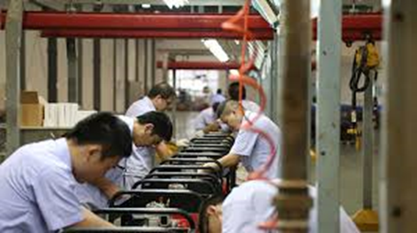
THINK ABOUT THIS
Why do you think the task of a Operations as a function did change in the last decade?
Discuss the importance of Operations Management.
What is productivity?
Can productivity influence your profit?

Slide 3

"Operations management is demanding, challenging, and exciting. It affects our lives every day. Ultimately, operations managers determine how well we live"

Slide 4
What is Operations Management ?
Production is the creation of goods and services.
Operations management (OM) is the set of activities that create value in the form of goods and services by transforming inputs into outputs

Slide 5
Basic functions for organisation to produce Goods and Services
Marketing – generates demand.
Production/operations – creates the product.
Finance/accounting – tracks how well the organisation is doing, pays bills, collects the money.

Slide 6
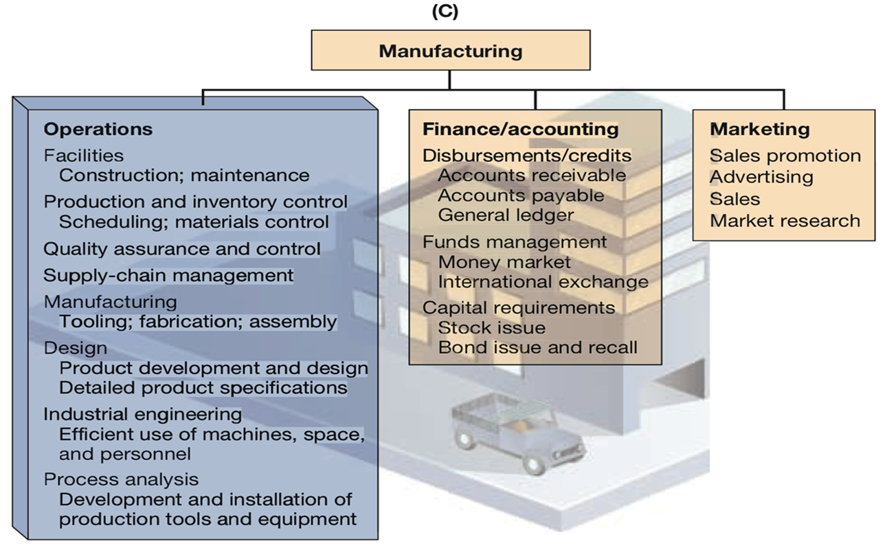
Organisational Chart

Slide 7
THINK ABOUT THIS?
What do you think is the importance of Operations Management?

Slide 8
Importance of Operations Management
OM is one of three major functions of any organisation, we want to study how people organise themselves for productive enterprise.
We want (and need) to know how goods and services are produced.
We want to understand what operations managers do.
OM is such a costly part of an organisation.

Slide 9
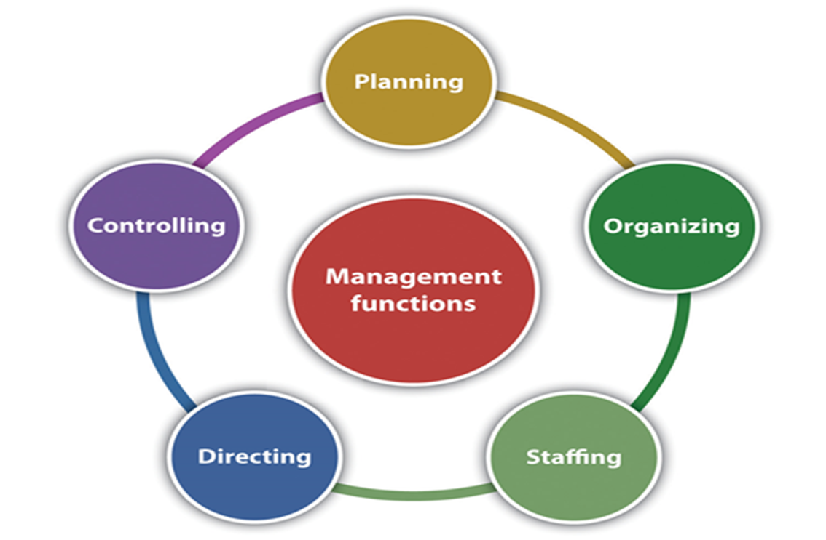
What does an Operations Manager do ?

Slide 10
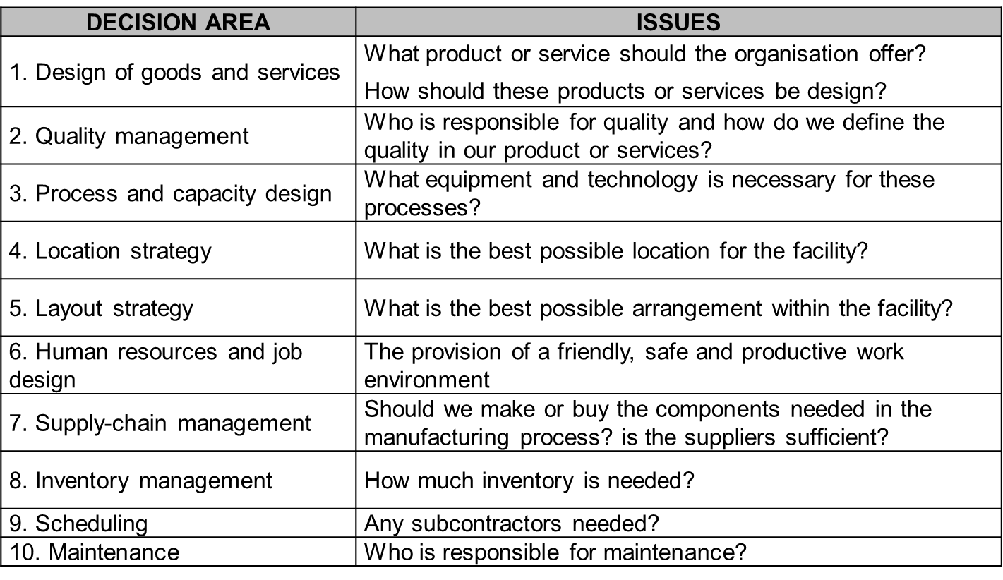
10 strategic Operations Management functions

Slide 11
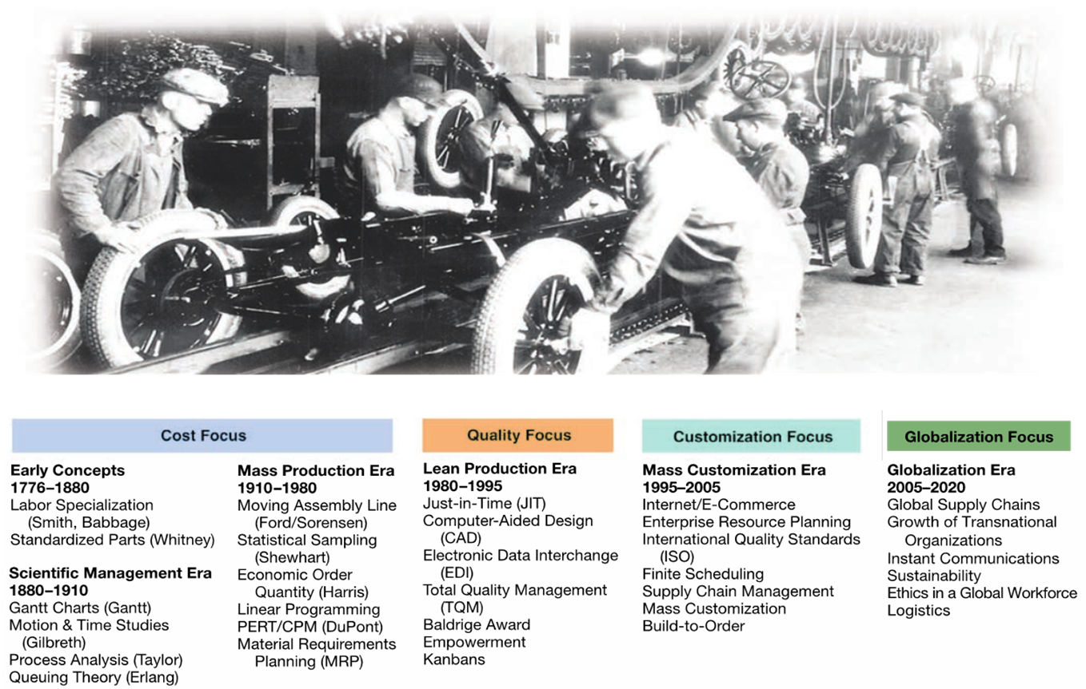
The history of Operations Management

Slide 12
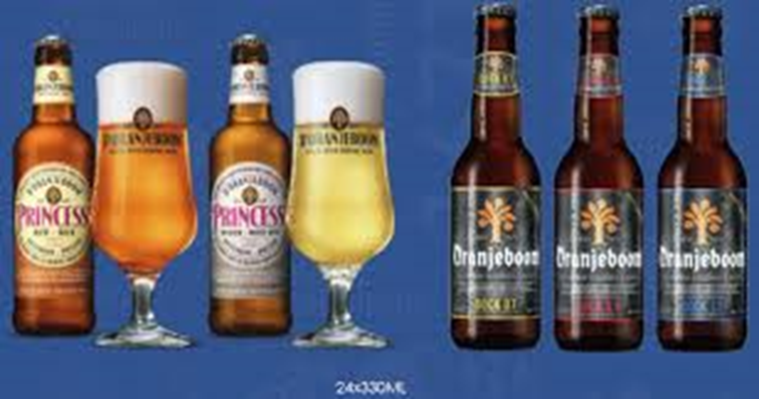

Operations for Goods and Services
List a few differences between goods and services?

Slide 13
Productivity Challenge
The objective is to improve productivity.
Productivity is the ratio of outputs (goods and services) divided by the inputs (resources such as labour and capital).
Production is a measure of output only and not a measure of efficiency.

Slide 14

Improving Productivity at Starbucks
Read the scenario on page 52. Make a list of what Starbucks can do to improve productivity.

Slide 15
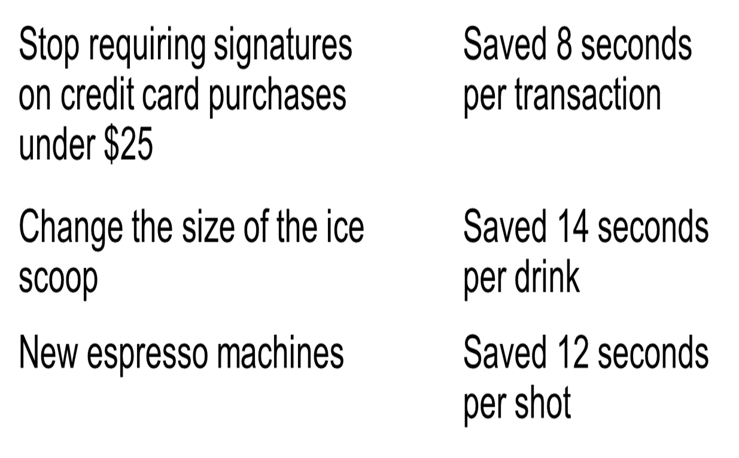
Improving Productivity at Starbucks

Slide 16
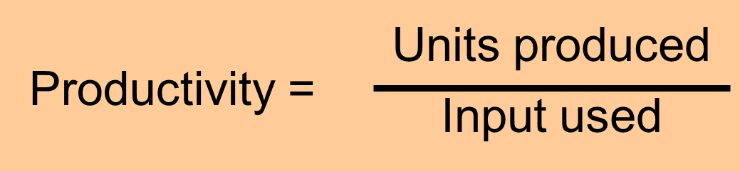
Productivity
Measure of process improvement
Represents output relative to input
Only through productivity increases can our standard of living improve

Slide 17
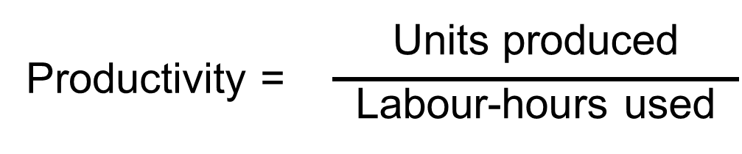
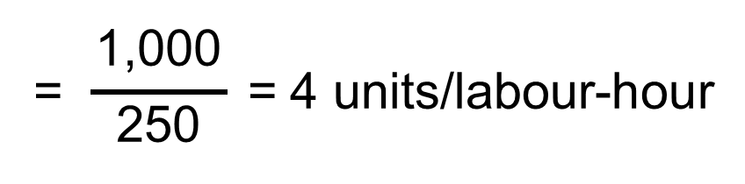

Productivity Calculations
Labour Productivity

Slide 18
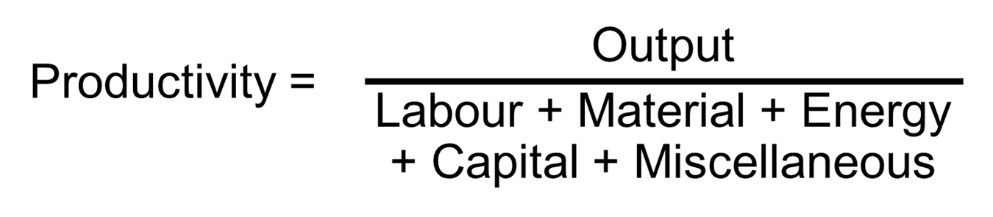

Multi-Factor Productivity

Slide 19
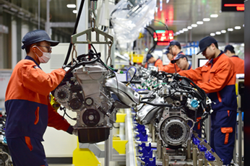
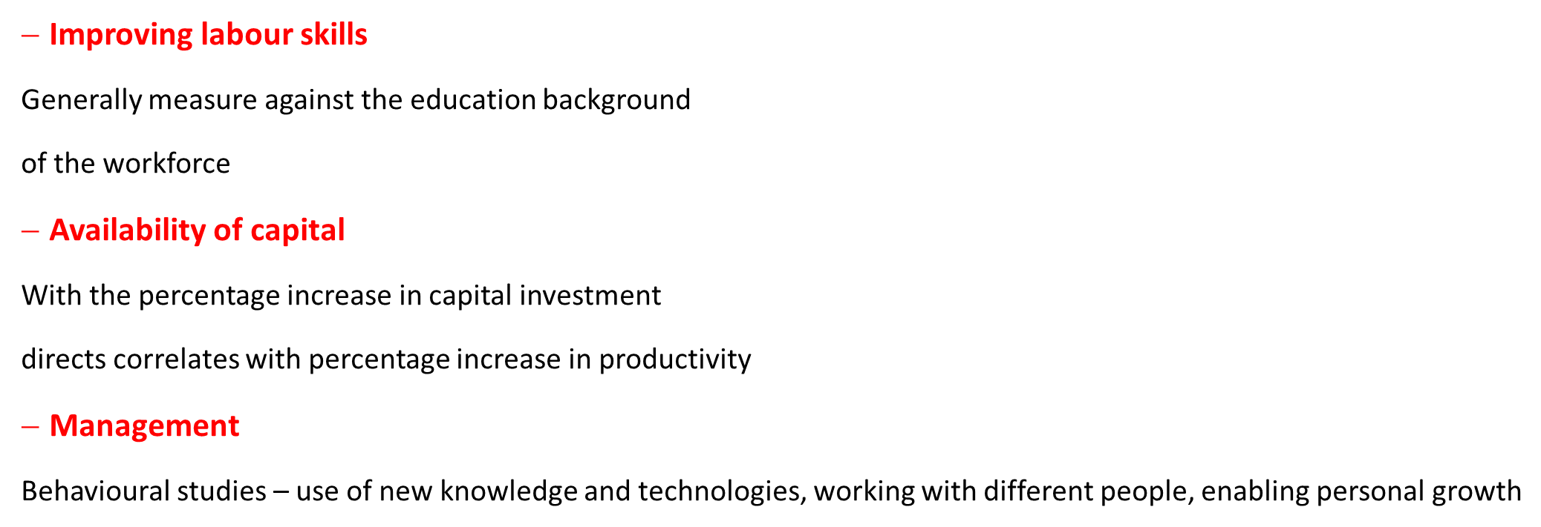


Key variables for improved labour productivity

Slide 20
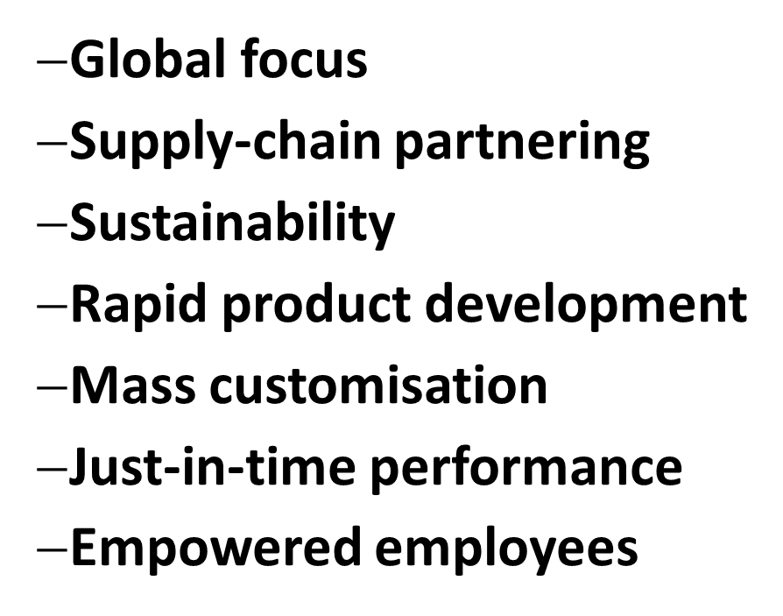
Challenges in Operations management

Slide 21

INDIVIDUAL TASK FOR NEXT SESSION
Read the case study on Hard Rock Cape (page 40-41) and the case study on page 63 – 64. This is information about Hard Rock Café.
Question to think about
Based on the information above think of reasons why you think Hard Rock Café is making a success of their Operations Management?

Slide 22
Operations management can be reduced to three words;
people, products and profits…."
Lee Lacocca

